Slide 1
Introduction to Qt
Siyu Liu
Nanjing University

Slide 2
Agenda
Features of Qt
C++ Refresher
Hello World Application
Core Classes
Objects and Object Communication

Slide 3
Agenda
Features of Qt
C++ Refresher
Hello World Application
Core Classes
Objects and Object Communication

Slide 4
What is Qt
Developed by C++, and coding in C++ style
For creating graphical user interfaces
Cross-platform software
Supports various compilers: the GCC C++ compiler, the Visual Studio suite, PHP…

Slide 5
Qt Is Used Everywhere
Software: KDE, Qt Creator, Google Earth, Skype (for Linux), VirtualBox, Spotify, VLC Media Player, AutoDesk Maya, AutoDesk MotionBuilder, 3D Studio Max
Games: EA Origin System
Mobile UX: Sharp Zaurus (Qtopia), Nokia N8 (Symbian), Nokia N9 (Meego), Blackberry 10 Cascades, Jolla (Meego), Ubuntu Touch, Kobo (e-reader)
Ported to Mobile Platforms: Android, iOS, Tizen, Windows RT
Ported to Real Time Operating Systems (QNX, VXWorks, Green Hills Integrity)
Robots: Suitable Beam
Companies: Disney Animation Studios

Slide 6
Why Qt?
Write code once to target multiple platforms (“Write Once, Compile Anywhere”)
Produce compact, high-performance applications
Focus on innovation, not infrastructure coding

Slide 7
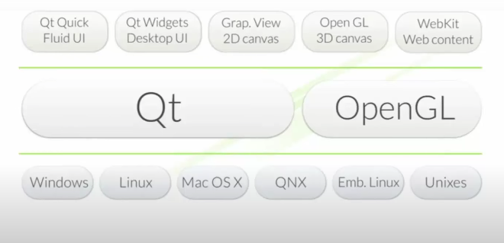
Qt Architecture

Slide 8
Agenda
Features of Qt
C++ Refresher
Hello World Application
Core Classes
Objects and Object Communication
A Look Ahead

Slide 9
How Much C++ Do You Need To Know?
Objects and classes
Declaring a class, inheritance, calling member functions etc.
Polymorphism
Virtual methods
Operator overloading
Templates
Limited to the container and concurrent classes
No...
...RTTI
...Sophisticated templates
...Exceptions
...C++11/C++14

Slide 10
Agenda
Features of Qt
C++ Refresher
Hello World Application
Core Classes
Objects and Object Communication

Slide 11
Widgets – Hello World Example
// Simple C++ widgets example
#include <QApplication>
#include <QPushButton>
int main(int argc, char *argv[])
{
QApplication app(argc, argv);
QPushButton hello("Hello, world!");
app.connect(&hello, SIGNAL(clicked()), &app, SLOT(quit()));
hello.show();
return app.exec();
}

Slide 12
Using qmake
qmake tool
Generates a Makefile or Visual Studio project
Build project using qmake
Tip: qmake -project
Creates default project file based on directory content
You can run qmake from a different directory to set up shadow build.
cd helloworld
qmake helloworld.pro # creates Makefile
make # compiles and links application
./helloworld # executes application
Qt Creator does it all for you

Slide 13
Example helloworld.pro
TEMPLATE = app # app is default - could be ‘subdirs’ or ‘lib’
TARGET = hello # executable or library name
QT += widgets # Qt modules to use
CONFIG += debug # release is default
SOURCES += main.cpp # source files

Slide 14
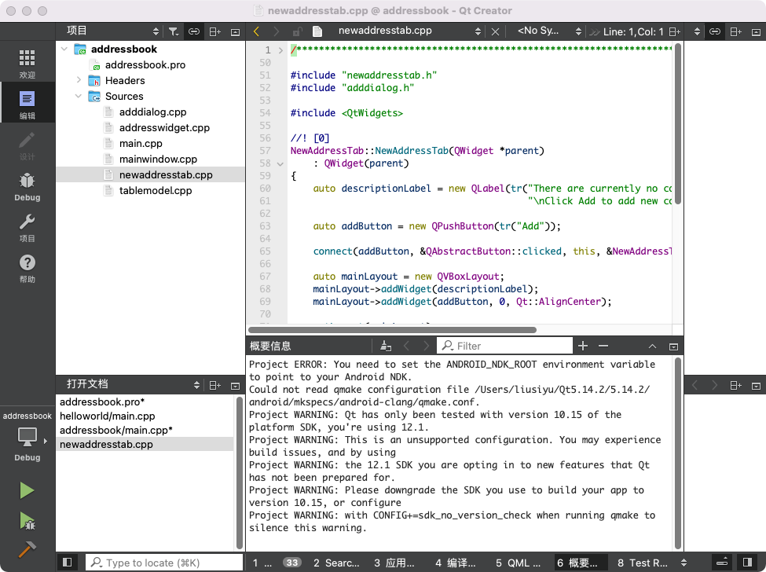
Qt Creator IDE

Slide 15
Finding the Answers
Documentation in Qt Assistant or Qt Creator
Qt's examples: $QTSRC/examples
Qt Project: http://www.qt.io/developers/
Qt Centre Forum: http://www.qtcentre.org/
Mailing lists: http://lists.qt-project.org
IRC: irc.freenode.org channel: #qt
Use the source. Qt's source code is easy to read, and can answer questions the reference docs cannot answer.

Slide 16
Modules
Qt Modules
Qt Essentials: includes QtCore, QtGui, QtWidgets, QtQml, QtQuick, QtSql, QtNetwork, QtTest, QtMultimedia, QtQuickControls, etc.
Add-on Modules included with Qt 5.6: QtBlueTooth, QtDbus, QtLocation, QtPositioning, QtSvg, QtUiTools, QtWebEngineCore, QtWebSockets, QtXml, QtXmlPatterns, etc.
Modules contain libraries, plugins, and documentation
Enable Qt Modules in qmake .pro file:
Default: qmake projects use QtCore and QtGui
QWidget based projects require QtWidgets module
QtQuick2 projects require QtQuick and QtQml
QT += widgets xml sql dbus multimedia network

Slide 17
More include Files
Every Qt class has a header file.
Every Qt Module has a header file.
Many modules have a corresponding Qt class.
Module headers include all of the classes in that module
#include <QApplication>
#include <QGuiApplication>
#include <QCoreApplication>
#include <QString>
#include <QColor>
#include <QWidget>
#include <QtCore>
#include <QtGui>
#include <QtWidgets>
#include <QtMultimedia>
#include <QtSql>
#include <QtConcurrent>

Slide 18
Agenda
Features of Qt
C++ Refresher
Hello World Application
Core Classes
Objects and Object Communication

Slide 19
Text Processing with QString
Strings can be created in a number of ways
Conversion constructor and assignment operators:
Create a numerical string using a static function:
From a char pointer using the static functions:
From char pointer with translations:
QString str("abc"); str = "def";
QString n = QString::number(1234);
QString text = QString::fromLatin1("Hello Qt");
QString text = QString::fromUtf8(inputText);
QString text = QString::fromLocal8Bit(cmdLineInput);
QString text = QStringLiteral("Literal string"); // UTF-8
QString text = tr("Hello Qt");

Slide 20
Text Processing with QString
simplified() // removes duplicate whitespace
left(), mid(), right() // part of a string
leftJustified(), rightJustified() // padded version
length(), endsWith(), startsWith()
contains(), count(), indexOf(), lastIndexOf()
toInt(), toDouble(), toLatin1(), toUtf8(), toLocal8Bit()
QString str = str1 + str2;
fileName += ".txt";

Slide 21
Formatted Output With QString::arg()
Convenience: (“multi-arg”). Only works with all QString arguments.
int i = ...;
int total = ...;
QString fileName = ...;
QString status = tr("Processing file %1 of %2: %3") .arg(i).arg(total).arg(fileName);
double d = 12.34;
QString str = QString::fromLatin1("delta: %1").arg(d,0,'E',3)
// str == "delta: 1.234E+01";
arg(QString,...,QString)

Slide 22
Text Processing With QStringList
QString::split(), QStringList::join()
QStringList::replaceInStrings()
QStringList::filter()

Slide 23
Container Classes
General purpose template-based container classes
QList<QString> - Sequence Container
Other: QLinkedList, QVector, QStack, QQueue
QMap<int, QString> - Associative Container
Other: QHash, QSet, QMultiMap, QMultiHash
Qt's Container Classes compared to STL:
Lighter, safer, and easier to use than STL containers
If you prefer STL, feel free to... well.. whatever :-)
Methods exist that convert between Qt and STL
E.g. you need to pass std::list to a Qt method

Slide 24
Using Containers
Using QList
Using QMap
QList<QString> list;
list << "one" << "two" << "three";
QString item1 = list[1]; // "two"
for(int i = 0; i < list.count(); i++) {
const QString &item2 = list.at(i);
}
int index = list.indexOf("two"); // returns 1
QMap<QString, int> map;
map["Norway"] = 5;
map["Italy"] = 48;
int val = map["France"]; // inserts key if not exists
if (map.contains("Norway")) {
int val2 = map.value("Norway"); // recommended lookup
}

Slide 25
Iterators
Allow reading a container's content sequentially
Java-style iterators: simple and easy to use
QListIterator<...> for read
QMutableListIterator<...> for read-write
STL-style iterators slightly more efficient
QList::const_iterator for read
QList::iteratorfor read-write
Same works for QSet, QMap, QHash

Slide 26
Iterators Java Style
Example QList iterator
Forward iteration
Backward iteration
QList<QString> list;
list << "A" << "B" << "C" << "D";
QListIterator<QString> it(list);
while (it.hasNext()) {
qDebug() << it.next(); // A B C D
}
it.toBack(); // position after the last item
while (it.hasPrevious()) {
qDebug() << it.previous(); // D C B A
}

Slide 27
STL-Style Iterators
Example QList iterator
Forward mutable iteration
Backward mutable iteration
QList<QString>::const_iterator for read-only
QList<QString> list;
list << "A" << "B" << "C" << "D";
QList<QString>::iterator i;
for (i = list.begin(); i != list.end(); ++i) { *i = (*i).toLower(); }
i = list.end(); while (i != list.begin()) { --i; *i = (*i).toLower(); }

Slide 28
The foreach Keyword
It is a macro, feels like a keyword
break and continue as normal
Modifying the container while iterating
Results in container being copied
Iteration continues in unmodified version
Not possible to modify item
Iterator variable is a const reference.
C++11 expands the for keyword for iteration over containers. C++11 auto feature can also be useful for iterators to infer the appropriate type.
foreach (const QString &str, list) { if (str.isEmpty()) break; qDebug() << str; }

Slide 29
Agenda
Features of Qt
C++ Refresher
Hello World Application
Core Classes
Objects and Object Communication
A Look Ahead

Slide 30
Implicit Sharing and Containers
Implicit Sharing
If an object is copied, then its data is copied only when the data of one of the objects is changed ("copy on write")
Shared class has a pointer to shared data block
Shared data block = reference counter and actual data
Assignment is a shallow copy
Changing results into deep copy (detach)
QList<int> list1, list2;
ist1 << 1 << 2; list2 = list1; // shallow-copy: shares data with list1
list2 << 3; // deep-copy: change triggers detach

Slide 31
Qt's C++ Object Model - QObject
QObject is the heart of Qt's object model
Include these features:
Memory management
Object properties
Introspection
Signals and Slots
Event handling
QObject has no visual representation

Slide 32
Object Trees
QObjects organize themselves in object trees
Based on parent-child relationship
QObject(QObject *parent = 0)
Parent adds object to list of children
Parent owns children
Construction/Destruction
Trees can be constructed in any order
Trees can be destroyed in any order
If object has a parent: object is first removed from the parent
If object has children: deletes each child first
No object is deleted twice
Note: Parent-child relationship is not inheritance!

Slide 33
Creating Objects - General Guidelines
On Heap - QObject with parent
QTimer *timer = new QTimer(this);
On Stack - QObject without parent:
QFile, usually local to a function
QApplication (local to main())
QSettings, lightweight to create, local to a function
On Stack - value types
QString, QList, QHash, QMap, QColor, QImage, QPixmap, QVariant
Stack or Heap - QDialog - depending on lifetime

Slide 34
Q_OBJECT - flag for MOC
Meta Object Compiler (MOC)
Q_OBJECT
Enhances QObject with QMetaObject information
Required for Q_PROPERTY, QObject::metaObject(), qobject_cast, etc.
Required for signals, slots, and QMetaObject::invokeMethod()
moc creates generates the QMetaObject code for each Q_OBJECT
Makefiles generated by qmake take care of making the Q_OBJECT-marked classes automatically for you.
moc -o moc_myclass.cpp myclass.h
c++ -c myclass.cpp
c++ -c moc_myclass.cpp
c++ -o myapp moc_myclass.o myclass.o

Slide 35
Agenda
Features of Qt
C++ Refresher
Hello World Application
Core Classes
Objects and Object Communication

Slide 36
Callbacks
General Problem: How do you get from "the user clicks a button" to your business logic?
Possible solutions
Callbacks
Based on function pointers
Traditionally not type-safe
Observer Pattern (Listener)
Based on interface classes
Needs listener registration
Many interface classes
Qt uses
Signals and slots for high-level (semantic) callbacks
Virtual methods for low-level (syntactic) events.

Slide 37
Connecting Signals to Slots
In C++ Code: Signal/Slot Connection Established Connecting Signals to Slots
QObject::connect(sliderItem, SIGNAL(valueChanged(QVariant)),
pickerItem, SLOT(setValue(QVariant)));

Slide 38
Custom Slots
File: myclass.h
File: myclass.cpp
class MyClass : public QObject
{
Q_OBJECT // marker for moc
// …
public slots:
void setValue(int value); // a custom slot
};
void MyClass::setValue(int value) {
// slot implementation
}

Slide 39
Custom Signals
File: myclass.h
File: myclass.cpp
Sending a signal
class MyClass : public QObject {
Q_OBJECT // marker for moc
// …
signals:
void valueChanged(int value); // a custom signal
};
// No implementation for a signal!
emit valueChanged(value);

