Slide 1
OrgFinder Design Process

Slide 2
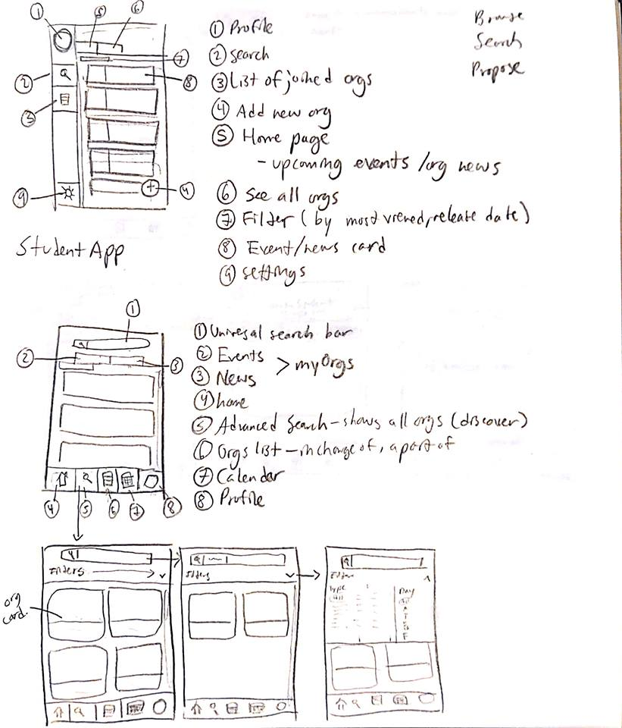
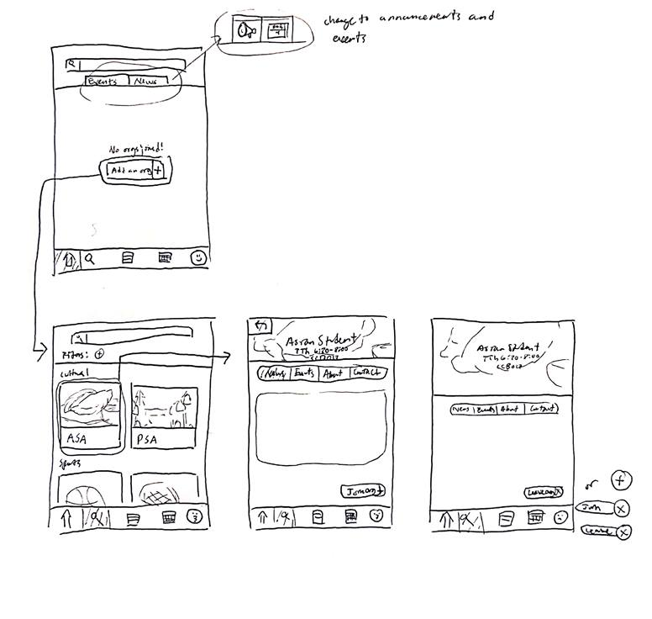
Design Process
Whiteboarding
I began by sketching out ideas, listing what I believed was necessary for the kind of app I was building.
I analyzed layout, flow, and ease of access. This part took me the longest, as I played through multiple scenarios in my head and asked others what they thought of the flow.
Since I was working alone on this project, once I got a good idea for the overall feel of the app and layout, I digitized my work.

Slide 3
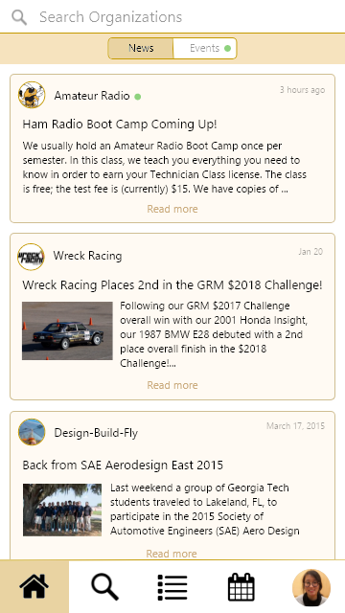
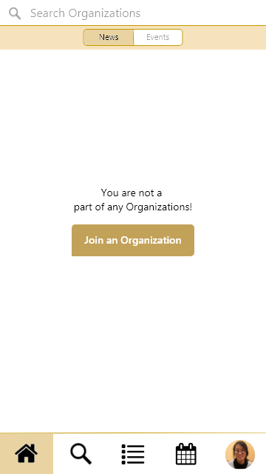
Design Process
2. Determining Style and Placement - Homescreen
I determined what to put in the nav bar. A homescreen is a great way to quickly glance over new things that may be happening in joined orgs. If the user is not in any organizations, this home screen has a button in the center prompting users to find some.
After determining the best tabs to put in the navigation bar, I used the homescreen to decide the theme for the rest of the app. I decided cards would be the cleanest way to group information.

Slide 4
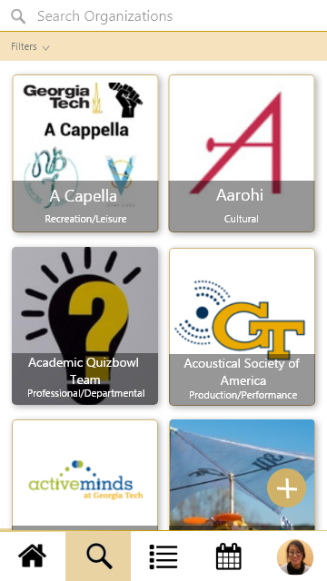
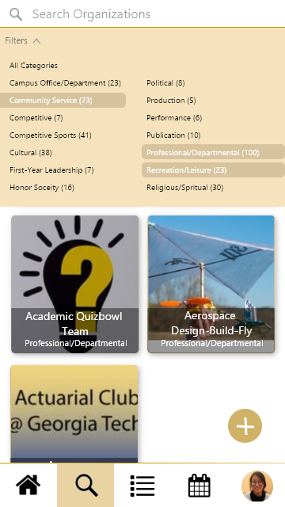
Design Process
3. Determining how to search and browse - Search Screen
The search screen allows users to both browse and search. I reasoned these should go together since browsing usually leads to searching. Keeping what is unknown for the user in one place would make it easier for the user to associate the search tab with discovering and finding new groups.

Slide 5
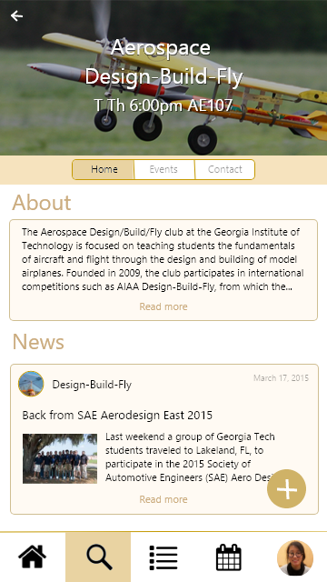
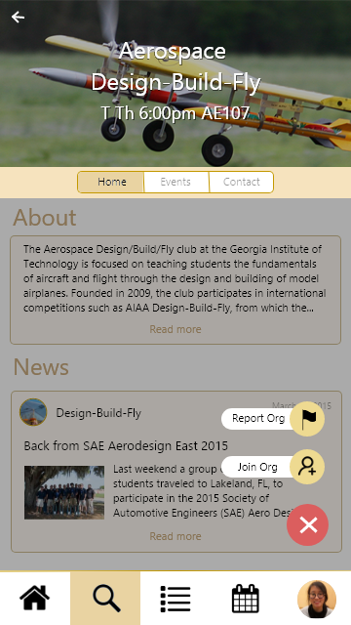
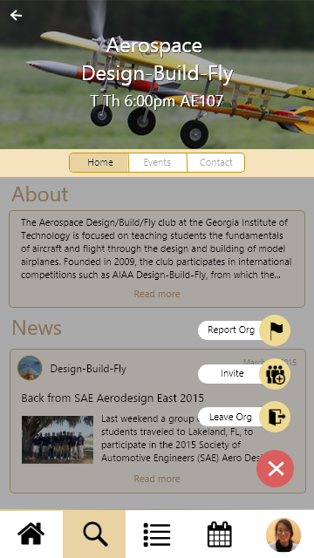
Design Process
4. Determining how to join and leave orgs - Org Screen
Information placed on home pages for individual groups is concise. Days, time, and location for meeting is provided near the name, making it easy to determine whether the user can make the club.
The floating + icon changes depending on whether the user is in the club or not, but usage type remains constant. Users can associate it with settings for the organization.

Slide 6
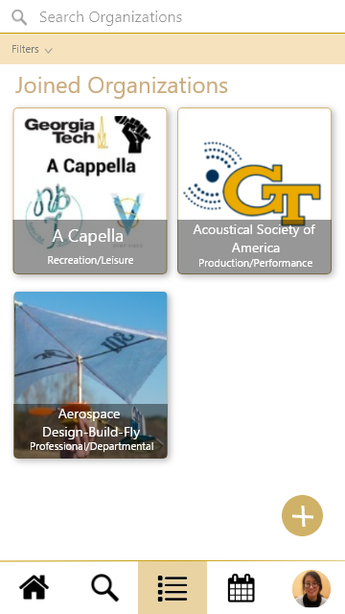
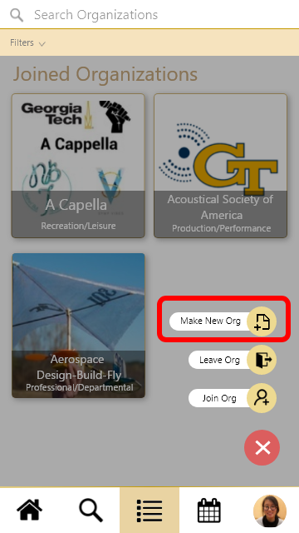
Design Process
5. Giving users more ways to join orgs - Joined Organizations Screen
The middle button in the navbar is a list of current organizations, which should be front and center for the user to browse. Clicking an org card will take the user back to the organization page.
The + button allows users to join new organizations or leave ones they select. It makes sense to allow them to join an org from their joined orgs page. It will navigate them back to the search screen.
This introduces making an organization as well.
This screen should include a section for owned organizations, which I forgot to include.

Slide 7
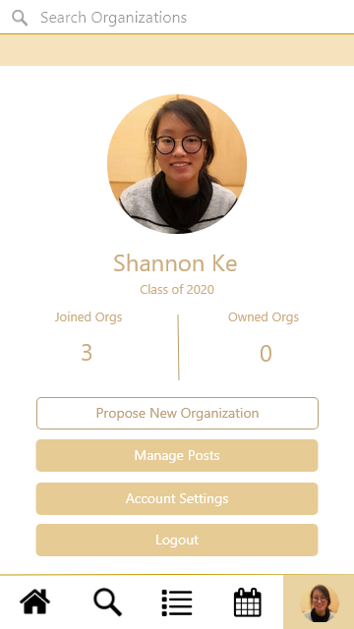

Design Process
6. Giving the users an overview of their activity - Profile
A user’s profile lets them know how involved they are with organizations.
Assuming the user can only govern one organization but possibly be on an executive board for others, there is a number included for owned orgs as well. Clicking either areas will navigate the user to their organizations list.
If the user does not own an organization, they may also create a new one from here.

Slide 8
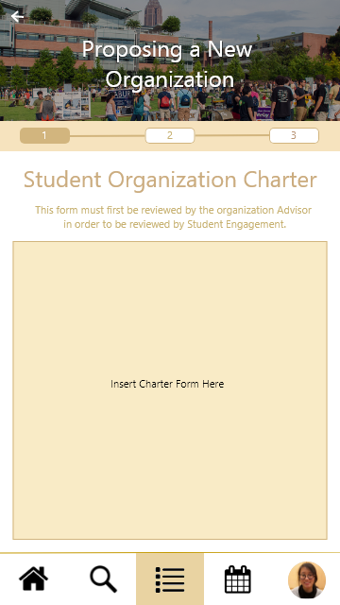
Design Process
Giving the user a way to make an organization - New Organization Form
Given that making the actual form was not a requirement, I have not done so.
A new organization can be proposed from 3 locations:
Search Screen - if user cannot find an organization of the type they are looking for, they can create one
Joined Organizations screen - For ease of access. If the user already has an idea of what they want to propose and are reminded by what they currently have that the org they want doesn’t exist.
Profile Screen - Since managing an organization is a big deal, it can almost define the user. Thus, it makes sense to allow users to make an org from their profile.

Slide 9
A final note...
I included a calendar button in the navbar but did not mock a screen for it.
Ideally it would hold all times for weekly meetings for orgs and events the user is interested in attending.
It could also be synced to google calendars to allow users to see a full overview of their schedule.

Slide 10
Complete Wireframe Flow

Slide 11
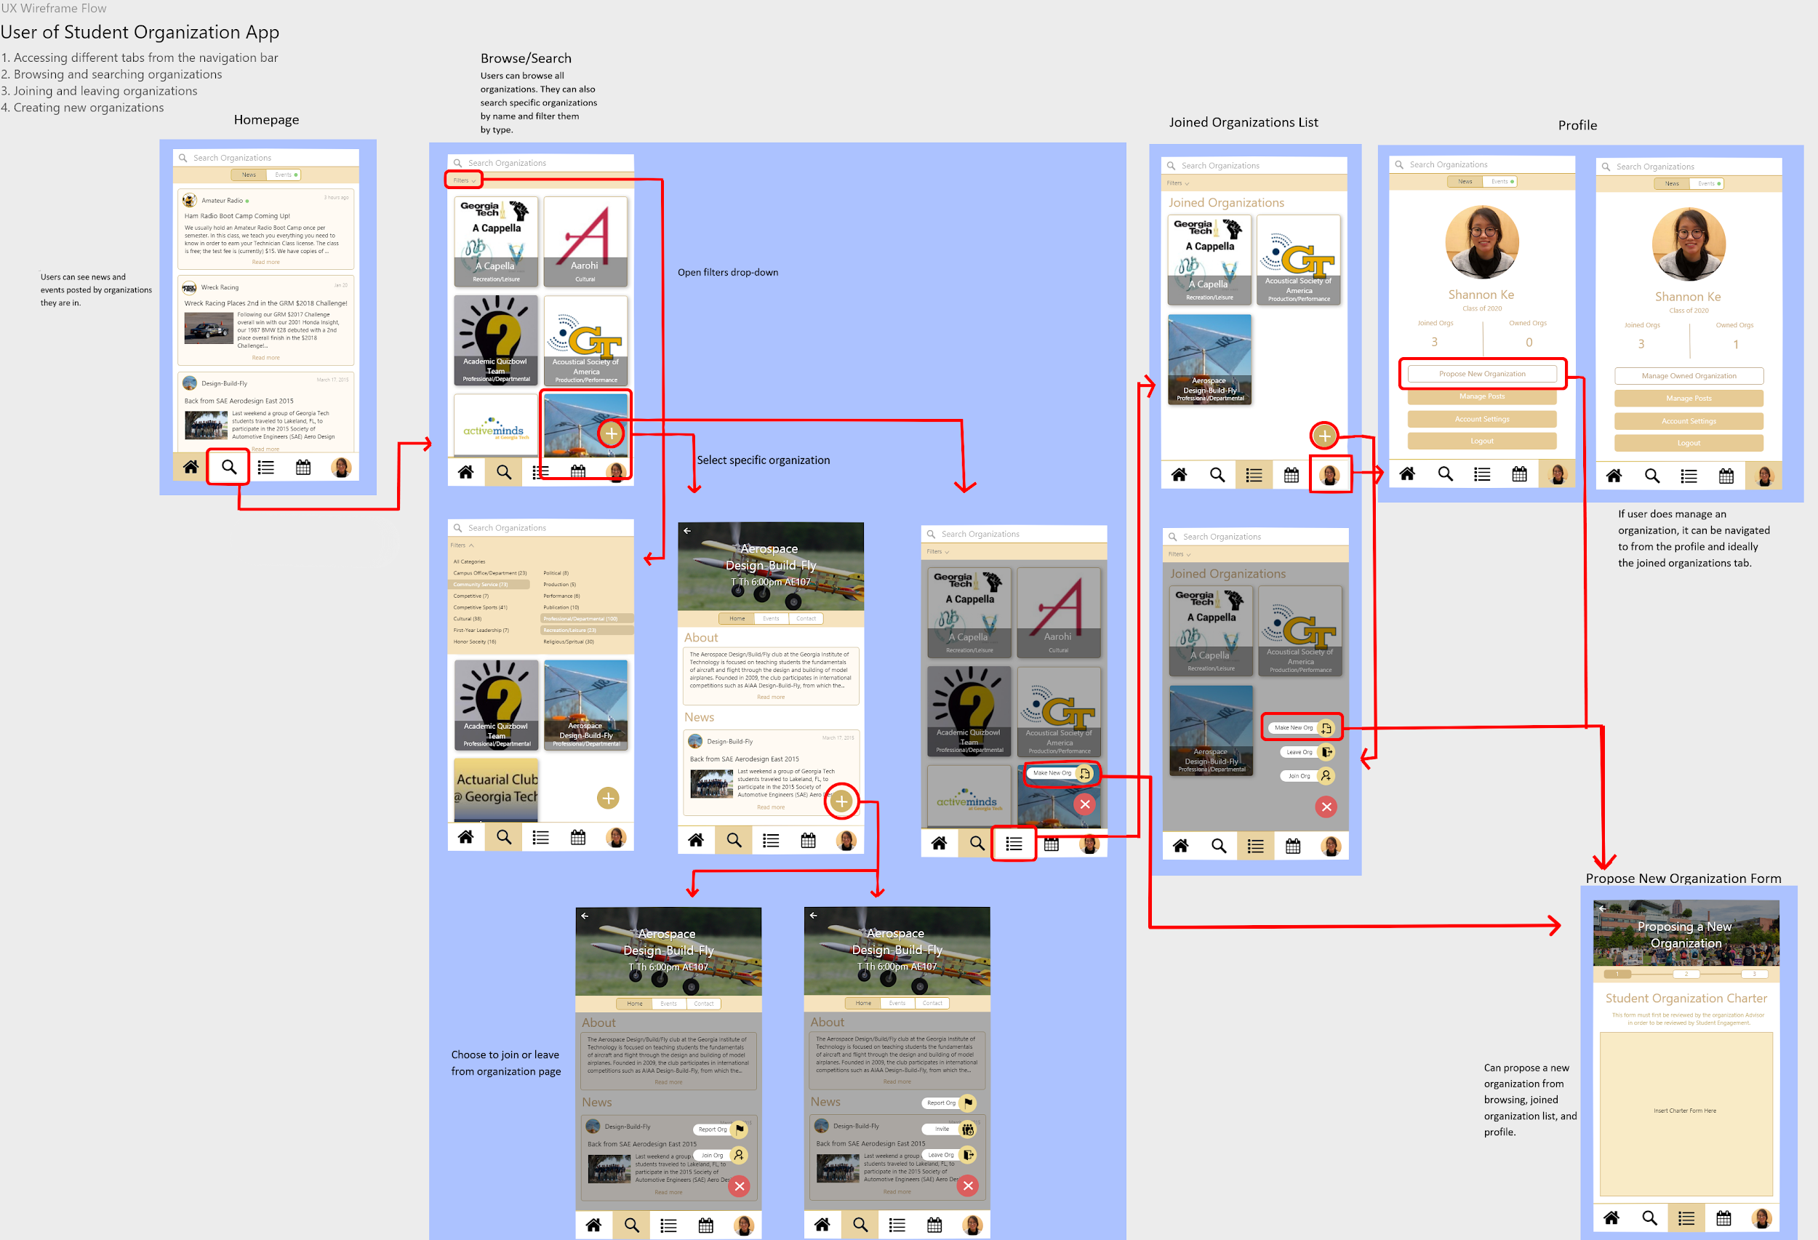

Slide 12
Future Work...
There are many aspects of the app that can be improved.
The actual usability of being able to create organizations from so many different places is questionable, but I included them so that the user has maximum ease of access. However, this may not be a good thing, considering creating an organization should be a decision scrutinized before executed.
Improvements for individuals with visual impairments were not considered when choosing color scheme.
Profile page needs to be revamped with a better and more relevant overview.
Overall app needs to be reviewed by more people. User testing needs to be conducted.

Slide 13
Thank you!

