Slide 1
AI-Powered Interview Preparation App
Shannon Fernandes
BEng Software & Electronic Engineering(Hons)
G00398070

Slide 2
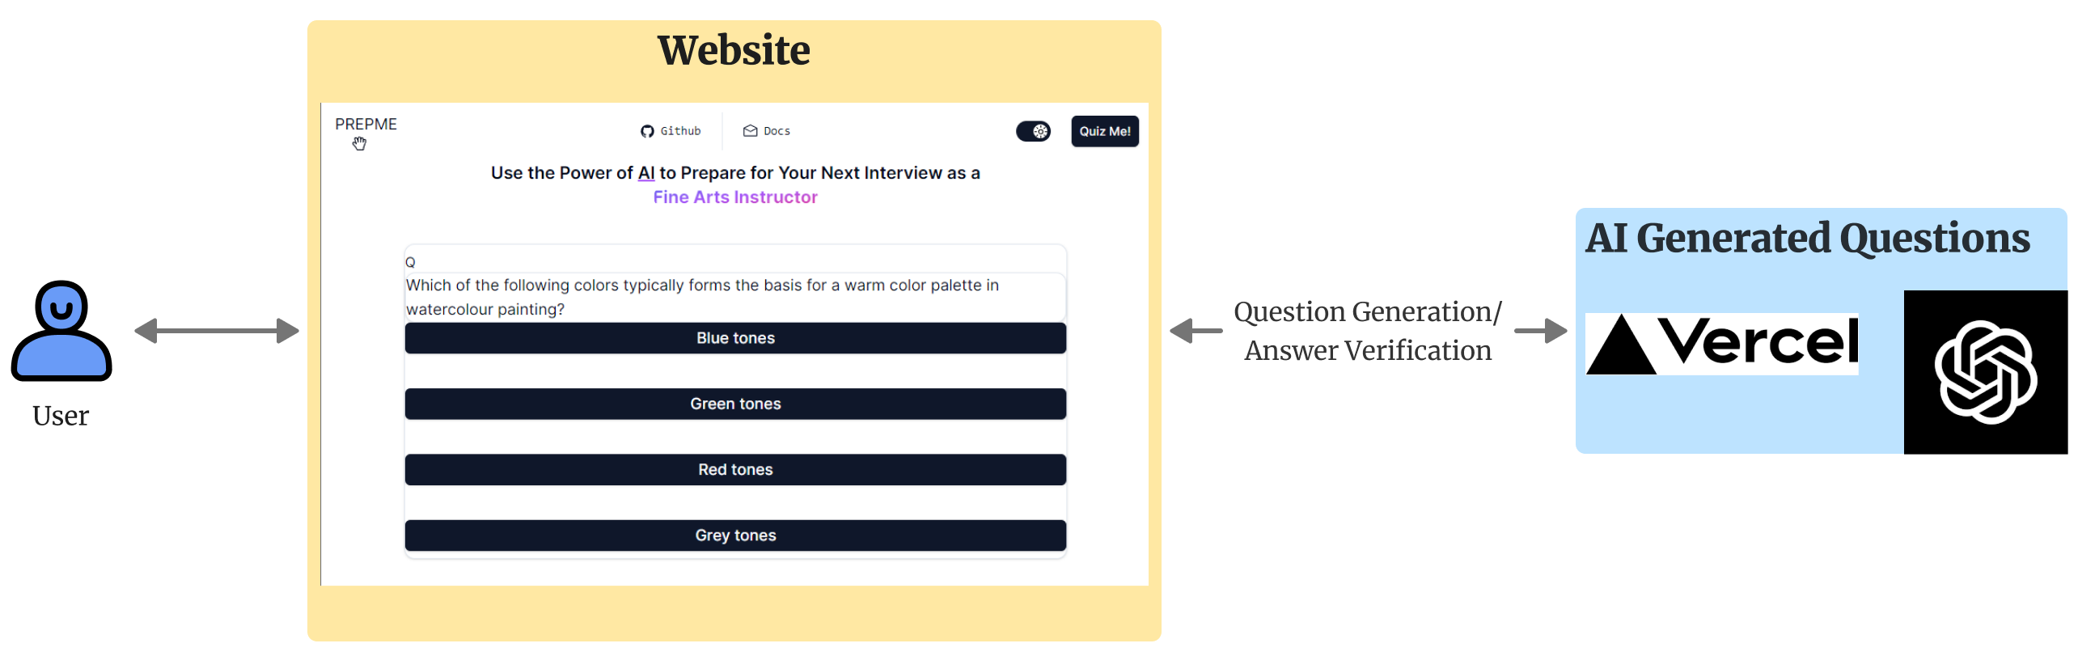
WHAT?
Fig 1.1 Simplified Architecture Diagram
MCQ web application
Questions and Answers generated by AI
Full Stack and Prompt Engineering focus
Gamify brushing up on technical topics

Slide 3

WHY?
Commitment
Convenience
Tailored to You
Stress
10 Questions – Small Commitment
AI handles question hunting
Questions suited to your industry; at the difficulty you want.
Middle ground between mock interviews and reading online.

Slide 4
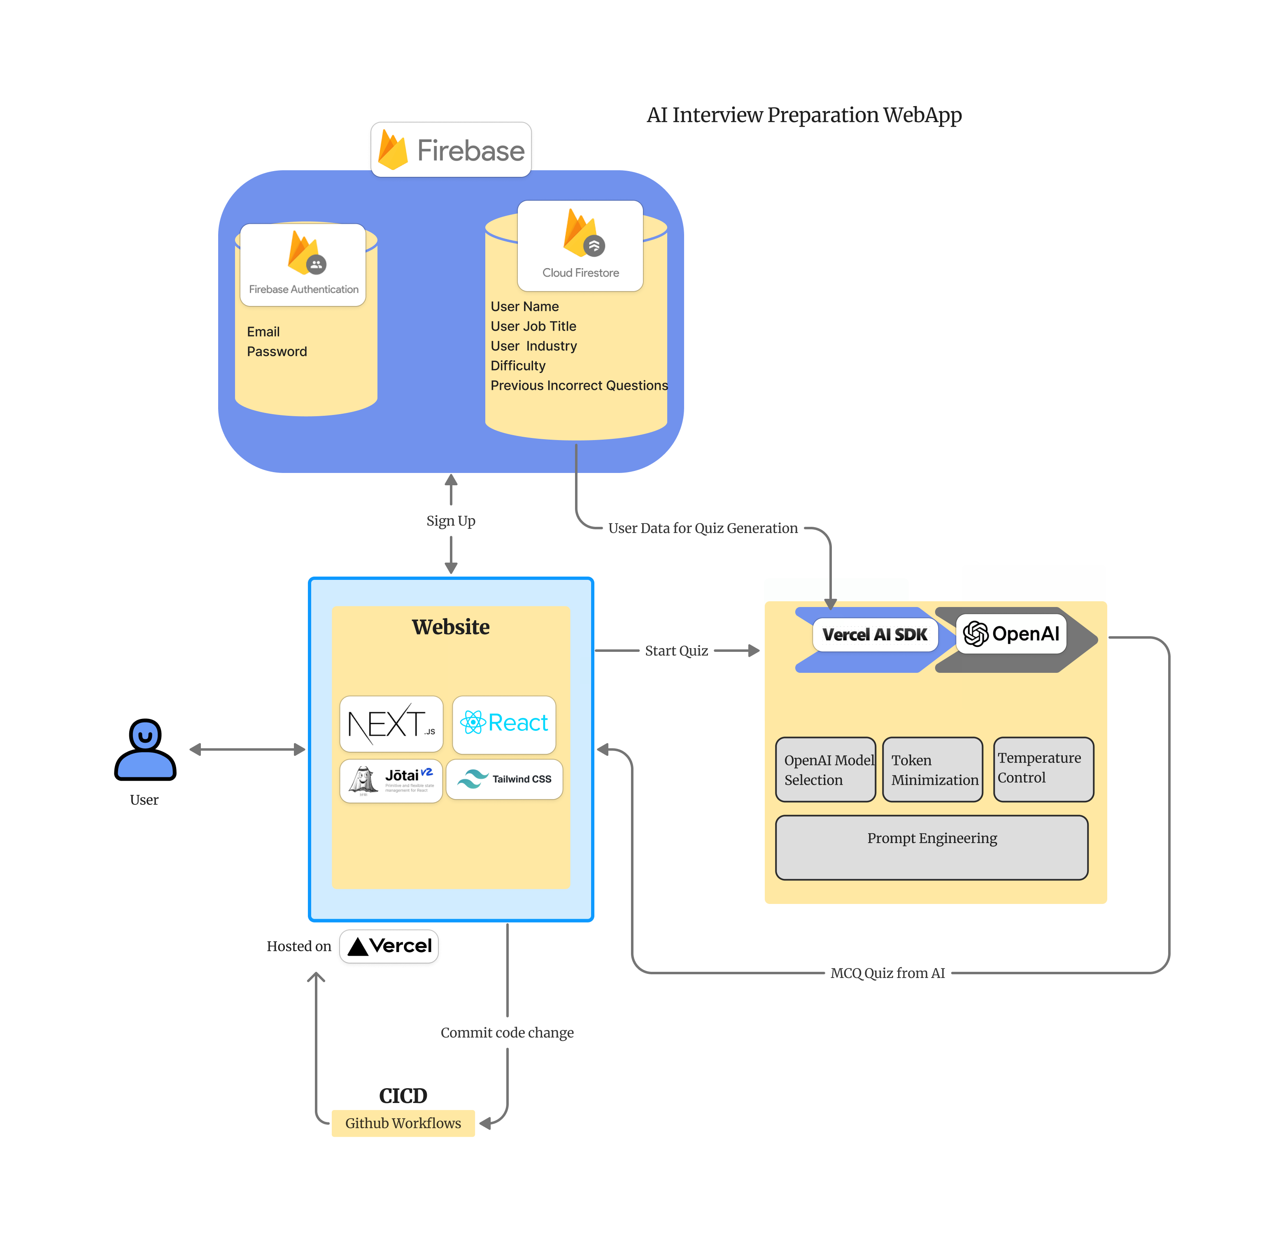
Fig 1.2 Architecture Diagram

Slide 5
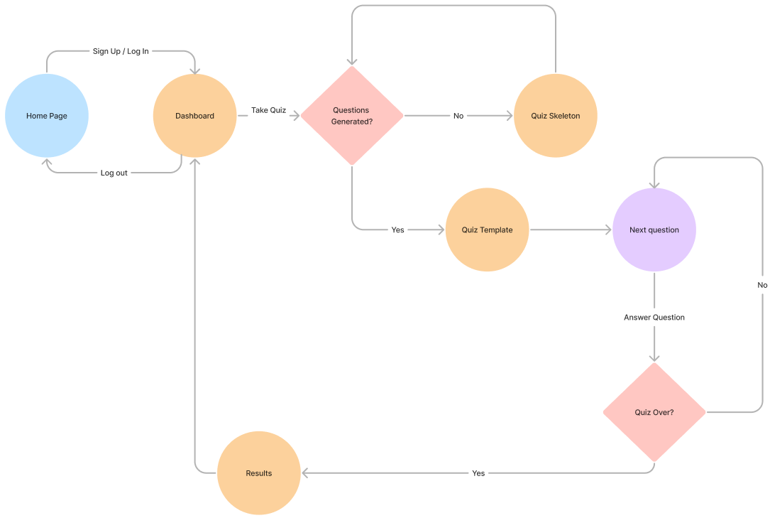
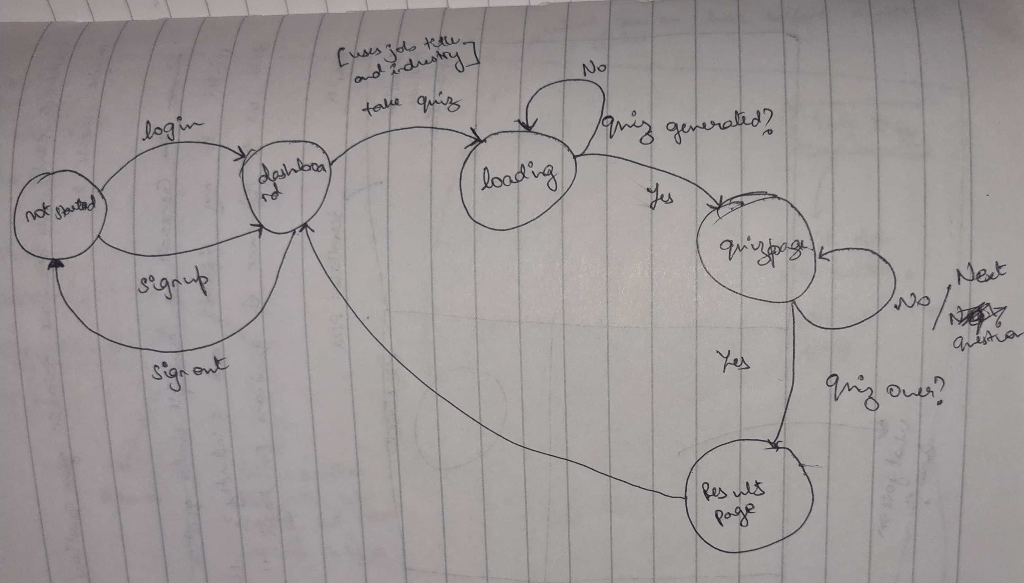
HOW?
Fig 1.4 Rough Sketch of Quiz Architecture
Fig 1.3 User Flow State Diagram

Slide 6
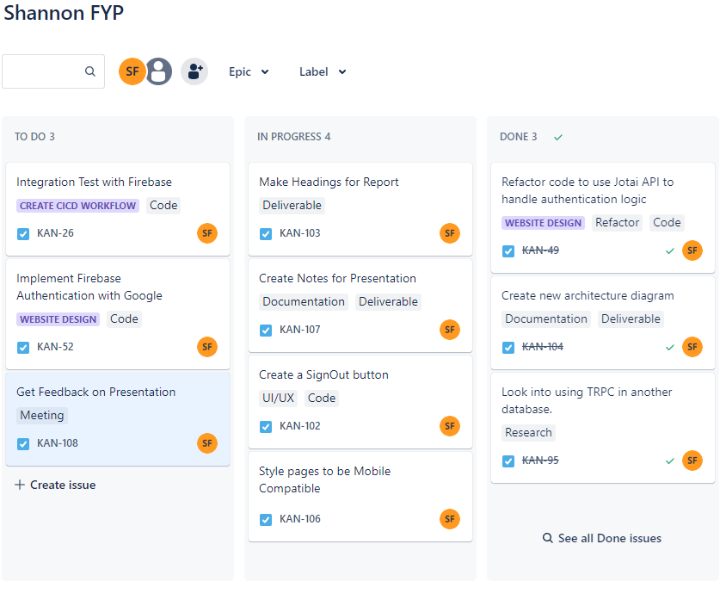
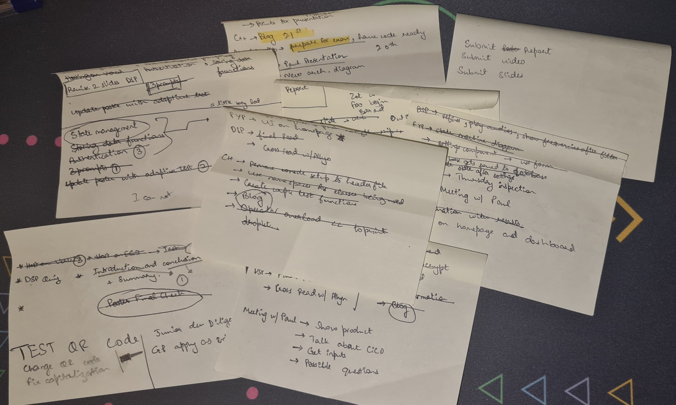
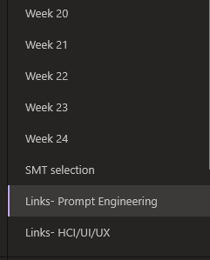
Project Organization
Fig 1.5 Sticky Notes for Daily Planning
Fig 1.4 Jira Kanban Board
Fig 1.6 OneNote Segregation of Research

Slide 7


Full Stack Development
Prompt Engineering
Less engineering, more art
What prompting method is suitable?
Trade-offs: Best practice, or working features?
Novel Technologies with Industry Collaboration

Slide 8
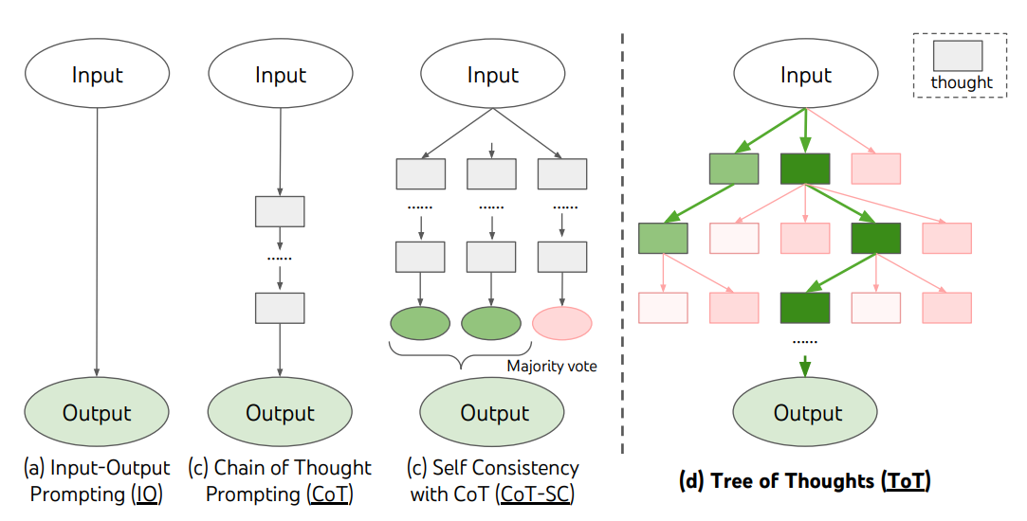
Prompting Techniques
Different tasks, different prompting techniques.
Factors to consider: depth and breadth of the corpus, context window of the machine.
No perfect prompts. Only better prompts.
One change at a time
Fig 2.1 Tree of Thought as a composite of common prompting techniques. Source: Yao et al. (2023)

Slide 9
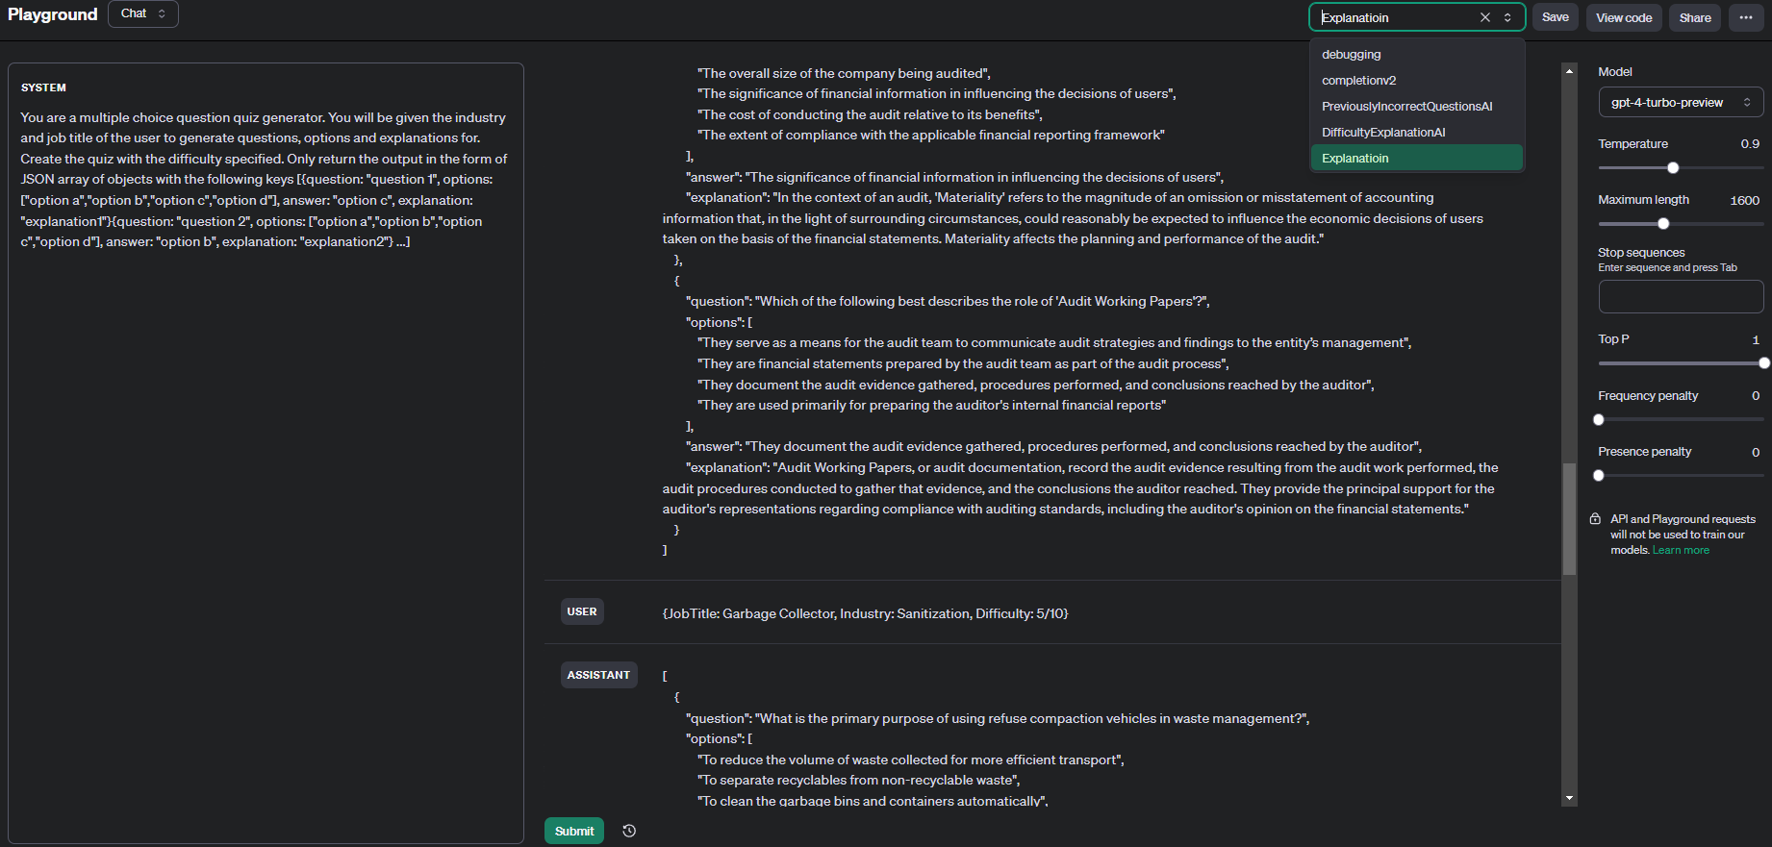
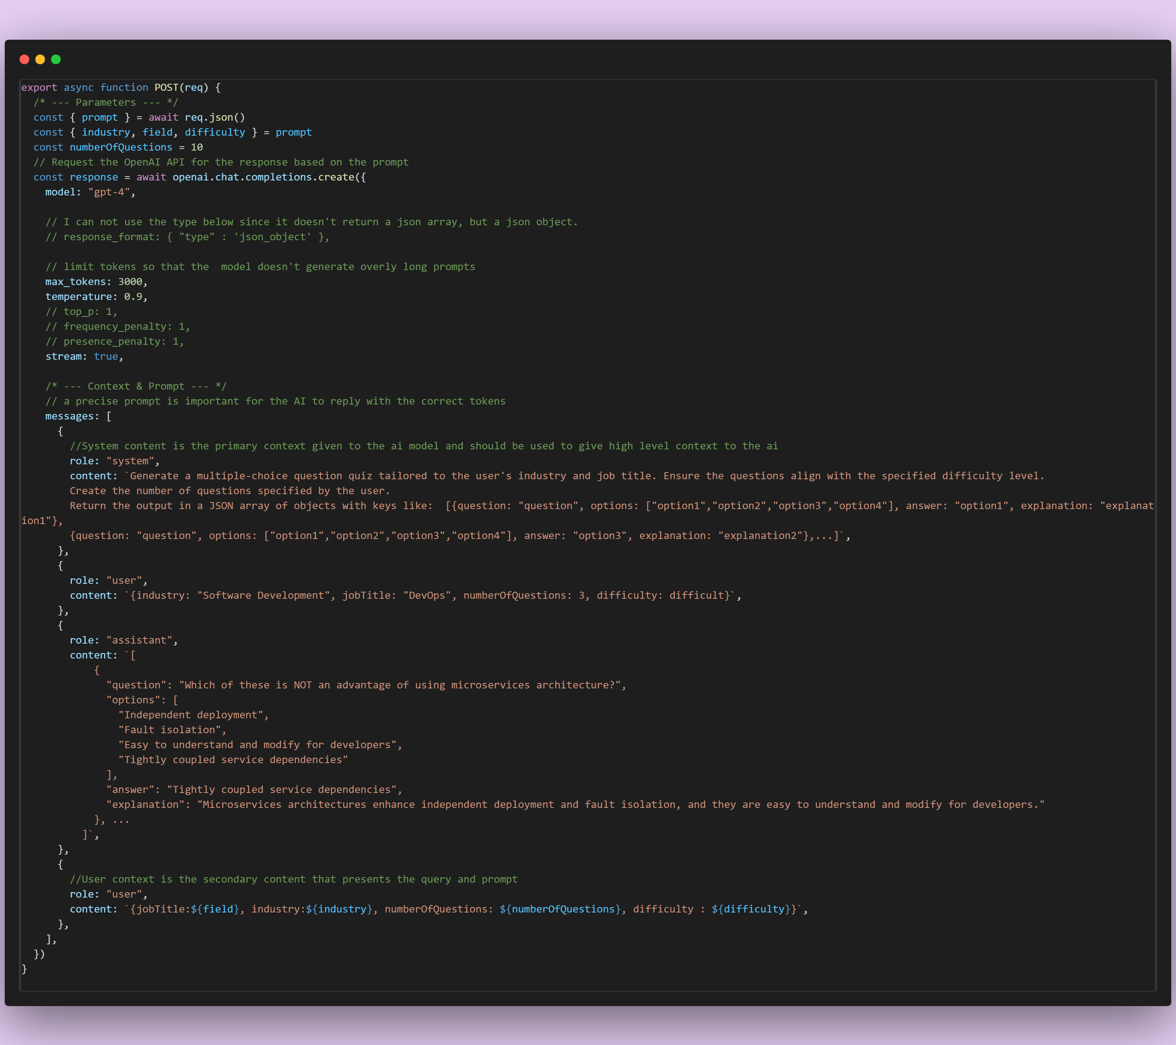
3.
1.
2.
Fig 2.2 Open AI playground for testing prompts and parameters

Slide 10
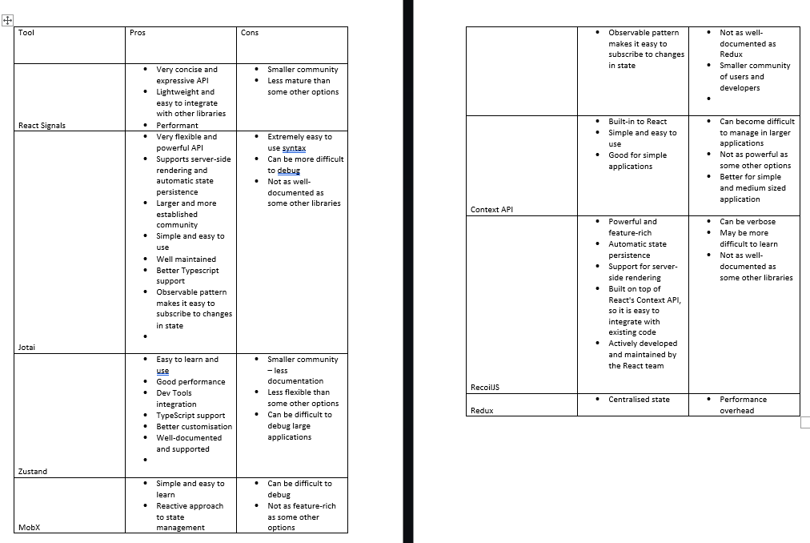
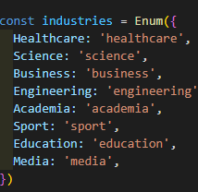


Industry Collaboration
Researching React State Management Tools – Comparing Context API, Redux, Zustand, Jotai, Recoil.
Useful design patterns and conventions: Enums, custom react hooks
Software development concepts: Separation of Concerns, SOLID principles, pure functions.
Fig 3.1 State Management Tool research done in collaboration with GP
Fig 3.2 Using Enumerations as a source of truth for multiple components

Slide 11
Further Developments
Text-to-Speech
Model Selection
Improved accessibility using WhisperAI to read text
Give users the option to pick different LLMs

Slide 12
THANKS!
https://ai-interview-preparation-app.vercel.app/
G00398070@atu.ie
shannongf74@gmail.com
Please keep this slide for attribution

