Slide 1
Gaming Presentation
Shannon

Slide 2
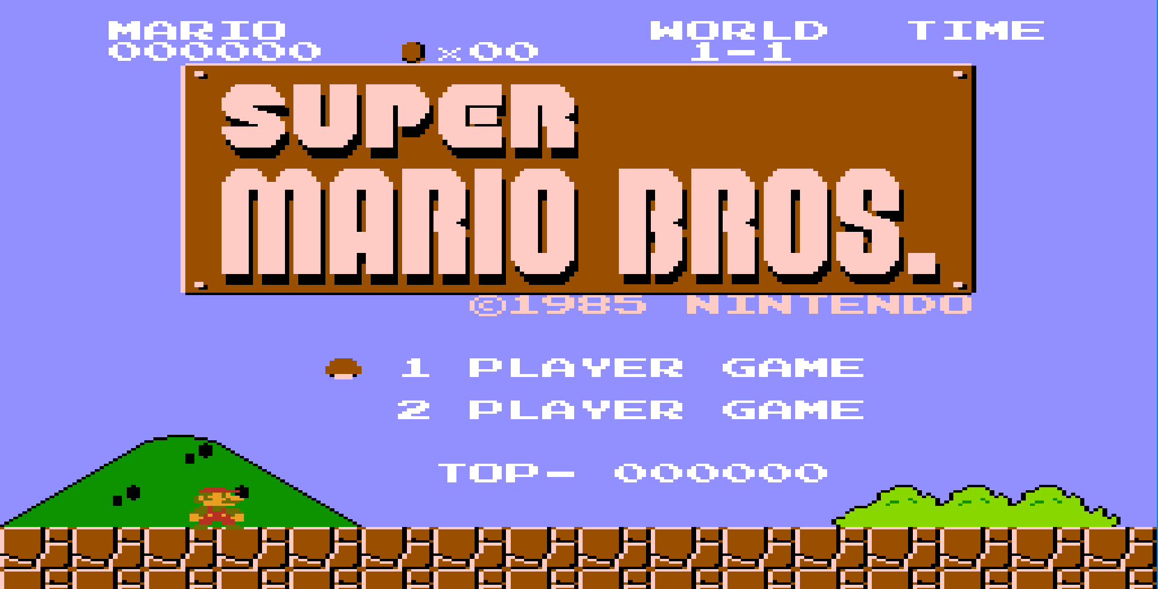
Super Mario Bros

Slide 3
Main Goals
Create Player Sprite
Code Player Movements
Create Ground Tile Layer
Code Player Physics
  Jumps, Gravity, Collision_Checks

Slide 4
Demo/Improvements
TileLayerMissing[ground]
Collision_check[keepPlayerObjActive]
GameSoundsMissing

Slide 5
END
QUESTIONS?

