Slide 1

Vanguard UI A/B testing
Shannon Knight

Slide 2
Overview
Founded in 1975 - US investment company, owned by the investors themselves
203 funds in the US, 227 in other markets
Low-cost uncomplicated investing, and our UI should demonstrate this
How effective is the new UI design in the savings product self-service portal?
Our company
Our philosophy
Our UI design

Slide 3
The testing process
01
02
Frame the question
Hypotheses
Did the new UI lead to higher completion rates?
The new design had (i) a higher success rate, (ii) a lower error rate and (iii) was quicker to complete
Four steps of A/B testing
04
03
Evaluate results
Experiment
Test showed overly positive results
Collected data for
50 500 users btw mid-March and mid-June

Slide 4
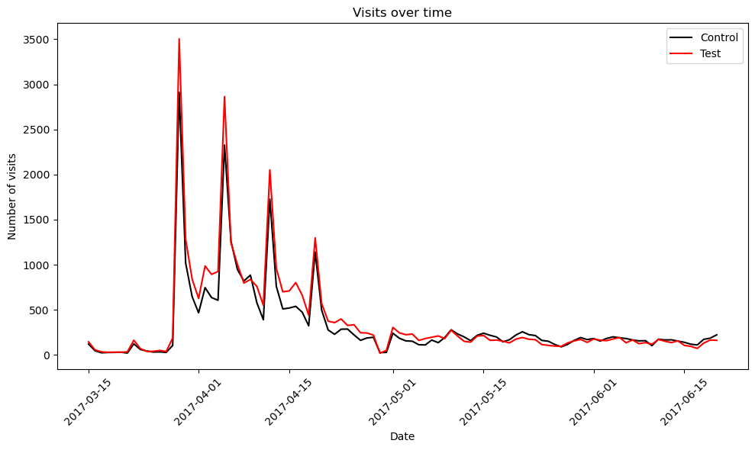
Data collection

Slide 5
A/B Summary Stats
Control #
Test #
23 397
26 679
Completed
Completed
15 434
18 687
Success rate
A
B
Success rate
66%
69%
Avg time
Avg time
8m 56s
8m 38s
Error rate
Error rate
7.6%
9.8%

Slide 6
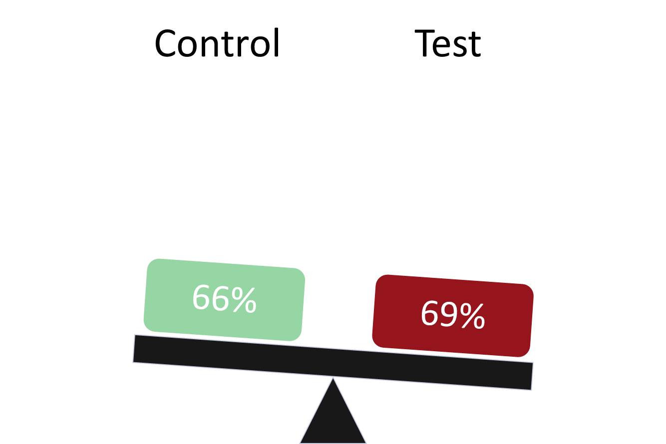

Hypothesis testing - new UI has a higher success rate
H0: success_c = success_t | 66% = 70%
H1: success_c < success_t | 66% < 70%
z-statistic | 8.881
p-value | 6.610
α | 0.05
Conclusion | Reject H0 - success rate for test higher than control
Notes:
Alpha is the significance level - threshold for

Slide 7
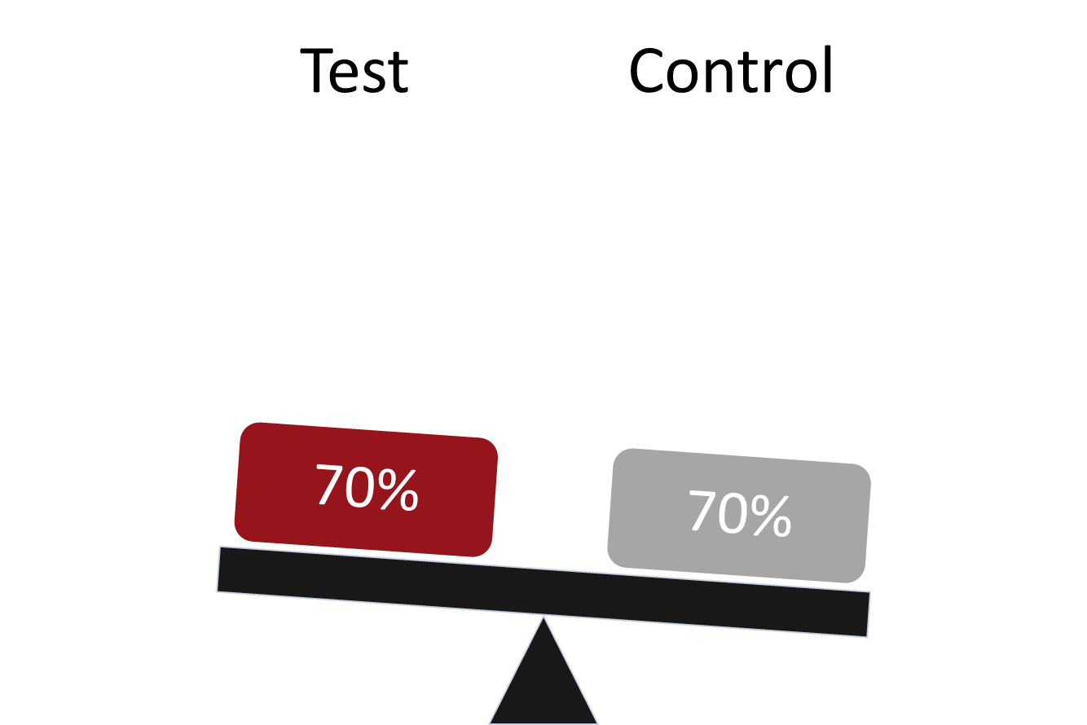
Hypothesis testing - new UI success rate meets threshold
H0: success_c = success_t | 69% = 70%
H1: success_c < success_t | 69% < 70%
t-statistic | -2.516
p-value | 0.006
α | 0.05
Conclusion | Accept H0 - success rate for test meets threshold
Notes:
Alpha is the significance level - threshold for

Slide 8
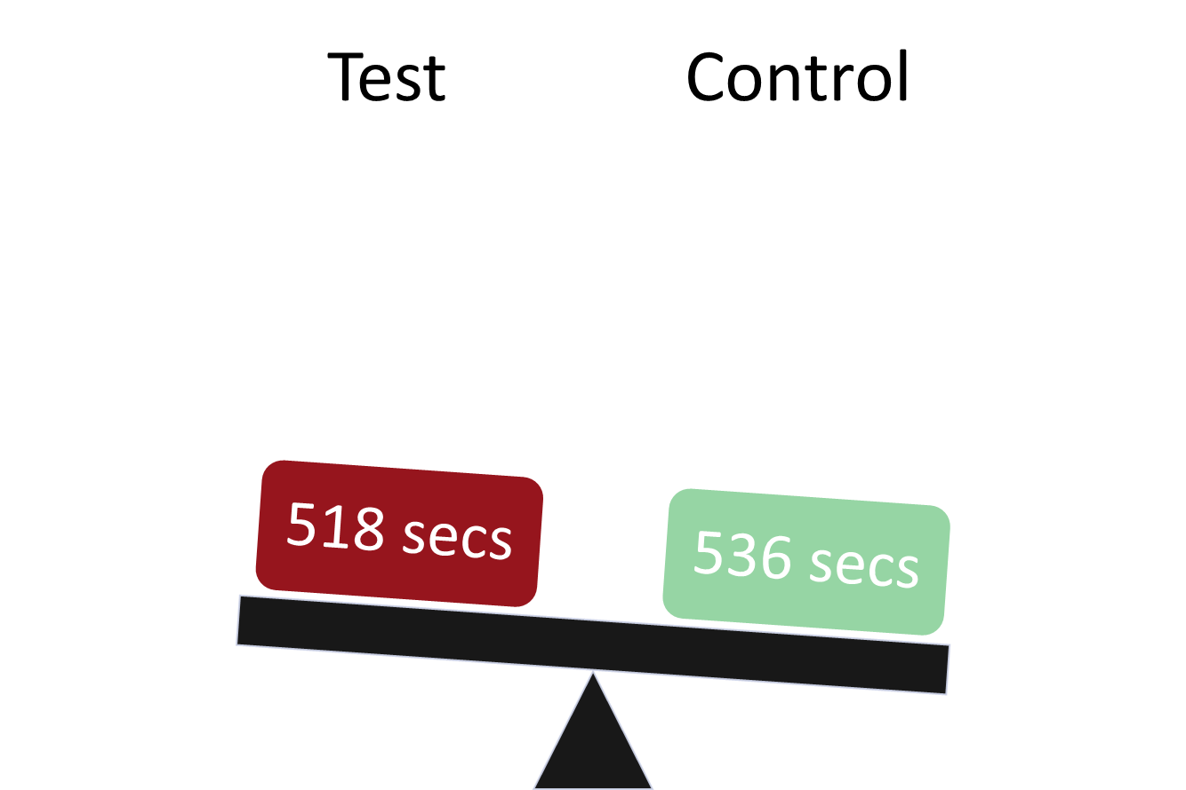
Hypothesis testing - new UI faster
H0: time_c = time_t | 536 sec = 518 sec
H1: time_c > time_t | 536 sec > 518 sec
z-statistic | -0.060
p-value | 0.952
α | 0.05
Conclusion | Reject H0 - time taken for test less than for the control
Notes:
Alpha is the significance level - threshold for

Slide 9
Next steps
Improvements required in the UI design to decrease the error rate
Need a geographically representative sample for further testing

