Slide 1
Chapter 4:
The Enhanced ER Model and Business Rules
Modern Database Management
8th Edition
Jeffrey A. Hoffer, Mary B. Prescott,
Fred R. McFadden
© 2007 by Prentice Hall

Slide 2
Objectives
Definition of terms
Use of supertype/subtype relationships
Use of generalization and specialization techniques
Specification of completeness and disjointness constraints
Develop supertype/subtype hierarchies for realistic business situations
Develop entity clusters
Explain universal data model
Name categories of business rules
Define operational constraints graphically and in English

Slide 3
Supertypes and Subtypes
Subtype: A subgrouping of the entities in an entity type that has attributes distinct from those in other subgroupings
Supertype: A generic entity type that has a relationship with one or more subtypes
Attribute Inheritance:
  Subtype entities inherit values of all attributes of the supertype
  An instance of a subtype is also an instance of the supertype

Slide 4
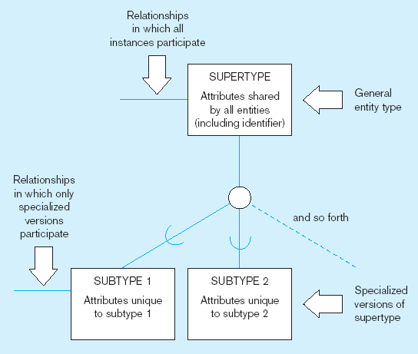
Figure 4-1 Basic notation for supertype/subtype notation
a) EER notation

Slide 5
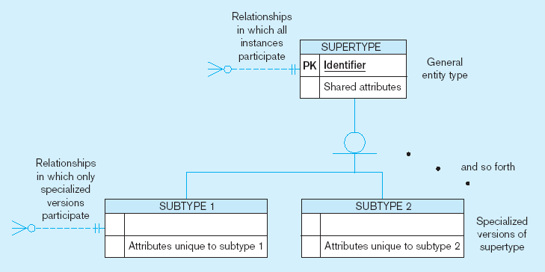
Figure 4-1 Basic notation for supertype/subtype notation (cont.)
b) Microsoft Visio Notation
Different modeling tools may have different notation for the same modeling constructs

Slide 6
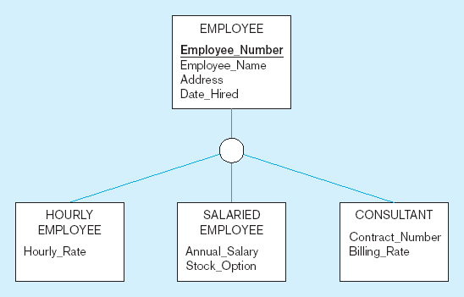
Figure 4-2 Employee supertype with three subtypes
All employee subtypes will have emp nbr, name, address, and date-hired
Each employee subtype will also have its own attributes

Slide 7
Relationships and Subtypes
Relationships at the supertype level indicate that all subtypes will participate in the relationship
The instances of a subtype may participate in a relationship unique to that subtype. In this situation, the relationship is shown at the subtype level

Slide 8
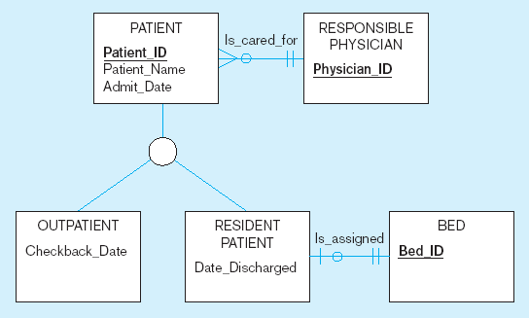
Figure 4-3 Supertype/subtype relationships in a hospital
Both outpatients and resident patients are cared for by a responsible physician
Only resident patients are assigned to a bed

Slide 9
Generalization and Specialization
Generalization: The process of defining a more general entity type from a set of more specialized entity types. BOTTOM-UP
Specialization: The process of defining one or more subtypes of the supertype and forming supertype/subtype relationships. TOP-DOWN

Slide 10
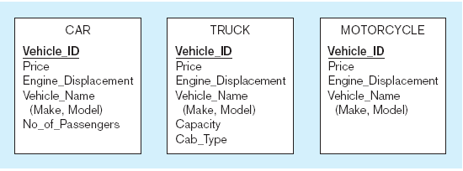
Figure 4-4 Example of generalization
a) Three entity types: CAR, TRUCK, and MOTORCYCLE
All these types of vehicles have common attributes

Slide 11
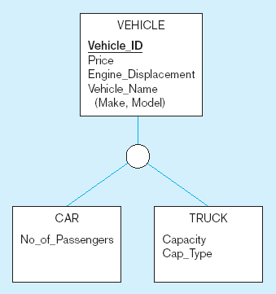
Figure 4-4 Example of generalization (cont.)
b) Generalization to VEHICLE supertype
So we put the shared attributes in a supertype
Note: no subtype for motorcycle, since it has no unique attributes

Slide 12
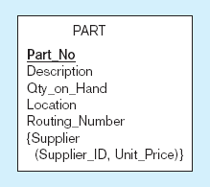
Figure 4-5 Example of specialization
a) Entity type PART
Only applies to manufactured parts
Applies only to purchased parts

Slide 13
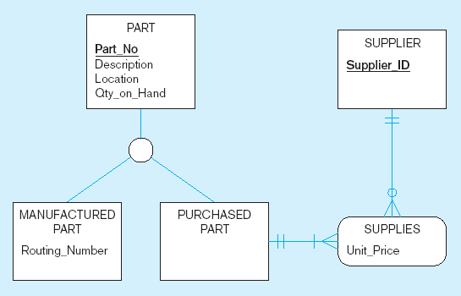
Figure 4-5 Example of specialization (cont.)
b) Specialization to MANUFACTURED PART and PURCHASED PART
Created 2 subtypes
Note: multivalued attribute was replaced by an associative entity relationship to another entity

Slide 14
Constraints in Supertype/ Completeness Constraint
Completeness Constraints: Whether an instance of a supertype must also be a member of at least one subtype
  Total Specialization Rule: Yes (double line)
  Partial Specialization Rule: No (single line)

Slide 15
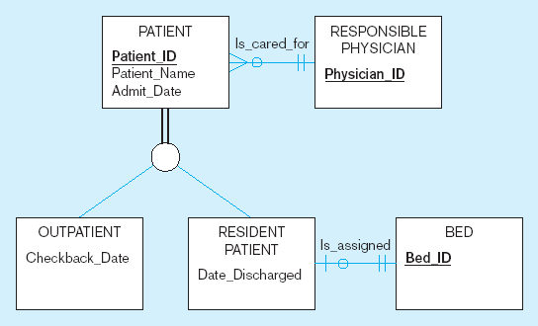
Figure 4-6 Examples of completeness constraints
a) Total specialization rule
A patient must be either an outpatient or a resident patient

Slide 16
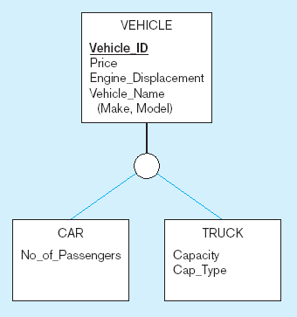
Figure 4-6 Examples of completeness constraints (cont.)
b) Partial specialization rule
A vehicle could be a car, a truck, or neither

Slide 17
Constraints in Supertype/ Disjointness constraint
Disjointness Constraints: Whether an instance of a supertype may simultaneously be a member of two (or more) subtypes
  Disjoint Rule: An instance of the supertype can be only ONE of the subtypes
  Overlap Rule: An instance of the supertype could be more than one of the subtypes

Slide 18
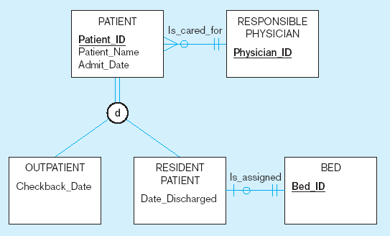
Figure 4-7 Examples of disjointness constraints
a) Disjoint rule
A patient can either be outpatient or resident, but not both

Slide 19
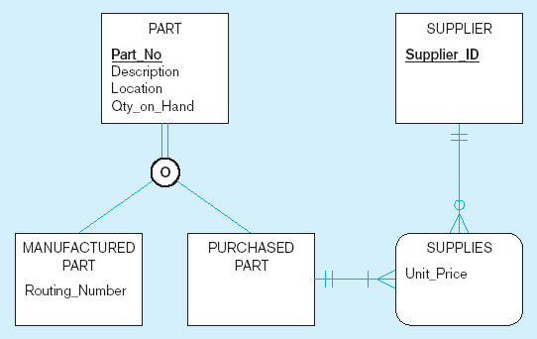
Figure 4-7 Examples of disjointness constraints (cont.)
b) Overlap rule
A part may be both purchased and manufactured

Slide 20
Constraints in Supertype/ Subtype Discriminators
Subtype Discriminator: An attribute of the supertype whose values determine the target subtype(s)
  Disjoint – a simple attribute with alternative values to indicate the possible subtypes
  Overlapping – a composite attribute whose subparts pertain to different subtypes. Each subpart contains a boolean value to indicate whether or not the instance belongs to the associated subtype

Slide 21
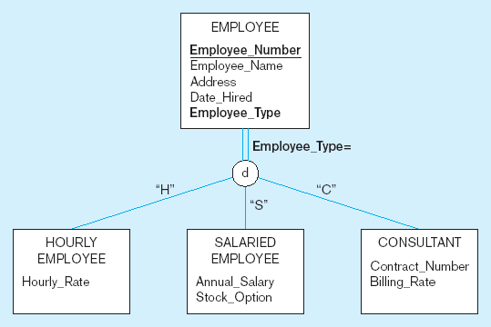
Figure 4-8 Introducing a subtype discriminator (disjoint rule)
A simple attribute with different possible values indicating the subtype

Slide 22
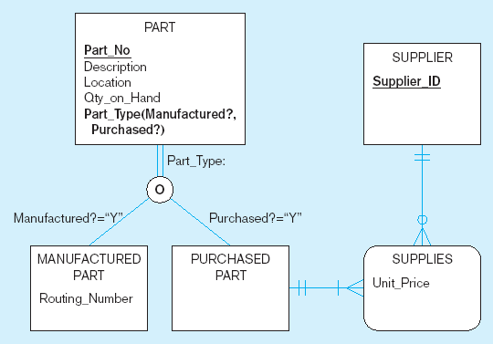
Figure 4-9 Subtype discriminator (overlap rule)
A composite attribute with sub-attributes indicating “yes” or “no” to determine whether it is of each subtype

Slide 23
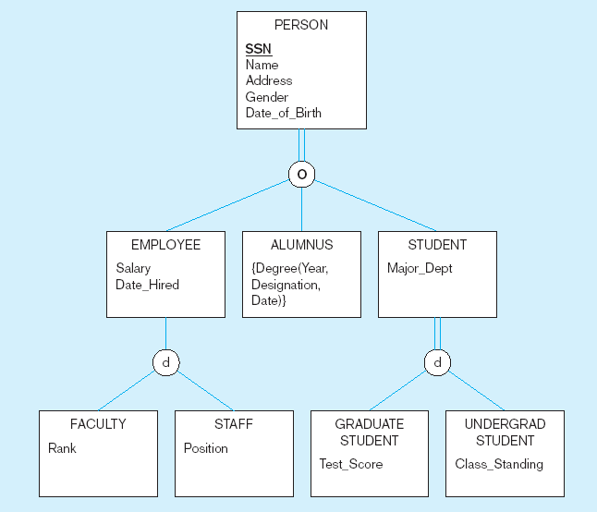
Figure 4-10 Example of supertype/subtype hierarchy

Slide 24
Entity Clusters
EER diagrams are difficult to read when there are too many entities and relationships
Solution: Group entities and relationships into entity clusters
Entity cluster: Set of one or more entity types and associated relationships grouped into a single abstract entity type

Slide 25
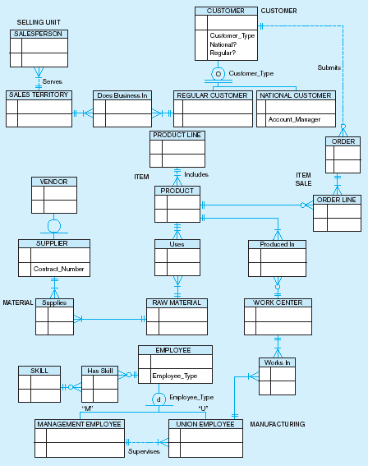
Figure 4-13a Possible entity clusters for Pine Valley Furniture in Microsoft Visio
Related groups of entities could become clusters

Slide 26
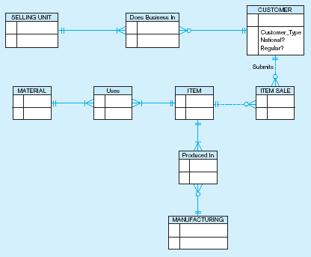
Figure 4-13b EER diagram of PVF entity clusters
More readable, isn’t it?

Slide 27
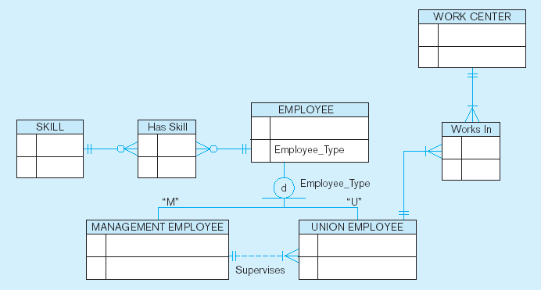
Figure 4-14 Manufacturing entity cluster
Detail for a single cluster

Slide 28
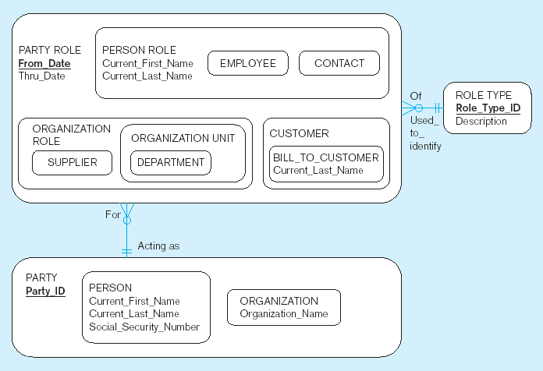
Packaged data models provide generic models that can be customized for a particular organization’s business rules

Slide 29
Business rules
Statements that define or constrain some aspect of the business
Classification of business rules:
  Derivation–rule derived from other knowledge, often in the form of a formula using attribute values
  Structural assertion–rule expressing static structure. Includes attributes, relationships, and definitions
  Action assertion–rule expressing constraints/control of organizational actions

Slide 30
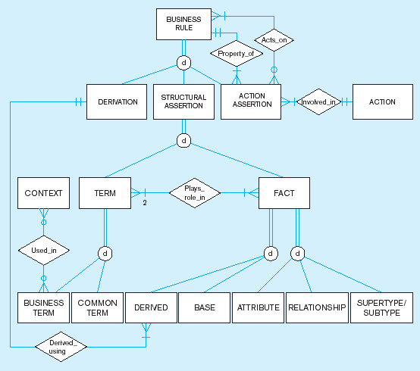
Figure 4-18
EER diagram to describe business rules

Slide 31
Types of Action Assertions
Result
  Condition–IF/THEN rule
  Integrity constraint–must always be true
  Authorization–privilege statement
Form
  Enabler–leads to creation of new object
  Timer–allows or disallows an action
  Executive–executes one or more actions
Rigor
  Controlling–something must or must not happen
  Influencing–guideline for which a notification must occur

Slide 32
Stating an Action Assertion
Anchor Object–an object on which actions are limited
Action–creation, deletion, update, or read
Corresponding Objects–an object influencing the ability to perform an action on another business rule
Action assertions identify corresponding objects that constrain the ability to perform actions on anchor objects

Slide 33
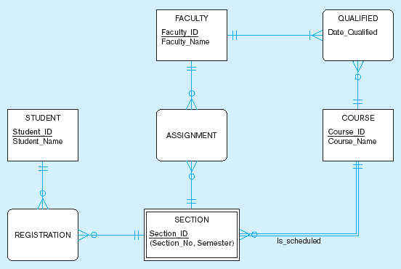
Figure 4-19 Data model segment for class scheduling

Slide 34
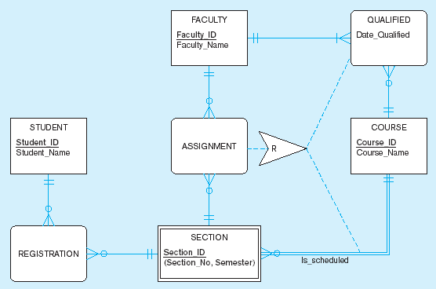
Figure 4-20 Business Rule 1: For a faculty member to be assigned to teach a section of a course, the faculty member must be qualified to teach the course for which that section is scheduled
Corresponding object
In this case, the action assertion is a Restriction
Action assertion
Anchor object
Corresponding object

Slide 35
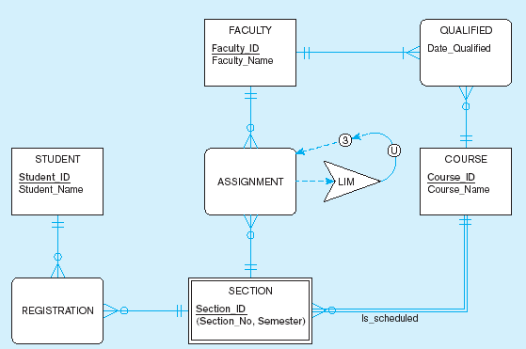
Figure 4-21 Business Rule 2: For a faculty member to be assigned to teach a section of a course, the faculty member must not be assigned to teach a total of more than three course sections
In this case, the action assertion is an
Upper LIMit
Corresponding object
Action assertion
Anchor object

