Slide 1
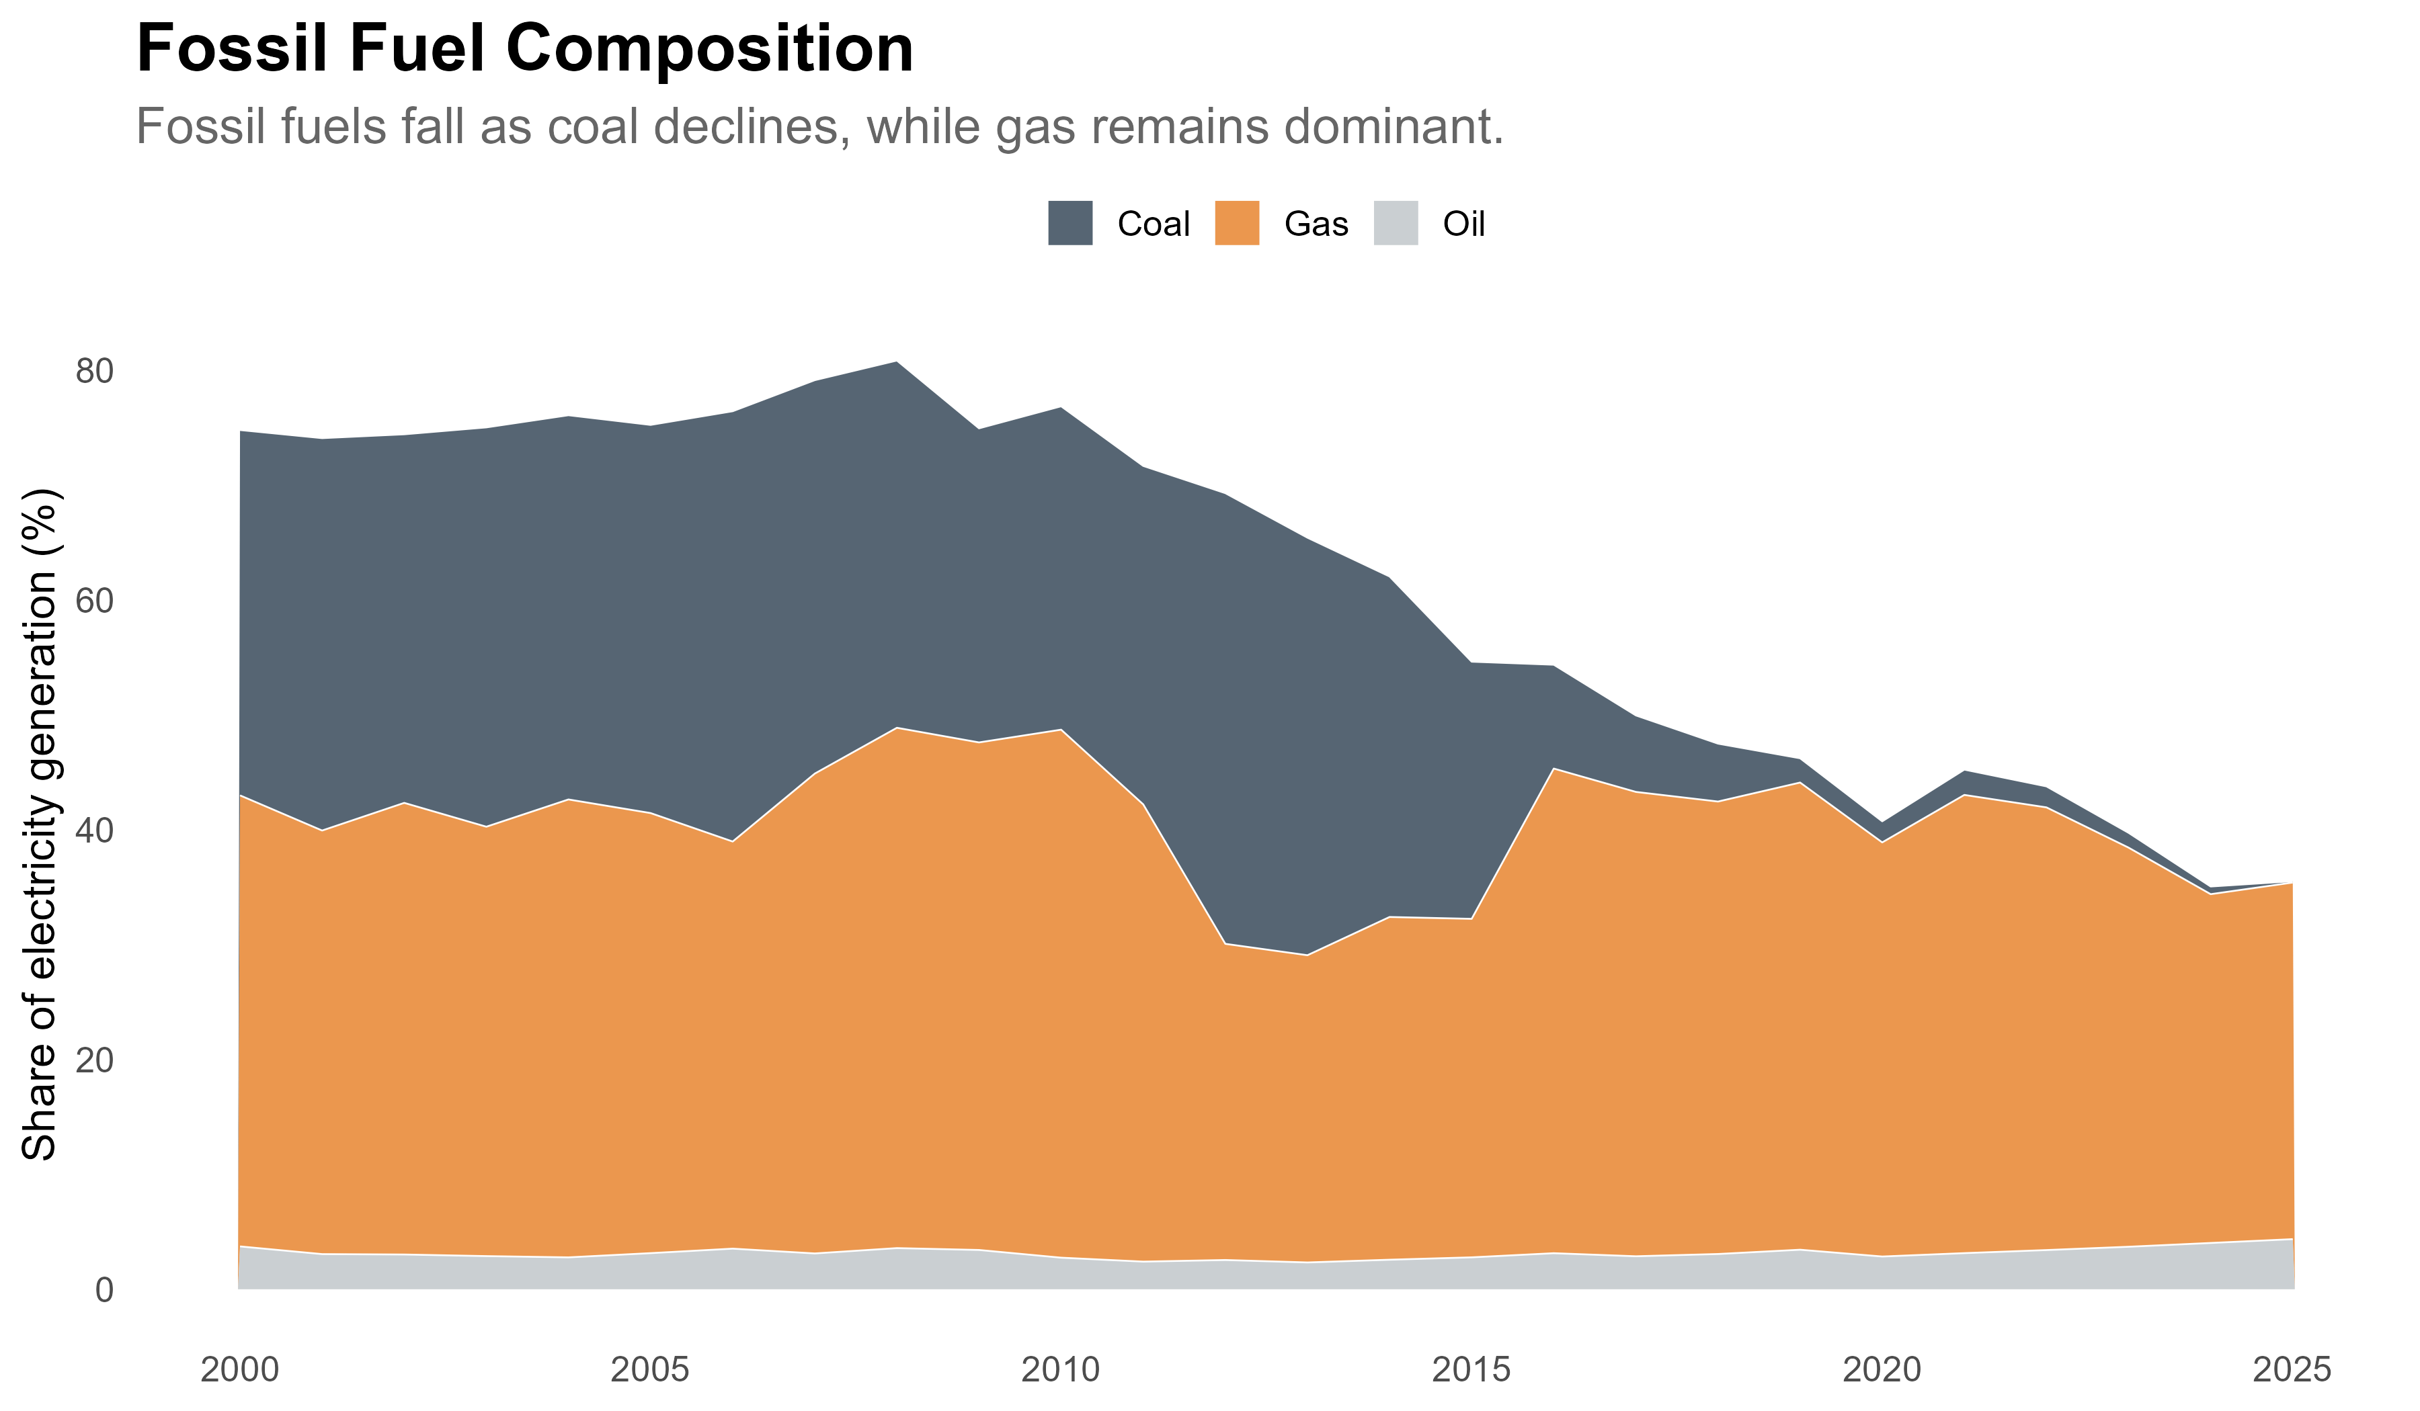
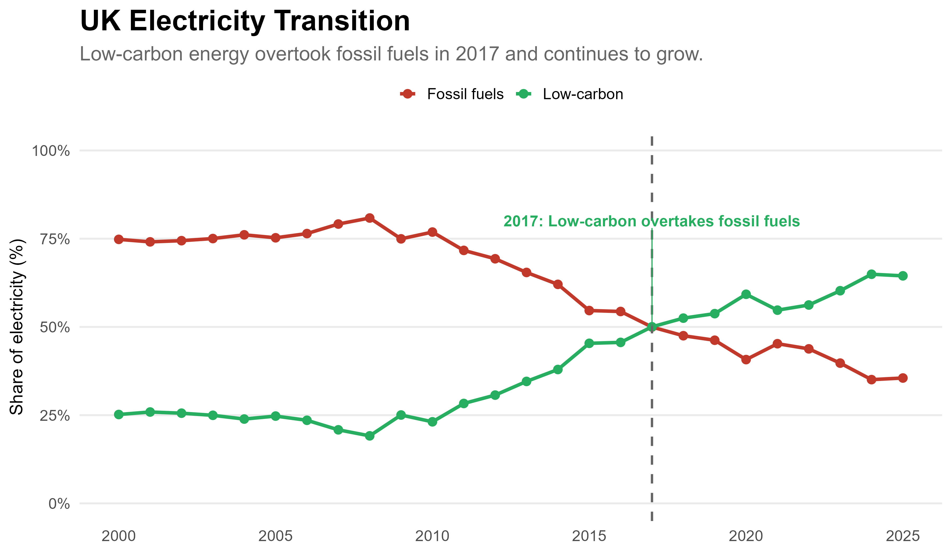
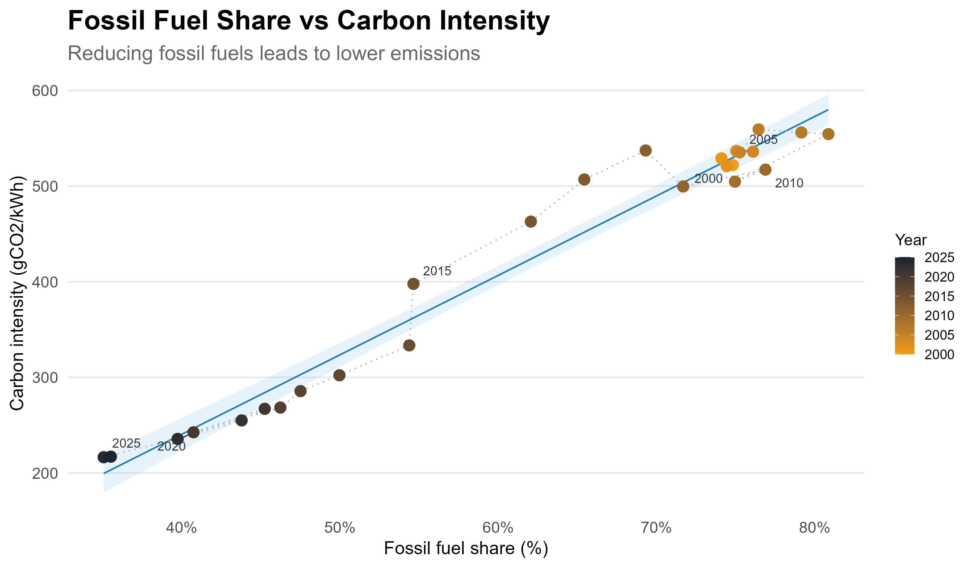
DECARBONISATION OF UK ELECTRICITY (2000-2025)
Tracking the shift from fossil fuels to low-carbon energy and its impact on emissions
Electricity generation is a major source of carbon emissions, and the UK has committed to reaching Net Zero by 2050. This poster shows how the electricity system has shifted since 2000, from fossil fuels to low-carbon energy, and how this transition has reduced emissions.
While the UK has significantly reduced electricity emissions through the shift to low-carbon energy, achieving Net Zero by 2050 will require fully phasing out natural gas.

