Slide 1
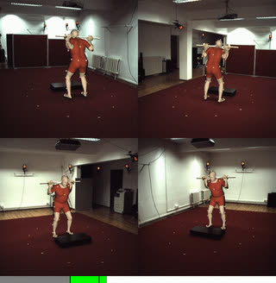
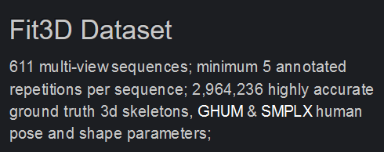
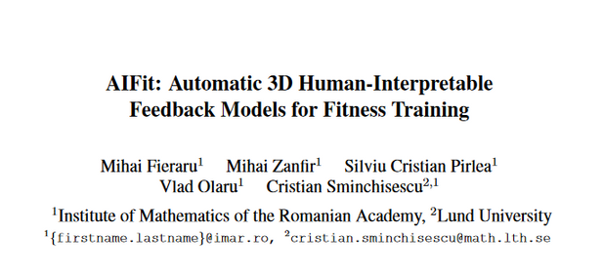
Gym Guard - Body Posture Monitoring & Injury Prevention
Use 3D Human Pose Estimation - MubyNet
Datasets: Fitbit3D, Human3.6M
Use MotionBERT
Related work = AI-FIT Project by IMAR
Metrics to work with:
MPJPE - Negative mean per joint position error
estimated 3d pose
angles b/w limbs, rythm sequence, momentum
With thanks to:
Institute of Mathematics of Romanian Academy (IMAR)

Slide 2
Mind Map
Fit3d - Train & Test Dataset
Pose to Representation
A generic mind map for GymGuard
Choose 1 to 3 excercise
Engineer Features
Applications:
Injury prevention
AI Trainer
Low-cost gym guard
Orientation, Angles, Rythm (Sequence)
Train & Test
Train for other excercises

Slide 3
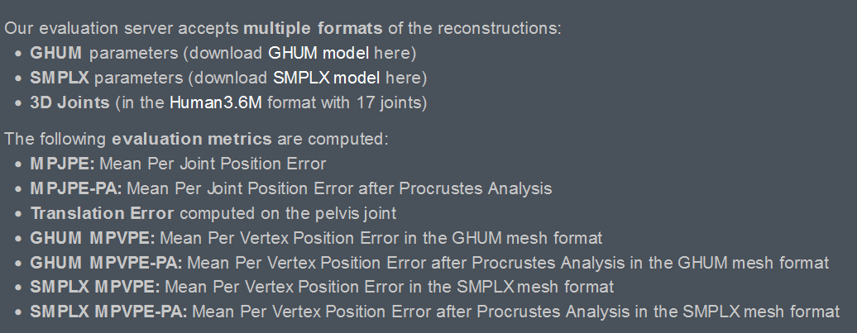

Slide 4
Other Topics
Twitch Chat AI MOD
ATS - AI Powered Applicant Tracking System

