Slide 1
GymGuard v1.0
An update

Slide 2
AGENDA
Exercise Identification
Python Application
Data Streaming

Slide 3
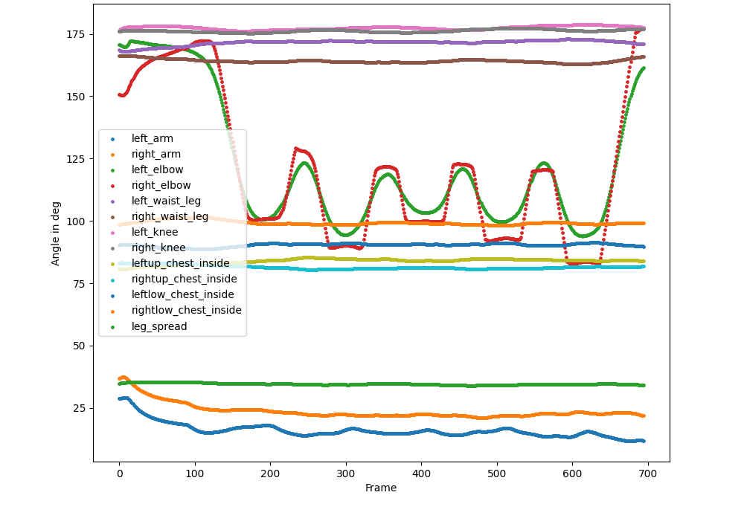
How? Bicep Curls

Slide 4
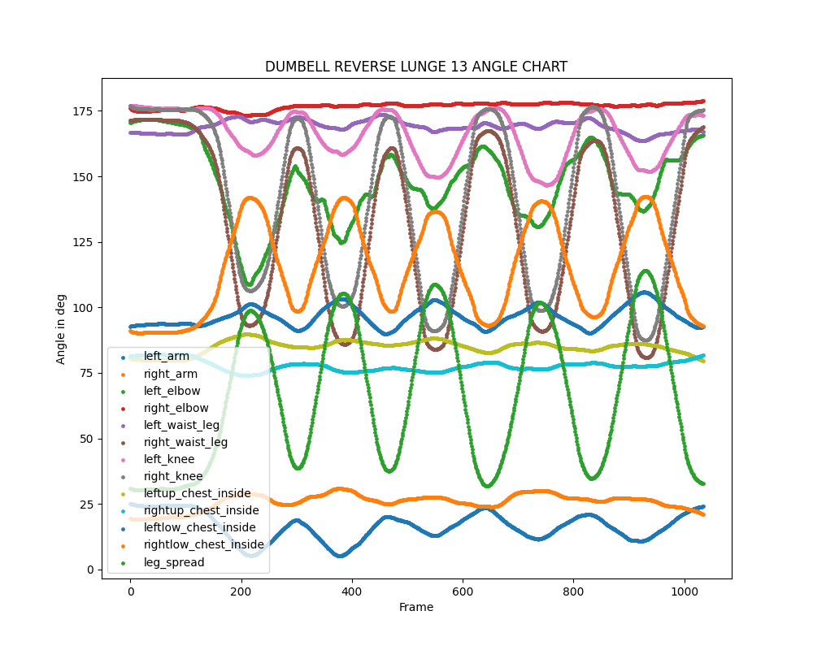
How? Dumbell Reverse Lunge

Slide 5
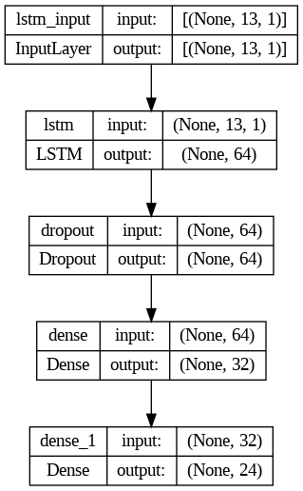
Model architecture

Slide 6
PYTHON APPLICATION
PYQT5
QTAWESOME
FONTAWESOME
PIKA (RABBITMQ)

Slide 7
