Slide 1




YOUR FITNESS, ANYTIME, ANYWHERE

Slide 2
Introduction to BEARITT
01
02
03
What is BEARITT?
How does it work?
Why does it matter? Training
✅ Users purchase coins instead of fixed memberships, allowing them to pay per visit at partnered gyms.
✅ They scan QR codes at the gym entrance for easy check-ins and automatic coin deduction.
✅ The platform includes AI-powered fitness tracking, expert consultations, and a reward system to enhance user experience.
✅ Solves the problem of wasted gym memberships and rigid contracts.
✅ Makes fitness affordable, flexible, and accessible for travelers, students, and professionals.
✅ Encourages consistency with progress tracking, rewards, and community challenges.
✅ Helps gyms attract more customers and increase revenue without depending solely on long-term memberships.
✅ BEARITT is a pay-as-you-go fitness platform that offers multi-location gym access without long-term commitments.
✅ It provides personalized fitness plans, expert guidance, and community-driven challenges to keep users engaged.

Slide 3







problems
Unused Gym Memberships
Fixed-location memberships limit access for travelers and relocators
Users struggle to track progress, making goals unclear.
Low consistency in fitness routines contributes to the rise of lifestyle diseases.
Minimal access to personalized training and health guidance.

Slide 4
Health Improvement: Promotes active lifestyles, reducing lifestyle diseases like obesity and hypertension.
Accessibility: Affordable fitness solutions for low-income individuals and underserved communities.
Social & Economic Impact
Job Creation: Supports local gyms, trainers, and fitness coaches, contributing to economic growth.
Community Building: Encourages social connections through group challenges and fitness events.

Slide 5






BEARITT’s Pay-as-you-go system reduces financial loss and boosts long-term adherence.
Our membership allows users, including travelers, to access various gym locations.
SOLUTIONS
Gamified progress-tracking tools drive user engagement, helping them reach their goals with ease
Personalized health plans and expert guidance strengthen customer loyalty and trust
Community-driven challenges and events build a vibrant, engaged fitness ecosystem

Slide 6








BEARITT APP
24/7 Support
Coin system
This slide is a Certified trainers provide tailored fitness plans, with assistance for user queries n editable slide with all your needs.
ThCoins are deducted per visit and used for gym payments, with expiration rules for non-referral coins
is slide is an editable slide with all your needs.
Member management
Health & fitness tools
This slide is an ed Track membership, attendance, rewards, and access gym listings . with all your needs.
TAccess to tools like BMR calculators, macro nutrient tracking, body fit metrics, and IRM for personalized fitness insights.
his slide is an editable slide with all your needs.
Store and reward s/m
Gym management
Tith aA one-stop shop for fitness gear and supplements, with referral coins that never expire to boost retention.
r needs.
This slidManage attendance, earnings, events, reviews, and receive monthly payments based on member coin balances
e is an editable slide with all your needs.
QR-code based attendance
Community Engagement
This slide is an editable slide with aMembers can scan QR codes to mark attendance at gyms, streamlining check-ins and tracking visits
ll your needs.
This slide is aHelps gyms and users connect better through engaging content
n editable slide with all your needs.

Slide 7

How It Works
Download and Register
Purchase Coins
Scan QR Codes
Track Progress
Access Trainers & Tools
Earn Rewards

Slide 8

What Sets BEARITT Apart?
✅ Pay-as-You-Go System: Flexible and budget-friendly alternative to rigid gym memberships.
✅ Multi-Gym Access: Allows users to visit various gyms under one platform.
✅ AI-Driven Guidance: Personalized fitness plans and progress tracking for smarter workouts.
✅ Community Challenges & Rewards: Keeps users motivated and engaged.
✅ Trainer Support: Direct access to certified trainers via the platform.

Slide 9
Current Achievements
Muay Thai Bootcamp Collaboration: Successfully conducted a Muay Thai bootcamp in partnership with Thaimak at our college, receiving positive engagement from participants.
01
02
Live BEARITT Website: Our platform is currently online, offering free access to tools, workout plans, and a growing fitness community.
Community Challenges & Rewards: Planning to launch fitness challenges where users can compete, complete tasks, and win gifts, increasing engagement.
03
04
First Gym Partnership Secured: We have partnered with 3 gym and fitness center, marking the beginning of our gym network expansion.

Slide 10








user benefits
Access multiple gyms with one membership.
Pay per use with a coin-based system.
Join challenges, earn rewards, and stay consistent
Get tailored health plans and expert guidance
gym benefits
Manage payments and attendance easily
Earn extra money with coins for each visit
Boost visibility via Bearitt’s platform.
Attract extra customers, including travelers and occasional users

Slide 11


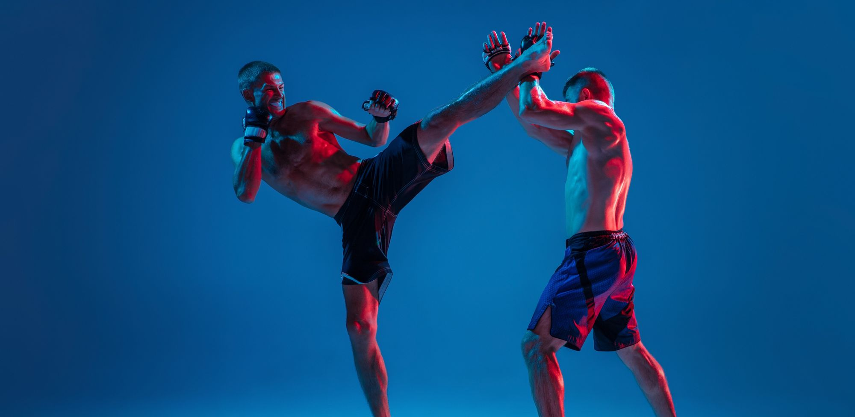



yoga
KICKBOXING
Advanced Coaching Services
BOXING
MUAYTHAI

Slide 12



Revenue Generation & Sustainability
Coin-Based System:
Users purchase coins to access gyms, ensuring a steady revenue stream., preferences, and behaviours.
In-App Purchases:
Generate revenue through personalized diet plans, workout guides, and fitness products
Membership Plans:
Offer flexible coin packages (e.g., daily, weekly, or monthly bundles).
Partnership Commission:
BEARITT earns a percentage of gym payouts based on coin usage.
Community Challenges:
Sponsored events and branded fitness campaigns can add revenue streams.
01
02
03
04
05

Slide 13
Financial Overview

Slide 14
Summary
Total Startup Costs: ₹3,00,000
Expected Break-even Point: 6-9 months with rapid revenue generation
Projected ROI for Investors: 2.5x – 5x return within 3 years.

Slide 15





Investment Presentation Template
, sed do eiusmod.
MVP App & Website Development: ₹1,20,000
, sed do eiusmod.
Marketing & Branding: ₹75,000
Investing
Strategy
Total Investment Required: ₹3,00,000
Legal & Compliance: ₹25,000
g elit, sed do eius
Operational Expenses: ₹80,000

Slide 16
, sed do eiusmod.
✅ Tech Costs (Servers, Maintenance): ₹15,000
✅ Marketing & Ads: ₹30,000
✅ Operational Expenses: ₹40,000
✅ Legal & Miscellaneous: ₹7,500
, sed do eiusmod.
Monthly & Yearly Expenses
Total Monthly Expenses: ₹92,500
Total Yearly Expenses: ₹10,80,000
g elit, sed do eius

Slide 17
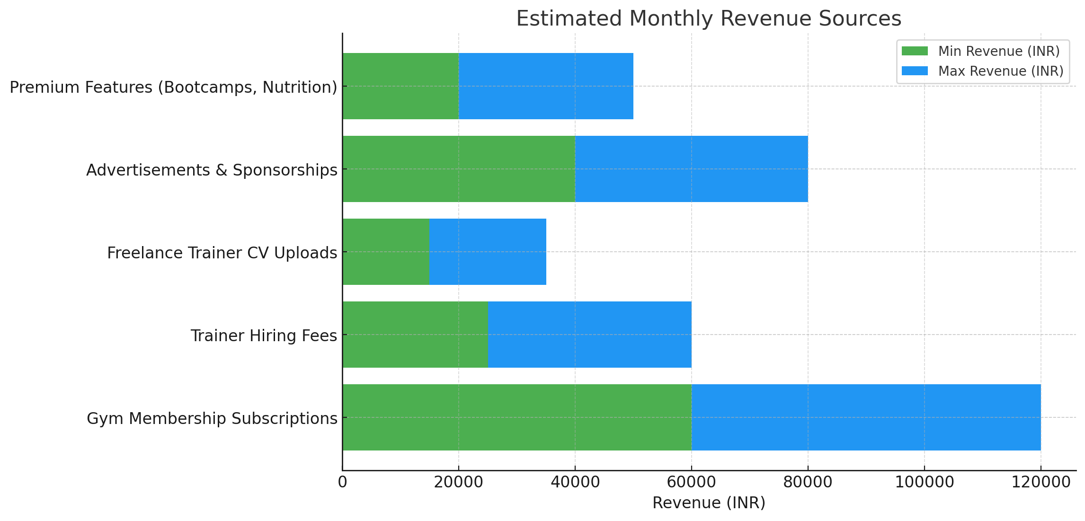
Estimated Monthly Revenue
Gym Membership Subscriptions:
₹60,000 – ₹1,20,000
Trainer Hiring Fees: ₹25,000 – ₹60,000
Freelance Trainer CV Uploads
₹15,000 – ₹35,000
Advertisements & Sponsorships:
₹40,000 – ₹80,000
Premium Features (Bootcamps, Nutrition):
₹20,000 – ₹50,000
Total Monthly Revenue: ₹1,60,000 – ₹3,45,000

Slide 18
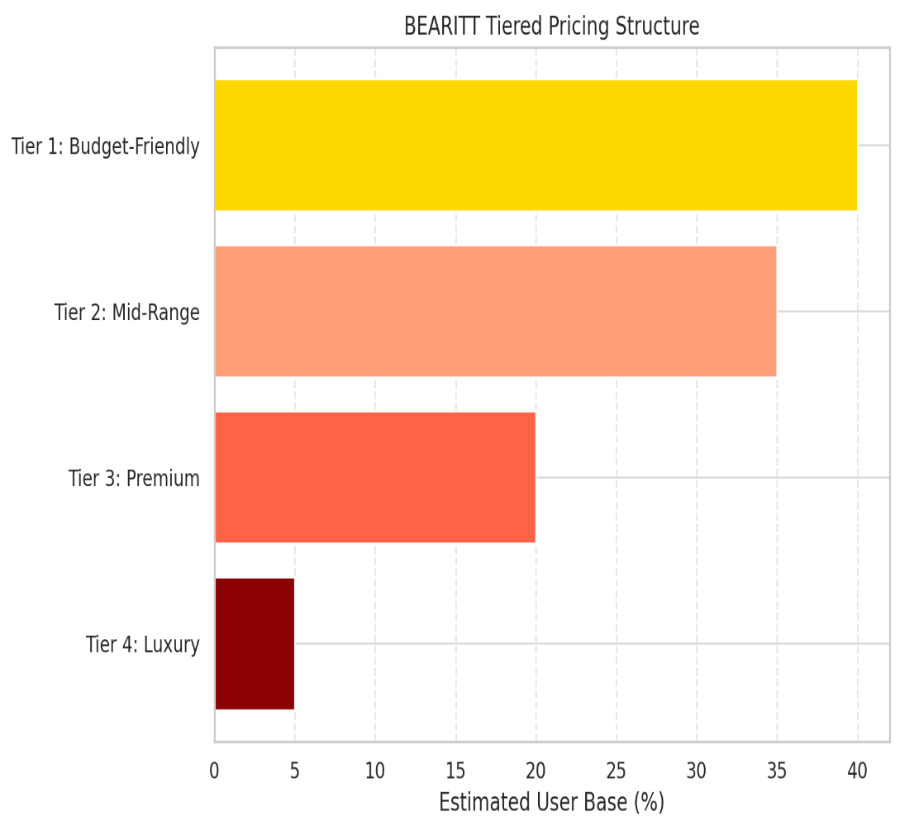
Tiered Pricing Structure
Tier 1 (Budget-Friendly): ₹500 – ₹1,500 (40%users)
Tier 2 (Mid-Range): ₹1,500 – ₹3,000 (35% users)
Tier 3 (Premium): ₹3,000 – ₹5,000+ (20% users)
Tier 4 (Luxury): ₹5,000+ (5% users)

Slide 19
Driving Efficiency for Growth
Automated Systems: QR code check-ins, automated coin deduction, and gym payouts reduce manual work.
Lean Marketing Strategies: Focus on social media, referral programs, and local partnerships to minimize costs.
Data-Driven Decisions: Use platform analytics to improve customer retention and gym engagement.

Slide 20






Future Roadmap
Expand gym partnerships nationally and globally for a seamless fitness network.
AI-powered suggestions for gyms, trainers, and workouts
Future goal to expand internationally, starting with fitness-conscious markets.
Sync fitness data with wearables for enhanced health tracking
Redeem coins with a swipe card, no smartphone needed
Referral System: Incentivize users to bring friends, accelerating organic growth.

Slide 21
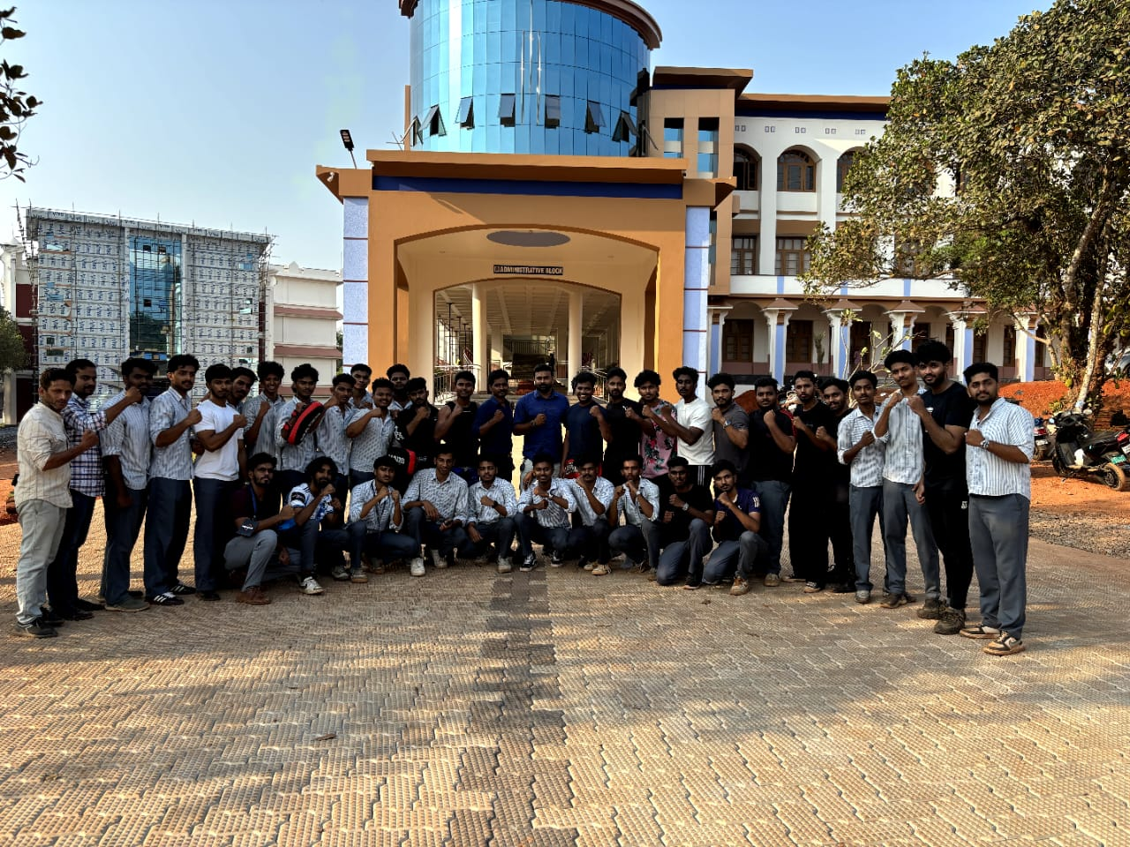

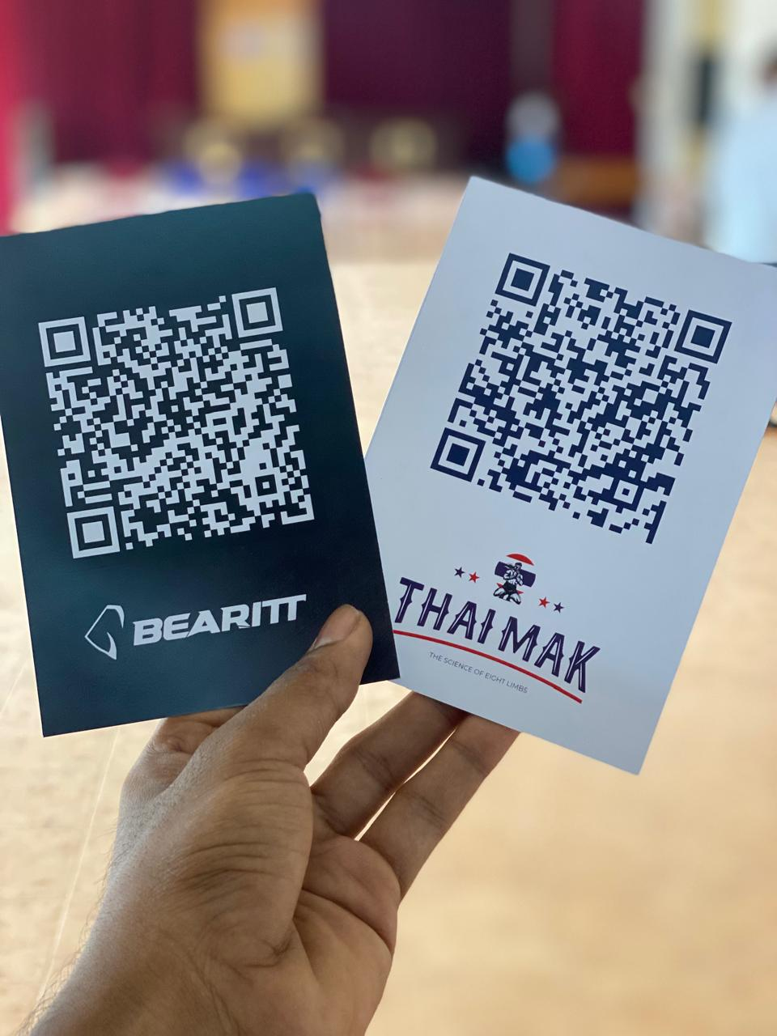
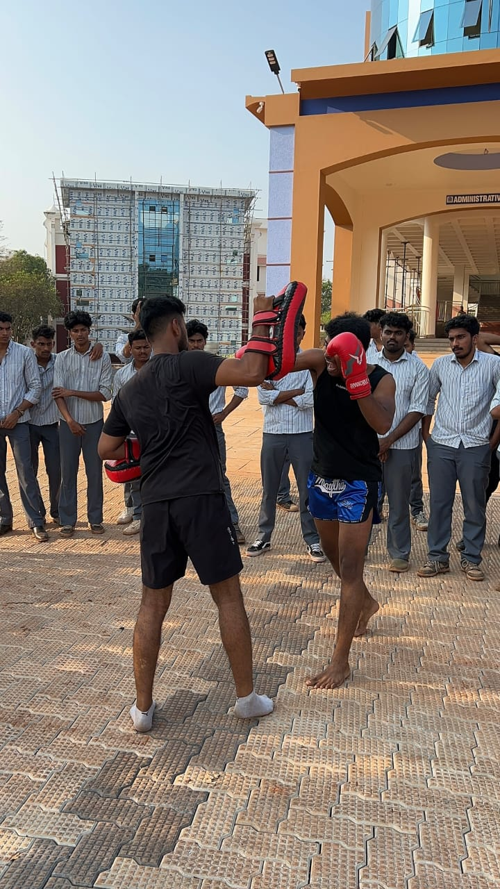
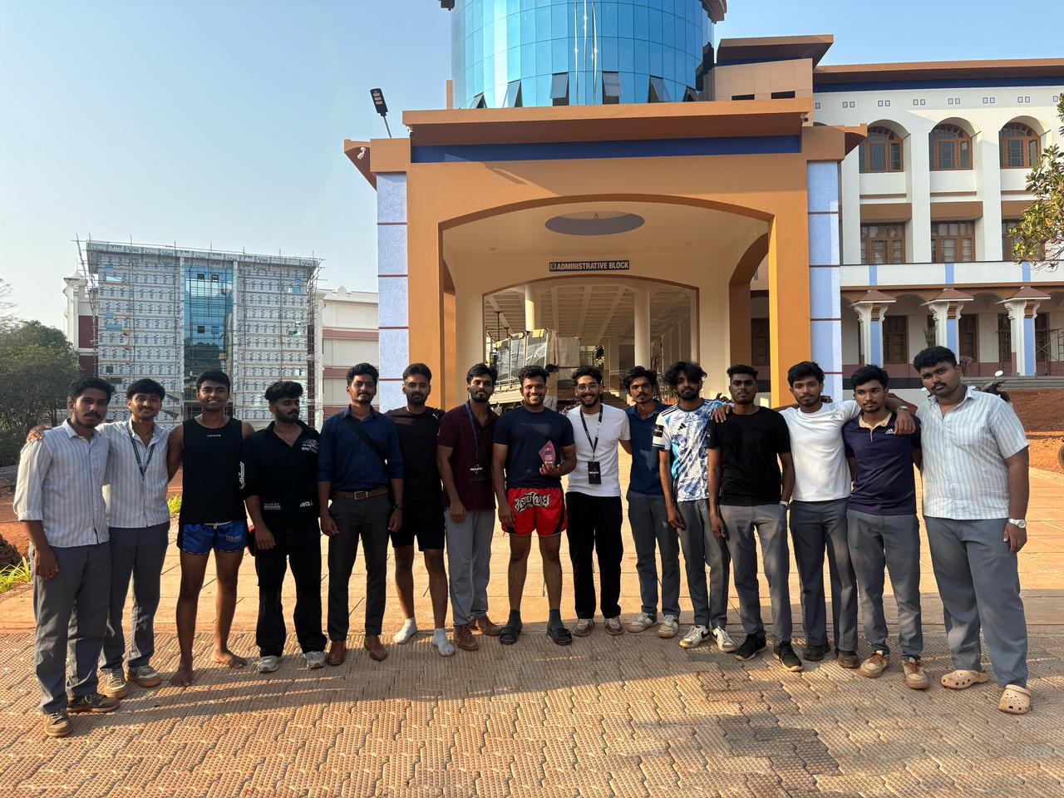
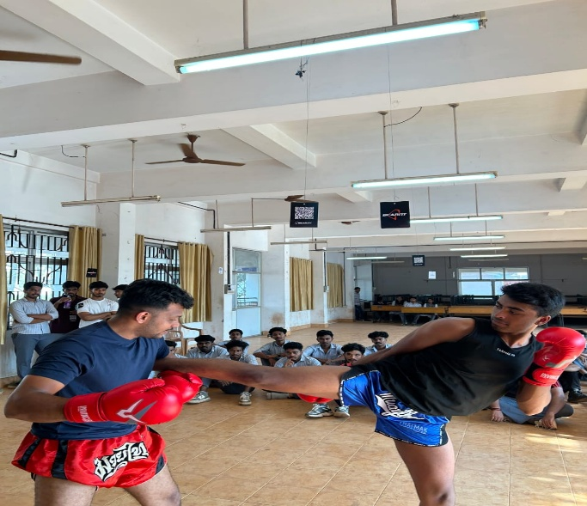
BOOTCAMPS
COMMUNITY

