Slide 1
Amazon Product Sales Analysis Dashboard

Slide 2
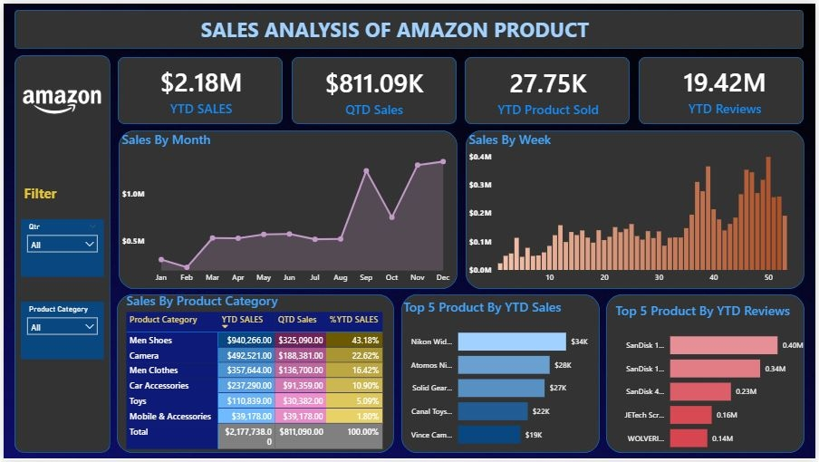
Dashboard Overview

Slide 3
About Dashboard
Total Sales & Orders – Overall business performance.
Quantity Sold – Units sold in the selected period.
Average Order Value – Revenue per order.
Sales Trend – Performance over time.
Top Products – Best-selling items.
Regional Sales – Revenue by location.
Customer Insights – Buying patterns & preferences.

Slide 4
Key Performance Indicators (KPIs)
1. YTD Sales ($2.18M): Total sales revenue from the start of the year to date.
2. QTD Sales ($811.09K): Sales revenue for the current quarter.
3. YTD Product Sold (27.75K): Total units sold year-to-date.
4. YTD Reviews (19.42M): Number of customer reviews received year-to-date.

Slide 5
Key Insights
Men Shoes is the top-performing category contributing 43.18% of YTD sales.
Camera category contributes 22.62% of YTD sales.
Sales peak in October and November, showing strong Q4 performance.
Top-selling product by YTD sales is Nikon Wind ($34K).
SanDisk products dominate in customer reviews, with over 0.4M reviews for the top product.

Slide 6
Recommendations
Increase stock and marketing for Men Shoes and Camera categories to leverage high demand.
Run targeted campaigns during Q4 to maximize seasonal sales spikes.
Promote SanDisk products further due to high brand engagement.
Explore upselling opportunities in mid-performing categories like Car Accessories and Toys.
Monitor review trends to address quality issues and enhance customer satisfaction.

