Slide 1
Cancer Cellularity in Breast Tissue
Shant Ayanian
Talal Alzahrani

Slide 2
Overview
Background
Goal of the Project
Datasets
Framework/Codes
Results

Slide 3
Background
Breast cancer is the most common cancer and the second most cause of cancer-related death in women.
The treatment of breast cancer depends on the pathological grade of the cancer.
Quantitative cancer cellularity in pathological slides is important for treatment and prognosis.

Slide 4
Aim
To develop convolutional neural network algorithms to determine cancer cellularity in breast cancer hematoxylin and eosin (H&E) stained pathological slides.
To compare the performance of different convolutional neural network architecture in determining cancer cellularity.

Slide 5
Dataset
The dataset of breast cancer pathology slides were from The SPIE (the international society for optics and photonics).
The SPIE, along with the American Association of Physicists in Medicine (AAPM), and the National Cancer Institute (NCI) provide this dataset as part of a challenge.

Slide 6
Dataset
The data is a set of 2570 patches from 64 H&E slides presented in 512*512 size, in a tif format.
The patches are graded by expert pathologists in terms of their cellularity from 0 to 1.
These represent the label for each image, which are presented in a separate csv file.

Slide 7
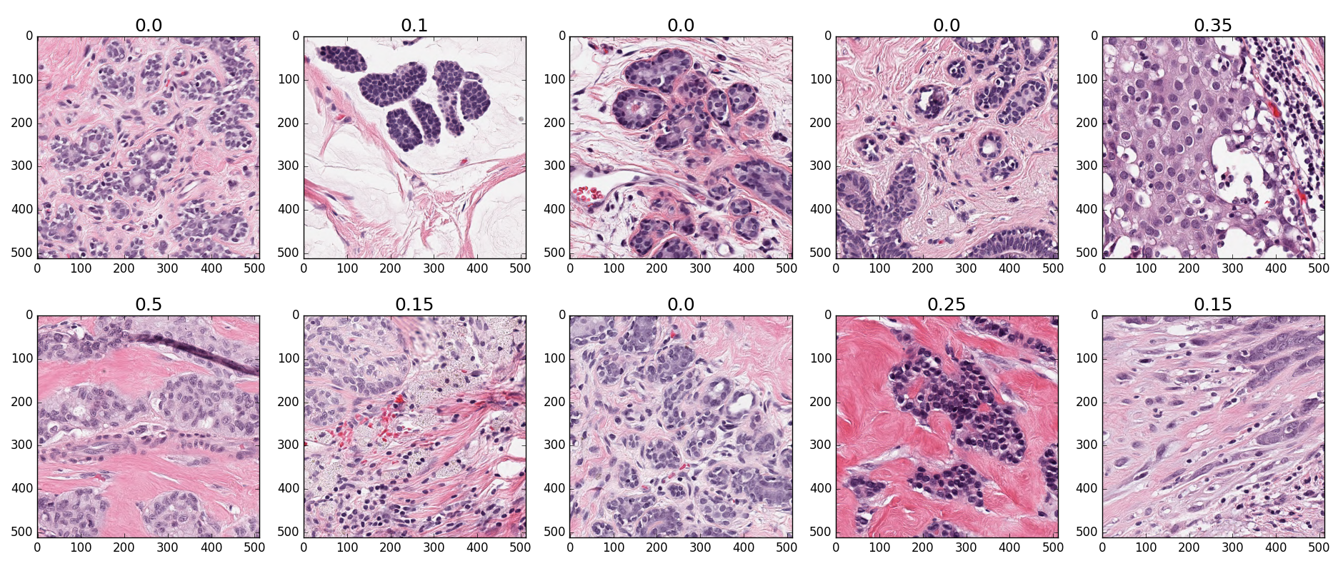

Slide 8
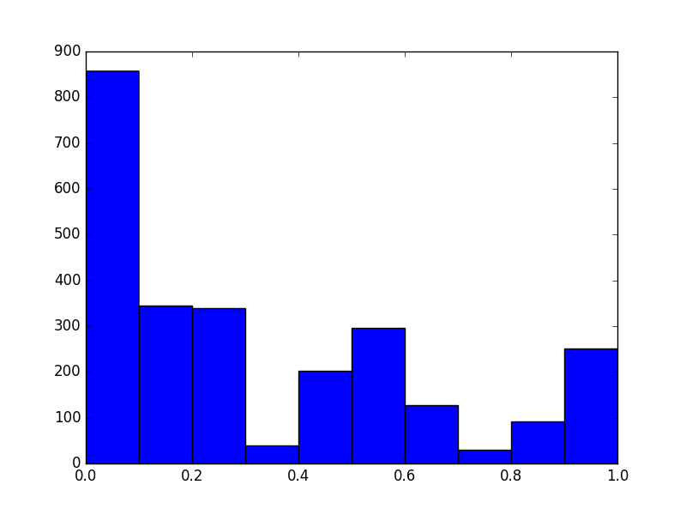
Labels

Slide 9
Framework/Codes
PyTorch was used as the framework to implement a deep convolutional neural network to conduct a regression analysis to train and then predict the cellularity of the data.
The initial network was a shallow network with two convolution networks as well as two pooling networks, two ReLUs and a final Linear layer as the output layer.

Slide 10
Framework/Codes
PyTorch was used as the framework to implement a deep convolutional neural network to conduct a regression analysis to train and then predict the cellularity of the data.
The initial network was a shallow network with two convolution networks as well as two pooling networks, two ReLUs and a final Linear layer as the output layer.

Slide 11
Framework/Codes
The second network was a deep network (ResNet).
The third network was dilated convolutional network.
The fourth network was DenseNet121.

Slide 12
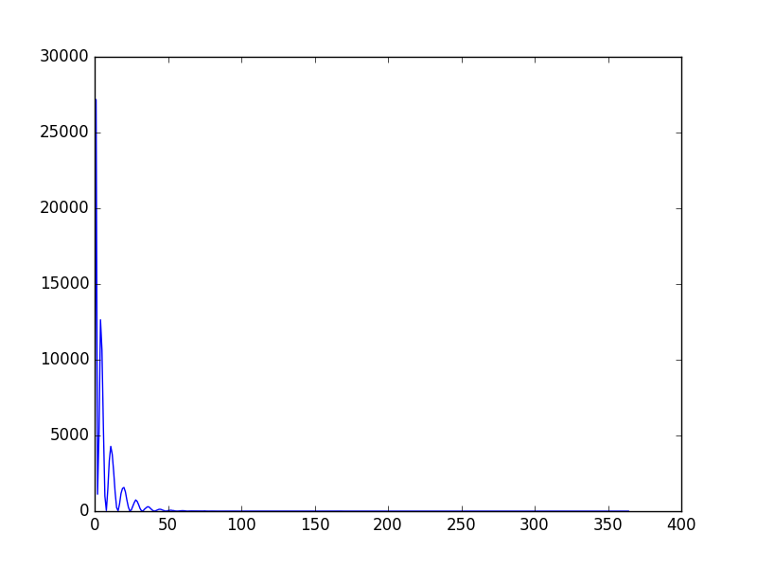
Shallow Network

Slide 13
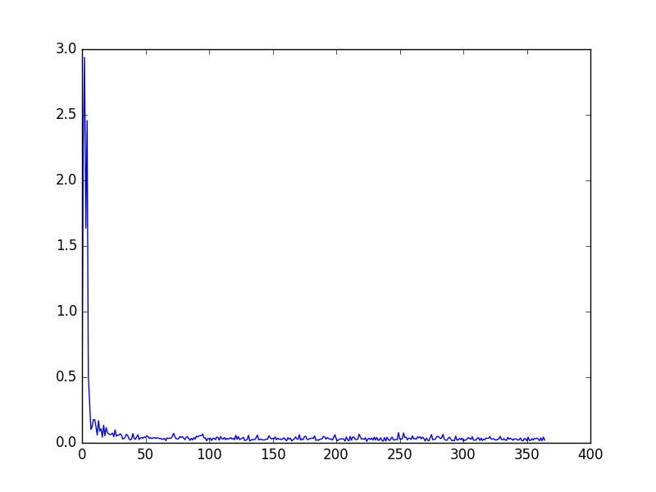
ResNet Network

Slide 14
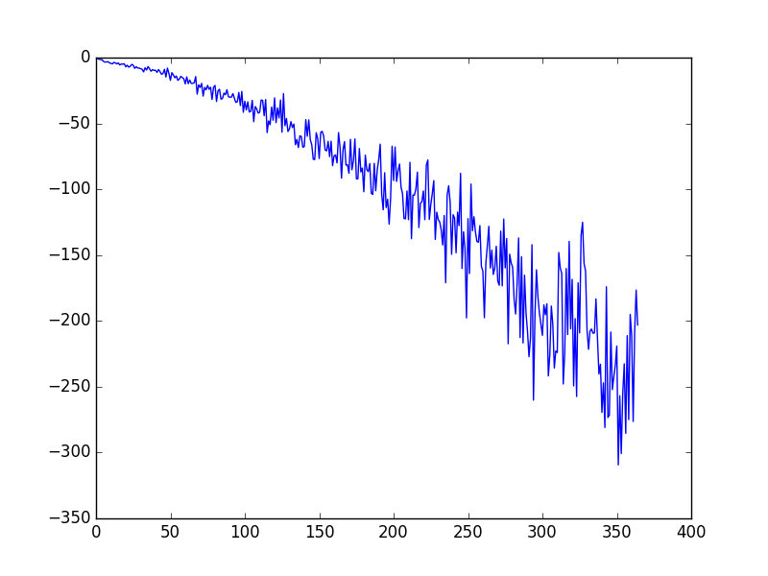
ResNet Network

Slide 15
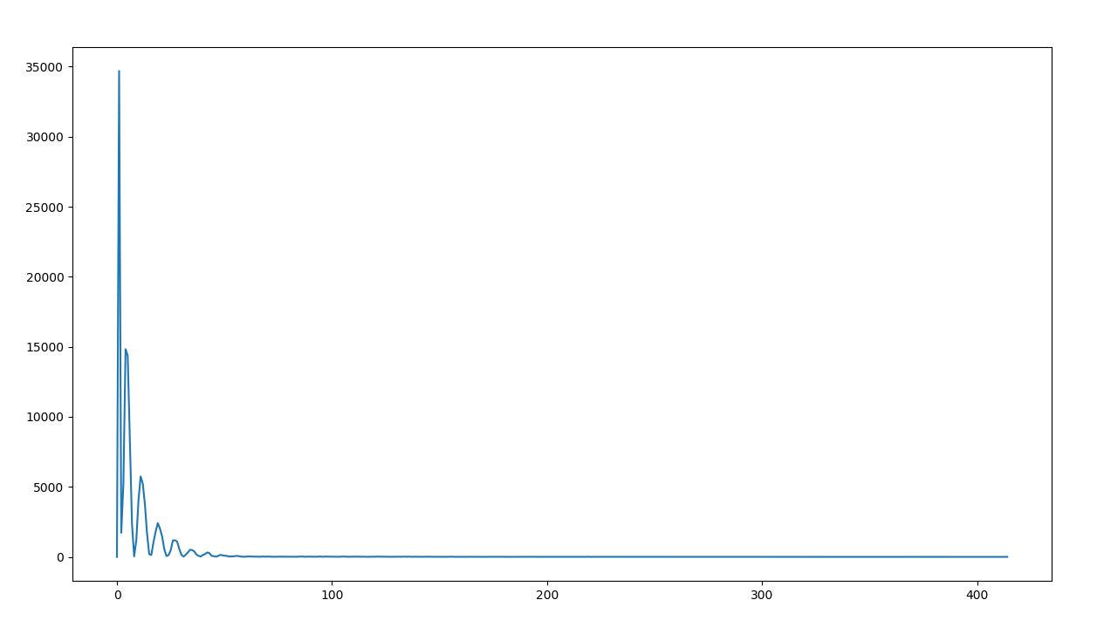
Dilated Network

Slide 16
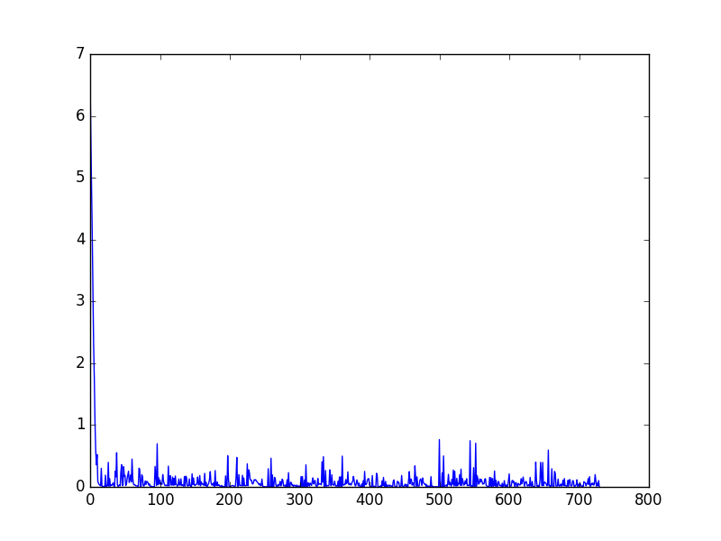
DenseNet121 Network

Slide 17
Conclusions
Shallow network and deeper resnet networks achieved a very good RMSE during testing when MSE used as loss function.
Model would need to be trained on a larger dataset
May need multiple transformations to achieve a low enough RMSE to be considered for clinical use

