Slide 1

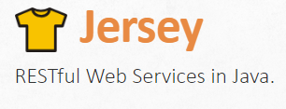

Learn JSON with Java APIs, jQuery and REST
Tuna Tore

Slide 2
Agenda
What is JSON (JavaScript Object Notation)?
JSON Data Types and Syntax
JSON jackson Data Binding
JSON jackson Java API Annotations
JSON jackson Tree Model
JSON jackson Streaming API
JSON jackson Schema and Validation
JSON Low-level parsing with Java Jackson API
JSON Serialization-Deserialization
XML jackson JAXB annotations
JSON with JavaScript, jQuery and RESTful Web Services

Slide 3
Development Environment Configuration
Installing Java JDK 8.0
Apache Tomcat 8.0 Server Installation
Eclipse IDE Integrated Development Environment

Slide 4
What is JSON?
JSON is a light-weight, text-based open standard for interchanging data
JSON is human readable and language independent
It is easy for computers to read and generate JSON
It is used in order to send data between client and servers (Browsers/Clients to Application Servers)
It is the abbreviation of Java Script Object Notation (derived version of it)

Slide 5
The Advantages of JSON over XML
XML is eXtensible Mark Language which is similar to JSON with values inside <key>value</key>
XML was designed to describe data
JSON is much more simpler than XML and has a smaller grammar
It is easy to read JSON documents than XML documents
JSON is processed more easily because the structure is smaller and simpler than XML documents
JSON has more compact and simple syntax

Slide 6
How JSON is structured?
Data Types and Syntax
Data is stored using key-value pairs in text format
Key is always enclosed in double quotes
Value can be String (double quotes), Number, Boolean, Whitespace, null (empty), Array, Object
Key-value pairs shown as key : value and separated with column
It is built on two structures such as Object and Ordered List of values which is Arrays

Slide 7
JSON Data Types and Syntax
Data is separated with comma
Values stores (string (double quotes), number (integer or floating points), object, array, true, false, null (empty data type))
Objects are represented within curly brackets {"key":"value", ...}
Arrays store values within square brackets [{"key","value"}, ...] (ordered values)

Slide 8
JSON Data Types and Syntax
JSON Object example;
{
"object": {"key":"value", "key1":"value1"}
}
JSON Array Example
{
"array": [{"key":"value"}, {"key1":"value1"}]
}

Slide 9
JSON Data Types and Syntax
{
"key":"value",
"booleankey":false,
"objectKey": {
"key1":"value1",
"key2":"value2"
},
"array": [{"key1":"value1"},{"key2":"value2"}],
"numberKey": 9,
"keyNull": null
}

Slide 10
JSON Jackson Data Binding
Data Binding converts JSON from and to Java Objects
It is based on property accessor conventions or json/xml annotations (JSON annotations or JAXB)
ObjectMapper will perform marshalling(writing json) and unmarshalling (reading) JSON
Developers can generate JSON files based on java classes or from JSON files to java objects

Slide 11
JSON Jackson Streaming API
Streaming API provides incremental parsing and reading of JSON documents
It reads and writes JSON based on API events such as START_OBJECT, START_ARRAY, END_OBJECT
Developers should handle events in order to read JSON
JsonParser reads JSON from file, inputstream, string etc and JsonGenerator writes JSON.

Slide 12
JSON Jackson Tree Model
Tree Model provides in memory tree model representation of JSON
It is similar to XML Document Object Model which you can access to nodes and get/remove values
ObjectMapper can build trees which consist JsonNodes
Developers can traverse/loop inside Json
Nodes are represented with ObjectNode, ArrayNode and JsonNode

Slide 13
JSON jackson annotations
@JsonPropertyOrder({"name", "name2"})
@JsonProperty("name")
@JsonInclude(JsonInclude.Include.NON_NULL)
@JsonPropertyDescription(value="desc")
@JsonIgnore
@JsonIgnoreProperties({ “ignore", “ignore1" })
@JsonIgnoreType
@JsonSerialize(using = JSONSerializer.class)
@JsonDeserialize(using = JSONDeserializer.class)

Slide 14
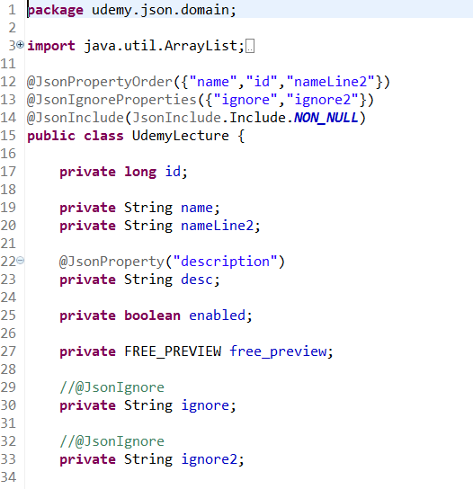
JSON jackson annotations

Slide 15
JSON jackson XML annotations
@XmlRootElement
@XmlType(propOrder = {"property1", "property2" })
@XmlElement(name = "property1")
@XmlAttribute(name="attribute")
@XmlTransient

Slide 16
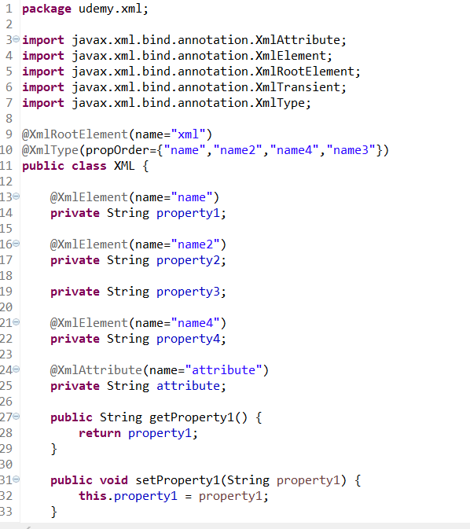
JSON jackson XML annotations

