Slide 1

ACE Demo Few Shot Learning
B. Shantan Kumar
4th-Mar-2023

Slide 2
ACE Goals & Timelines - Target Vs Actual
Target timelines for ACE completion is 3 months from the day of start of ACE PoC
S/no. | Activities | Start date | End date | Status
1 | Use case identification | 1-Nov-2022 | 17-Nov-2022 | Completed
2 | Initial understanding about the use case | 18-Nov-2022 | 28-Nov-2022 | Completed
3 | Reproducing the ref. code of part1 and part 2 | 29-Nov-2022 | 5-Dec-2022 | Completed
4 | Identifying the real time dataset | 6-Dec-2022 | 18-Dec-2022 | Completed
5 | Preparing the dataset(Automobile, Steel Surface) | 19-Dec-2022 | 25-Dec-2022 | Completed
6 | Part 1: Building the One shot Learning using Siamese | 26-Dec-2022 | 10-Jan-2023 | Completed
7 | Validating and Fine tuning the Part 1 | 11-Jan-2023 | 31-Jan-2023 | Completed
8 | Part 2: Building the Few shot Bayesian learning using DKT | 1-Feb-2023 | 8-Feb-2023 | Completed
9 | Validating and Fine tuning the Part 2 | 8-Feb-2023 | 15-Mar-2023 | Completed
10 | ACE Final presentation |  | TBD | Pending

Slide 3
Demo of the Assignment
B Shantan Kumar

Slide 4
Overall Approach
We have planned experiments in Two phases.
Phase/Part1: Applying Few (One) shot Learning using Siamese network on the Two real time datasets
Reproducing the Existing results of the Paper
Building a Baseline model for Use case 1 - Automobile Tool kit
Building a Baseline model for Use case 2 - Steel Surface defects
Application of the Siamese model on Use case 1 – Automobile Tool kit
Application of the Siamese model on Use case 2 – Steel Surface defects
Comparing the results with baseline and the Siamese Model for both the use cases
Phase/Part2: Applying Few shot Learning using Bayesian-meta approach on the Two real time datasets
Reproducing the Existing results of the Paper
Building a Baseline model for Use case 1 - Automobile Tool kit
Building a Baseline model for Use case 2 - Steel Surface defects
Application of the Bayesian few shot meta learning on Use case 1 – Automobile Tool kit
Application of the Bayesian few shot meta learning 2 – Steel Surface defects
Comparing the results with baseline and the Bayesian few shot meta learning for both the use cases

Slide 5
Part 1: One shot Learning Technique using Siamese Network

Slide 6
Assignment Abstract
To understand and implement the One Shot learning on the real time use case from CV using Siamese Network to classify unknown classes.

Slide 7
Introduction
One Shot Technique:
One shot Learning is a machine learning algorithm that required very little database to identify or access the similarities between the objects from unknown classes.
One-shot learning for computer vision tasks is based on a special type of convolutional neural networks (CNNs) called Siamese neural networks (SNNs).
Siamese Network:
A Siamese neural network (sometimes called a twin neural network) is an artificial neural network that uses the same weights while working in tandem on two different input vectors to compute comparable output vectors.
Often one of the output vectors is precomputed, thus forming a baseline against which the other output vector is compared.

Slide 8
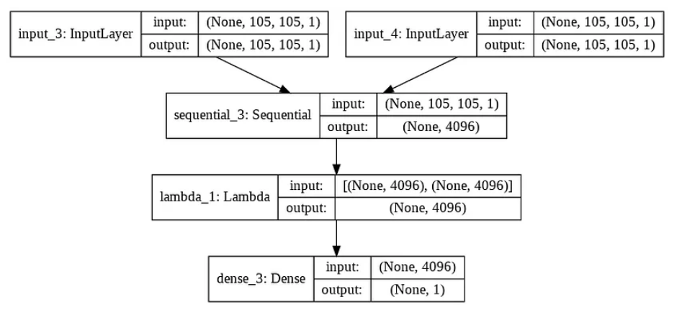
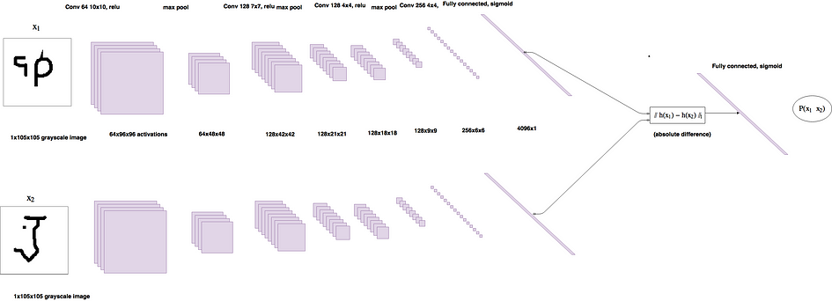
Communication Flow Diagram
Component/Layer wise Architecture
Feature Vectors of Img2
Image2 (X2)
Sigmoid
Conv Network
Output
Absolute Diff
Image1 (X1)
Dense Layer with Sigmoid unit to generate similarity score
Feature Vectors of Img1
High level Architecture

Slide 9
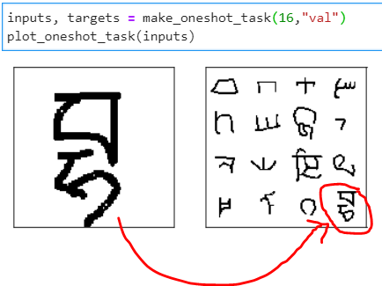
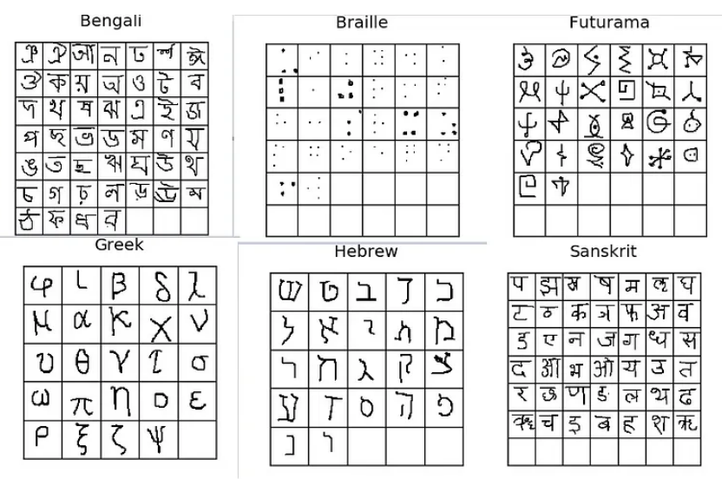
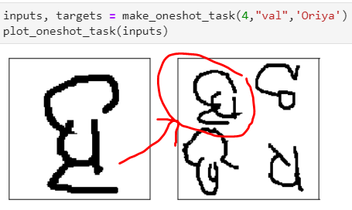
Reproducing the paper code and Results
Paper has leveraged Omniglot dataset for One shot – Siamese Technique.
Omniglot dataset which is a collection of 1623 hand drawn characters from 50 different Languages. In every character there are just 20 examples, each drawn by a different person. Each image is a gray scale image of resolution 105x105.
Achieved 96% for 19 way one-shot accuracy over a 50 Random samples
Output (Test vs Support) sampled from Oriya Language
Output (Test vs Support) sampled from entire Test dataset classes
Dataset Looks like

Slide 10
Application of usecase1: Automobile Tool Kit
Dataset: Is about Automobile (Enfield) tools and its defects. Its an Automobile dataset.
Objective: Is to find out the model performance when trained and tested on a different dataset.
Specifics:
Classes# | Data size(Images) | Highest Images# | Lowest Images# | Data Shape | Remarks
4 | 627 | 388 | 15 | (1920,1080,3) | Imbalanced dataset. Training and validation dataset have different images and belongs to different classes, without repetition.
Refer Images here:

Slide 11
Benchmark(Automobile Toolkit)
S/No | Environment/Accelerator | Total Classes | Train class | Val class | Train Size | Val Size | Hyperparameters | Val Accuracy
1 | Keras, Conv 2D | 4 | 2 (Different) | 2 (Different) | 30 (15,15) | 30 (15,15) | Lr=0.00005 Batch_Size = 16 | 50%

Slide 12
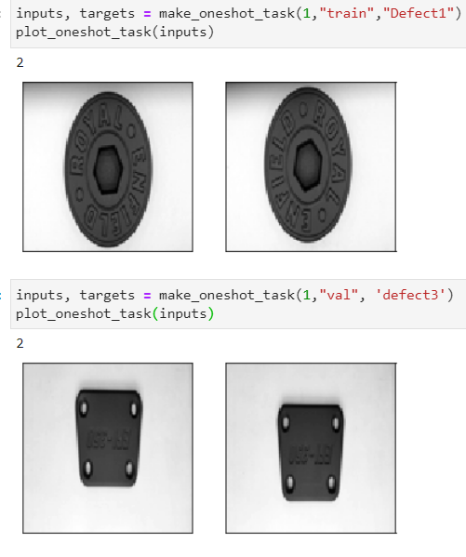
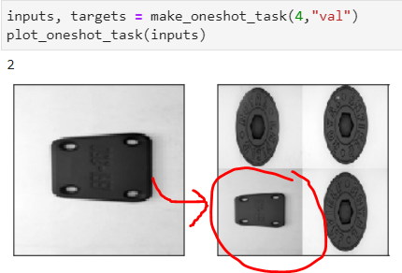
One shot - Experimental Results (Automobile Tool kit)
S/No. | Enviroment/Accelerator | Train Class | Test Class | Train Size | Test Size | Hyperparameters | Val Accuracy (%)
1 | Tensorflow/ Keras, Conv 2D | 2 (Diff) | 2 (Diff) | 100 (50,50) | 30 (15,15) | Lr=1e-5 Batch_Size=28 Iterations=10,000 | 49%
2 | Tensorflow/ Keras, Conv 2D | 2 (Diff) | 2 (Diff) | 100 (50,50) | 30 (15,15) | Lr=0.00005 Batch_Size=16 Iterations=20,000 | 71%
3 | Tensorflow/ Keras, Conv 2D | 2 (Diff) | 2 (Diff) | 100 (50,50) | 30 (15,15) | Lr=0.00004 Batch_Size=16 Iterations=20,000 | 73%
4 | Tensorflow/ Keras, Conv 2D | 2 (Diff) | 2 (Diff) | 100 (50,50) | 30 (15,15) | Lr=0.00005 Batch_Size=16 Iterations=25,000 | 75%
5 | Tensorflow/ Keras, Conv 2D | 2 (Diff) | 2 (Diff) | 30 (15,15) | 30 (15,15) | Lr=0.00005 Batch_Size=16 Iterations=25,000 | 83%
Inference: We have seen a better accuracy of 83% with One shot Technique for unknown classes when compared to Baseline model (50%)

Slide 13
Application of usecase2: Steel Surface defects
Dataset: Is about steel surface and its defects before processing for manufacturing further. Its an industrial dataset.
Objective: Is to find out the model performance when trained and tested on a different dataset.
Specifics:
Classes# | Data size(Images) | Highest Images# | Lowest Images# | Data Shape | Remarks
10 | 3057 | 569 | 74 | (2048,1000,1) | Imbalanced dataset. Training and validation dataset have different images and belongs to different classes, without repetition.
Refer Images here:

Slide 14
Benchmark (Steel_Surface)
S/No | Environment/Accelerator | Total Classes | Train class | Val class | Train Size | Val Size | Hyperparameters | Val Accuracy
1 | Tensorflow/Keras, Conv 2D | 10 | 6 (Different) | 4 (Different) | 300 (each 50#) | 120 (each 30#) | Lr=0.01 Batch_Size = 16 | 25%

Slide 15
One shot - Experimental Results (Steel_Surface)
S/No. | Environment/Accelerator | Train Class | Test Class | Train Size | Test Size | Hyper parameters | Val Accuracy (%)
1 | DGX, Keras, Conv 2D | 6 (Diff) | 4 (Diff) | 300 (Each 50#) | 120 (Each 30) | Lr=1e-5 Batch_size=28 Iterations: 20,000 | 83%
2 | DGX, Keras, Conv 2D | 6 (Diff) | 4 (Diff) | 300 (Each 50#) | 120 (Each 30) | Lr=1e-5 Batch_size=28 Iterations: 25,000 | 82%
3 | DGX, Keras, Conv 2D | 6 (Diff) | 4 (Diff) | 300 (Each 50#) | 120 (Each 30) | Lr=1e-5 Batch_size=16 iterations=13,000 | 81%
4 | DGX, Keras, Conv 2D | 6 (Diff) | 4 (Diff) | 300 (Each 50#) | 120 (Each 30) | Lr=0.00005 Batch_Size=16 Iterations=25,000 | 75%
5 | DGX, Keras, Conv 2D | 6 (Diff) | 4 (Diff) | 300 (Each 50#) | 120 (Each 30) | Lr=1e-5 Batch_size=32 iterations=20,000 | 77%
Inference: We have seen a better accuracy of 83% with One shot Technique for unknown classes when compared to Baseline model (25%)

Slide 16
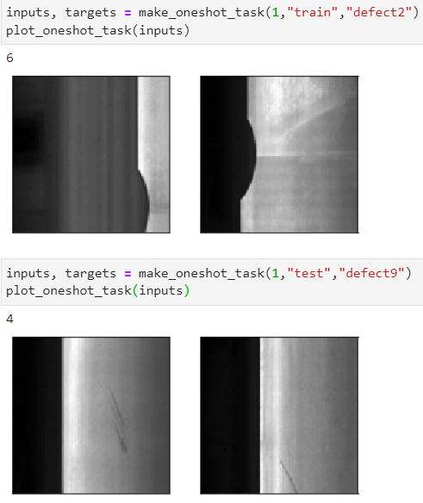
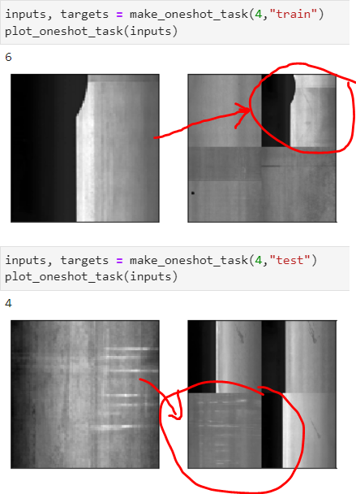
Sample Outputs (Steel_Surface)
***
Defect1-Crease
Defect2 – Crescent gap
Defect3 – Inclusion
Defect4 – Oil_spot
Defect5 – Punching hole
Defect 6 – Rolled_pit
Defect7 – silk_spot
Defect8 – Waist welding
Defect9 – Water_spot
Defect10 – Welding_line

Slide 17
Part 2: Bayesian Meta-Learning for the Few-Shot Setting via Deep Kernels

Slide 18
Assignment Abstract
To understand and implement the Few Shot meta learning on the real time use case from CV using Bayesian inference via deep kernel technique to classify unknown classes.

Slide 19
Introduction
Meta Learning:
Meta-learning or as often referred to learning to learn is achieved by abstracting learning into two or more levels. The inner-most levels acquire task-specific knowledge (e.g. fine-tuning a model on a new dataset) , whereas the outer-most level acquires across-task knowledge (e.g. learning to transfer between tasks more efficiently).
Few Shot Learning:
Few-shot learning is the problem of making predictions of unknown classes based on a limited number of samples.
Bayes Theorem:
The probability of an event occurrence, based on prior knowledge of conditions that might be related to the event.
Deep Kernel Transfer:
Deep kernel is a prior which enumerates during the process of training of Outer loop of the network which has a knowledge of the input and output distribution.
This prior with parameters shared across tasks, so that given a new unseen task it is possible to effectively estimate the posterior distribution over a query set conditioned on a small support set.
As this prior transfer the knowledge from Outer loop to inner loop, this is called as DKT.

Slide 20
Communication Flow Diagram
Meta block
Outer Loop
Support set (Image,Label)
Gaussian Block
Query Set (Image)
Inner Loop
Preprocessing stage
Cropping, color, normalization
GP Layer(MLL)
Conv or Restnet Blocks
Calculates the Marginal likelihood by Marginalizing the Evidence
Prior Transfer
Backprop
Update
Backprop
Update
MLL Loss
Loss
Posterior probability
Query Data (Label)
High level Model Design

Slide 21
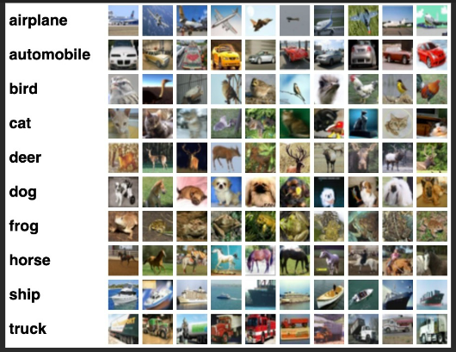
Reproducing the paper code and Results
Paper has leveraged Mini Imagenet dataset for Bayesian Few shot Technique
This dataset consists of 50000 training images and 10000 testing images, evenly distributed across 100 classes with 600 samples of 84×84 color images per class
Paper has achieved following results when –
Trained on Mini imagenet
Tested on Mini imagenet using BNCossim +DKT is 49.73% with 1-shot, 5-way
We have achieved a result of 49.51% when trained & tested on Mini Imagenet with 1-shot,5-way
Dataset looks like here

Slide 22
Application of usecase1: Automobile Tool Kit
Dataset: Is about Automobile (Enfield) tools and its defects. Its an Automobile dataset.
Objective: Is to find out the model performance when trained and tested on a different dataset.
Specifics:
Classes# | Data size(Images) | Highest Images# | Lowest Images# | Data Shape | Remarks
4 | 627 | 388 | 15 | (1920,1080,3) | Imbalanced dataset. Training and validation dataset have different images and belongs to different classes, without repetition.
Refer Images here:

Slide 23
Benchmark(Automobile Toolkit)
S/No | Environment/Accelerator | Total Classes | Train class | Val class | Train Size | Val Size | Hyperparameters | Val Accuracy
1 | Tensorflow/Keras, Conv 2D | 4 | 2 (Different) | 2 (Different) | 30 (15,15) | 30 (15,15) | Lr=0.00005 Batch_Size = 16 | 50%

Slide 24
Few shot - Experimental Results (Automobile Tool kit)
S/No. | Environment/Accelerator | Method | Total classes | Train class | Train class | Train Size | Test Size | (N-shot) | (N-way) | Accuracy (%)
1 | Pytorch,DGX,Conv4 | DKT+ Cossim | 4 | 2 (Diff) | 2 (Diff) | 30 (15 each) | 30 (15 each) | 1 | 2 | 100%
2 | Pytorch,DGX,Conv4 | DKT+ Cossim | 4 | 2 (Diff) | 2 (Diff) | 40 (20 each) | 360 (180 each) | 1 | 2 | 55.26%
3 | Pytorch,DGX,Conv4 | DKT+ Linear | 4 | 2 (Diff) | 2 (Diff) | 40 (20 each) | 360 (180 each) | 1 | 2 | 53.18%
4 | Pytorch,DGX,Conv6 | DKT+ Linear | 4 | 2 (Diff) | 2 (Diff) | 40 (20 each) | 360 (180 each) | 1 | 2 | 52.96%
5 | Pytorch,DGX,Conv6 | DKT+ Cossim | 4 | 2 (Diff) | 2 (Diff) | 40 (20 each) | 360 (180 each) | 1 | 2 | 53.82%
6 | Pytorch,DGX,Conv6 | DKT+ BNCossim | 4 | 2 (Diff) | 2 (Diff) | 40 (20 each) | 360 (180 each) | 1 | 2 | 52.76%
*Note: Performed several experiments, above table has only few but with good accuracy results
Inference: We have seen a better accuracy of 100% with Few shot Bayesian Technique for unknown classes when compared to Baseline model (50%)

Slide 25
Application of usecase2: Steel Surface defects
Dataset: Is about steel surface and its defects before processing for manufacturing further. Its an industrial dataset.
Objective: Is to find out the model performance when trained and tested on a different dataset.
Specifics:
Classes# | Data size(Images) | Highest Images# | Lowest Images# | Data Shape | Remarks
10 | 3057 | 569 | 74 | (2048,1000,1) | Imbalanced dataset. Training and validation dataset have different images and belongs to different classes, without repetition.
Refer Images here:

Slide 26
Benchmark (Steel_Surface)
S/No | Environment/Accelerator | Total Classes | Train class | Val class | Train Size | Val Size | Hyperparameters | Val Accuracy
1 | Tensorflow/Keras, Conv 2D | 50 | 4 (Different) | 3 (Different) | 120 (each 30#) | 90 (each 30#) | Lr=0.01 Batch_Size = 16 | 55.56%

Slide 27
Few shot - Experimental Results (Steel_Surface)
S/No. | Environment/Accelerator | Method | Total classes | Train class | Test class | Val class | Train Size | Test Size | Val Size | (N-shot) | (N-way) | Accuracy (%)
1 | Pytorch, DGX, Conv6 | DKT+ Cossim | 10 | 6 (Diff) | 2 (Diff) | 2 (Diff) | 180 (30 each) | 60 (30 each) | 60 (30 each) | 1 | 2 | 74.56%
2 | Pytorch, DGX, Conv6 | DKT+ Cossim | 10 | 4 (Diff) | 3 (Diff) | 3 (Diff) | 120 (30 each) | 90 (30 each) | 90 (30 each) | 1 | 3 | 76.22%
3 | Pytorch, DGX, Conv6 | DKT+ Cossim | 10 | 4 (Diff) | 3 (Diff) | 3 (Diff) | 120 (30 each) | 90 (30 each) | 90 (30 each) | 5 | 3 | 83.04%
4 | Pytorch, DGX, Conv6 | DKT+ Cossim | 10 | 4 (Diff) | 3 (Diff) | 3 (Diff) | 200 (50 each) | 90 (30 each) | 90 (30 each) | 1 | 3 | 55.79%
Inference: We have seen a better accuracy of 83% with Few shot Bayesian Technique for unknown classes when compared to Baseline model (55%)

Slide 28
Future work
We would like to extend our work on Few shot meta learning Technique for Regression and NLP (TTS) use cases.

Slide 29
References:
https://github.com/akshaysharma096/Siamese-Networks
https://sorenbouma.github.io/blog/oneshot/
https://www.cs.cmu.edu/~rsalakhu/papers/oneshot1.pdf
[1910.05199] Bayesian Meta-Learning for the Few-Shot Setting via Deep Kernels (arxiv.org)
GitHub - BayesWatch/deep-kernel-transfer: Official pytorch implementation of the paper "Bayesian Meta-Learning for the Few-Shot Setting via Deep Kernels" (NeurIPS 2020)
https://github.com/wyharveychen/CloserLookFewShot

Slide 30
Mentor-Mentee – Interactions
Interactions were scheduled thrice a week, which has helped understand the expectations better and increased scope of improvement wherever is required, starting from identifying the use case to building the model.

Slide 31
What helped my learning during ACE?
ACE helped to learn the following Techniques/Frameworks/Libraries:
To learn Basics of Tensorflow, Keras, Pytorch and associated frameworks/libraries like Torch Lightning, Gpytorch etc.
To understand Bayesian Processes and associated libraries to implement pure- statistical/procedural Bayesian processes to apply on real time problems
To understand Siamese network and its adoption in several areas of Machine learning
To deal with real time problem solving capacity and capability

Slide 32
Knowledge Gained from ACE
Gained knowledge on Data Sourcing
Gained knowledge on Tensorflow/Keras framework and associated Libraries
Gained knowledge on Torch framework and associated Libraries
Gained knowledge on Bayesian process and its implementation on the real time use-cases.
Gained knowledge on Few shot Learning and its implementation in CV.
Gained knowledge about Siamese (Twin) network and its application in CV

Slide 33
Business Impact
Use case looks promising and can be applied on real time business problems especially in CV where the labeled data is limited and the need/plan to build a deep classifier to predict unknown classes
We can use this case with any of the following domains like
Medical
Industrial
Automobile and others
This approach currently yield good results. By testing with many different datasets, we shall come to know the stability of these approaches.

Slide 34
ACE– Feedback on the Program
This is a good platform to learn. Personally, I have experienced a greater level of learning and understanding of ML/DL concepts, though the program is very advanced. This may build that gap of learning-only the concepts vs. actual implementation of the learning to the real time business problems effectively.

Slide 35
Questions from Panel

Slide 36
Appendix

Slide 37
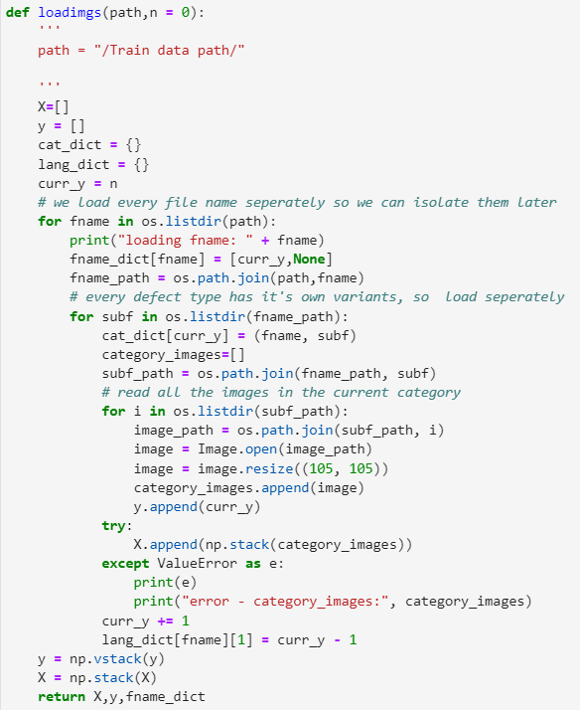
Data Preprocessing – One shot & Siamese
Image Data processing, where each of the image folders are capsulated in a parent folder which are entitled as class folder
Each of the images in each of the class folders is Stacked against its Label for further processing
Images represented by “X” are extracted in the form of array of dimension (N, n, H, W)
N -> Number of classes
n -> Number of Images per Class
H -> Height of the Image
W -> Width of the image
y -> Label of the image

Slide 38
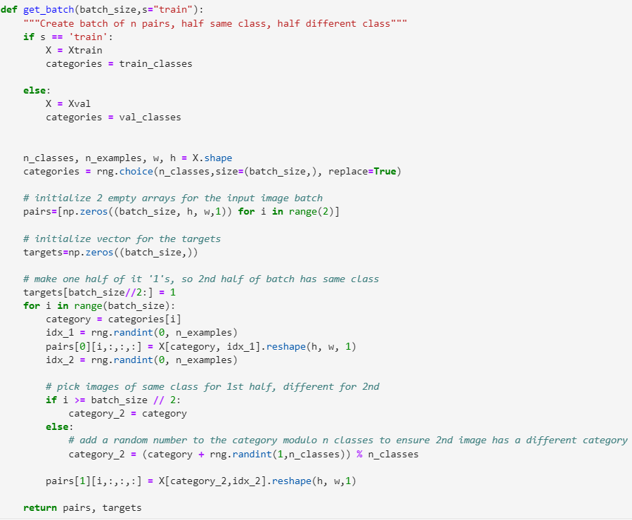

Initializing & Generating Training Batches – One shot & Siamese
Configuration of Training batches
In the form of pairs of images and Targets
Each of the Pairs generated and consists of Image from same class and other class are loaded

Slide 39
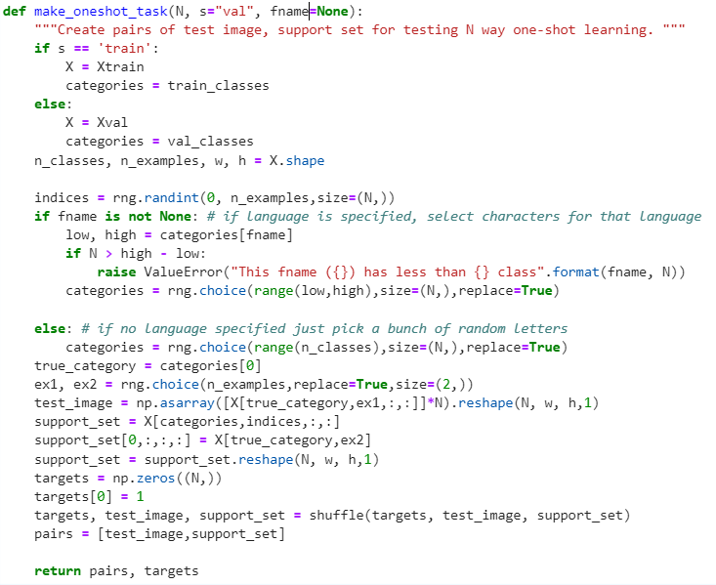
Initializing the Test and Support batches – One shot & Siamese
Configuration of Testing & Support set batches
In the form of pairs of images and Targets
Unless specified, images from support set will be from multi classes, other wise the same class of which test image is belongs to.

Slide 40
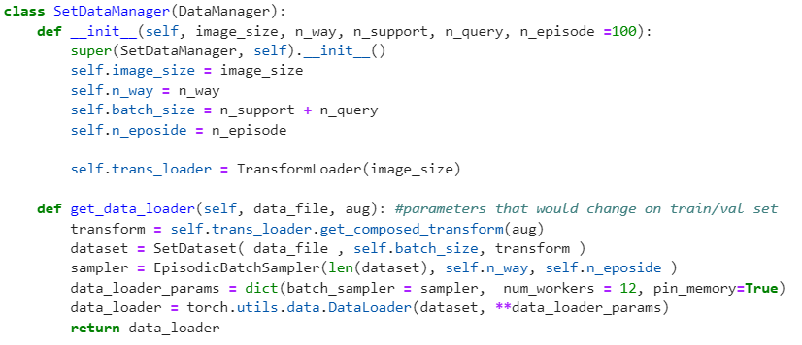
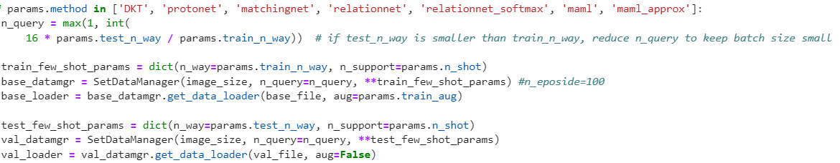
Data Preprocessing – Few Shot & Bayesian
Initializing Data manager with its required parameters
Initializing the Data loaders -> Base loader, Val loader,.

Slide 41
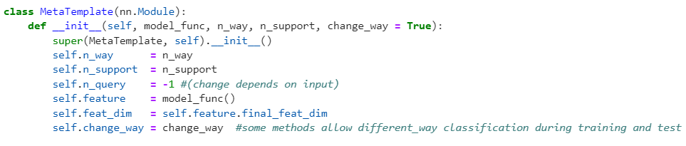
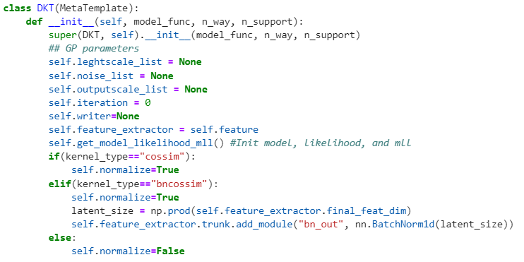
Initializing the DKT approach – Few Shot & Bayesian
Initializing the Meta class with its Parameters
Initializing the DKT class with its Parameters

Slide 42
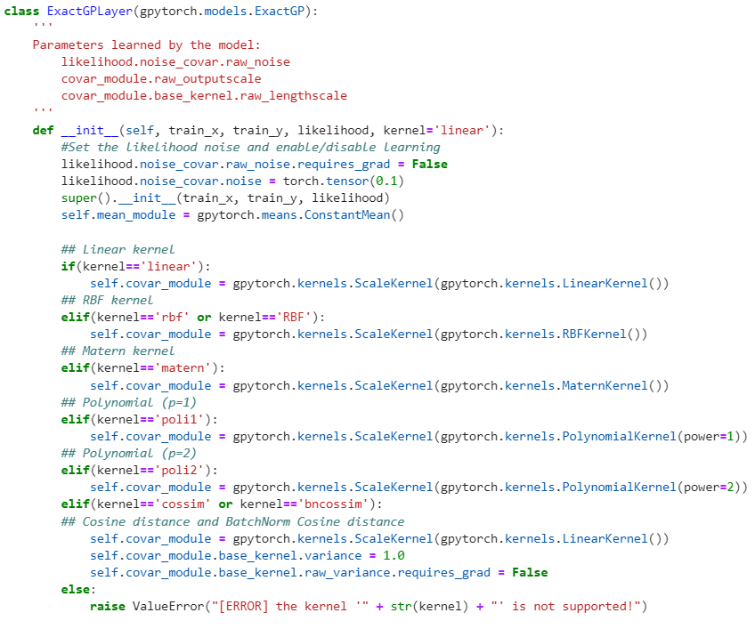
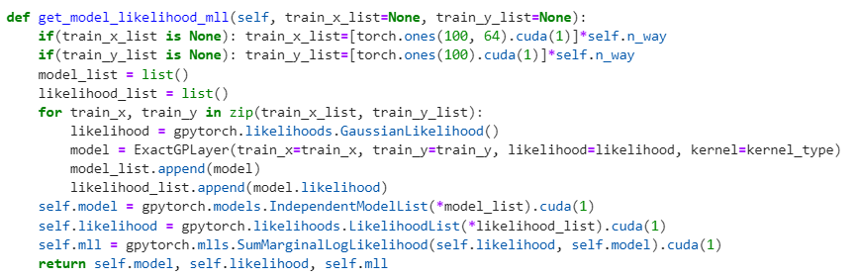
Initializing the Gaussian Process – Few Shot & Bayesian
Initializing the GP Layer and its parameters and the GP Inference via Exact Method for Likelihood computation

Slide 43
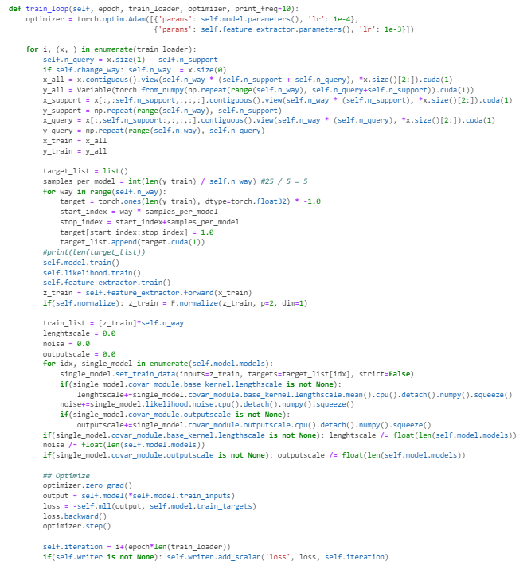
Training Initialization – Few Shot & Bayesian
Initializing the training with the required parameters by calling model and data loader using the GP inference

Slide 44
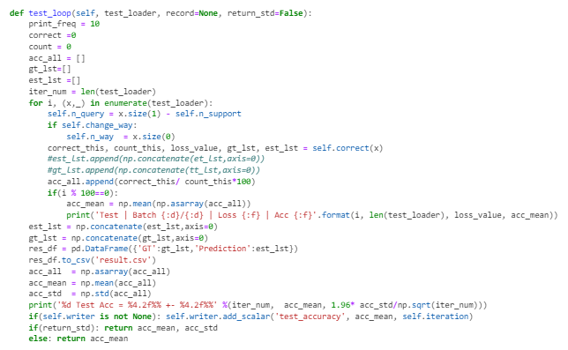
Test Initialization – Few Shot & Bayesian
Initializing the testing with the required parameters by calling model and data loader using the GP inference
Computing the Accuracy, Prediction

Slide 45
Advantages of DKT
Simplicity and efficiency: Straightforward to implement as a single optimizer
Robustness: it provides a measure of uncertainty with respect to new instances
Flexibility: It can be used in a variety of settings such as regression, cross-domain and within-domain classification, with state-of-the-art performance

Slide 46
Thank You!

