Slide 1
Fire Fighting Robot

Slide 2
Index
Index
INTRODUCTION
HARDWARE DESCRIPTION
BLOCK DIAGRAM
COMPONENT LIST
ADVANTAGES AND APPLICATIONS
CONCLUSION

Slide 3
Abstract
The aim of the project is to make a robot which can follow a black strip on a white floor and can extinguish the fire on the path. The robot can be used in the rescue operation. Thus the robot can act as a path guider in normal case and as a fire extinguisher in emergency.

Slide 4
Hardware Description
Our project mainly consist of five sections, they are as follows:
1) Main control circuit with µc PIC16F72
2) Black line detection circuit
3) Motor controlling circuit
4) Flame detection circuit
5) Fire extinguishing circuit

Slide 5
1. Main control circuit
Main circuit is using microcontroller PIC 16F72, which controls all the actions by the robot to extinguish the fire.
All the other circuits are interfaced with the microcontroller using I/O ports
PIC16F72 contains two 8-Bit ports & one 5-Bit port, 5-Bit port is also used as ADC.\
Port A is used as input port for three IR receptors &
Port C is used as output for three IR transmitters.
According to the input to the Port A from the IR receptors µc will generate PWM signal on output Port B which controls the two DC servo motors connected to the port.

Slide 6
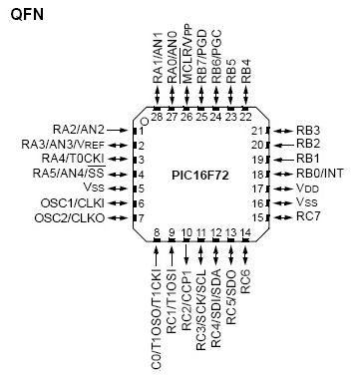
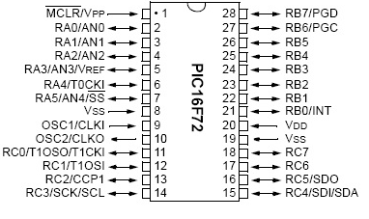
PIC16F72

Slide 7
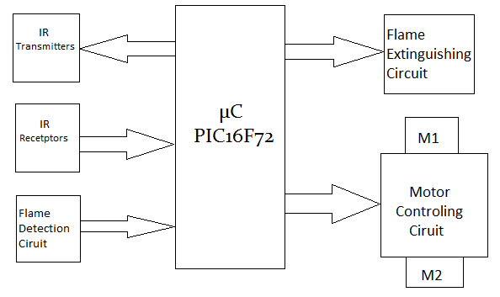
Flame detection sensor UVTRON is also connected to the I/P Port A which generates low signal after detecting flame. \
Flame detection sensor UVTRON is also connected to the I/P Port A which generates low signal after detecting flame.
As soon as µc receives the signal from UVTRON it will stops the motors from moving and give high pulse to the Flame extinguishing circuit.
When relay receives the fire extinguishing signal from µc it will starts the water pump which throws water on flame for 300 ms.

Slide 8
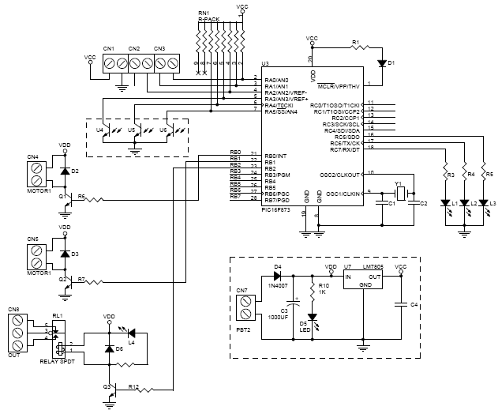

Slide 9
2. Black line detection circuit
The path to each room is marked by a black line and the candle is located in the end of the line. Certain algorithms will be dependent upon whether the robot is in a room or a hallway, or if it is close enough to the candle to extinguish it. Since the floor of the arena is solid white, a black line should be easy enough to detect by measuring light being reflected off the surface of the floor.
The circuit that will be used to accomplish this will consist of a light emitter and detector. It will be powered by a +5V power supply. This will be done using IR transmitter and receiver. A schematic for this circuit is shown in Figure below.

Slide 10
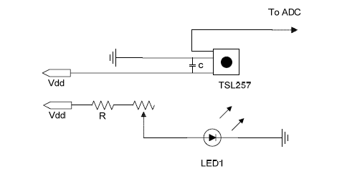

Slide 11
3. Motor controlling circuit
Motor control is one of the most important concepts that must be considered for the robot. Without excellent control over the motors, the robot would not be able to stop itself once it detects black line or flame.
Motor 1 & Motor 2 are connected to the pin no 21 & 22 of µc simultaneously. But motor cannot be driven by the µc directly because it have very low current. To overcome from this problem we use there Darlington Transistor to drive the servo motors. Because of Darlington transistors current amplification takes place and we get proper current get drive the Motors.

Slide 12
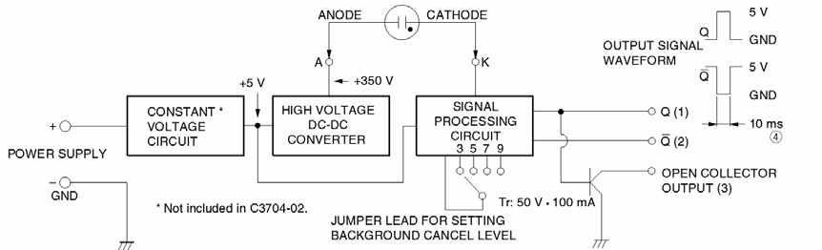
3. Flame detection circuit

Slide 13
Ultraviolet
The robot will pause when it detects the flame. It will then receive information from the Hamamatsu UVTRON R2868 Flame Sensor as to whether or not a flame is in the periphery of the sensor. The angular sensitivity of the UVTRON is shown in Figure below .
The output of this circuit will be connected directly the microcontroller’s input pins. Since the output signal is already a digital signal, there is no need for A/D conversion. With the output signal being a pulse of duration 10ms, the microcontroller can count the number of pulses it receives. When this number falls in a defined range, this will tell the controller that the candle is present.

Slide 14
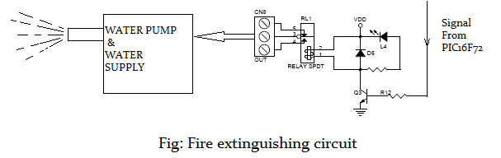
5. Fire extinguishing circuit

Slide 15
Fire extinguish circuit mainly consist of SPDT relay, water supply & water pump. When flame sensor detects the flame it will give on high signal on pin 23 which is connected to relay. Because of this high pulse relay start the water pump. Water pump throws water on the flame for 300 ms.

Slide 16
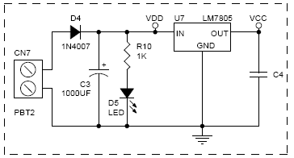
Power supply
Microcontroller and all digital related IC’s require +5V regulated power supply. The signal conditioning circuit op-amps need +5 and -5V regulated power supply. The power supply section consists of bridge rectifier, filter circuit and regulator section.

Slide 17
Applications
The main purpose of robot to detect fire and extinguish it if possible.
The robot can be used as a guider to guide the visitors from the entrance to the main office.
It can help doctors to carry the medicines from one ward to another.
The main purpose is to rescue the people by extinguishing fire in a building.

Slide 18
References
[1]Embedded.com, “Quadrature-Encoded Position and Beyond”, Don Morgan, 26 February 2001, http://embedded.com/columns/spectra/9900043
[2]”Pulse width modulation quietens fans and blowers”, Zetex Semiconductors, Laurence Armstrong, September 2004
[3] Tone Detect, http://members.cox.net/rbirac3/Snuffy/tone_detect.htm
[4] NTE Electronics, Datasheet, NTE832, Integrated Circuit Tone Decoder
[5] Texas Advanced Optical Solutions, Datasheet, TSL257, High-Sensitivity Light-to-Voltage Converter.
[6] Hamamatsu, Datasheet, R2868, Flame Sensor UVTRON R2868.
[7] Hamamatsu, Datasheet, C3704, UVTRON Driving Circuit C3704 Series.

