Slide 1
Life Expectancy Prediction
Goup no 9:
Shantanu S. Dixit 223317
Namrata A. Dhane 223330
Mr. Prashant Karhale
Center Coordinator
Mr. Akshay Tilekar
Project Guide

Slide 2

Contents
Introduction
Workflow
Data Preprocessing and Cleaning
Exploratory Data Analysis (EDA)
Model Building
Random Forest Regressor
Evaluation of Random Forest Regressor
Gradient Boosting Regressor
Evaluation of Gradient Boosting Regressor
Comparison of Models
Final Prediction
Requirement Specification
Future scope
References

Slide 3
Introduction
The term “life expectancy” refers to the number of years a person can expect to live. By definition, life expectancy is based on an estimate of the average age that members of a particular population group will be when they die
Everything has an expiration date; humans are no exception either. With ongoing advancements in Machine Learning and Data Science, we can precisely predict the life span of a person using given essential parameters.
Life expectancy refers to number of years person can expect to live. Using global data of 20 years, we aim to explore parameters affecting the life span of a person.

Slide 4
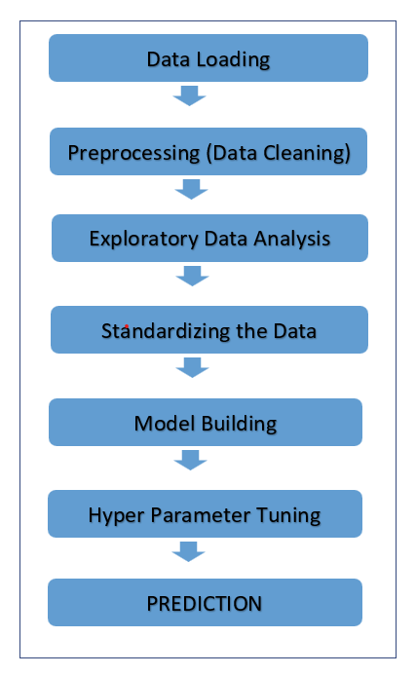
Workflow

Slide 5
Data preprocessing and cleaning
Pivoting and Unpivoting
Merging Dataframes
Fill missing values
Filtration

Slide 6
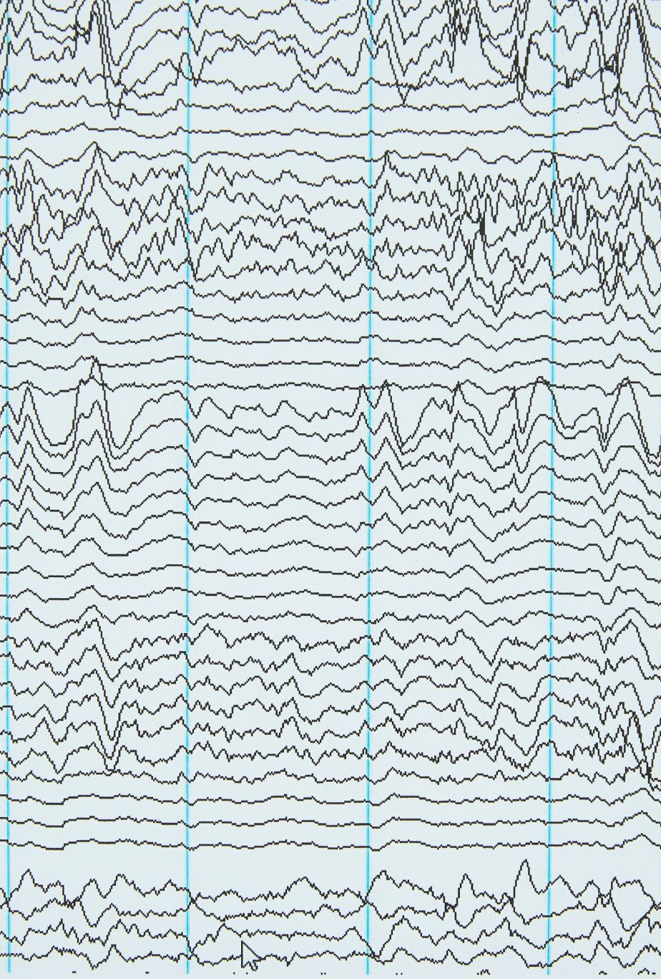
Exploratory Data Analysis (EDA)
Numerical column description
Skewness
Histogram
Boxplot
Outlier Detection and Imputation
Regplot
Correlation

Slide 7
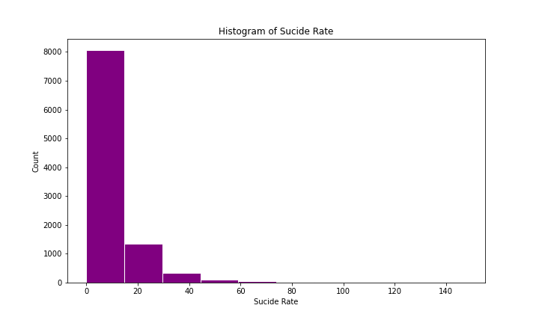
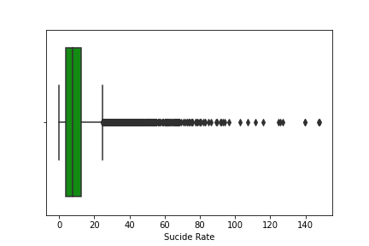
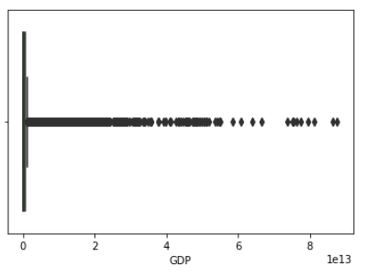
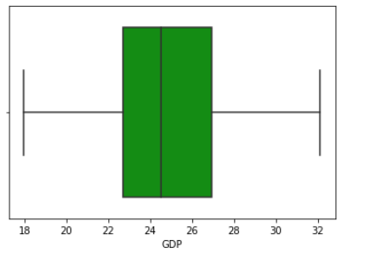

Slide 8
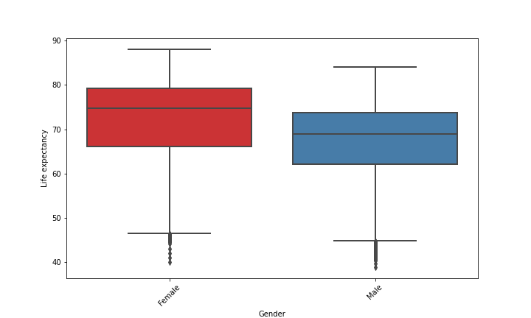
From this boxplot, we can easily predict that female has higher Life expectancy than male.

Slide 9
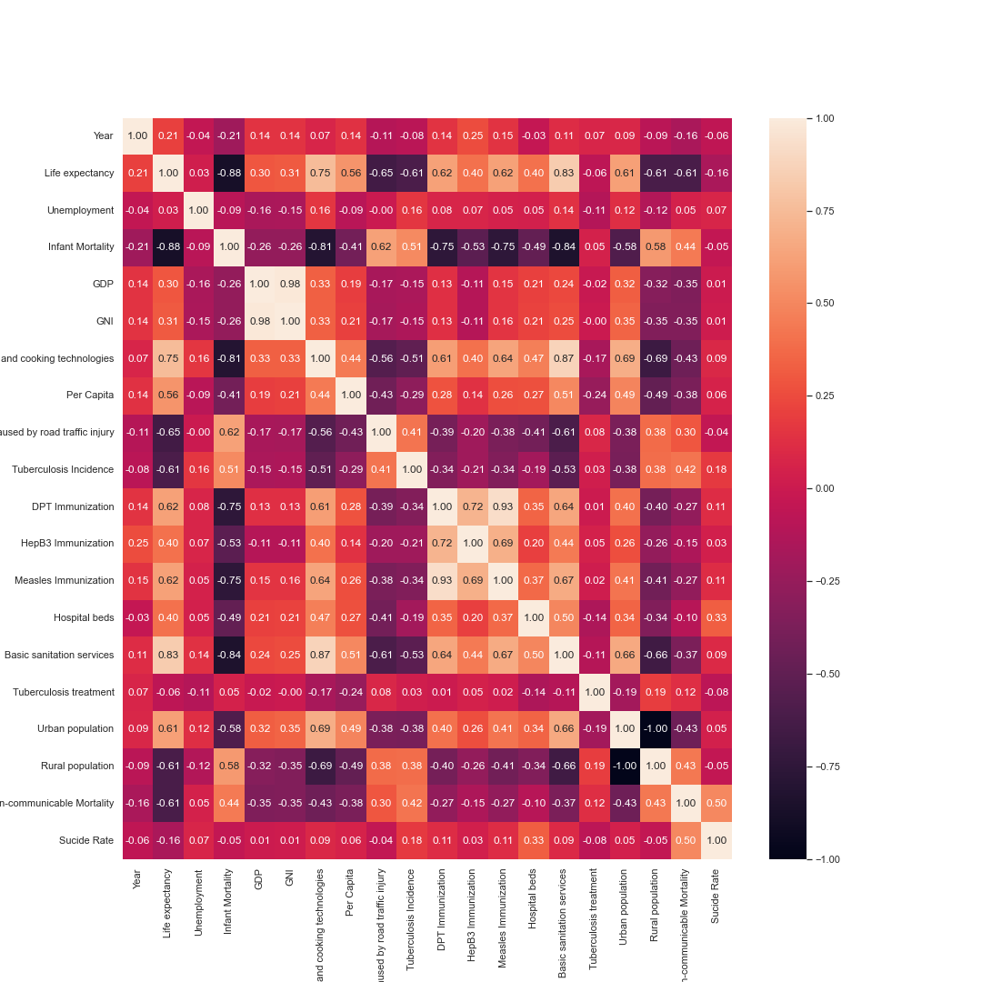
From the this corelation plot we can easily say that there are some multicollinearity issues between the variables. To solve this issue, we are going to implement the PCA technique (feature selection).

Slide 10
Model Building
Train/Test Split
Standardize the data
Feature Selection
Random Forest Regressor
Gradient Boosting Regressor
Comparison of Evaluation

Slide 11
Model Building
Train/Test Split - In machine learning models, to determine accuracy, We can Split the dataset into two pieces: a training set and a testing set.
Standardize the data - We are using standard scalar model for this purpose which standardize features by removing the mean and scaling to unit variance.
Feature Selection – In PCA, first few components explains the data maximum and as we keep increasing components data variance explained decreases exponentially

Slide 12
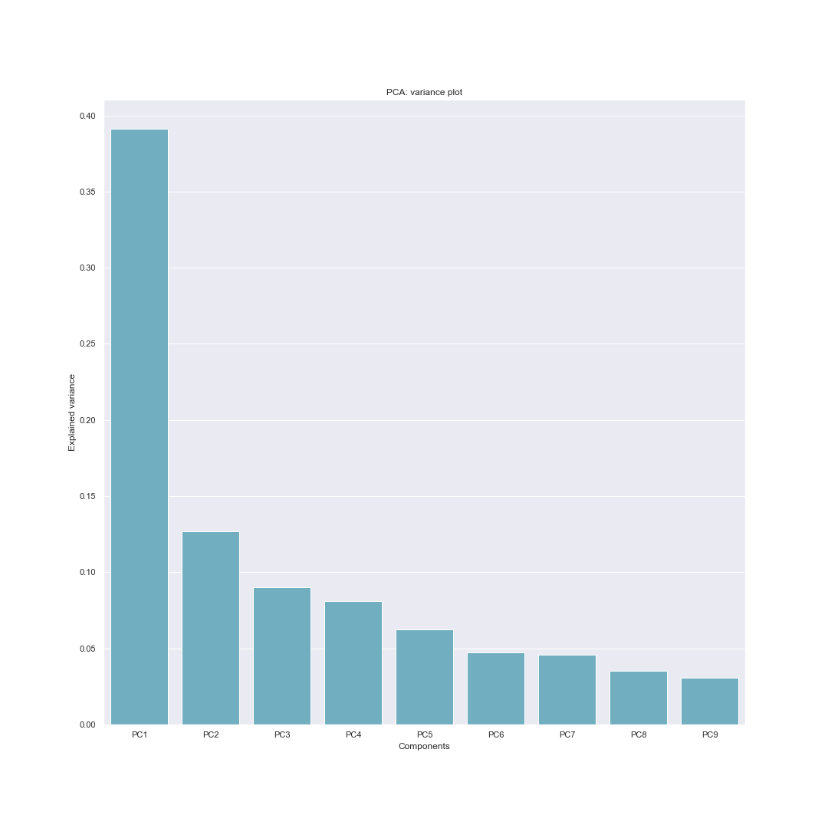
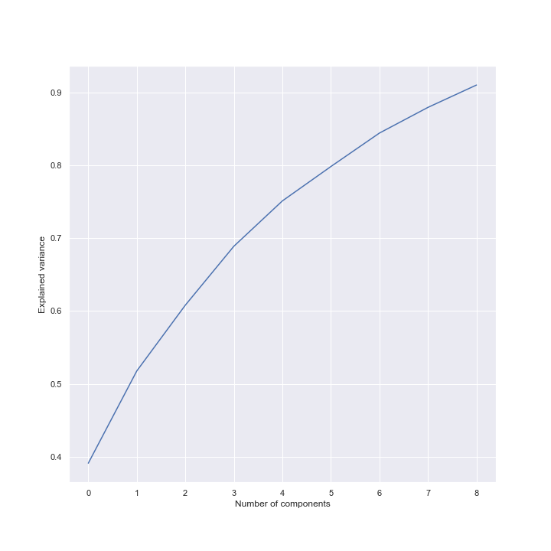

Slide 13
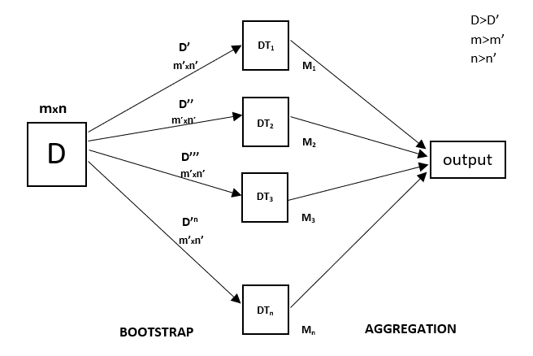
Random Forest Regressor
Random Forest is an ensemble technique capable of performing both regression and classification tasks with the use of multiple decision trees and a technique called Bootstrap and Aggregation, commonly known as bagging.

Slide 14
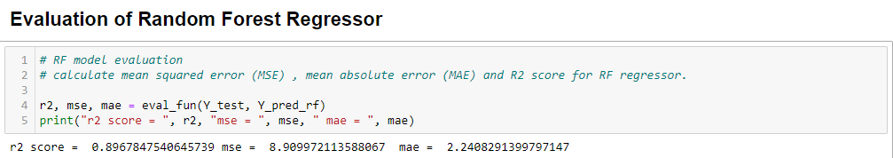
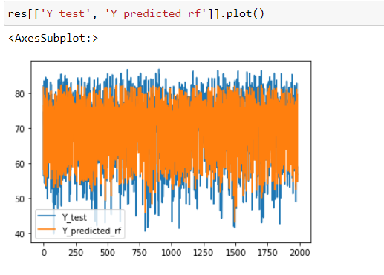
Evaluation of Random Forest Regressor

Slide 15
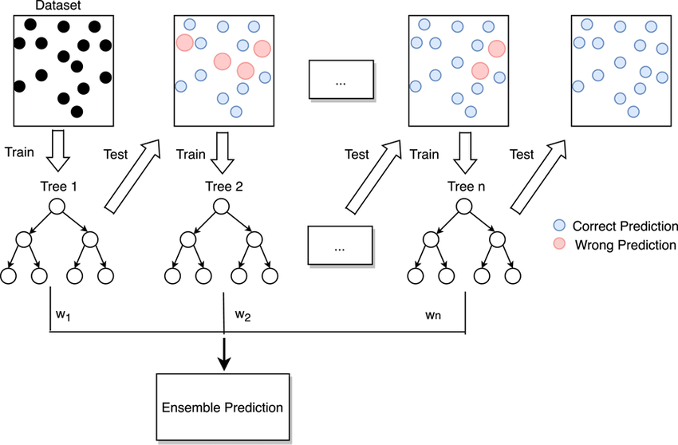
Gradient Boosting Regressor
Gradient Boosting is a popular boosting algorithm. In gradient boosting, each predictor corrects its predecessor’s error.

Slide 16
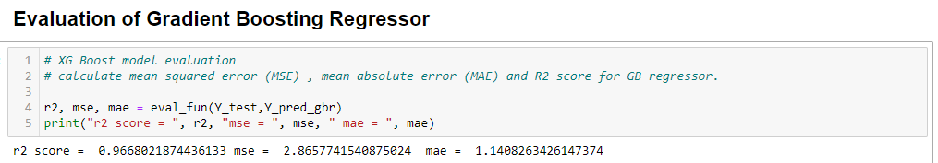
Evaluation of Gradient boosting Regressor

Slide 17
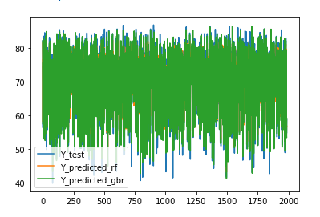
Comparison OF models
Model | MAE | MSE | R2 Score
Random Forest Regressor | 2.240 | 8.909 | 0.896
Gradient Boosting Regressor | 1.140 | 2.865 | 0.966

Slide 18
Final Prediction
After evaluation, among different models, Gradient Boosting Regressor performs best fit with an MAE = 1.140, MSE = 2.865, R2 Score = 0.966

Slide 19
Requirement Specification
Hardware Requirement:
100 GB hard drive (Minimum requirement)
8 GB RAM (Minimum requirement)
PC x64-bit CPU 3.2
Software Requirement:
Windows/Mac/Linux
Python- 3.9.12
VS Code/Anaconda/Jupyter
Libraries:
Pandas
Numpy
Missingno
Matplotlib
Seaborn
Sklearn

Slide 20
Future scope
This project is quite useful in studying the life structure and living patterns of population.
Life Expectancy predictions are used in field of research and policy making decisions. Numerous gov healthcare policies can be prepared using these results.
Generic Life Expectancy predictions can also help population to improve their lifestyles and to make efficient, healthier decisions individually.

Slide 21
References
Dataset :-
https://www.kaggle.com/datasets/kiranshahi/life-expectancy-dataset
Code References :-
https://towardsdatascience.com/hyperparameter-tuning-the-random-forest-in-python-using-scikit-learn-28d2aa77dd74
https://intellipaat.com/blog/what-is-random-forest-algorithm-in-python/
https://www.youtube.com/watch?v=hpT7dYsghjM&list=PLZoTAELRMXVPjaAzURB77Kz0YXxj65tYz&index=7

Slide 22
THANK YOU

