Slide 1

DEPLO -
From Repo
To Reality
Name :- Shantnu Baban Kumbhirkar
Roll No. :- 220101075
Semester 6
Department of Computer Science and Engineering
Indian Institute of Information Technology
Manipur
Under the Supervision of Dr. Khoirom Motilal Singh
Assistant Professor
Department of Computer Science and Engineering
Indian Institute of Information Technology
Manipur

Slide 2
Introduction & Objective
Introduction
Objective
Deplo – From Repo To Reality is a cloud-based platform that automates the deployment of GitHub repositories into production-ready applications.It controls repository validation and deployment setup. The software delivery procedure is made simpler and faster with Deplo, which is built for scalability and reliability.
The aim of the platform is to simplify manual deployment by combining environment variable management, build automation, repository selection, and real-time execution into a single workflow. Through the automation of such essential stages, the platform seeks to improve reproducibility, lower operational costs, and guarantee scalability.

Slide 3
Key Features
1] Repository Selection :- Users have access to browse and choose their repositories.
2] Metadata Extraction :- The metadata needed for deployment setup is efficiently retrieved and processed by the backend system.
3] Scalable Backend Architecture :- The backend, which uses Express.js and Prisma ORM is made to manage large number of deployment requests effectively while maintaning data integrity and steady performance.
4] Real-Time Deployment Monitoring :- The status of their deployments is updated in real time for users.
5] Asynchronous Event Handling :- This means that one task does not need to wait for another to complete before initiating.

Slide 4
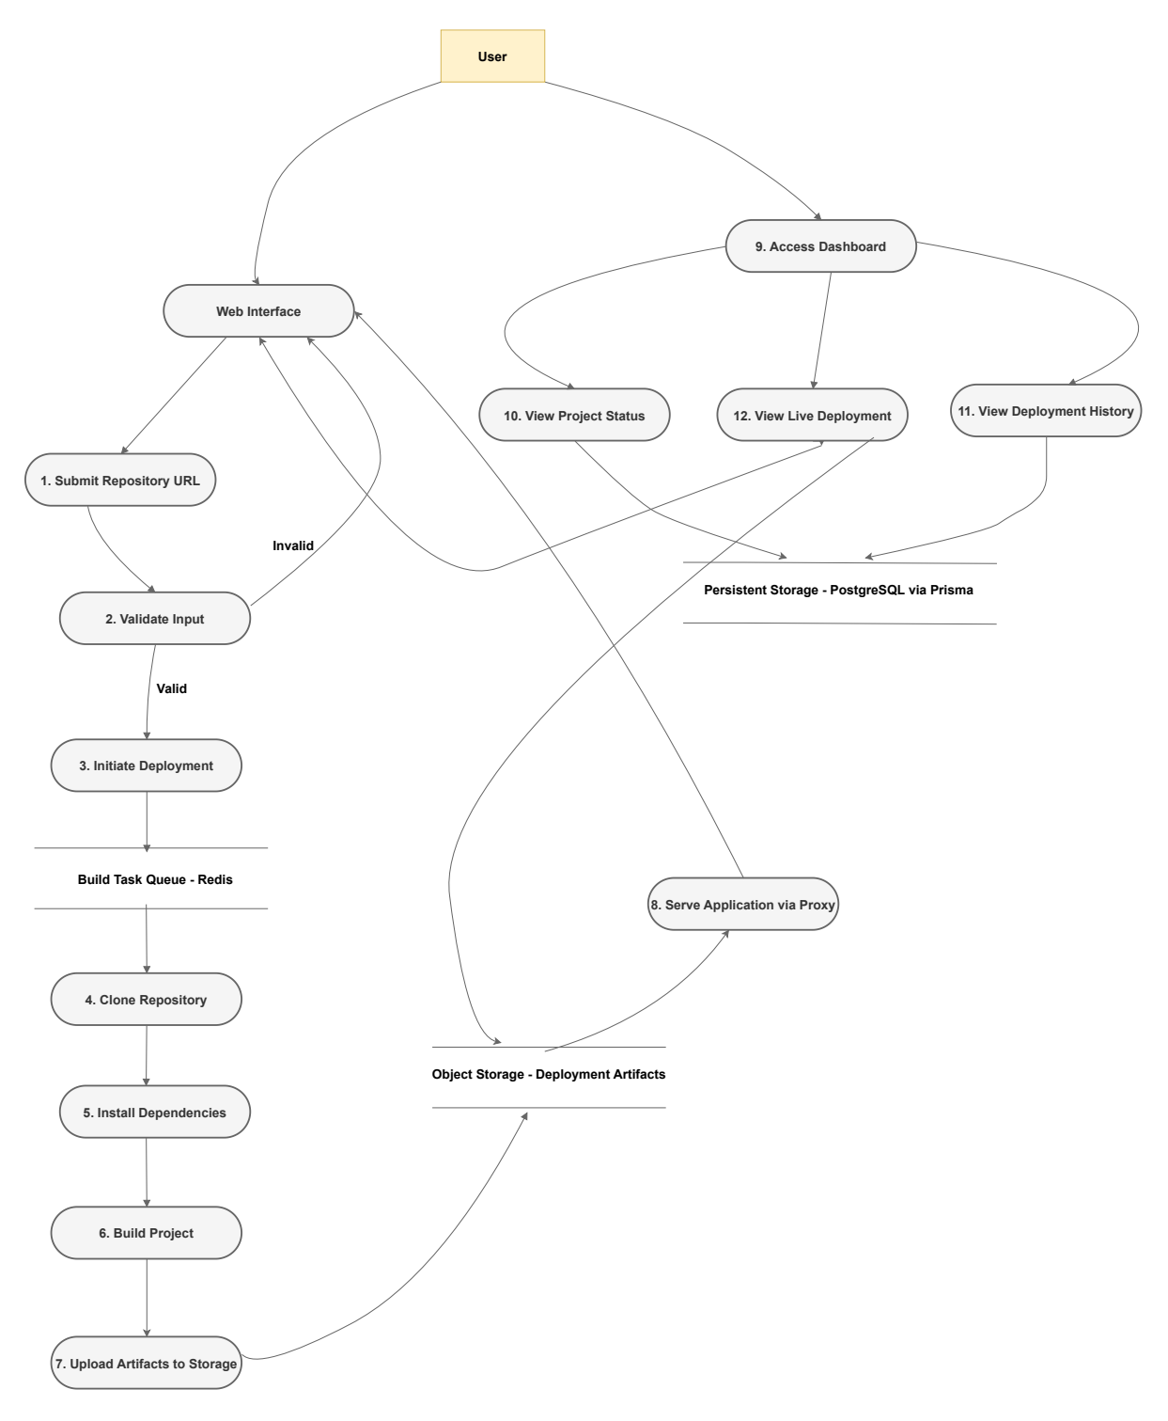
System Design
Data Flow Diagram :- Level 1

Slide 5
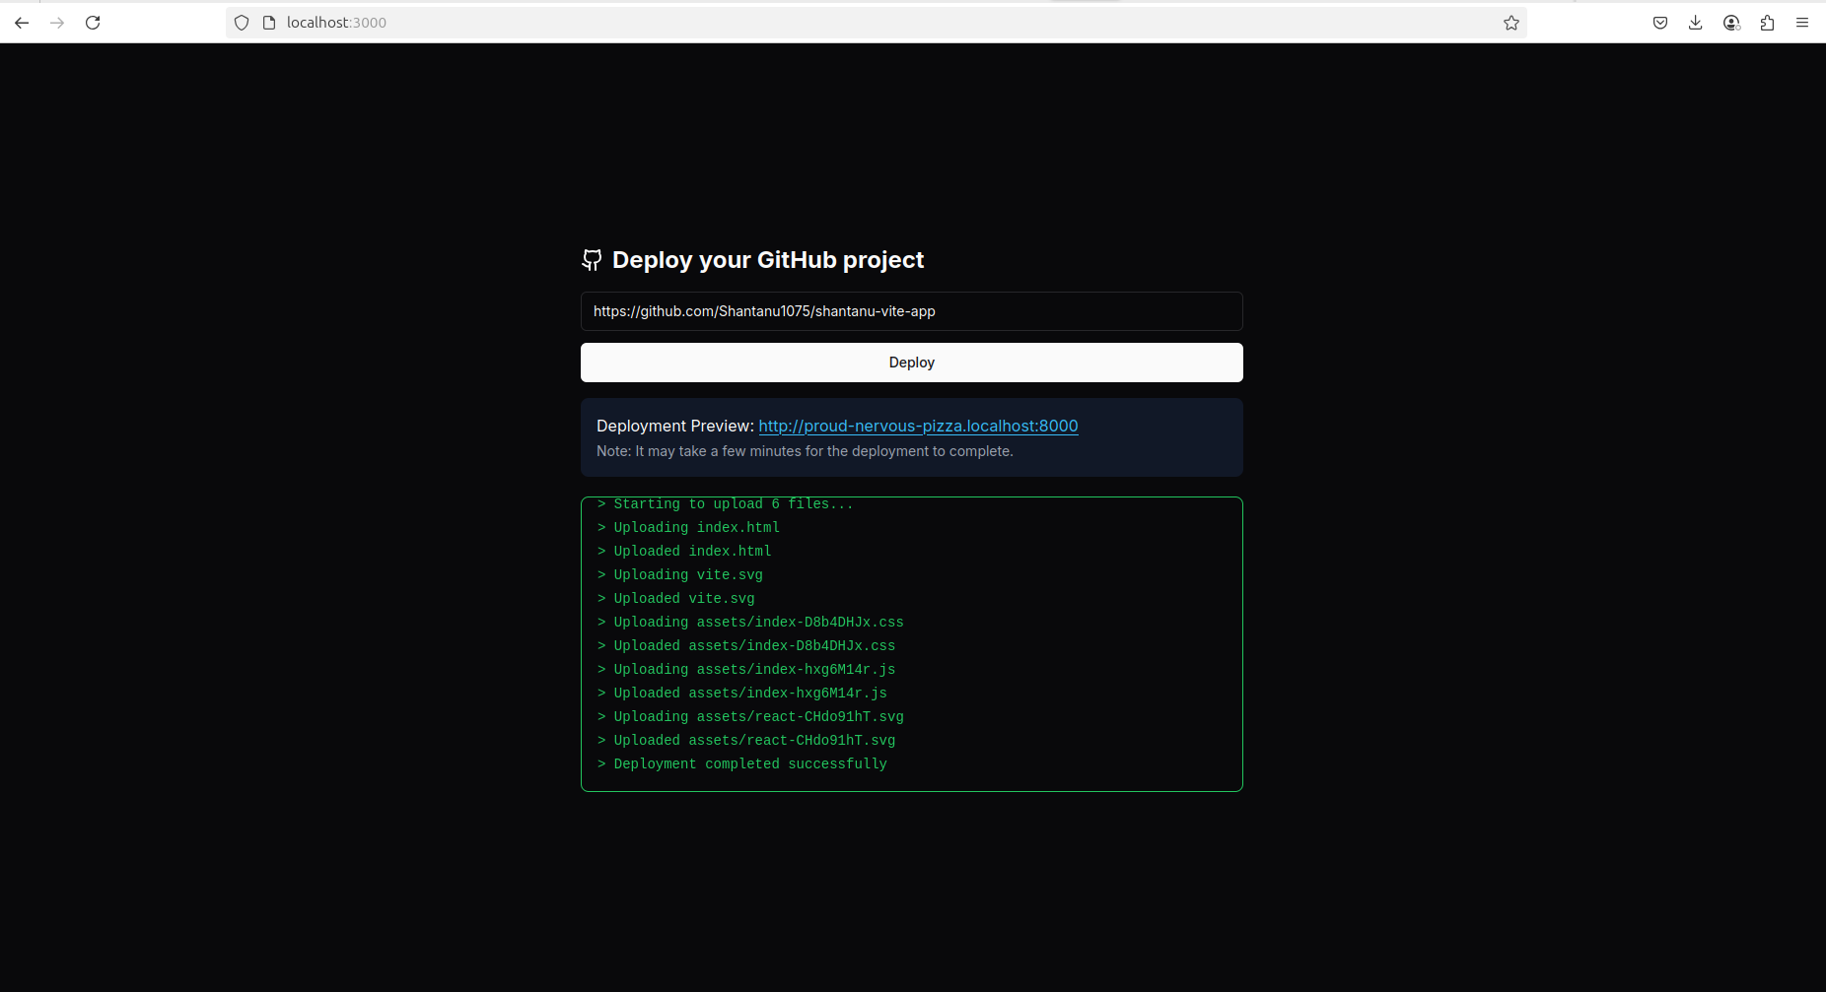
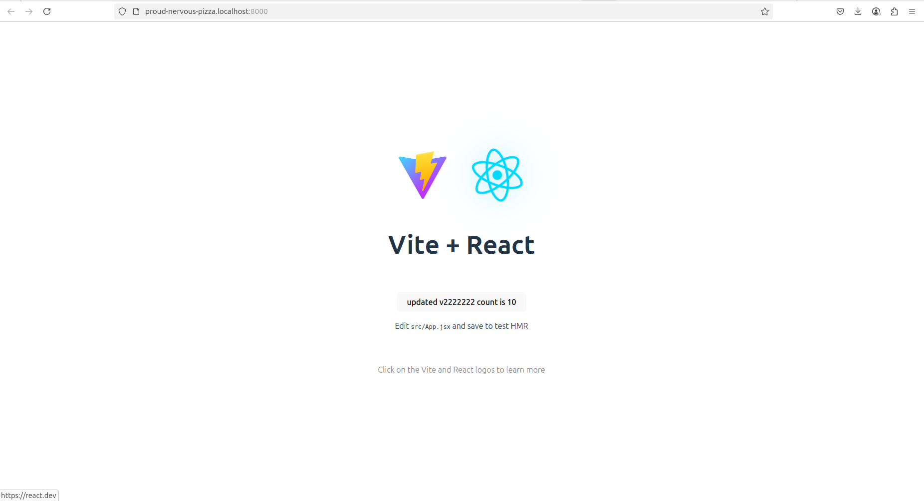
Output
Fig. 1 : Deployment Preview and Console Log Interface
Fig. 2 : Live Preview of Deployed Application

Slide 6
Conclusion
The deployment process is automated using Deplo. To ensure scalability, relibility, and real-time management, it combines modern frontend and backend technologies with services like AWS ECS, Kafka, and ClickHouse. The platform speeds up the software delivery lifecycle, improves reproducibility, and lowers operational costs by doing away with manual deployment procedures.

Slide 7
Thank You !

