Slide 1
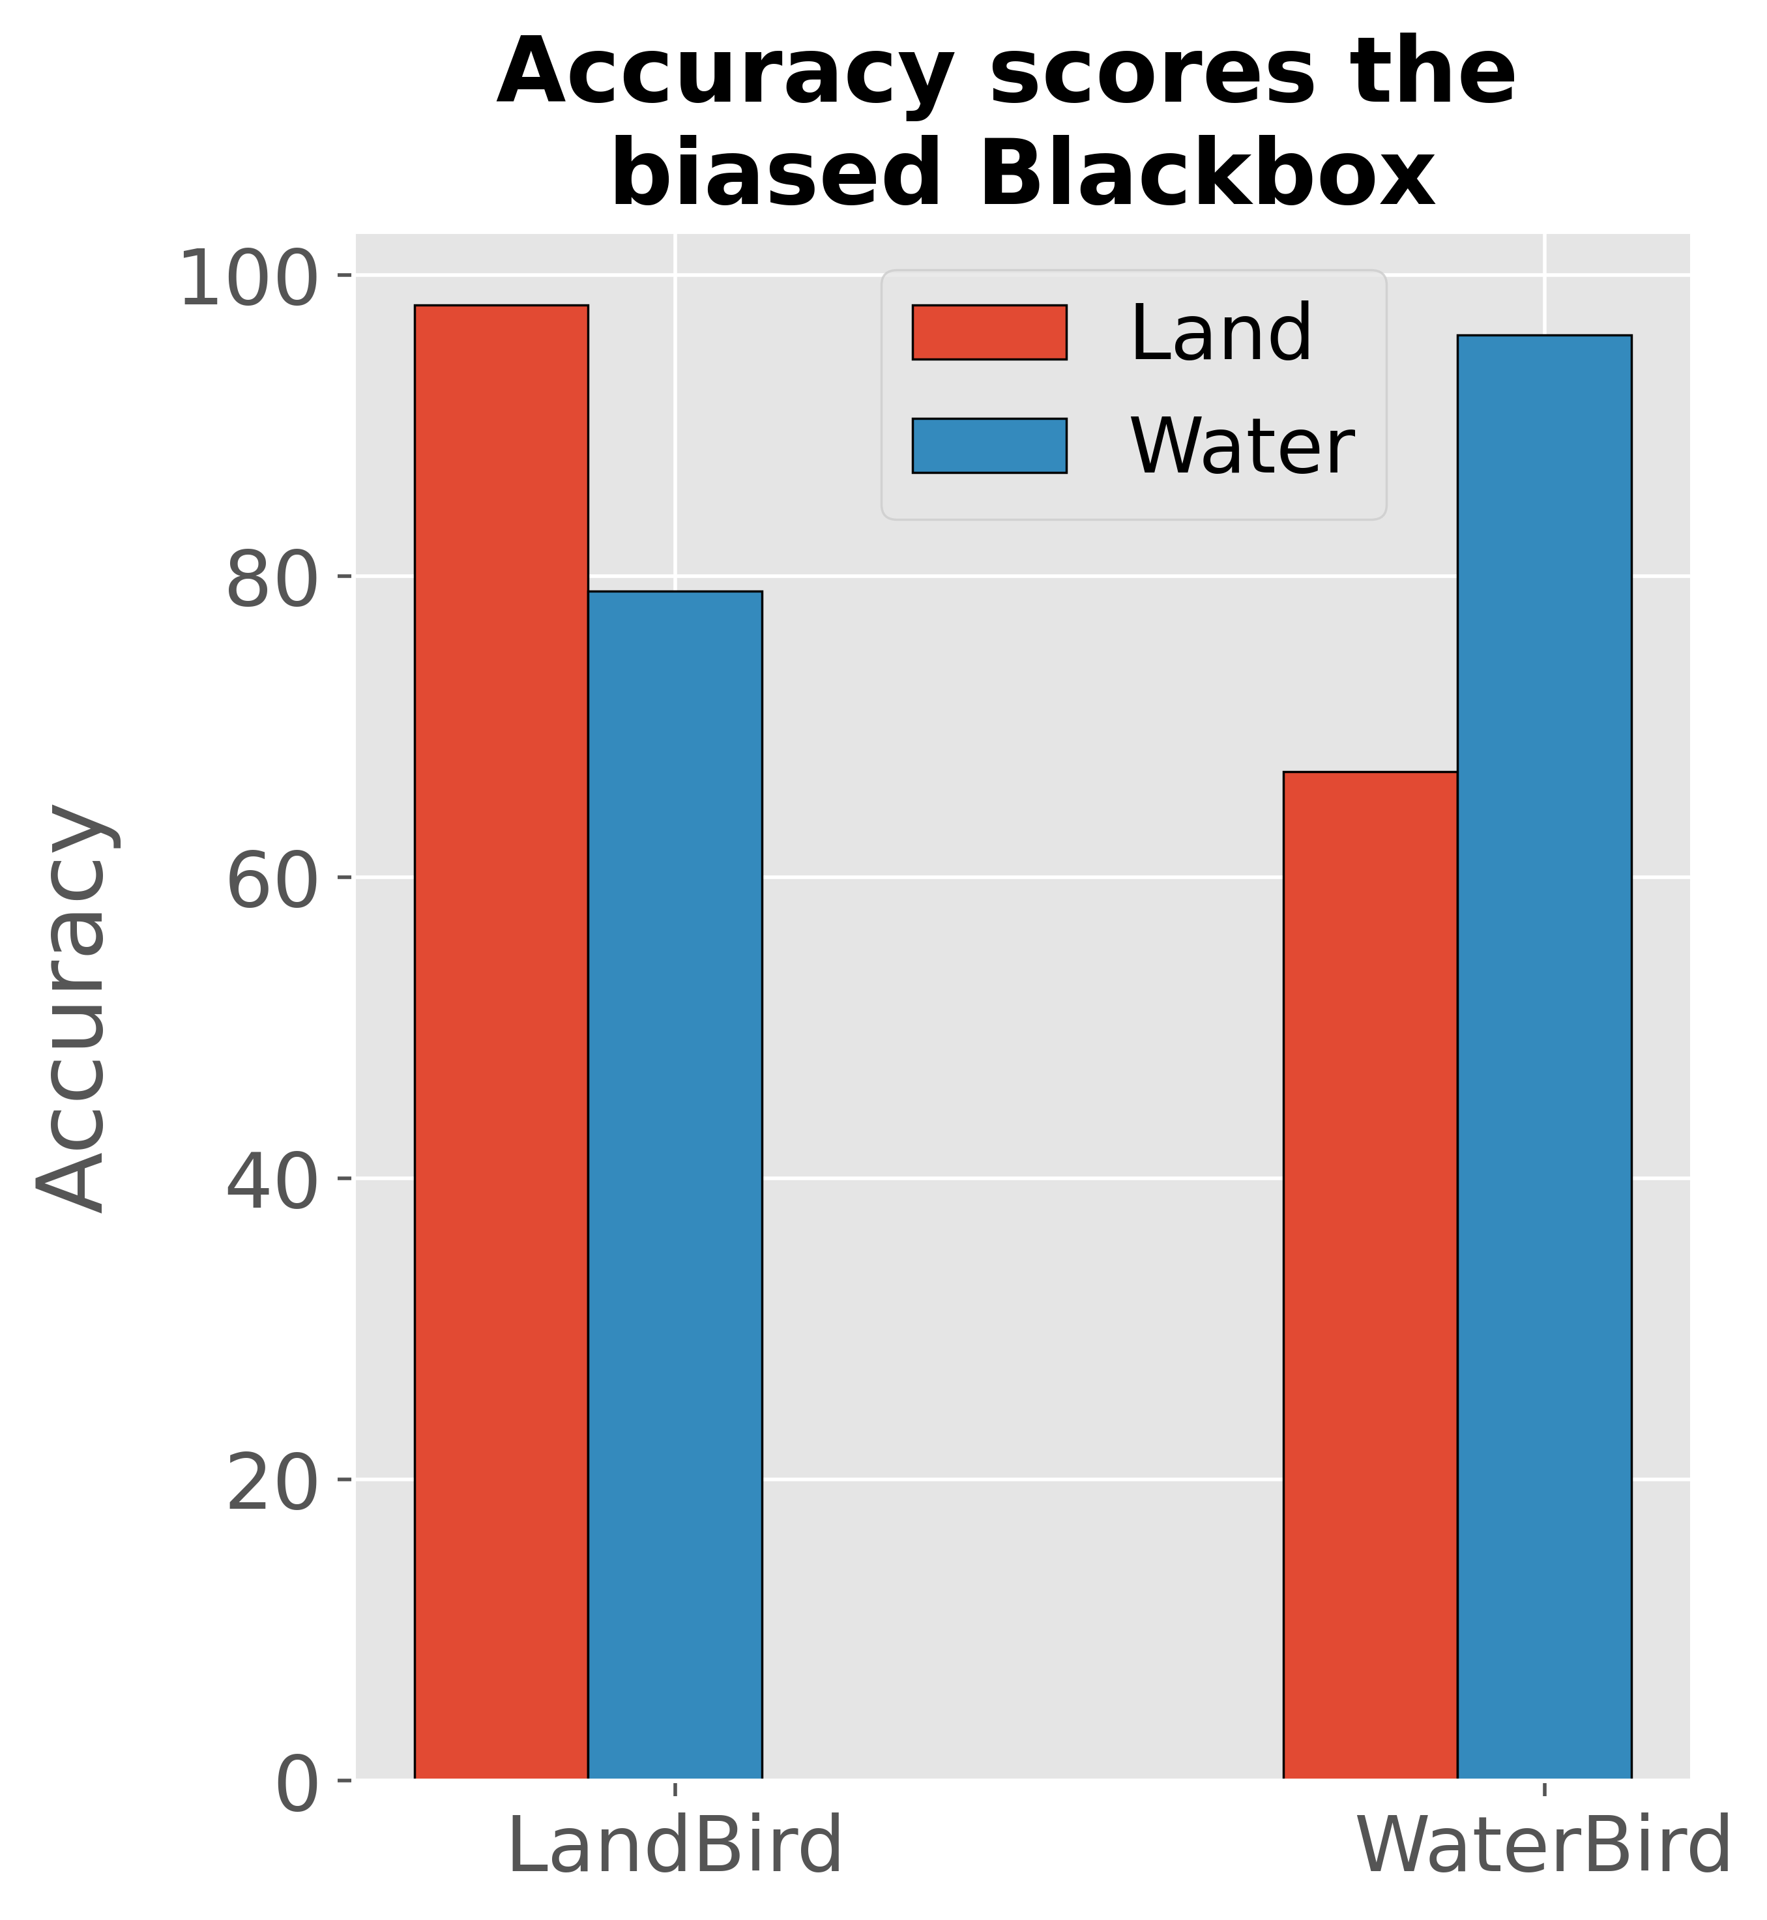
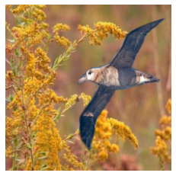
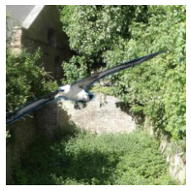
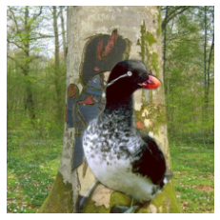
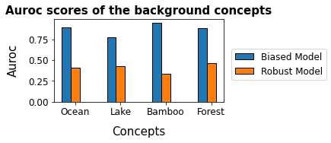
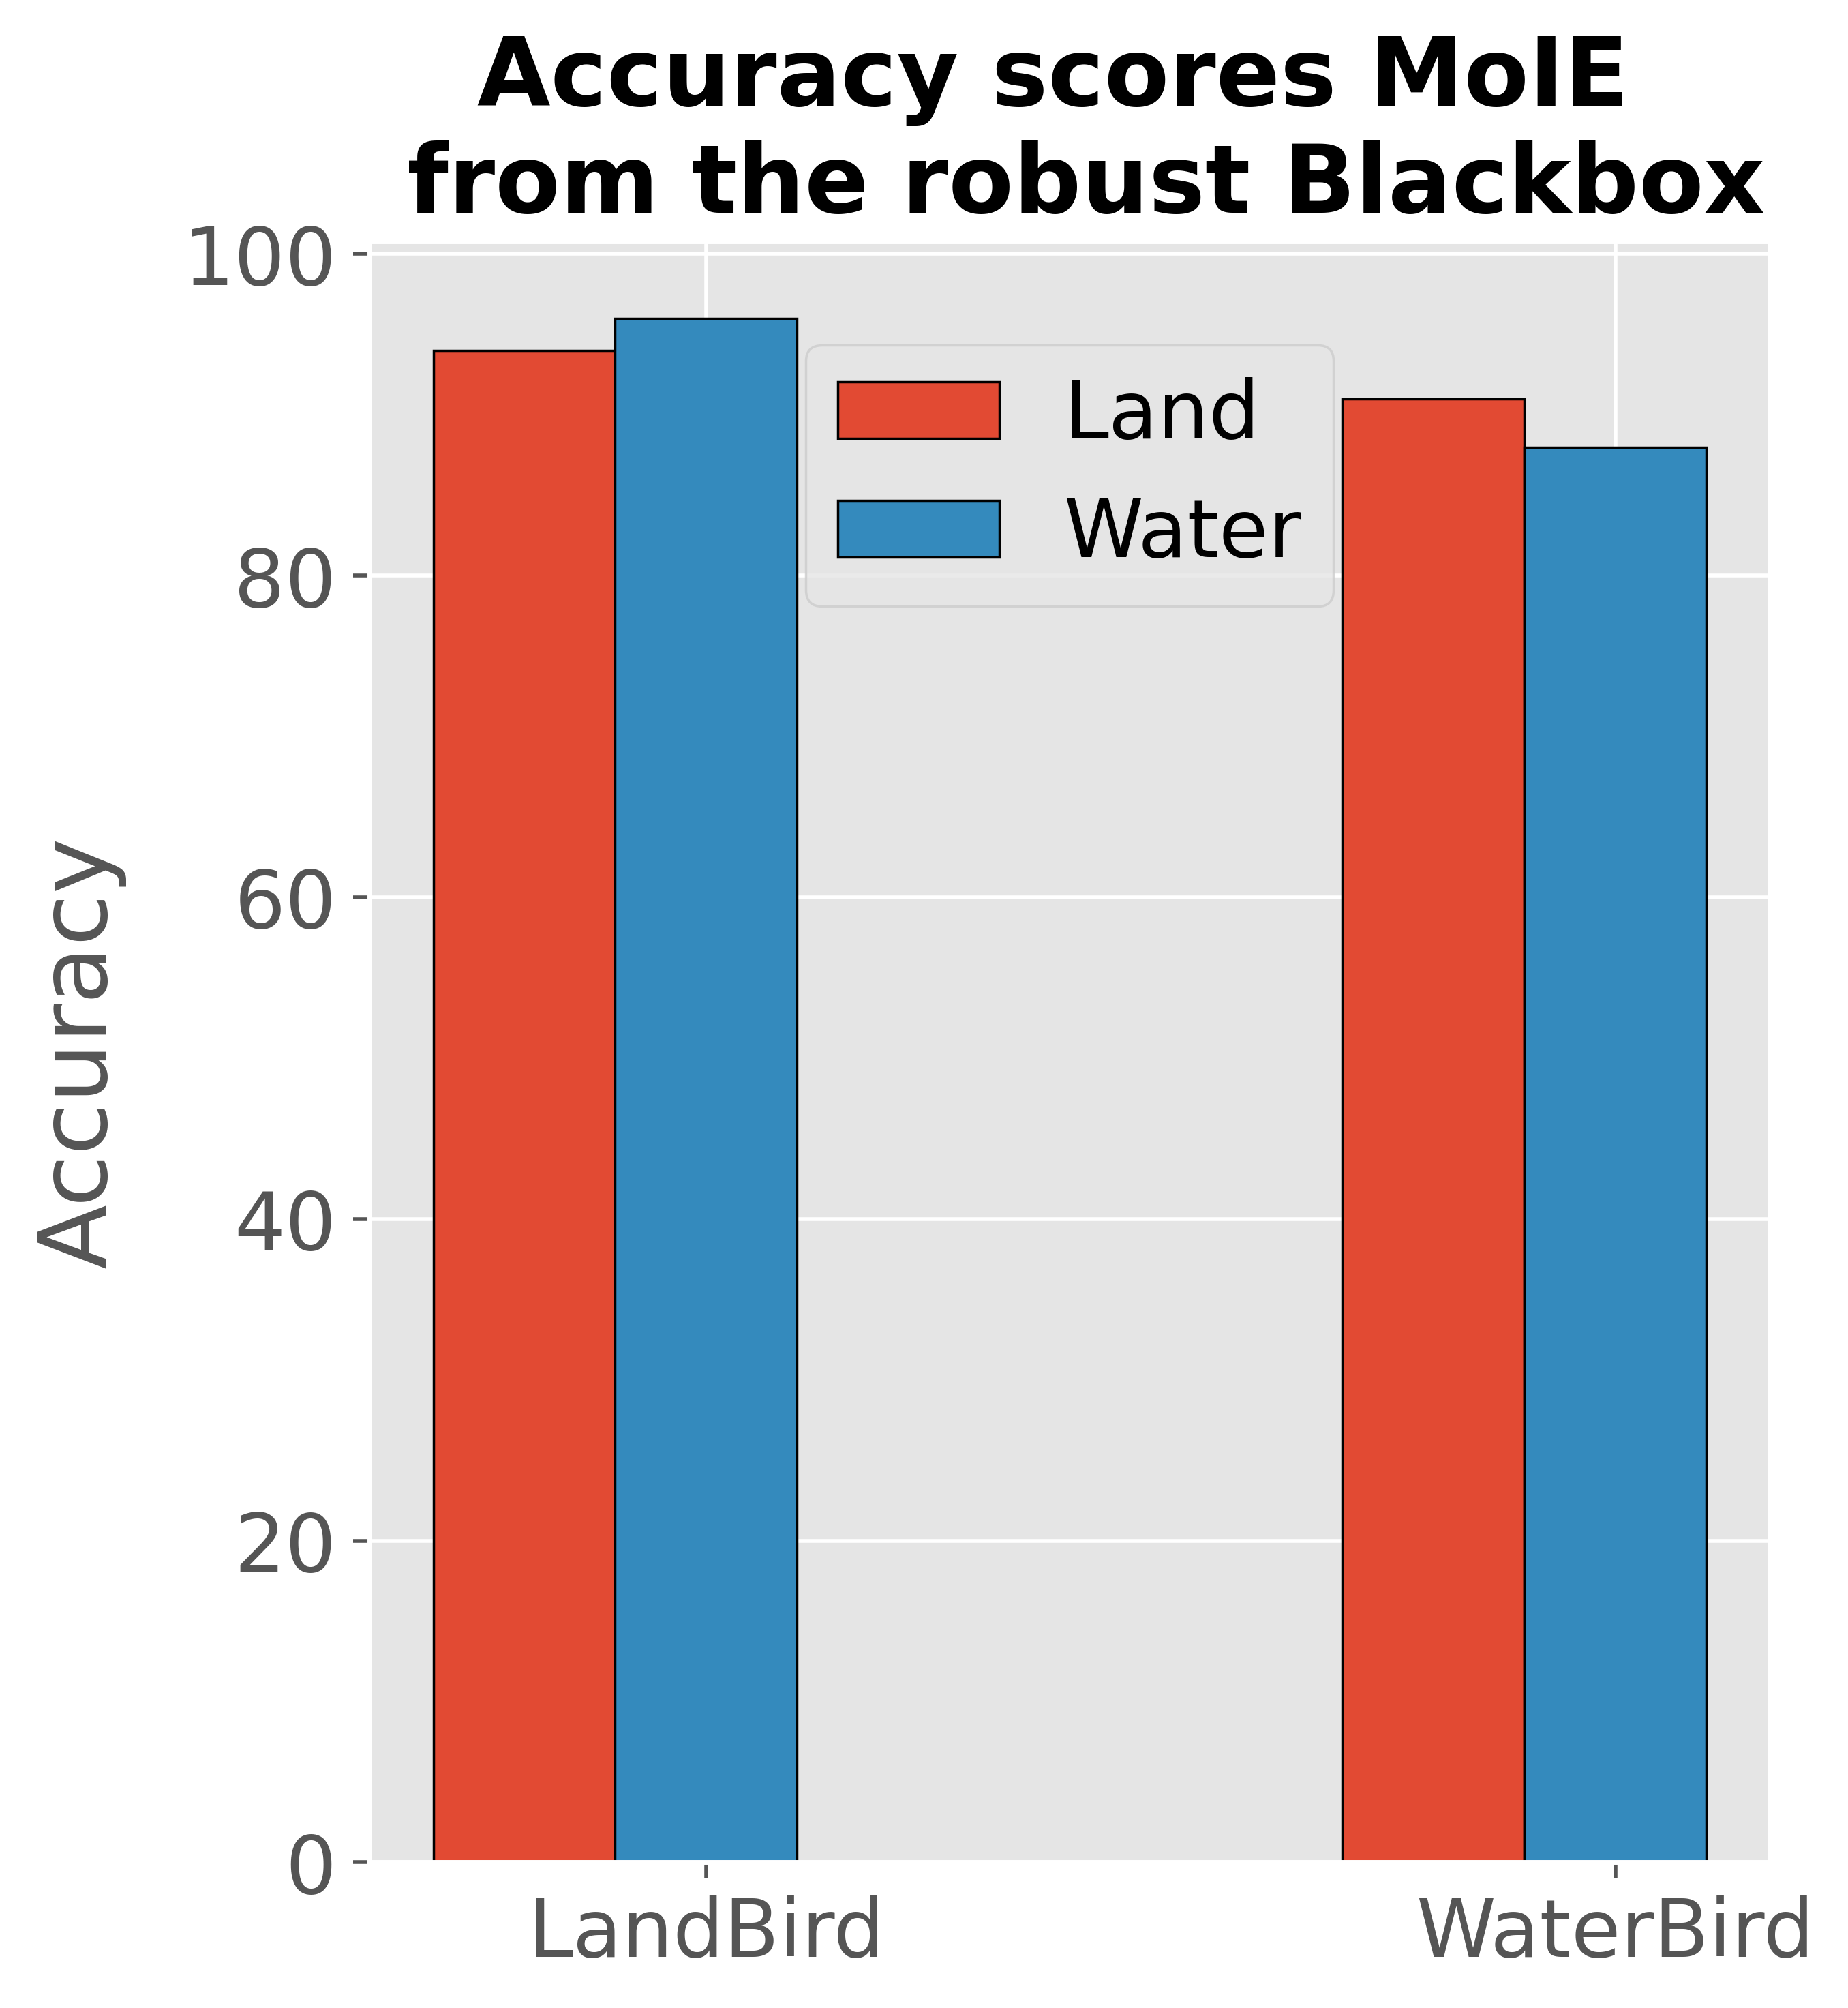
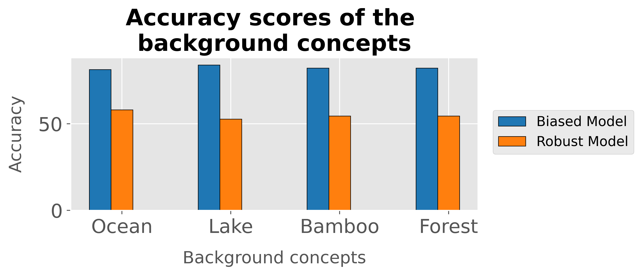
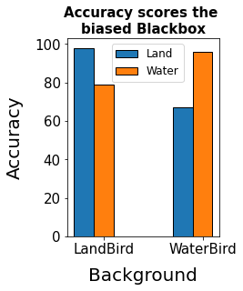
Biased Blackbox
(e)
Robust Blackbox
(a)
(c)
(b)
(d)
Notes:
Make forest bold
&\text{Groundtruth: WaterBird} \\
&\text{Prediction : LandBird} \\
&\text{Explanation}: \text{LandBird} \leftrightarrow \text{WingShapeRoundedwings} \hspace{0.0000001pt} \land \text{\textbf{\textcolor{red}{Forest}}}
&\text{Groundtruth: WaterBird} \\
&\text{Prediction : WaterBird} \\
&\text{Explanation}: \text{WaterBird} \leftrightarrow \text{BillLengthAboutTheSameAsHead} \hspace{0.0000001pt} \land \\
& \qquad \qquad \qquad \qquad \qquad \qquad \neg\text{BillLengthShorterThanHead } \hspace{0.0000001pt} \land \\
& \qquad \qquad \qquad \qquad \qquad \qquad \neg\text{SizeSmall5\_\_9in} \hspace{0.0000001pt} \land \neg\text{ShapePerchingLike} \hspace{0.0000001pt} \land \\
& \qquad \qquad \qquad \qquad \qquad \qquad \text{CrownColorWhite}

