Slide 1
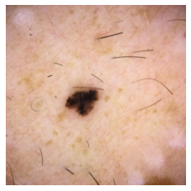
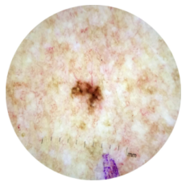
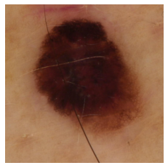
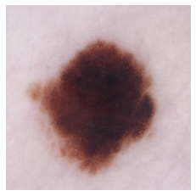
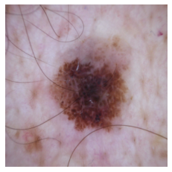
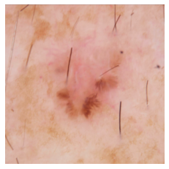
Expert3
Expert5
Baseline (PCBM + ELEN)
Expert3
Expert6
Baseline (PCBM + ELEN)
Notes:
% Malignant
&\text{\textbf{Malignant}} \leftrightarrow \text{IrregularStreaks} \lor \neg\text{{RegularDG}}
% Malignant
&\text{\textbf{Malignant}} \leftrightarrow \text{\textcolor{blue}{AtypicalPigmentNetwork}} \lor \text{\textcolor{blue}{BWV}}
% Malignant
\text{\textbf{Malignant}} \leftrightarrow \text{{BWV}} \lor \text{\textcolor{red}{RegressionStructures}}
% Malignant
\text{\textbf{Malignant}} \leftrightarrow & \text{\textcolor{blue}{IrregularStreaks}} \lor \big(\text{AtypicalPigmentNetwork} \land \text{BWV}\big) \lor \big(\text{BWV} \land \text{\textcolor{blue}{IrregularDG}}\big) \\
& \lor \big(\text{BWV} \land \text{\textcolor{blue}{RegularStreaks}} \land \neg\text{\textcolor{blue}{RegularDG}} \big) \\
& \lor \big(\text{AtypicalPigmentNetwork} \land \neg \text{\textcolor{blue}{IrregularDG}} \land \neg\text{\textcolor{blue}{RegularDG}} \land \neg\text{\textcolor{blue}{RegularStreaks}} \big) \\
& \lor \big(\neg \text{AtypicalPigmentNetwork} \land \text{\textcolor{blue}{IrregularDG}} \land \neg\text{\textcolor{blue}{RegularDG}} \land \neg\text{\textcolor{blue}{RegularStreaks}} \big)
% Malignant
&\text{\textbf{Malignant}} \leftrightarrow \text{\textcolor{BrickRed}{AtypicalPigmentNetwork}}
&\text{\textbf{Malignant}} \leftrightarrow \text{\textcolor{red}{AtypicalPigmentNetwork}}

