Slide 1

Personalized Healthcare Recommendation System
Internship Project Presentation
-BY SHANTANU DESHMUKH
Data Science Intern
Unified Mentor Pvt. Ltd
5 December 2025 - 5 March 2026

Slide 2
INTRODUCTION
Modern healthcare systems generate vast amounts of clinical and biomedical data from hospitals, laboratories, wearable devices, and electronic health records.
Personalized medicine uses this data to tailor treatments according to individual patient characteristics, improving diagnosis accuracy and overall patient outcomes.
Machine learning plays a key role by analyzing complex biomedical data to identify patterns, make predictions, and support clinical decision-making.
In this system, machine learning algorithms are used to predict patient health risk levels based on biomedical parameters, enabling early intervention and better healthcare management.

Slide 3
PROBLEM STATEMENT
Analyze patient medical data
Identify health risk levels
Predict disease probability
Generate personalized healthcare recommendations
Support preventive decision-making
Provide the report on their email address

Slide 4
DATASET DESCRIPTION
The dataset contains key biomedical and lifestyle parameters used to assess an individual’s health condition and predict risk levels.
Age & Gender – Basic demographic information that influences disease risk and health patterns.
Blood Pressure – Measures the force of blood flow in arteries; high levels may indicate cardiovascular risk.
Blood Glucose – Indicates sugar levels in the blood, important for detecting diabetes risk.
Cholesterol – Measures fat levels in the blood that affect heart health.
BMI (Body Mass Index) – Evaluates body weight relative to height to assess obesity or underweight conditions.
Heart Rate – Number of heartbeats per minute, reflecting cardiovascular function.
Smoking Status – Indicates whether a person smokes, a major risk factor for many diseases.
Exercise Level – Represents physical activity, which impacts overall health and disease prevention.

Slide 5
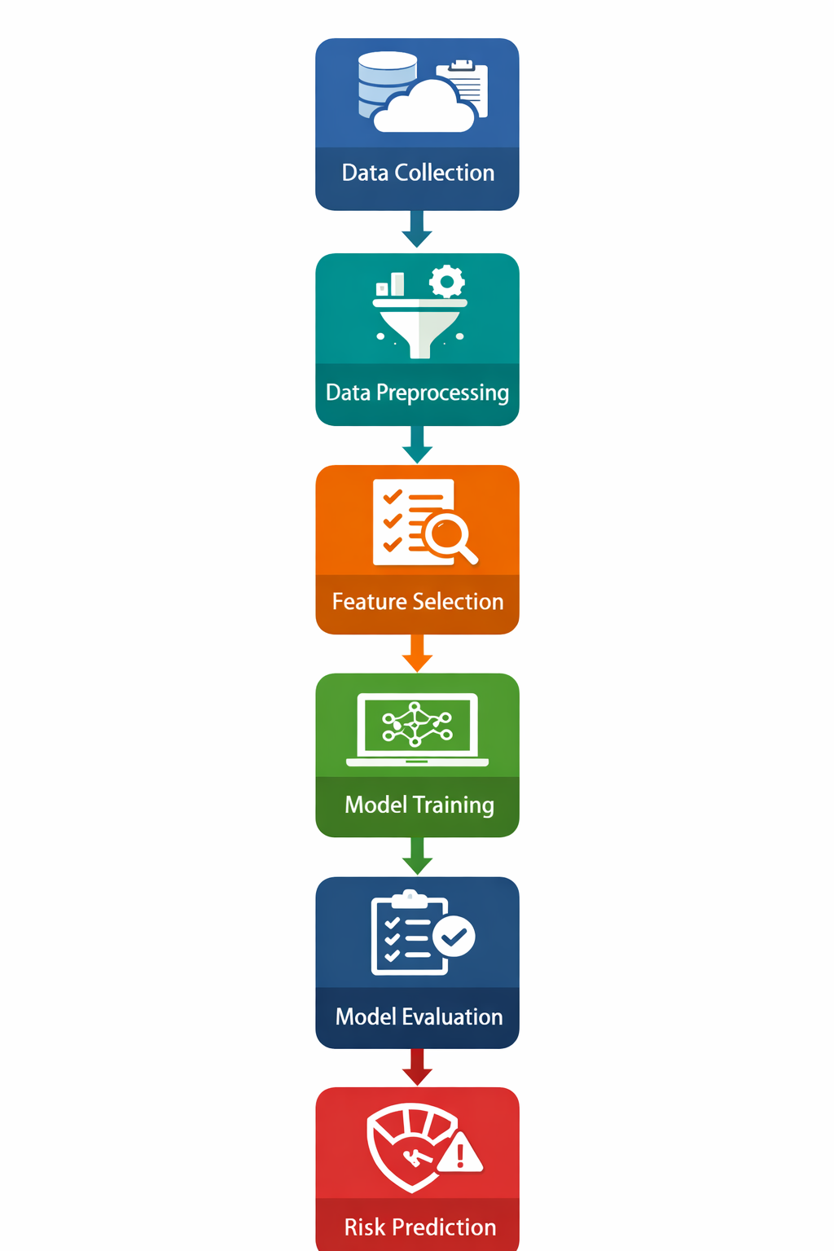
SYSTEM ARCHITECTURE
Data Collection :
Biomedical and lifestyle data are gathered from medical records, sensors, or health databases.
Data Preprocessing :
Raw data is cleaned, organized, and transformed to remove errors, missing values, and inconsistencies.
Feature Selection :
The most relevant health parameters are selected to improve model accuracy and reduce complexity.
Model Training :
Machine learning algorithms learn patterns from the data to identify relationships between features and health risks.
Model Evaluation :
The model’s performance is tested using evaluation metrics to ensure accuracy and reliability.
Risk Prediction :
The trained model predicts an individual’s health risk level based on input biomedical data.

Slide 6
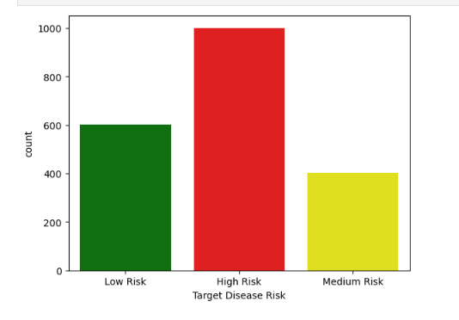
EXPLORATORY DATA ANALYSIS (EDA)
High Risk Dominates
  The majority of individuals fall into the High Risk (1000) category.
  This suggests a significant portion of the population may require immediate medical attention or preventive intervention.
Moderate Low-Risk Population
  600 individuals are categorized as Low Risk.
  Indicates a reasonable segment maintaining healthier profiles.
Smallest Group – Medium Risk
  Only 400 individuals fall under Medium Risk.
  This could imply either:
    Risk factors sharply separate individuals into high or low categories, or
    Screening criteria strongly classify borderline cases into high risk.
Potential Concern
  With High Risk being the largest group (~50% of total), there may be:
    Underlying lifestyle or environmental issues
    Need for stronger preventive healthcare programs
6.1 Distribution of Target Disease Risk Levels

Slide 7
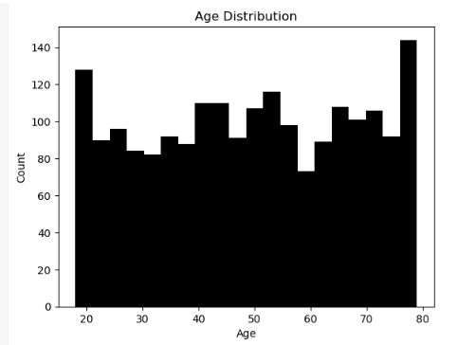
Wide Age Coverage
  Participants span a broad age range (young adults to elderly).
  Indicates the dataset represents multiple life stages.
Relatively Balanced Distribution
  Counts across age groups are fairly consistent.
  No single age group overwhelmingly dominates the sample.
Slight Variations Across Ages
    Minor peaks and dips appear across different age intervals.
  These fluctuations are normal and suggest natural sampling variation.
Good Representation for Risk Analysis
  Balanced age representation supports reliable comparisons across age groups.
  Useful for studying how disease risk changes with age.
6.2 Age Distribution of Participants

Slide 8
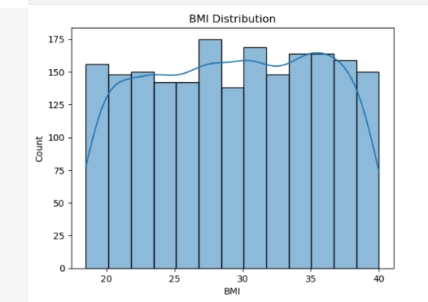
Broad BMI Range
  Participants fall between underweight threshold (~18.5) and obese category (>30).
  Indicates a mix of normal, overweight, and obese individuals.
Higher Concentration in Overweight/Obese Range
  Many individuals appear clustered between 25–35 BMI.
  Suggests a large portion of the population is overweight or obese.
Potential Health Risk Indicator
  Since BMI is strongly linked to chronic diseases (e.g., diabetes, heart disease),
  a higher BMI concentration may explain elevated disease risk levels seen earlier.
Relatively Smooth Distribution
  No extreme skewness or sharp spikes.
  Dataset appears well-balanced for statistical modeling.
6.2 BMI Distribution of Participants

Slide 9
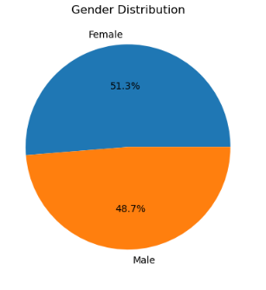
Near Equal Representation
  Female: 51.3%
  Male: 48.7%
  The dataset is well-balanced by gender.
Minimal Gender Bias
  Neither gender dominates the sample significantly.
  Results and risk patterns are less likely to be skewed by gender imbalance.
Reliable Comparative Analysis
  Balanced representation supports meaningful gender-based health comparisons.
6.4 Gender Distribution of Participants

Slide 10
DATA PREPROCESSING
Missing Value Imputation :
Missing or incomplete data values are filled using statistical methods to maintain dataset consistency.
Feature Scaling & Standardization :
Numerical values are normalized to a common scale so that all features contribute equally to the model.
One-Hot Encoding :
Categorical variables (like gender or smoking status) are converted into numerical format for machine learning.
Train-Test Split :
The dataset is divided into training and testing sets to evaluate model performance on unseen data.
Noise & Redundancy Removal :
Irrelevant, duplicate, or inconsistent data is removed to improve model accuracy and efficiency.

Slide 11
FEATURE SELECTION
Correlation Analysis :
Identifies relationships between features and the target variable to select highly relevant attributes.
Statistical Importance Techniques :
Uses methods like statistical tests or feature importance scores to determine the most significant variables.
Removal of Irrelevant Features :
Eliminates unnecessary or weak features to reduce noise and overfitting.
Improved Model Performance :
Selecting important features increases model accuracy and efficiency.
Enhanced Interpretability :
A smaller, relevant feature set makes the model easier to understand and explain.

Slide 12
RANDOM FOREST CLASSIFIER
Improves accuracy and generalization
Ensemble learning method using multiple decision trees
Each tree is trained on bootstrap samples (random subsets of data with replacement)
Final prediction made using majority voting
Helps reduce overfitting compared to a single decision tree

Slide 13
EVALUATION METRICS
1. Accuracy
Ratio of correctly predicted observations
Formula:
Accuracy = (TP + TN) / (TP + TN + FP + FN)
2. Precision
How many predicted positives are actually positive
Precision = TP / (TP + FP)
3. Recall (Sensitivity)
How many actual positives are correctly predicted
Recall = TP / (TP + FN)
4. F1-Score
Harmonic mean of Precision & Recall
F1 = 2 × (Precision × Recall) / (Precision + Recall)
5. ROC Curve
Plots True Positive Rate (Recall) vs False Positive Rate
Shows model’s classification performance at different thresholds
6. AUC (Area Under Curve)
Value between 0 and 1
Closer to 1 → Better model

Slide 14

RECOMMENDATION GENERATION
Based on the predicted risk level, the system provides personalized health recommendations:
Low Risk → Preventive Monitoring
Maintain healthy lifestyle
Regular check-ups
Track basic health indicators
Moderate Risk → Lifestyle Modification
Improve diet and physical activity
Reduce stress and harmful habits
Follow preventive care guidelines
High Risk → Clinical Consultation
Seek professional medical advice
Diagnostic testing if required
Follow prescribed treatment plan

Slide 15
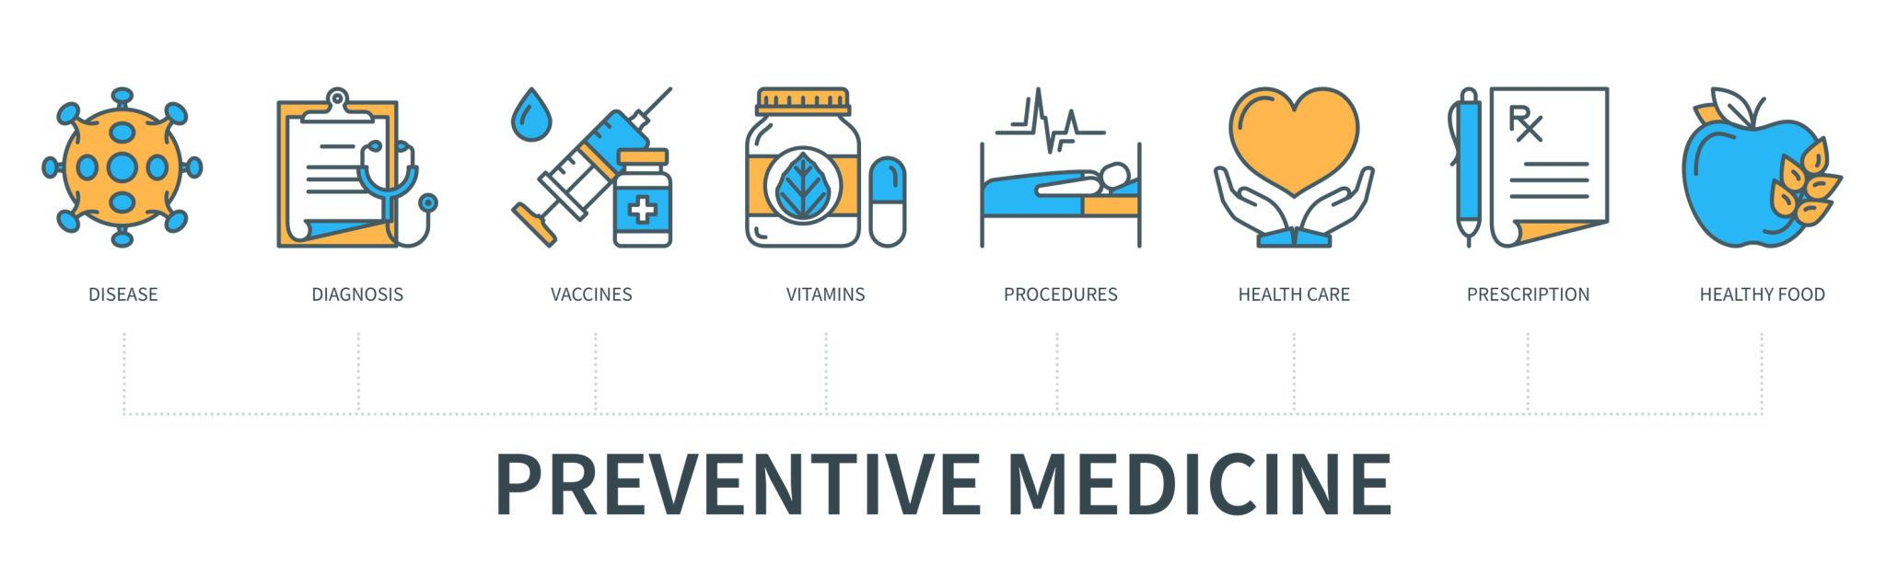
ADVANTAGES
1. Personalized Healthcare Guidance
Provides recommendations based on individual risk level
Improves patient-specific decision making
2. Early Disease Risk Detection
Identifies potential health risks at an early stage
Enables timely intervention
3. Scalable Predictive System
Can handle large datasets
Suitable for hospitals and healthcare platforms
4. Supports Preventive Medicine
Encourages lifestyle changes before disease progression
Reduces long-term healthcare costs

Slide 16
LIMITATIONS
1. Depends on Data Quality
Model performance relies on accurate and complete data
Poor data can reduce prediction reliability
2. Limited Dataset
Smaller dataset may affect generalization
Model may not capture all real-world variations
3. Requires Clinical Validation
Predictions need verification by healthcare professionals
Not a replacement for medical diagnosis
4. No Real-Time Deployment
System is not yet implemented for live monitoring
Requires integration for real-time use

Slide 17

FUTURE SCOPE
Deep Learning Integration
Use advanced neural networks for improved prediction accuracy
Better pattern recognition in complex medical data
Wearable Device Connectivity
Integration with smartwatches and health trackers
Continuous collection of patient health data
Real-Time Monitoring
Live health tracking and instant risk prediction
Faster medical response and intervention
Explainable AI
Transparent and interpretable model decisions
Builds trust among doctors and patients
Hospital Deployment
Integration into hospital management systems
Support clinical decision-making in real settings

Slide 18
CONCLUSION
In conclusion, the proposed machine learning system enhances healthcare analytics by effectively analyzing medical data and predicting patient risk levels with improved accuracy. By identifying potential health risks early, the model enables timely intervention and better clinical decision-making. It also generates personalized recommendations based on individual risk profiles, supporting targeted and proactive healthcare management. Overall, the system contributes to preventive healthcare by promoting early detection, reducing complications, and improving patient outcomes.

Slide 19
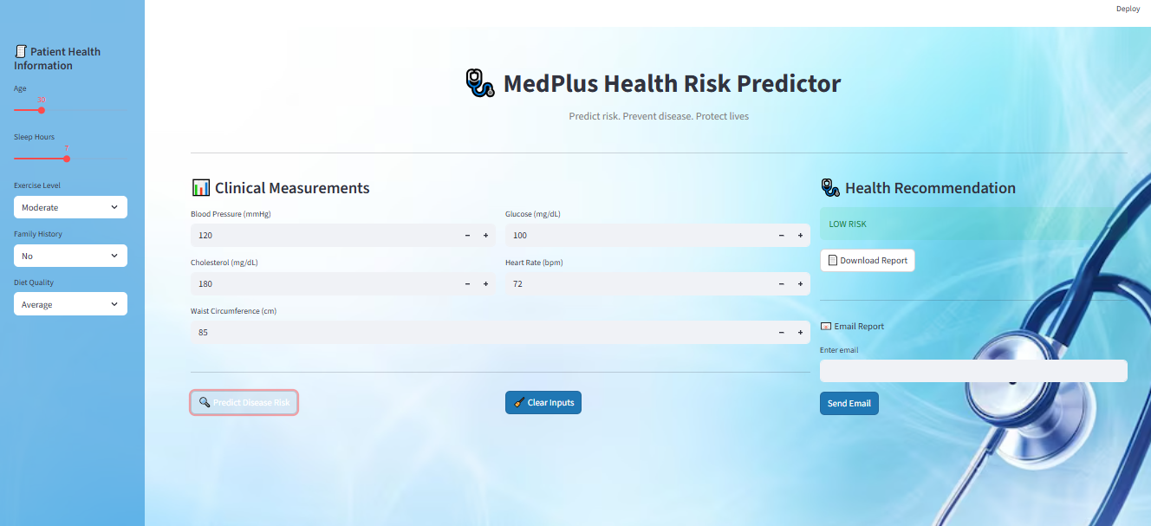
USER INTERFACE

Slide 20
Thank You

