Slide 1


SMART INDIA HACKATHON 2025
AI-Powered ERP System for Rural Schools
Problem Statement ID - SIH25012
Problem Statement Title - Automated Attendance System for Rural Schools
Theme - Smart Education
PS Category - Software
Team ID -
Team Name - E-Pluse

Slide 2
AI-Powered ERP for Rural Schools
E-Pluse
Proposed Solution:-
Centralized ERP platform tailored for rural schools.
Works offline-first with data sync when internet is available.
Smart attendance through Face Recognition , RFID Cards or QR.
Unified dashboard for teachers, students, admins, and parents.
Integrated modules for attendance, academics, scholarships, and mid-day meals.
Uniqueness & Innovation:-
Offline + Cloud Hybrid → Works seamlessly without stable internet.
AI-Powered Analytics → Face recognition, predict dropouts, absenteeism trends.
Low-cost hardware integration → QR/RFID/face recognition using Raspberry Pi.
Scalable solution → Deployable across multiple schools.

Slide 3
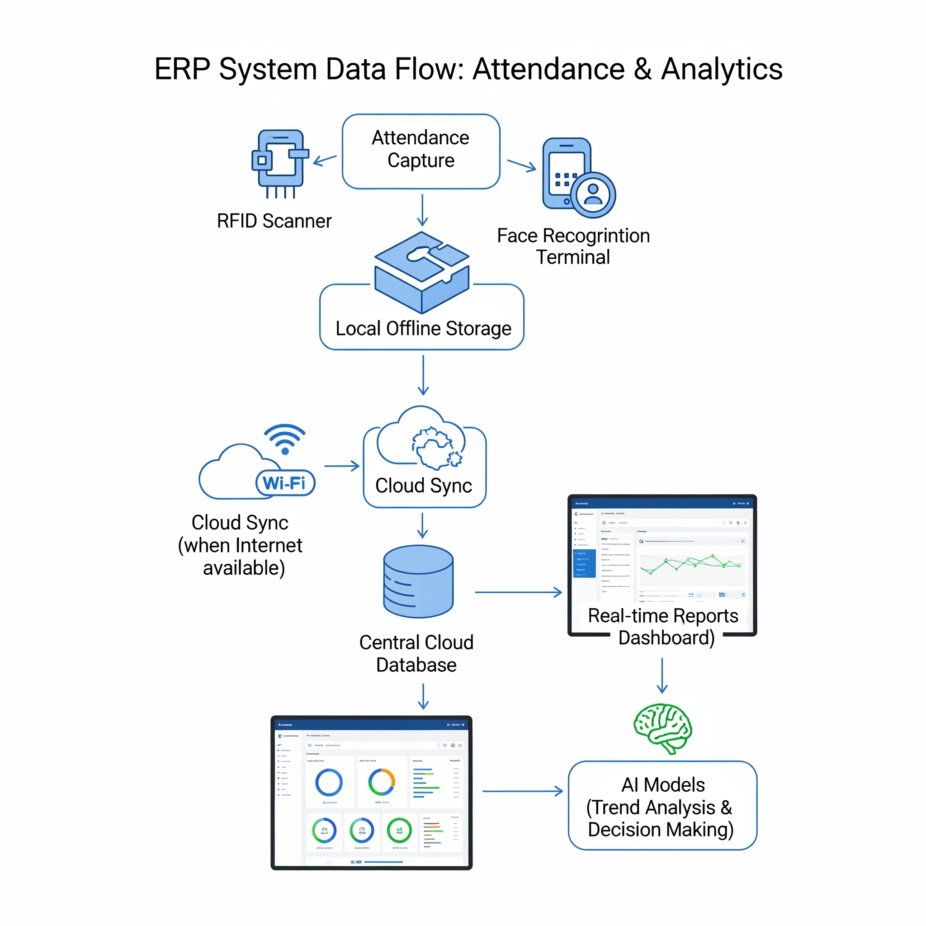
TECHNICAL APPROACH
E-Pluse
Technologies::-
Frontend: ReactJS / Flutter (Mobile App)
Backend: Python (Flask/Django)
Database: SQLite (Offline), PostgreSQL/MySQL (Cloud)
AI: OpenCV for face recognition, TensorFlow Lite for edge AI
Hardware: RFID readers, QR scanners

Slide 4
FEASIBILITY AND VIABILITY
E-Pluse
Feasibility:-
Low-cost implementation using Raspberry Pi & open-source software.
Scalable architecture for multiple schools.
Minimal training required for teachers.
Challenges:-
Initial resistance to adopting new tech.
Strategies to Overcome:-
Simple UI in local languages for ease of use.

Slide 5
IMPACT AND BENEFITS
E-Pluse
Impact on Rural Schools :-
Accurate, tamper-proof attendance tracking.
Transparent reporting for government schemes (mid-day meals, scholarships).
Data-driven decisions for resource allocation.
Benefits:-
Social: Increased student retention and engagement.
Economic: Reduced administrative costs and manual work.
Environmental: Digital records reduce paper usage.

Slide 6
RESEARCH AND REFERENCES
E-Pluse
Research Sources:-
Leveraging Artificial Intelligence for Rural Education → https://www.preprints.org/manuscript/202504.0598/v1
Artificial Intelligence and Data Literacy in Rural Schools’ Teaching Practices → https://www.mdpi.com/2227-7102/15/3/352
Offline-first Architecture for Education Systems in Low-connectivity Areas → https://unesdoc.unesco.org/ark:/48223/pf0000385077

Slide 7
IMPORTANT INSTRUCTIONS
Please ensure below pointers are met while submitting the Idea PPT:
Kindly keep the maximum slides limit up to six (6). ( Including the title slide)
Try to avoid paragraphs and post your idea in points /diagrams / Infographics /pictures
Keep your explanation precise and easy to understand
Idea should be unique and novel.
You can only use provided template for making the PPT without changing the idea details pointers (mentioned in previous slides).
You need to save the file in PDF and upload the same on portal. No PPT, Word Doc or any other format will be supported.
Note - You can delete this slide (Important Pointers) when you upload the details of your idea on SIH portal.

