Slide 1


Guru Gobind Singh College of Engineering & Research Centre, Nashik
Department of Computer Engineering
Academic Year 2025-26
Technical Seminar Review-1
On
Use of Artificial Intelligence in Space
By
TE-CO- 132
Guided by:-
Prof. Pradnay Shirsath
Monday,01/09/2025

Slide 2
Content
Introduction of topic
Motivation
Problem Statement
Literature Review
Conclusion
References

Slide 3
Introduction
Background of the topic: The governance of space activities is progressively transforming with the integration of AI and machine learning (ML). This seminar will examine the fundamental legal challenges associated with using AI in the space domain.
Why this seminar is chosen?: The nature of the space and satellite industry is a quintessential use-case for AI, with applications in virtually all space activities.
Relevance to computer engineering / industry: AI applications include autonomous robots like spacecraft and satellite constellations, and the analysis of big data for tasks such as debris monitoring and predictive analytics.

Slide 4
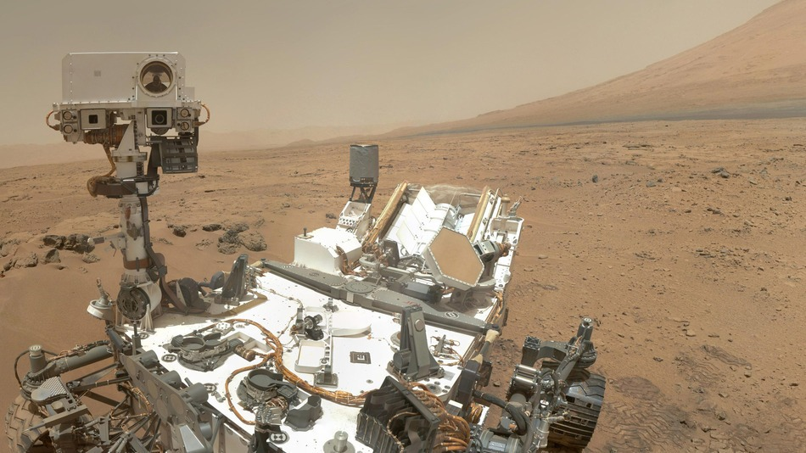
NASA's Mars Rover
Use Case: NASA's Mars rovers (like Curiosity and Perseverance) are prime examples of AI in space.
AI Functions: They use AI for autonomous navigation, allowing them to traverse difficult terrain and plan their own routes without constant human intervention.
Scientific Application: AI helps the rover analyze geological features, identify potential rock samples, and decide which data to prioritize sending back to Earth. This is a crucial application of AI for analyzing big data in real-time.

Slide 5
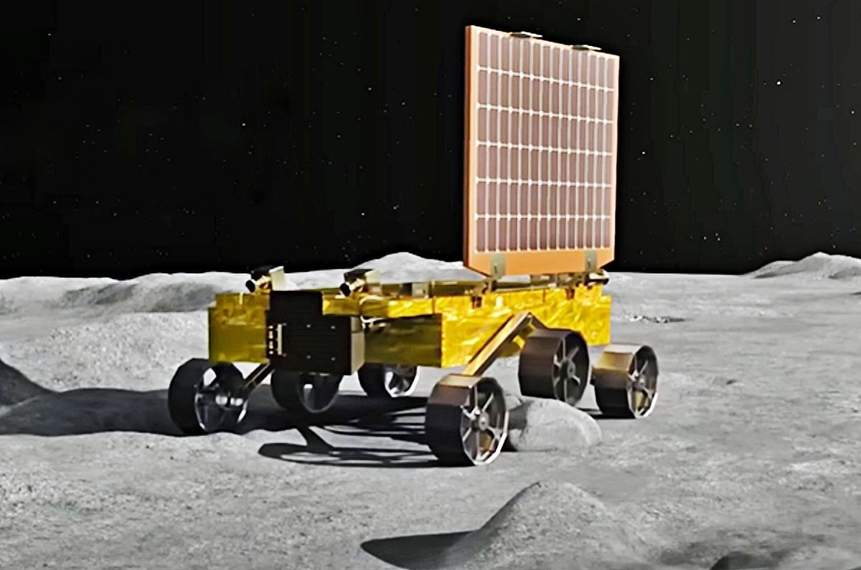
ISRO Chandrayaan-3 Rover
Use Case: The Chandrayaan mission, particularly the Pragyan Rover, demonstrates India's use of AI in lunar exploration.
AI Functions: The rover's AI assists in navigation and obstacle detection on the lunar surface, ensuring its safety and path-finding capabilities in an unknown environment.
Scientific Application: AI helps the rover's instruments collect and transmit scientific data, such as images of the lunar surface, to the lander, which then sends the data to Earth.

Slide 6
Motivation
Growing complexity of space missions → traditional ground-based control is insufficient.
Communication delays with deep space (e.g., Mars-Earth: up to 24 minutes one way).
Massive data from satellites, telescopes, and sensors require intelligent processing.
Emergence of New Space Economy: privatization, small satellites, mega-constellations.
AI promises:
Cost reduction.
Safer autonomous operations.
Faster scientific discoveries.
Strengthening space-based services for Earth (climate monitoring, smart cities, disaster management).

Slide 7
Problem Statement
Human-led decision making is slow, error-prone, and resource-heavy for space operations.
Challenges:
Real-time anomaly detection in spacecraft systems.
Autonomous navigation in harsh and unknown planetary terrains.
Collision avoidance with space debris and natural threats (asteroids, dust).
Data overload from high-resolution satellites and IoT in space.
Legal and ethical challenges: privacy issues in Earth Observation, liability for AI-driven satellites.
Core problem: Need for trustworthy AI systems that can operate autonomously and reliably in outer space.

Slide 8
Objectives
Develop AI systems for:
Autonomous navigation & control of spacecraft.
Real-time satellite data analysis for weather, Earth monitoring, and astronomy.
Health monitoring of astronauts during long missions.
Predictive maintenance of spacecraft systems.
Integrate AI with existing space mission pipelines to increase efficiency and safety.

Slide 9
Literature Review _____________________________
Author/Year | Approach / Technology | Limitations of Current Systems
Downer, B. (2018) | AI in Mars Rovers for autonomous navigation & obstacle avoidance. | Still dependent on Earth-based control for complex decisions; not fully autonomous.
ESA (2019) | Space 4.0 → AI integrated with IoT & Big Data for satellite data processing. | Limited on-board processing power; relies heavily on ground stations.
Long, G.A. (2018) | Legal studies on AI-controlled spacecraft and autonomy in space law. | No global legal framework; accountability in AI failures unresolved.

Slide 10
Soille et al. (2019) | AI in geospatial analytics for Earth observation & climate monitoring. | Concerns about data privacy, uneven access, and bias in AI models.
NASA (2020) | AI in spacecraft fault detection, anomaly diagnosis & predictive maintenance. | Requires large high-quality datasets; unexpected failures may still occur.
OECD (2020) | Governance studies for responsible AI in critical domains including space. | Lack of universal AI policy for outer space; possible misuse by military/private actors.
JAXA (2022) | AI-based astronaut physiological & psychological health monitorin | Experimental stage; less accurate under radiation and isolation stress.
ECSS (2023) | On-board AI for satellite autonomy (collision avoidance, orbit adjustment). | Limited energy/resources on satellites; high risk if AI malfunctions.

Slide 11
Conclusion
AI has become a crucial technology for space exploration.
Major Benefits:
Manages large amounts of data well.
Helps spacecraft navigate on their own in new places.
Predicts when equipment might fail and finds problems early.
Helps keep astronauts healthy and safe.
Future Directions:
Spacecraft that can fix themselves with AI.
AI to help with building colonies on the Moon, Mars, and beyond.
Using large groups of small AI satellites to monitor the entire planet.
AI to help protect against asteroids and with mining operations.
AI will be a partner for humanity as we journey into space.

Slide 12
References
Books
George Anthony Gal et al., Artificial Intelligence in Space, 2025.
Research Papers / Journal Articles
Downer, B. (2018). The Role of AI in Space Exploration.
Soille, P. (2019). Big Data from Space (BiDS’2019).
DeepMind (2021). AI in Astronomy Research.
JAXA (2022). Astronaut Health and Safety AI Applications.
Websites / Online Reports
European Space Agency (2019). What is Space 4.0? Available at: https://www.esa.int/Enabling_Support/Preparing_for_the_Future/Discovery_and_Preparation/Artificial_intelligence_in_space
NASA (2020). AI Applications in Space Exploration. Available at: https://www.nasa.gov/artificial-intelligence

