Slide 1


Guru Gobind Singh College of Engineering & Research Centre, Nashik
Department of Computer Engineering
Academic Year 2025-26
Technical Seminar Review-2
On
Use of Artificial Intelligence in Space
By
TE-CO- 132
Guided by:-
Prof. Pradnya Shirsath
Monday,22/09/2025

Slide 2
Content
Introduction of the topic
Objective
Literature Review
Methodology / Working Principle
Applications
Advantages & Limitations
Future Scope
Conclusion
References

Slide 3
Introduction
Artificial Intelligence (AI) is transforming space exploration by enabling autonomous systems that can make decisions, process data, and operate efficiently without constant human guidance.
Problem Statement
Artificial Intelligence (AI) is transforming space exploration by enabling autonomous systems that can make decisions, process data, and operate efficiently without constant human guidance.
Motivation
AI improves mission safety, reduces costs, and accelerates scientific discoveries through automation. It also supports astronaut health monitoring and fuels innovation in the growing New Space Economy, making space exploration smarter and more sustainable.

Slide 4
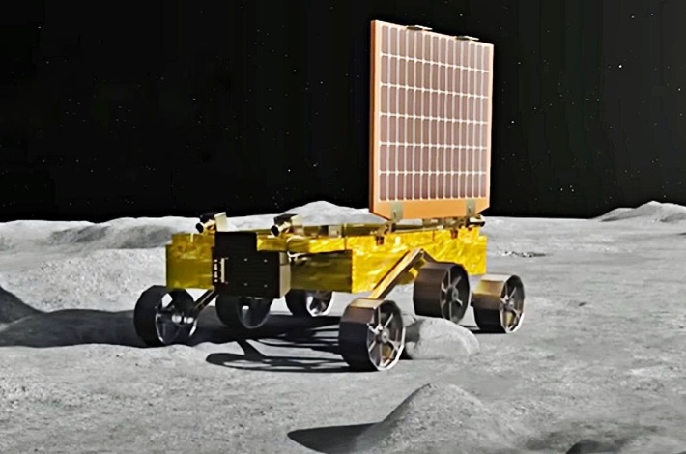
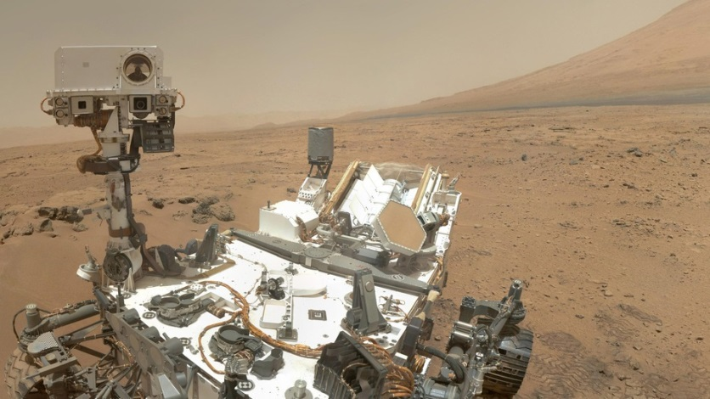
Space Rover’s
Fg.1 Pragyan Rover
Fg.2 Curiosity and Perseverance
AI Functions: AI enables autonomous navigation, helping rovers plan routes and handle tough terrain without human input.
Scientific Application: AI analyzes geology, selects rock samples, and prioritizes data for real-time big data analysis.

Slide 5
Literature Review _____________________________
Author/Year | Approach / Technology | Limitations of Current Systems
Downer, B. (2018) | AI in Mars Rovers for autonomous navigation & obstacle avoidance. | Still dependent on Earth-based control for complex decisions; not fully autonomous.
ESA (2019) | Space 4.0 → AI integrated with IoT & Big Data for satellite data processing. | Limited on-board processing power; relies heavily on ground stations.
Long, G.A. (2018) | Legal studies on AI-controlled spacecraft and autonomy in space law. | No global legal framework; accountability in AI failures unresolved.

Slide 6
Soille et al. (2019) | AI in geospatial analytics for Earth observation & climate monitoring. | Concerns about data privacy, uneven access, and bias in AI models.
NASA (2020) | AI in spacecraft fault detection, anomaly diagnosis & predictive maintenance. | Requires large high-quality datasets; unexpected failures may still occur.
OECD (2020) | Governance studies for responsible AI in critical domains including space. | Lack of universal AI policy for outer space; possible misuse by military/private actors.
JAXA (2022) | AI-based astronaut physiological & psychological health monitorin | Experimental stage; less accurate under radiation and isolation stress.
ECSS (2023) | On-board AI for satellite autonomy (collision avoidance, orbit adjustment). | Limited energy/resources on satellites; high risk if AI malfunctions.

Slide 7
Methodology / Working Principle
Data Collection
Rovers, satellites, and sensors collect raw data from space missions.
AI Integration
Machine Learning & Computer Vision process data in real time.
Predictive models detect potential spacecraft issues in advance.
Autonomous Operations
AI enables rovers and spacecraft to make independent decisions without waiting for Earth-based commands.
Data Transmission & Prioritization
AI filters and prioritizes critical data for faster transmission back to mission control.

Slide 8
Applications
Autonomous Rovers:
Example: Curiosity, Perseverance, and Pragyan navigate and conduct experiments without direct human control.
Space Debris Management:
AI predicts collisions and manages satellite orbits to avoid damage.
Astronaut Health Monitoring:
Continuous tracking of astronauts' health for long missions.
Earth Monitoring:
AI processes data for climate studies, disaster prediction, and urban planning.
Swarm Satellites:
Coordinated small satellites for global communication and Earth observation.

Slide 9
Advantages & Limitations
Advantages | Limitations
Real-time decision-making without delays. | High initial development costs.
Increased mission safety and reliability. | Vulnerability to cybersecurity threats.
Efficient big data analysis and prioritization. | Legal and ethical challenges with autonomous decision-making.
Reduced operational costs through automation. | AI system failures can jeopardize missions.

Slide 10
Future Scope
Self-repairing spacecraft for autonomous maintenance and repair.
AI-driven lunar and Martian colonies for sustainable human presence.
Autonomous asteroid mining for resource extraction.
AI-based planetary defense systems against asteroid impacts.
Space traffic management for mega-constellations and debris control.
Fully autonomous interplanetary missions.

Slide 11
Conclusion
AI has become a crucial technology for space exploration.
Major Benefits:
Manages large amounts of data well.
Helps spacecraft navigate on their own in new places.
Predicts when equipment might fail and finds problems early.
Helps keep astronauts healthy and safe.
Future Directions:
Spacecraft that can fix themselves with AI.
AI to help with building colonies on the Moon, Mars, and beyond.
Using large groups of small AI satellites to monitor the entire planet.
AI to help protect against asteroids and with mining operations.
AI will be a partner for humanity as we journey into space.

Slide 12
References
Research Papers / Journal Articles
[George Anthony Gal] (2025) “Artificial Intelligence in Space”
[Downer, B] (2018) “The Role of AI in Space Exploration”
[Soille, P] (2019) “Big Data from Space (BiDS’2019)”
[DeepMind] (2021) “AI in Astronomy Research”
[JAXA] (2022) “Astronaut Health and Safety AI Applications”
Websites / Online Reports
European Space Agency (2019). What is Space 4.0? Available at: https://www.esa.int/Enabling_Support/Preparing_for_the_Future/Discovery_and_Preparation/Artificial_intelligence_in_space
NASA (2020). AI Applications in Space Exploration. Available at: https://www.nasa.gov/artificial-intelligence

