Slide 1


Guru Gobind Singh College of Engineering & Research Centre, Nashik
Department of Computer Engineering
Academic Year 2025-26
Technical Seminar Review-1
On
The Role of AI in Game Development and Player Experience
By
TE-CO- 132
Guided by:-
Mrs. Pradnay Shirsath
Friday, 29/08/2025

Slide 2
Content
Introduction of topic
Motivation
Problem Statement
Literature Review
Conclusion
References

Slide 3
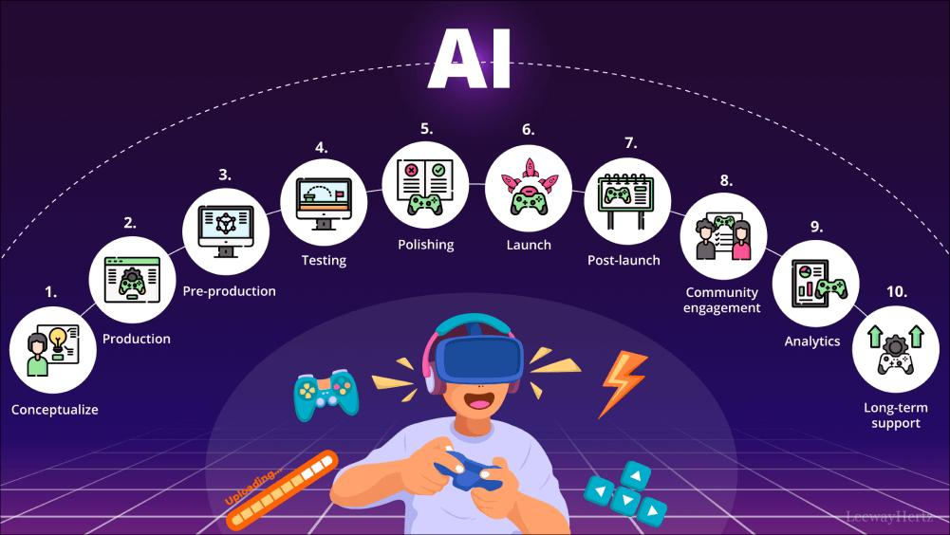
Introduction
AI now shapes gameplay beyond scripted behavior—enabling dynamic adaptation, richer narratives, and improved NPC realism.
Techniques such as procedural generation, machine learning, and generative models enhance both development workflows and player experiences.

Slide 4

Motivation
Games increasingly demand personalized experiences: adapting difficulty, context-aware storytelling, and believable NPCs enrich engagement.
AI tools reduce workload and empower creators to produce more content in less time.
Generative AI pushes creativity forward—but some developers worry it may dilute uniqueness or introduce ethical challenges.

Slide 5
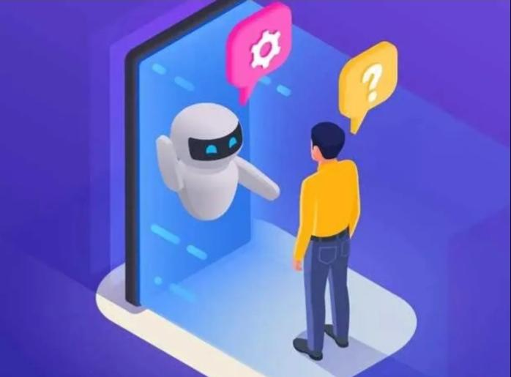
Problem Statement
Traditional NPCs and content tend to be static and predictable.
Manual design of levels, dialogue, and behavior is resource-intensive.
Challenges include algorithmic limitations, ethical concerns around AI-generated content, and preserving game “feel.”

Slide 6

Objectives
Explore AI techniques in game development: adaptive NPCs, procedural content, narrative generation.
Evaluate how these methods impact creativity, efficiency, and player immersion.
Critically assess issues like ethical implications, developer concerns, and potential limitations.

Slide 7
Literature Review
Author / Year | Focus Area | Key Contribution | Limitations / Challenges
Mehta, N. (2025) – The Role of AI in Game Development and Player Experience. | Adaptive NPCs, procedural generation, dynamic difficulty. | Demonstrates personalized gameplay (e.g., Red Dead Redemption 2) | Computational complexity, ethical concerns in balancing difficulty.
Cui, Y. (2025) – Exploring AI Applications in Game Development | Multi-agent interaction, procedural level design, optimization | Reviews AI use in content generation, level building, and development process automation | Technical challenges in real-time adaptation, unpredictability

Slide 8

Conclusion
AI plays a transformative role in enhancing interactivity, personalization, and production efficiency in games.
When thoughtfully integrated, AI enriches both player and developer experiences.
Future work should emphasize responsible integration—balancing innovation with ethics and creative integrity.

Slide 9
References
Mehta, N. (2025). The Role of AI in Game Development and Player Experience. SSRN Electronic Journal. Cui, Y. (2025).
Link: https://www.researchgate.net/publication/389358711_The_Role_of_AI_in_Game_Development_and_Player_Experience

