Slide 1


Guru Gobind Singh College of Engineering & Research Centre, Nashik
Department of Computer Engineering
Academic Year 2025-26
Technical Seminar Review-1
On
Use of Artificial Intelligence in Space
By
TE-CO- 132
Guided by:-
Prof. Pradnya Shirsath
Monday,03/09/2025

Slide 2
Content
Introduction of topic
Motivation
Problem Statement
Literature Review
Conclusion
References

Slide 3
Introduction
Background of the topic: AI and ML are driving automation in space missions and satellite systems.
Why this seminar is chosen?: The nature of the space and satellite industry is a quintessential use-case for AI, with applications in virtually all space activities.
Relevance to computer engineering / industry: Links to computer engineering via robotics, big data, and intelligent systems.

Slide 4
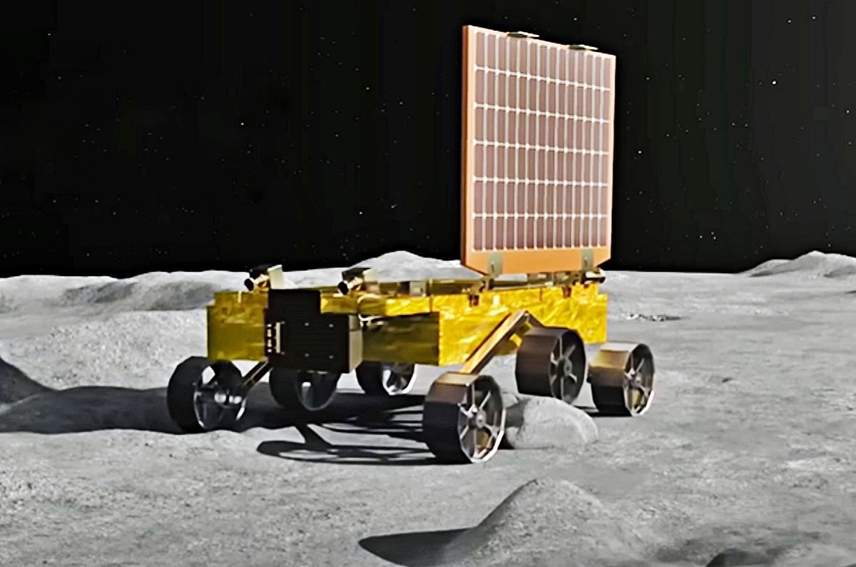
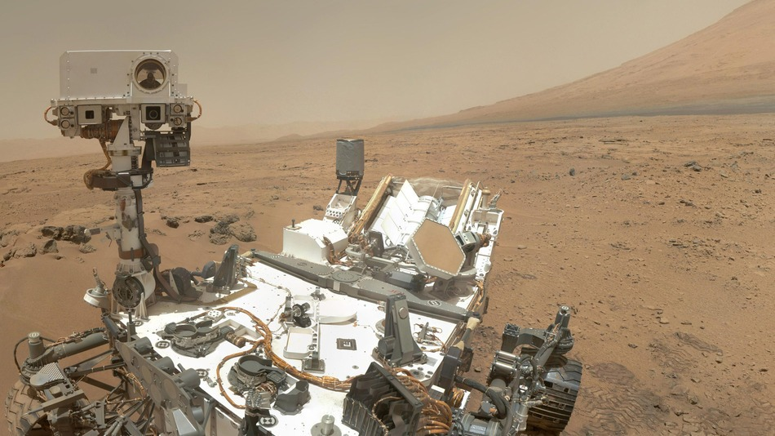
Space Rover’s
Fg.1 Pragyan Rover
Fg.2 Curiosity and Perseverance
AI Functions: AI enables autonomous navigation, helping rovers plan routes and handle tough terrain without human input.
Scientific Application: AI analyzes geology, selects rock samples, and prioritizes data for real-time big data analysis.

Slide 5
Motivation
Growing complexity of space missions → traditional ground-based control is insufficient.
Communication delays with deep space (e.g., Mars-Earth: up to 24 minutes one way).
Massive data from satellites, telescopes, and sensors require intelligent processing.
Emergence of New Space Economy: privatization, small satellites, mega-constellations.
AI promises:
Cost reduction.
Safer autonomous operations.
Faster scientific discoveries.
Strengthening space-based services for Earth (climate monitoring, smart cities, disaster management).

Slide 6
Problem Statement
Human-led decision-making in space operations is often slow, error-prone, and resource-intensive.
Key challenges include real-time anomaly detection in spacecraft systems, autonomous navigation in harsh planetary terrains, and collision avoidance with space debris or natural threats like asteroids and dust.
Space missions also face data overload from high-resolution satellites and IoT devices, alongside legal and ethical issues such as privacy concerns in Earth observation and liability for AI-driven satellites. These challenges highlight the core problem: the urgent need for trustworthy AI systems that can operate autonomously and reliably in outer space.

Slide 7
Objectives
To develop AI systems for autonomous navigation and spacecraft control.
To apply AI for real-time satellite data analysis in weather, Earth monitoring, and astronomy.
To use AI for health monitoring of astronauts during long missions.
To implement AI for predictive maintenance of spacecraft systems.
To integrate AI into space mission pipelines to improve efficiency and safety.

Slide 8
Literature Review _____________________________
Author/Year | Approach / Technology | Limitations of Current Systems
Downer, B. (2018) | AI in Mars Rovers for autonomous navigation & obstacle avoidance. | Still dependent on Earth-based control for complex decisions; not fully autonomous.
ESA (2019) | Space 4.0 → AI integrated with IoT & Big Data for satellite data processing. | Limited on-board processing power; relies heavily on ground stations.
Long, G.A. (2018) | Legal studies on AI-controlled spacecraft and autonomy in space law. | No global legal framework; accountability in AI failures unresolved.

Slide 9
Soille et al. (2019) | AI in geospatial analytics for Earth observation & climate monitoring. | Concerns about data privacy, uneven access, and bias in AI models.
NASA (2020) | AI in spacecraft fault detection, anomaly diagnosis & predictive maintenance. | Requires large high-quality datasets; unexpected failures may still occur.
OECD (2020) | Governance studies for responsible AI in critical domains including space. | Lack of universal AI policy for outer space; possible misuse by military/private actors.
JAXA (2022) | AI-based astronaut physiological & psychological health monitorin | Experimental stage; less accurate under radiation and isolation stress.
ECSS (2023) | On-board AI for satellite autonomy (collision avoidance, orbit adjustment). | Limited energy/resources on satellites; high risk if AI malfunctions.

Slide 10
Conclusion
AI has become a crucial technology for space exploration.
Major Benefits:
Manages large amounts of data well.
Helps spacecraft navigate on their own in new places.
Predicts when equipment might fail and finds problems early.
Helps keep astronauts healthy and safe.
Future Directions:
Spacecraft that can fix themselves with AI.
AI to help with building colonies on the Moon, Mars, and beyond.
Using large groups of small AI satellites to monitor the entire planet.
AI to help protect against asteroids and with mining operations.
AI will be a partner for humanity as we journey into space.

Slide 11
References
Research Papers / Journal Articles
[George Anthony Gal] (2025) “Artificial Intelligence in Space”
[Downer, B] (2018) “The Role of AI in Space Exploration”
[Soille, P] (2019) “Big Data from Space (BiDS’2019)”
[DeepMind] (2021) “AI in Astronomy Research”
[JAXA] (2022) “Astronaut Health and Safety AI Applications”
Websites / Online Reports
European Space Agency (2019). What is Space 4.0? Available at: https://www.esa.int/Enabling_Support/Preparing_for_the_Future/Discovery_and_Preparation/Artificial_intelligence_in_space
NASA (2020). AI Applications in Space Exploration. Available at: https://www.nasa.gov/artificial-intelligence

