Slide 1


Guru Gobind Singh College of Engineering & Research Centre, Nashik
Department of Computer Engineering
Academic Year 2025-26
Technical Seminar Review-2
On
Use of Artificial Intelligence in Space
By
TE-CO- 132
Guided by:-
Prof. Pradnya Shirsath
Monday,22/09/2025

Slide 2
Content
Introduction of the topic
Objective
Literature Review
Methodology / Working Principle
Applications
Advantages & Limitations
Future Scope
Conclusion
References

Slide 3
Introduction
Artificial Intelligence (AI) is transforming space exploration by enabling autonomous systems that can make decisions, process data, and operate efficiently without constant human guidance.
Problem Statement
Artificial Intelligence (AI) is transforming space exploration by enabling autonomous systems that can make decisions, process data, and operate efficiently without constant human guidance.
Motivation
AI improves mission safety, reduces costs, and accelerates scientific discoveries through automation. It also supports astronaut health monitoring and fuels innovation in the growing New Space Economy, making space exploration smarter and more sustainable.

Slide 4
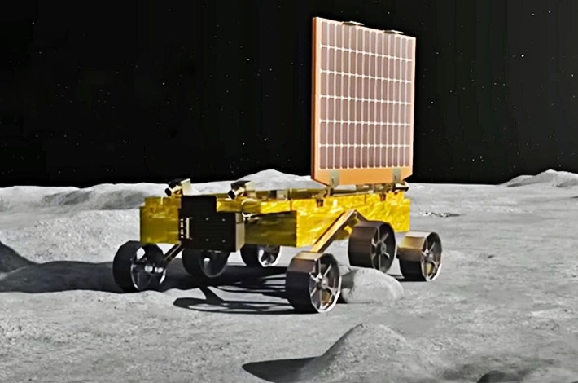
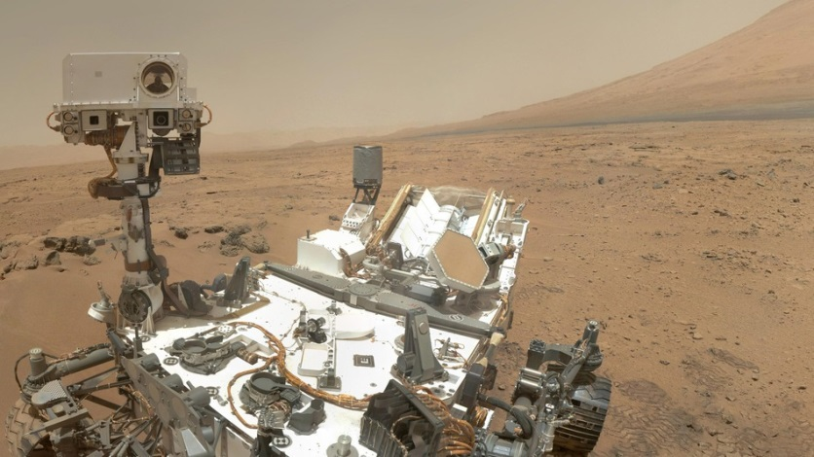
Space Rover’s
Fg.1 Pragyan Rover
Fg.2 Curiosity and Perseverance
AI Functions: AI enables autonomous navigation, helping rovers plan routes and handle tough terrain without human input.
Scientific Application: AI analyzes geology, selects rock samples, and prioritizes data for real-time big data analysis.

Slide 5
Literature Review _____________________________
Author/Year | Approach / Technology | Limitations of Current Systems
Downer, B. (2018) | AI in Mars Rovers for autonomous navigation & obstacle avoidance. | Still dependent on Earth-based control for complex decisions; not fully autonomous.
ESA (2019) | Space 4.0 → AI integrated with IoT & Big Data for satellite data processing. | Limited on-board processing power; relies heavily on ground stations.
Long, G.A. (2018) | Legal studies on AI-controlled spacecraft and autonomy in space law. | No global legal framework; accountability in AI failures unresolved.

Slide 6
Soille et al. (2019) | AI in geospatial analytics for Earth observation & climate monitoring. | Concerns about data privacy, uneven access, and bias in AI models.
NASA (2020) | AI in spacecraft fault detection, anomaly diagnosis & predictive maintenance. | Requires large high-quality datasets; unexpected failures may still occur.
OECD (2020) | Governance studies for responsible AI in critical domains including space. | Lack of universal AI policy for outer space; possible misuse by military/private actors.
JAXA (2022) | AI-based astronaut physiological & psychological health monitorin | Experimental stage; less accurate under radiation and isolation stress.
ECSS (2023) | On-board AI for satellite autonomy (collision avoidance, orbit adjustment). | Limited energy/resources on satellites; high risk if AI malfunctions.

Slide 7
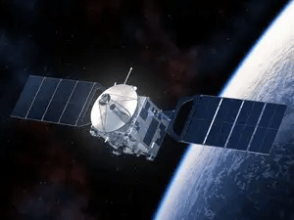
Methodology / Working Principle
Data Collection
Satellites, rovers, sensors, and telescopes collect raw data like images, terrain maps, environmental readings, and system health status.
Examples:
Planet surface images for navigation.
Space weather and asteroid movement tracking.
Astronaut health and life-support system monitoring.

Slide 8
Methodology / Working Principle
Methodology / Working Principle
2. Data Processing and Analysis using AI
The collected data is processed on-board using Machine Learning (ML) and Deep Learning (DL) algorithms.
Computer Vision helps spacecraft:
Recognize terrain patterns and avoid obstacles.
Identify points of scientific interest automatically.
Predictive algorithms analyze system performance and detect potential failures before they happen.
3. Autonomous Decision-Making
AI enables spacecraft and rovers to make independent decisions in real time without waiting for commands from Earth.
Example functions:
Deciding the safest path for rovers.
Changing satellite orbit to avoid space debris collisions.
Adjusting scientific instruments based on findings.
This is critical for deep space missions where communication delays can last up to 24 minutes.

Slide 9
Methodology / Working Principle
4. Prioritization and Data Transmission
Space missions generate huge volumes of data that cannot all be sent to Earth at once.
AI filters and prioritizes important information:
High-value scientific discoveries are transmitted first.
Less important data is stored for later analysis.
This saves bandwidth and speeds up decision-making.
5. Continuous Learning and Optimization
AI systems continuously learn from new mission data, improving their accuracy and performance over time.
Helps future missions:
Become smarter and more autonomous.
Reduce dependence on ground-based mission control.

Slide 10
Applications
Autonomous Rovers:
Example: Curiosity, Perseverance, and Pragyan navigate and conduct experiments without direct human control.
Space Debris Management:
AI predicts collisions and manages satellite orbits to avoid damage.
Astronaut Health Monitoring:
Continuous tracking of astronauts' health for long missions.
Earth Monitoring:
AI processes data for climate studies, disaster prediction, and urban planning.
Swarm Satellites:
Coordinated small satellites for global communication and Earth observation.

Slide 11
Advantages & Limitations
Advantages | Limitations
Real-time decision-making without delays. | High initial development costs.
Increased mission safety and reliability. | Vulnerability to cybersecurity threats.
Efficient big data analysis and prioritization. | Legal and ethical challenges with autonomous decision-making.
Reduced operational costs through automation. | AI system failures can jeopardize missions.

Slide 12
Future Scope
Self-repairing spacecraft for autonomous maintenance and repair.
AI-driven lunar and Martian colonies for sustainable human presence.
Autonomous asteroid mining for resource extraction.
AI-based planetary defense systems against asteroid impacts.
Space traffic management for mega-constellations and debris control.
Fully autonomous interplanetary missions.

Slide 13
Conclusion
AI has become a vital technology in space exploration, offering numerous benefits such as efficiently managing vast amounts of data, enabling spacecraft to navigate independently in unknown environments, predicting equipment failures, and ensuring the health and safety of astronauts. Looking ahead, AI has the potential to revolutionize space missions by creating self-repairing spacecraft, assisting in building colonies on the Moon, Mars, and beyond, deploying swarms of small satellites for global monitoring, and supporting asteroid defense as well as space mining operations. As humanity continues its journey into space, AI will serve as a powerful partner, driving innovation and expanding our reach into the cosmos.

Slide 14
References
Research Papers / Journal Articles
[1] George Anthony Gal (2025) “Artificial Intelligence in Space”
[2] Downer, B (2018) “The Role of AI in Space Exploration”
[3] Soille, P (2019) “Big Data from Space (BiDS’2019)”
[4] DeepMind (2021) “AI in Astronomy Research”
[5] JAXA (2022) “Astronaut Health and Safety AI Applications”
Websites / Online Reports
European Space Agency (2019). What is Space 4.0? Available at: https://www.esa.int/Enabling_Support/Preparing_for_the_Future/Discovery_and_Preparation/Artificial_intelligence_in_space
NASA (2020). AI Applications in Space Exploration. Available at: https://www.nasa.gov/artificial-intelligence

