Slide 1
Survey on Automatic number plate detection techniques

Slide 2
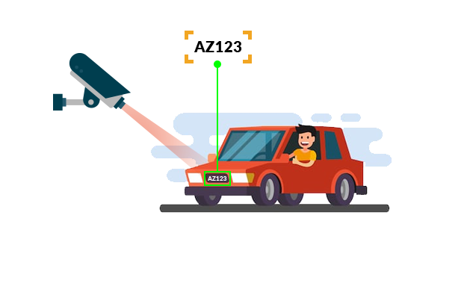
What is Automatic Number Plate Detection ?
Automatic number plate recognition is a computer vision technique that allows devices to read license number plates on vehicles quickly and automatically, without any human interaction.

Slide 3
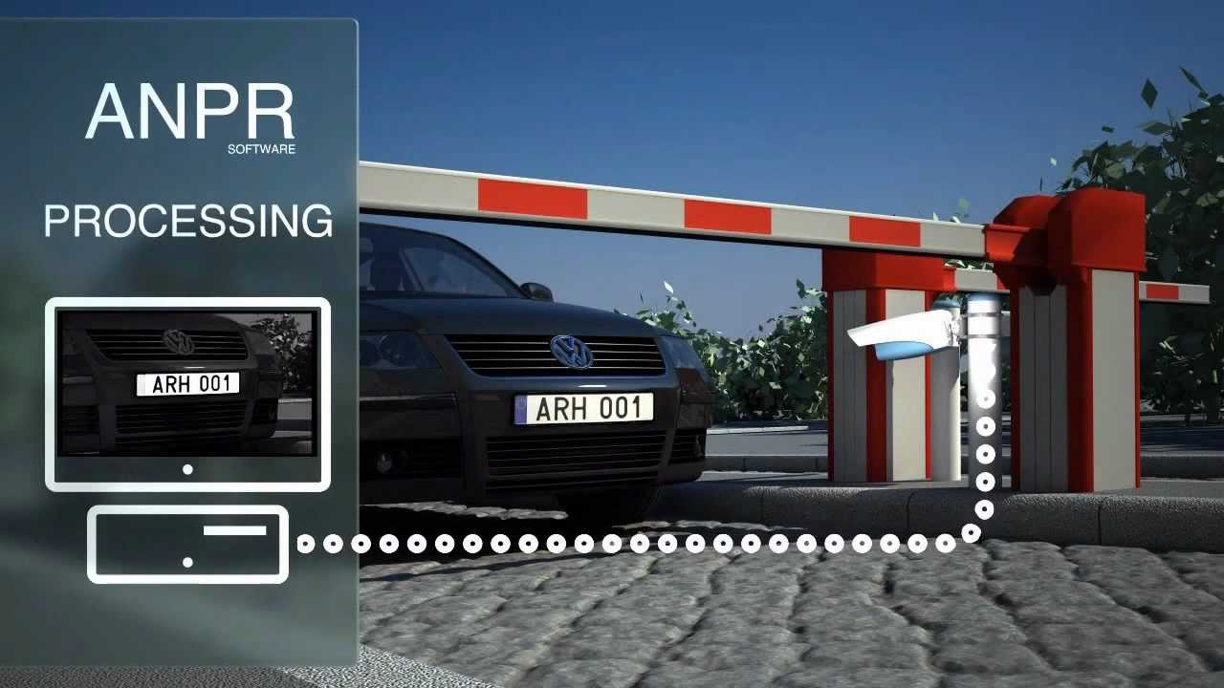
Implementation of ANPR
Law enforcement
Car parking management
Journey time analysis
Tollbooth records
Traffic management
Retail park security

Slide 4
Technique-1
Number Plate Recognition using OpenCV, Tesseract OCR and Canny Algorithm
This algorithm uses various preprocessing image techniques like grey scale converter and blurring effects to reduce noise.
Uses Canny Algorithm to detect edges in the preprocessed image of the car.
Counters and bounding boxes are approximated using openCV.
For extracting the text from the cropped image, it uses Tesseract OCR.

Slide 5
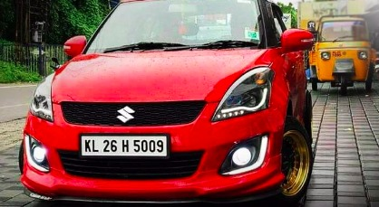
Output-1

Slide 6
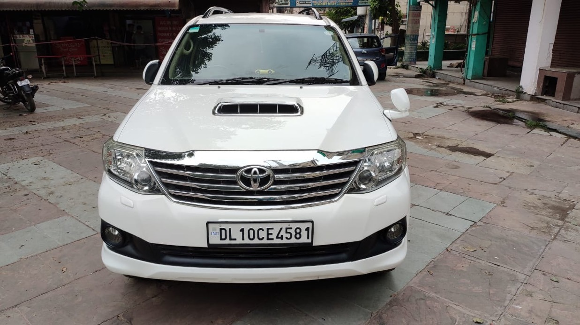
Output-2

Slide 7
Technique-2
License Plate Detection And Recognition Using OpenCv And Pytesseract
Taking an image of a car as input - The program takes in the input of the car in which the license plate is to be detected.
Processing the input - The image taken as the input undergoes processing to detect the part of the car that is the license plate.
Recognizing the number plate - The values of the detected license plate are extracted from the number plate image.

Slide 8
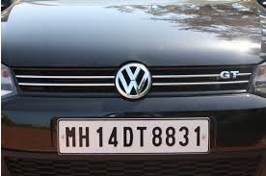
Output-1

Slide 9
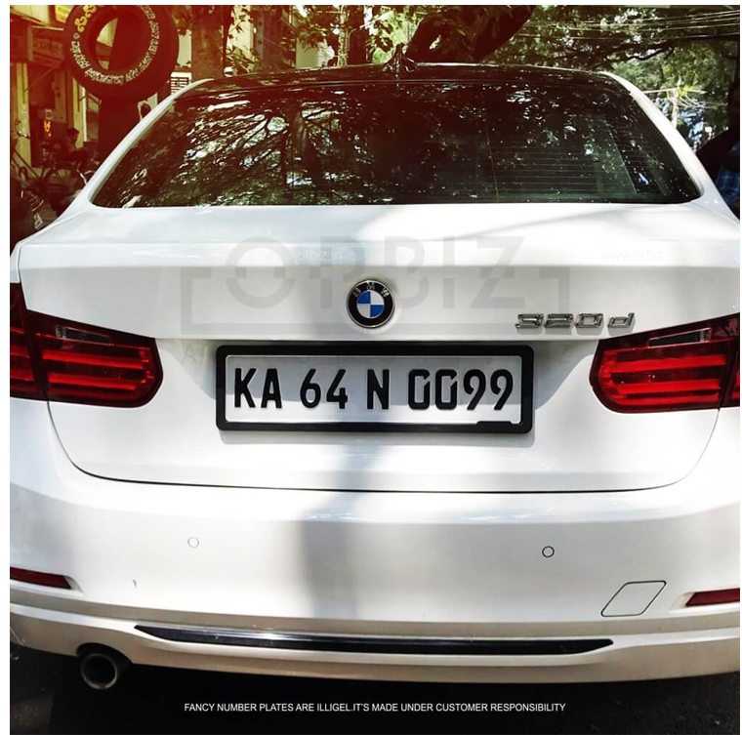
Output-2

Slide 10
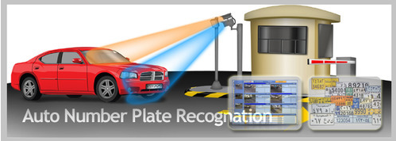
Technique-3
Automatic-Number-plate-detection-for-Indian-vehicles
In the proposed algorithm an efficient method for recognition of Indian vehicle number plates has been devised.
Able to deal with noisy, low illuminated, cross angled, non-standard font number plates.
This work employs several image processing techniques such as, morphological transformation, Gaussian smoothing, Gaussian thresholding etc.
Contours are applied by border following and contours are filtered based on character dimensions and spatial localization.

Slide 11
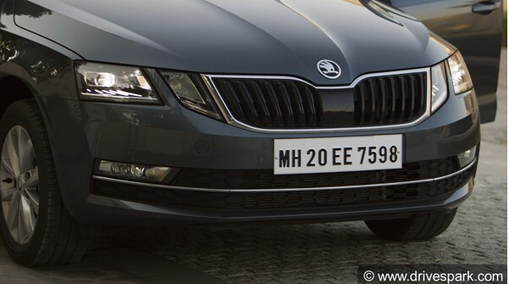
Output 1

Slide 12
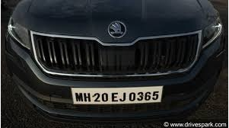
Output 2

Slide 13
Techniques
Automatic Number Plate Recognition (ANPR) system for Indian conditions (2009) : https://ieeexplore.ieee.org/document/5158763
Automatic number plate recognition system using modified stroke width transform (2013) : https://ieeexplore.ieee.org/document/6776246
Effective algorithms and methods for automatic number plate Recognition (2014) : https://ieeexplore.ieee.org/document/7035951
Automatic number plate detection for varying illumination conditions (2016) : https://ieeexplore.ieee.org/document/7754224

Slide 14
An efficient approach for automatic license plate recognition system (2017) : https://ieeexplore.ieee.org/document/8261267
Automatic number plate recognition using CNN based self synthesized feature learning (2017) : https://ieeexplore.ieee.org/document/8280759
Detection and Recognition of Multiple License Plate From Still Images
(2018) : https://ieeexplore.ieee.org/document/8821138
Automatic Number Plate Detection in Vehicles using Faster R-CNN (2020) : https://ieeexplore.ieee.org/document/9262400

Slide 15
Challenges and solution:
Dealing with bright and dark objects.
Solution: Many details present in any image become less salient when converted into grayscale.
Dealing with noisy images.
Solution: Convolved the image with a Gaussian filter in the pre-processing stage to reduce the noise present in the image.

Slide 16
Dealing with cross-angled or skewed number plates.
Solution: De-skewing, i.e. rotating the image to the required position can be done to detect the text present on the plate.
Dealing with non-standard number plates.
Solution: The implemented code won’t work if number plate is not satisfying required standards.

Slide 17
Conclusion :
The future scope is that the automatic vehicle recognition system plays a major role in detecting threats to defense.
The system robustness can be increase if bright and sharp camera is used and the accuracy of extracting the number plate for low quiet mood can be increased.
Many algorithms for the detection of the number plate and the algorithm for segmentation have been introduced in past some years.

Slide 18
Thank you
Research done by:
Harsh Joshi 2001CS28
Shantanu Tiwari 2001CS63
Under Guidance of:
Dr. Suman Kumar Maji

