Slide 1
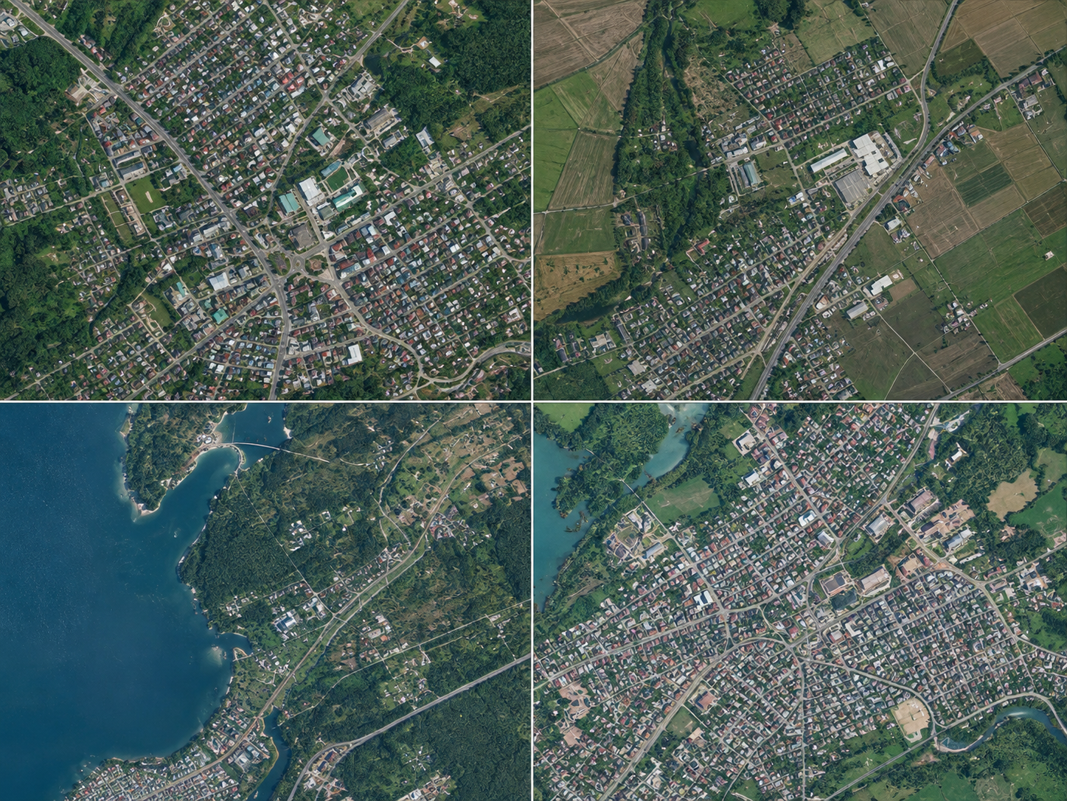
Deep Learning-Based Super-Resolution Mapping from Medium-Resolution Satellite Imagery
Enhancing Satellite Imagery for Detailed Geospatial Mapping
Shantanu Vasagadekar (1012412110)
Aniruddha Kadam (1012412113)
Shrihari Kshirsagar (1012412139)

Slide 2
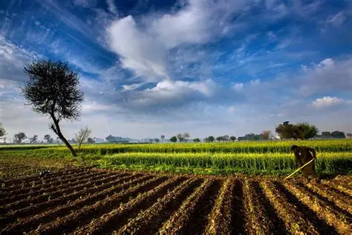
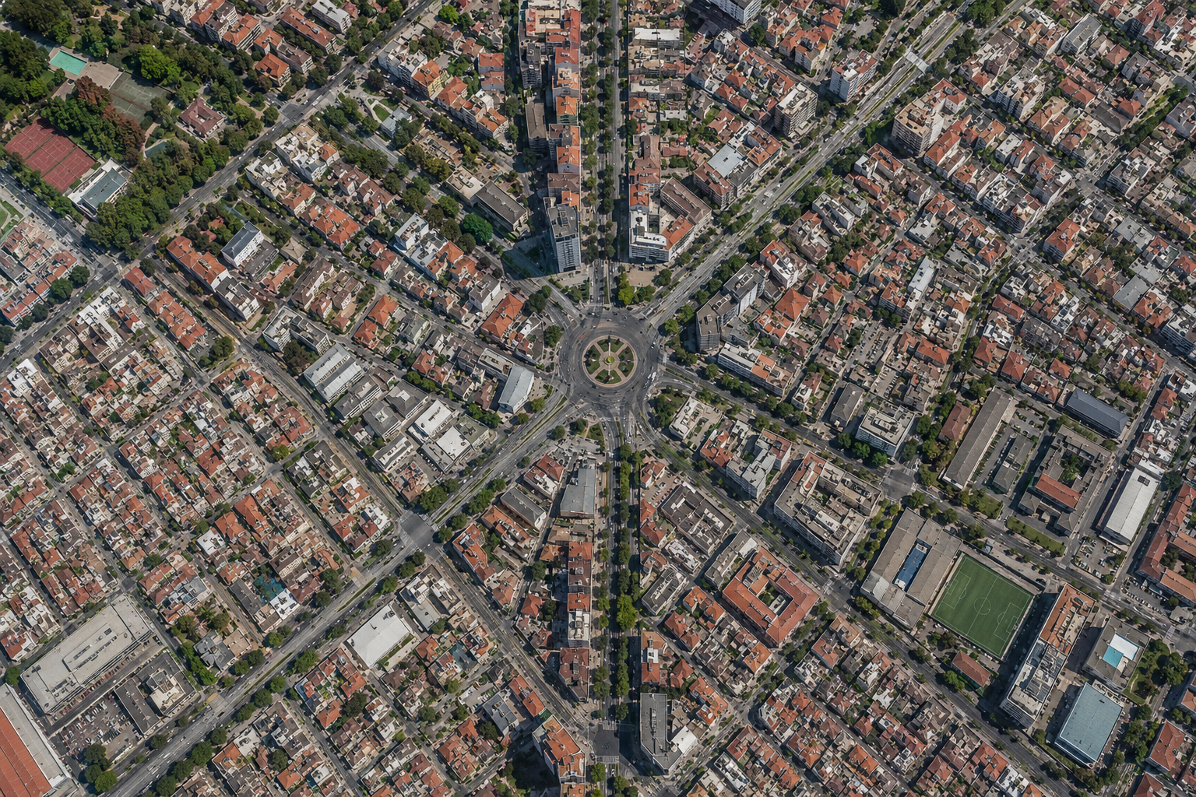
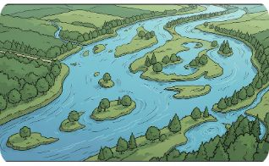
Introduction & Motivation
Agriculture
Urban Planning
Environmental Monitoring
Crop boundaries, field health monitoring, precision agriculture support.
Mapping small buildings, narrow roads, and informal structures.
Track small water bodies and fine vegetation patterns.
Problem:
Sentinel-2 imagery has a spatial resolution of 10 m for its highest-resolution bands, which limits the visibility and analysis of small-scale spatial features.
Goal:
Use deep-learning-based super-resolution to reconstruct finer spatial details from Sentinel-2 imagery, producing enhanced-resolution imagery that can support more detailed and actionable GIS analysis.

Slide 3
Problem
Objectives
Wide coverage but limited spatial detail at 10 m.
Conventional interpolation (nearest, bilinear, bicubic) enlarges pixels without learning structure.
Small objects (narrow roads, small buildings) remain unresolved.
Acquire and preprocess Sentinel-2 imagery for a selected AOI.
Construct training pairs using controlled degradation/downsampling.
Develop and train a deep-learning super-resolution model.
Generate enhanced-resolution imagery and evaluate its quality.
Assess whether super-resolution improves geographic feature extraction and segmentation.
Visualize and export the resulting GIS information.

Slide 4
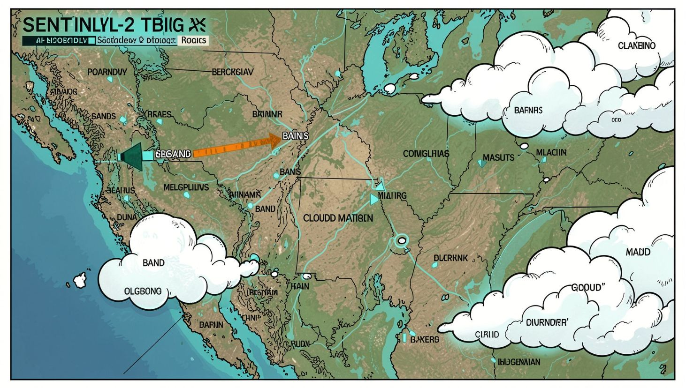
Satellite Data and Preparation
Data Source & Preparation
Sentinel-2 MSI Level-2A imagery at 10 m resolution (B2, B3, B4, B8) is collected for the selected AOI in Poland.
Images are cloud-masked, aligned, normalized, and divided into patches.
Higher-resolution reference images are downsampled to create paired training data.
These pairs train the model to learn low-resolution → high-resolution spatial enhancement.

Slide 5
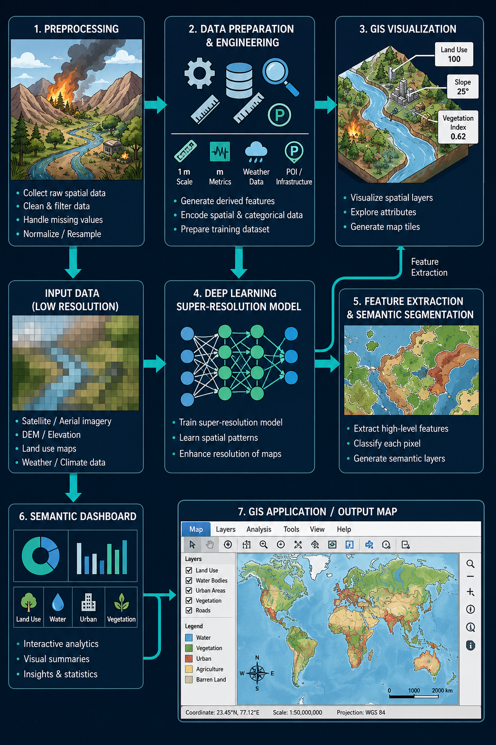
Proposed System — End-to-End Architecture
Outputs
Notes
1. Enhanced satellite image (visual & spectral fidelity) 2. Intelligent geographic map (features + attributes)
Project scope: software-only, implementable within a mini-project timeline. Emphasis on reproducible pipeline rather than novel claims.

Slide 6

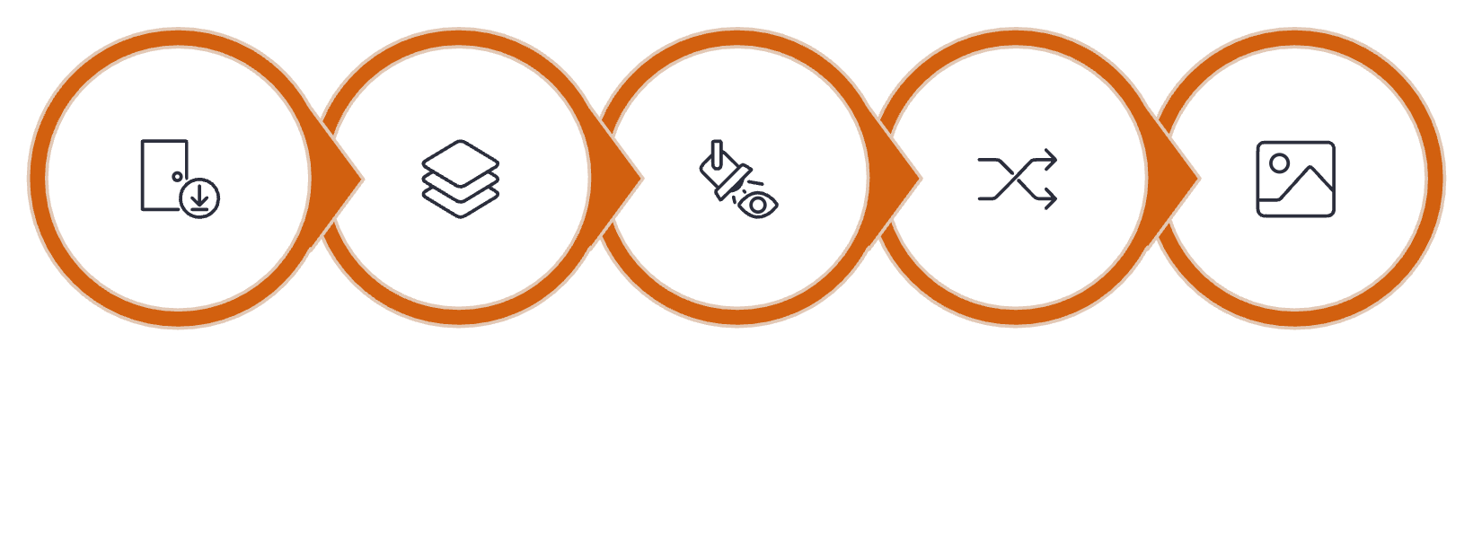


Super-Resolution Model
Core components
Feature extractor, residual/attention blocks, upsampling (pixel-shuffle), reconstruction head.
Alternative models
Feature Extraction
Residual & Attention
Reconstruction
SRCNN, EDSR, ESRGAN, SwinIR — chosen based on accuracy vs compute trade-offs.
Input
Upsampling
The model learns mappings from LR to HR using adversarial and perceptual losses; ESRGAN used as the primary example.
Design goal
Reconstruct meaningful spatial patterns (edges, small objects), not only resize pixels.

Slide 7
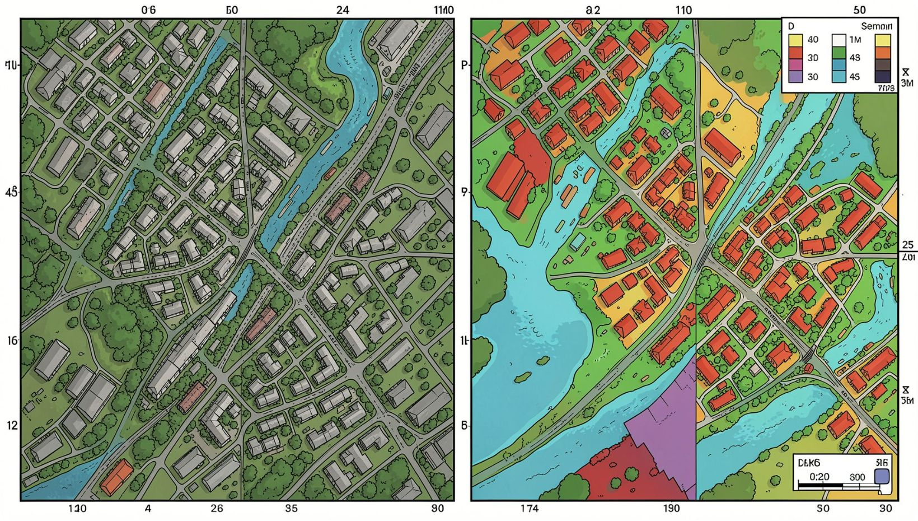
From Enhanced Image to Intelligent Map
Pipeline:
Super-resolved imagery → semantic segmentation model (U-Net / DeepLab variants).
Classify pixels into target classes: Buildings, Roads, Vegetation, Water, Bare Land.
Post-processing: morphological cleaning, vectorization, topology checks.
Example classes: 🟥 Buildings • 🟨 Roads • 🟩 Vegetation • 🟦 Water • 🟫 Bare Land

Slide 8
Evaluation Metrics & Practical Applications
Evaluation
Applications
Super-resolution: PSNR, SSIM, spectral similarity, edge-preservation metrics.
Mapping: IoU, Precision, Recall, F1-score for segmentation classes.
Uncertainty visualization: per-pixel confidence maps and error masks.
Urban planning — detect small structures and narrow roads.
Agriculture — delineate field boundaries and crop patches.
Disaster response — improve mapping of flood-affected small water channels.
Environmental monitoring — track small water bodies and fine vegetation changes.

Slide 9
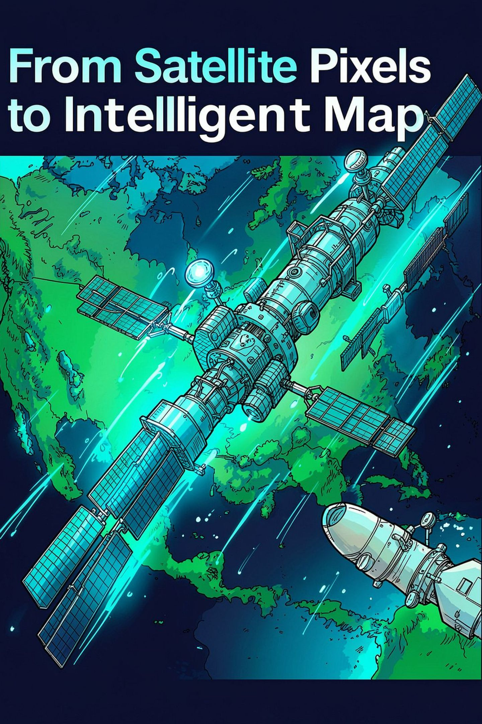
Conclusion & Future Scope
Conclusion
Future Scope
Combines Sentinel-2 inputs, deep-learning super-resolution, semantic segmentation and GIS visualization to transform medium-resolution imagery into usable geospatial maps.
Transformer-based SR, diffusion models, multispectral SR, SAR-optical fusion, automated change detection, crop monitoring, scalable cloud deployment.
Thank you — Questions?

