Slide 1


Late Purushottam Hari (Ganesh) Patil Shikshan Sanstha’s
Mauli Group of Institution’s
College of Engineering and Technology Shegaon.
Project Name:
Machine Learning Preprocessing CLI
Submitted By :
Shiva D. Mehenge
Abhijit S. Borchate
Rutuja R. Gire
Avirat R. Deshmukh
Shantanu M. Ghate
Guided By : Prof. R. S. Shinde
Department of Computer Science and Engineering
Session:2023-24

Slide 2
CONTENTS
Introduction
Literature Review
Technologies
Architecture of CLI
Application
Techniques for CLI
Advantages
Conclusion
References

Slide 3
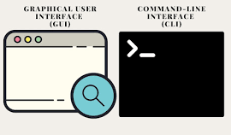
INTRODUCTION
The "Machine Learning Preprocessing CLI" project aims to provide a command-line interface for efficient data preprocessing in machine learning tasks.
Preprocessing is a critical step in preparing raw data for model training, and automating this process through a command-line interface enhances workflow efficiency.
The CLI made to preprocess the database and save your time.

Slide 4
LITERATURE REVIEW
Author | Title of Paper | Remark
Brownlee, J. (2019). | “Feature Engineering for Machine Learning: A Comprehensive Overview” | Highlights diverse applications of web scraping.
Pedregosa, F., et al. (2011). | “Scikit-learn: Machine Learning in Python” | Provides an overview of popular tools and techniques.
Little, R. J., & Rubin, D. B. (2002). | “Statistical Analysis with Missing Data.” | Extraction of valuable data from the web for analysis and insights.

Slide 5
TECHNOLOGIES
Hardware : Computer System
Software : Windows 10
IDE: PyCharm or Visual Studio
Libraries: Pandas, NumPy & Scikit-Learn

Slide 6
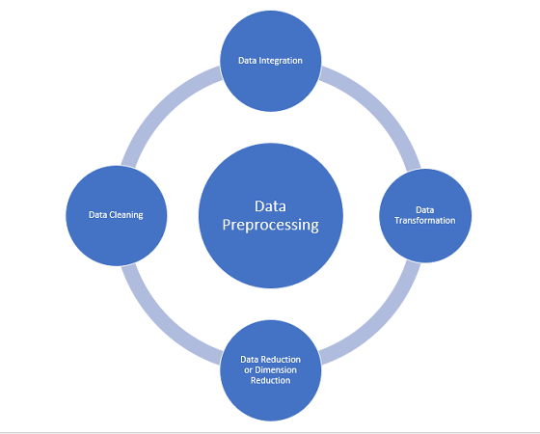
ARCHITECTURE OF PREPROCESSING

Slide 7
TECHNIQUES OF CLI
Handling Missing Values
Data Description
Standardization
Feature Scaling

Slide 8
ADVANTAGES
User friendly Interface
Flexible
Time Efficiency
Scalability

Slide 9
CONCLUSION
The "Machine Learning Preprocessing CLI" project simplifies and accelerates the data preprocessing phase in machine learning projects. By providing a user-friendly command-line interface, it facilitates consistency, reproducibility, and time efficiency in the preprocessing pipeline, contributing to the overall success of machine learning endeavors.

Slide 10
References
[1] Brownlee, J. "Feature Engineering for Machine Learning: A Comprehensive Overview” (2019).
[2] Pedregosa, F., et al. "Scikit-learn: Machine Learning in Python." Journal of Machine Learning Research, 12, 2825-2830 (2011).
[3] Little, R. J., & Rubin, D. B. "Statistical Analysis with Missing Data" (2nd ed.). John Wiley & Sons (2002).

Slide 11
THANK YOU !!!!

