Slide 1
Logistics Optimization for Delivery Routes – FedEx
Name : Shantanu Dipak Manohar
Course : Data Science
Batch : 14 Feb
Project : FedEx SQL Project
Video Link : https://www.loom.com/share/14baacfa261c455baccc6a86de76c227

Slide 2
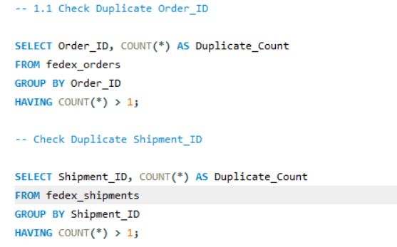
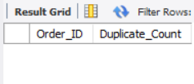
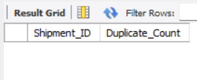
Identify and delete duplicate Order_ID or Shipment_ID records.

Slide 3
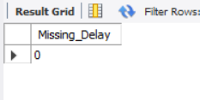
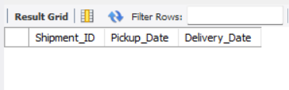
Replace null or missing Delay_Hours values in the Shipments Table with the average delay for that Route_ID.
Ensure that no Delivery_Date occurs before Pickup_Date (flag such records).

Slide 4
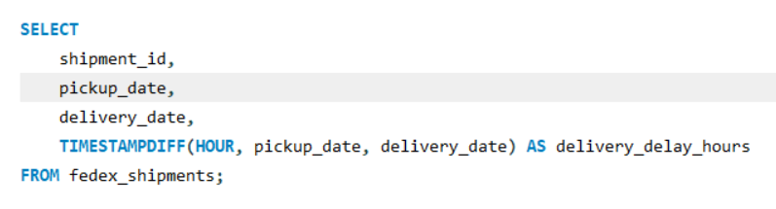
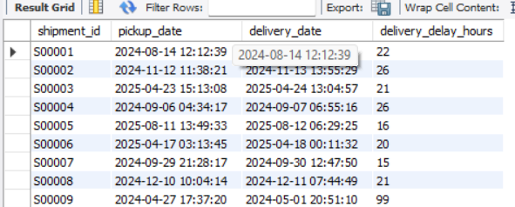
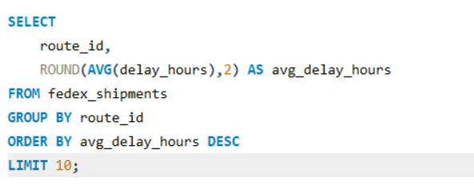
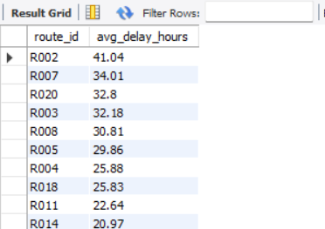
Calculate delivery delay (in hours) for each shipment using Delivery_Date – Pickup_Date.
Find the Top 10 delayed routes based on average delay hours

Slide 6
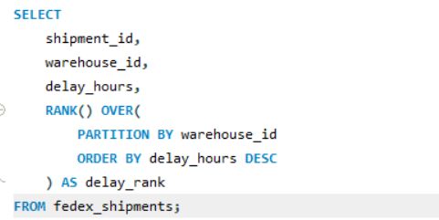
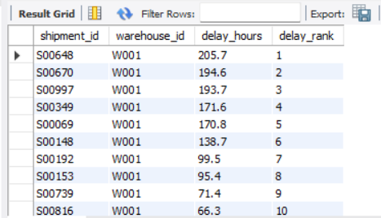
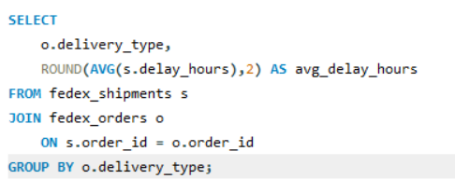
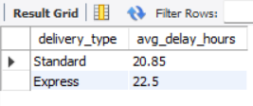
Use SQL window functions to rank shipments by delay within each Warehouse_ID.
Identify the average delay per Delivery_Type (Express / Standard) to compare service-level efficiency.

Slide 8
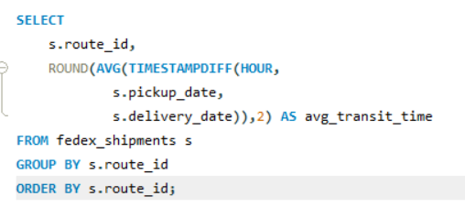
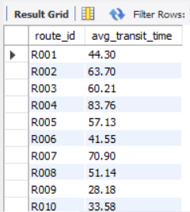
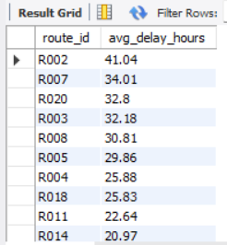
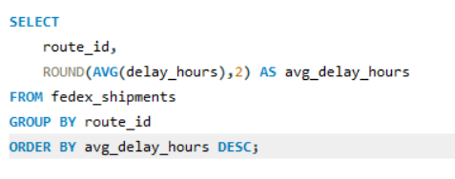
Average transit time (in hours) across all shipments.
Average delay (in hours) per route

Slide 10
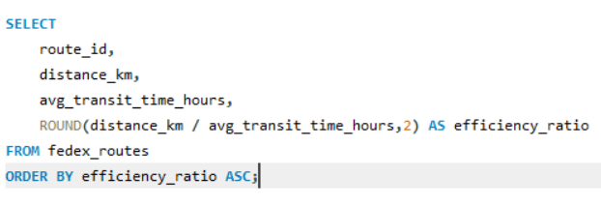
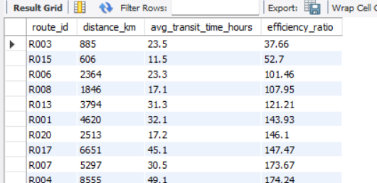
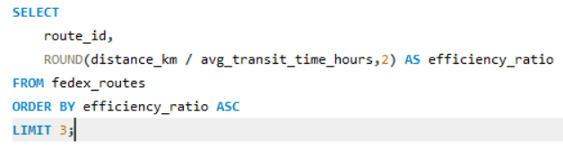
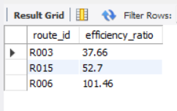
Distance-to-time efficiency ratio = Distance_KM / Avg_Transit_Time_Hours.
Identify 3 routes with the worst efficiency ratio (lowest distance-to-time).

Slide 12
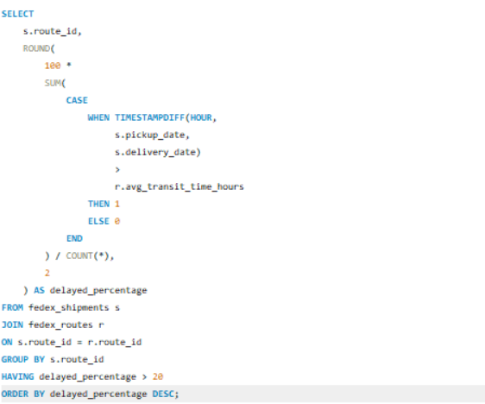
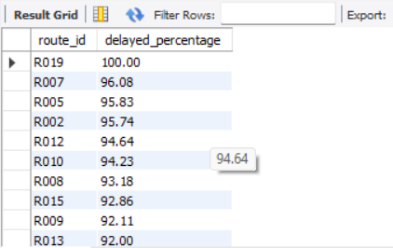
Find routes with >20% of shipments delayed beyond expected transit time.
Recommend potential routes or hub pairs for optimization.
Route Optimization Recommendations
Focus on R002, R007, and R020, as they have the highest average delivery delays.
Improve R003, R015, and R006, which show the lowest route efficiency ratios.
Optimize hub-to-hub transfers and reduce unnecessary transit points.
Implement predictive delay monitoring using historical shipment data.
Increase capacity and staffing during peak shipping periods.
Streamline customs and documentation processes for international routes.

Slide 14
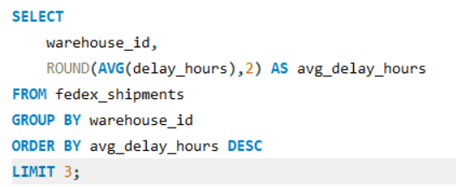
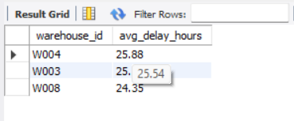
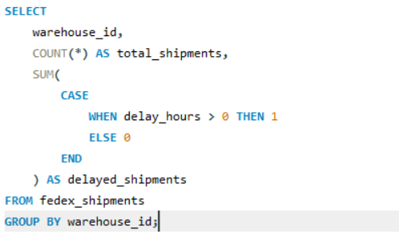
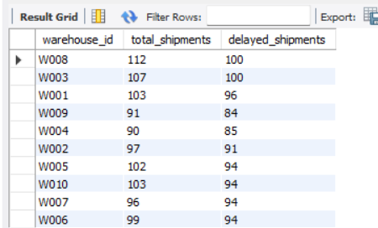
Find the top 3 warehouses with the highest average delay in shipments dispatched.
Calculate total shipments vs delayed shipments for each warehouse.

Slide 16
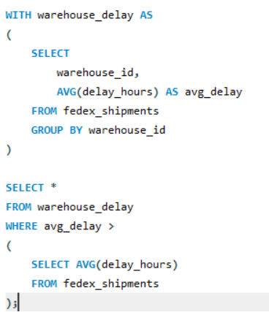
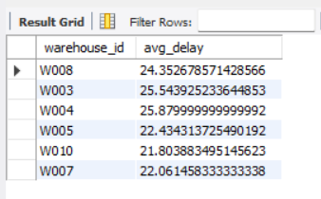
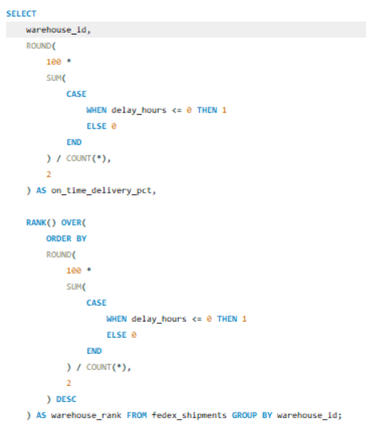
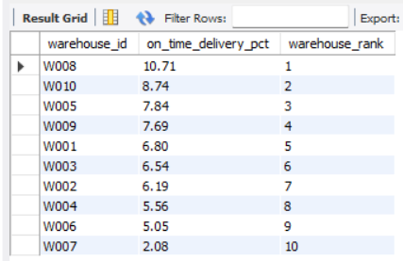
Use CTEs to identify warehouses where average delay exceeds the global average delay
Rank all warehouses based on on-time delivery percentage.

Slide 18
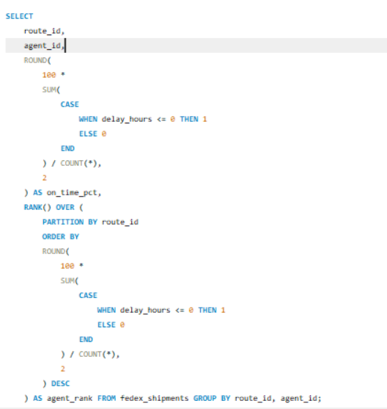
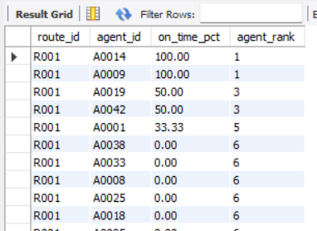
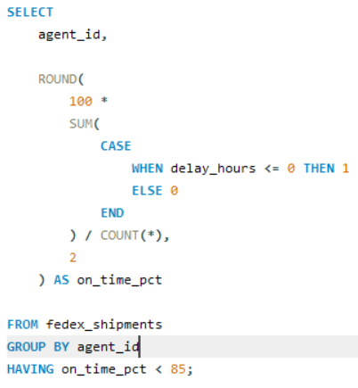
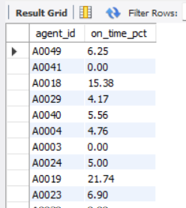
Rank delivery agents (per route) by on-time delivery percentage
Find agents whose on-time % is below 85%.

Slide 19
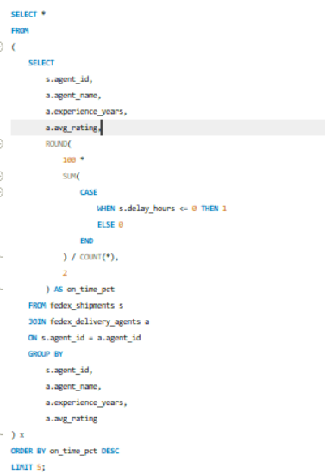
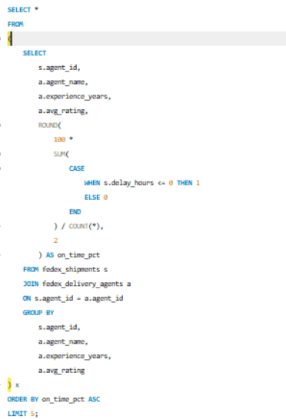
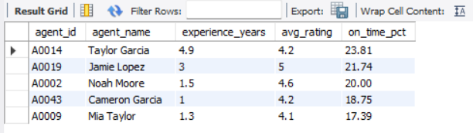
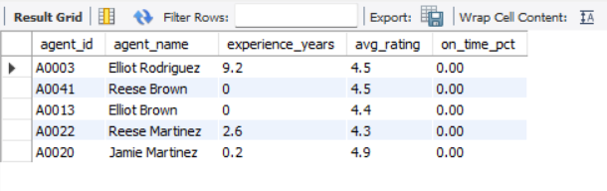
Compare the average rating and experience (in years) of the top 5 vs bottom 5 agents using subqueries.
Top 5 Agents
Bottom 5 Agents

Slide 21
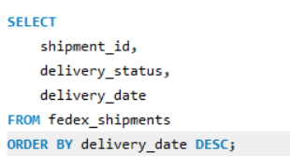
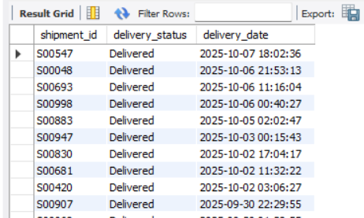
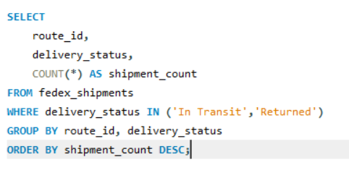
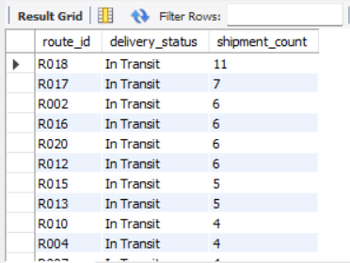
For each shipment, display the latest status (Delivered, In Transit, or Returned) along with the latest Delivery_Date.
Identify routes where the majority of shipments are still “In Transit” or “Returned”

Slide 23
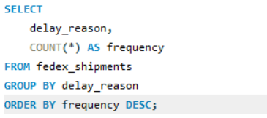
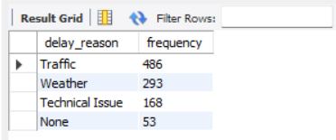
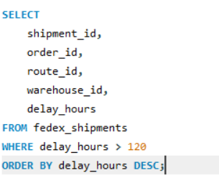
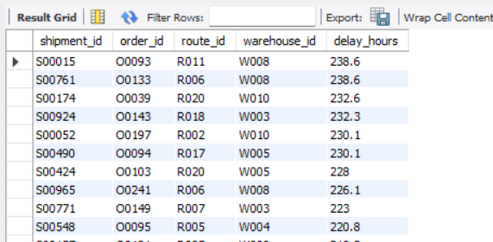
Find the most frequent delay reasons (if available in delay-related columns or flags).
Identify orders with exceptionally high delay (>120 hours) to investigate potential bottlenecks.

Slide 24
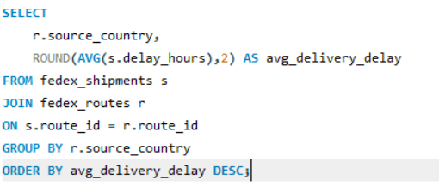
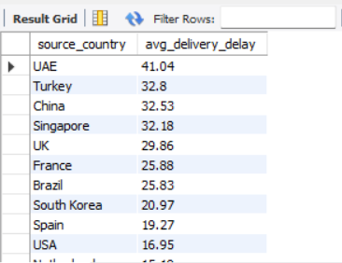
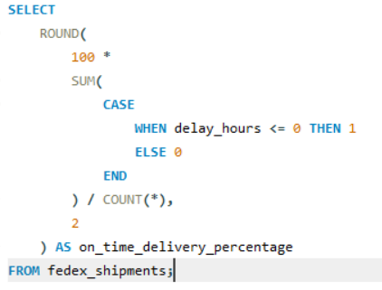

Average Delivery Delay per Source_Country.
On-Time Delivery % = (Total On-Time Deliveries / Total Deliveries) * 100.

Slide 26




Average Delay (in hours) per Route_ID.
Warehouse Utilization % = (Shipments_Handled / Capacity_per_day) * 100.

Slide 28
Final Project Conclusion
The FedEx Logistics Analytics project used SQL to analyze shipment delays, route performance, warehouse operations, and delivery agent efficiency. The analysis found that routes R002, R007, and R020 had the highest delays, while R003, R015, and R006 showed the lowest efficiency.
The study also showed that traffic, weather, and technical issues were the main reasons for delays. By improving route planning, warehouse operations, and agent performance, FedEx can reduce delays, improve delivery reliability, and increase customer satisfaction.

