Slide 1
Quiz On
SUBMITTED TO:
MR.MANOJ VARSHNEY
PRESENTED by:
SHANTANU SARASWAT
ASHISH CHAUDHARY
PALASH GOYAL

Slide 2
Problem Statement
QUIZ SYSTEM is a software developed to conduct an Online Quiz based on time constraints.
As per the current scenario, it is hard to evaluate or judge the ones performance. So it become mandatory to use internet and mobile devices to held the quiz for record the performance of students.

Slide 3
Introduction
QUIZ SYSTEM is a software developed to conduct an Online Quiz based on time constraints.
Quiz is started by displaying ten questions with four options each based on category.
If the answer is correct, score is incremented by two and no negative marks for wrong answers.
Question progress is showing how many question are left.
Final score will be displayed and updated in the database with username.

Slide 4
System Requirement
Technologies used:
Html
Css
Javascript
Tools used:
Vs studio
Chrome browser
Trivia open DB
Local strorage

Slide 5
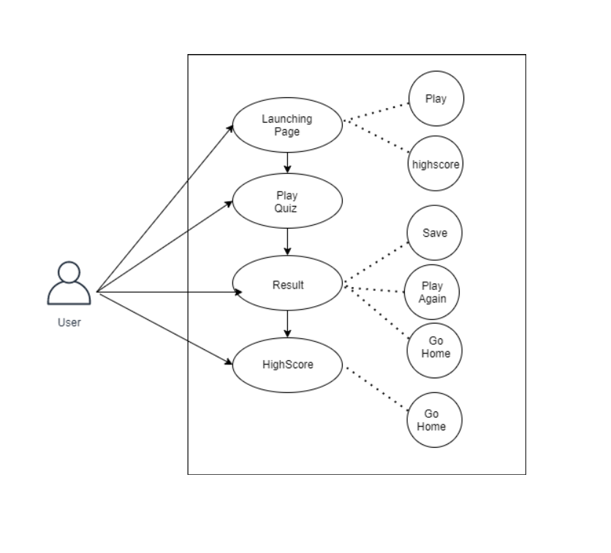
User case diagram

Slide 6
user interface

Slide 7
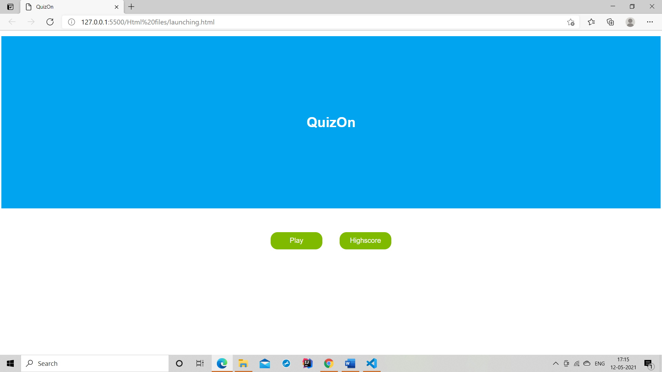
Launching page

Slide 8
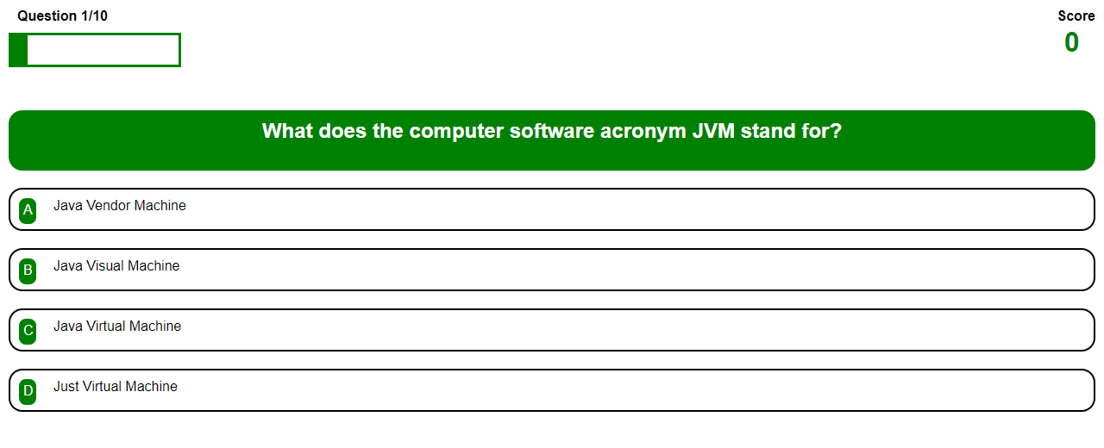
Play Page

Slide 9
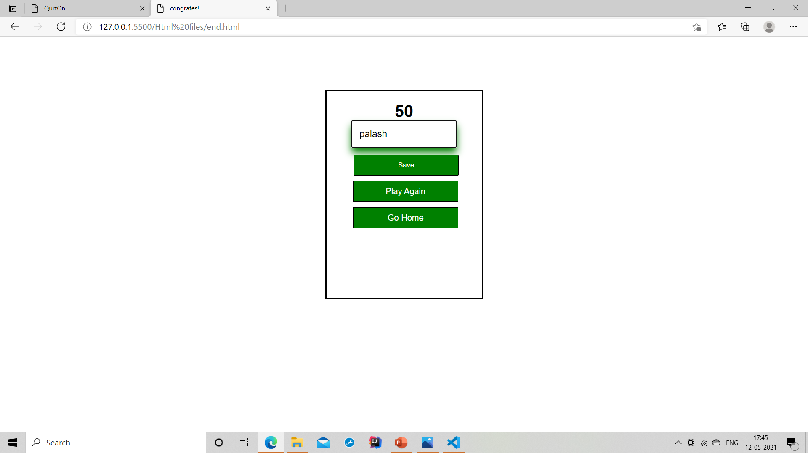
Result Page

Slide 10
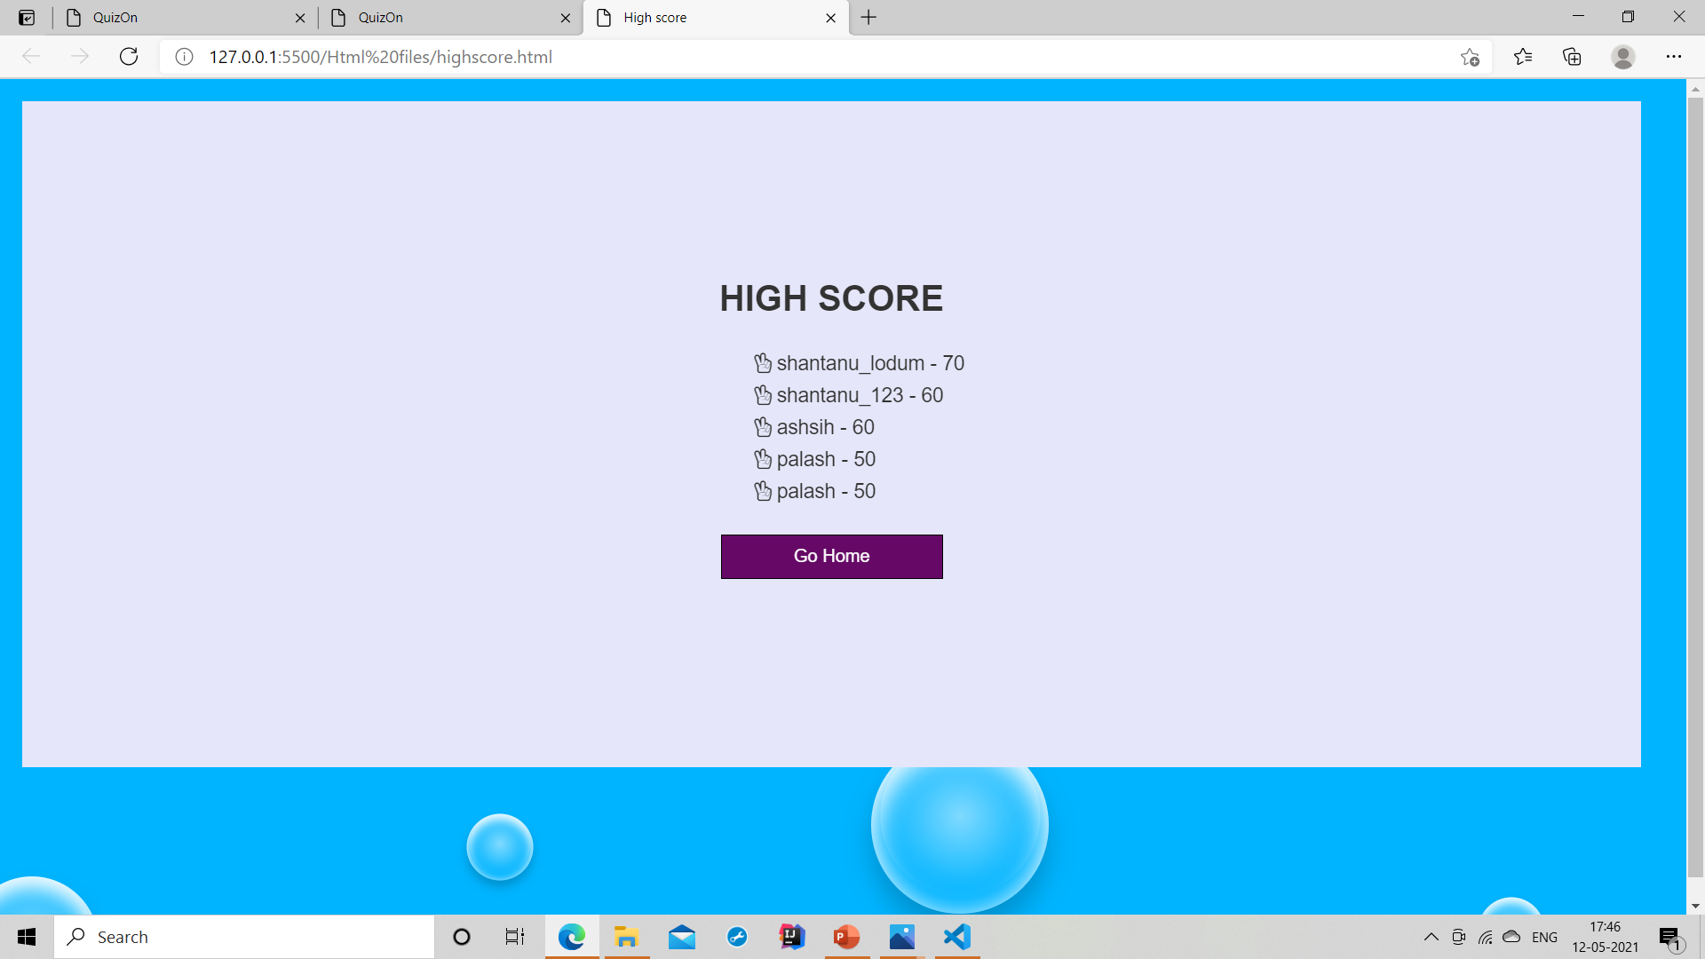
Highscore Page

Slide 11
Conclusion
After working on the ‘Quizz Up ‘ we would like to concluded that most of the work in this domain (web development ) is currently worked upon by the students. But still there are many things which are need to be addressed as which type of query should be choose as which type of query should be choose as the Application or not.so basically by doing this project we are trying to focus the attention of Computer Science and Information Technology Students in this domain as Big companies like Google, Yahoo are hiring people which has the appropriate knowledge of Front-end as well as in Back-end has contributed most of the time to this domain.

Slide 12
References
www.youtube.com
https://www.geeksforgeeks.org/
https://www.beta-labs.in/p/html.html

