Slide 1
This is : Handwritten Character recognition Mini-Project

Slide 2
Group ID: MP-18
Name of the students:
1.Shantanu Badgujar
2. Kartik Ballal
3. Soham Mirajgaonkar

Slide 3
Aim :
1
To accept an image, and with the help of image processing, perform operations to return the handwritten text and characters contained in the image in the digital format.

Slide 4
Objectives:
To apply image processing and understanding the same.
To analyze the captured image and extracting the text by recognizing it
To convert the recognized text into different digital formats like audio, translating it to different languages by integrating it with machine learning models, etc.

Slide 5
Project Idea:
The idea of this project is to develop such a tool which takes an Image as input and extract characters (alphabets, digits, symbols) from it. The Image can be of handwritten document or Printed document.

Slide 6
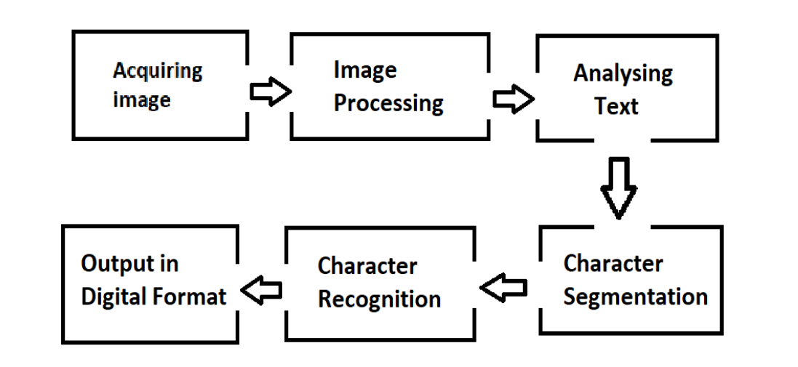
Block Diagram:

Slide 7
Expected Outcome/ Result:
We can obtain results in digital format for example a searchable pdf, audio books, datasets of license plates and we can also translate the digital output into any desired language by integrating with google translate. We can even create large datasets which are useful for training models in machine learning for the purpose of training.

Slide 8
Applications:
Automatic number plate recognition.
Extracting business card information into a contact list.
Assistive technology for visually impaired users.
Language translations.
Make electronic images of printed documents searchable.

Slide 9
References: Latest by 03 yrs
1.https://perun.pmf.uns.ac.rs/radovanovic/dmsem/completed/2006/OCR.pdf
2.https://yann.lecun.com/exdb/publis/pdf/matan-90.pdf
3.https://automatetheboringstuff.com/chapter13/

