Slide 1
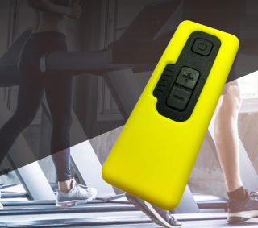
1 Channel EMS
2026, March 10

Slide 2
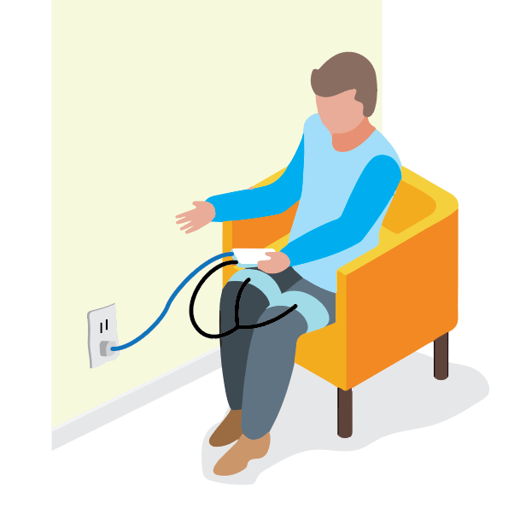
Device Overview
Handheld device (Electrodes attached to device by stereo jack)
Electrodes connected to 2 thigh belts by 4mm buttons.
Power plugin. Connect to wall socket for power (Power plug attached by USB-C)
1.
2.
3.

Slide 3
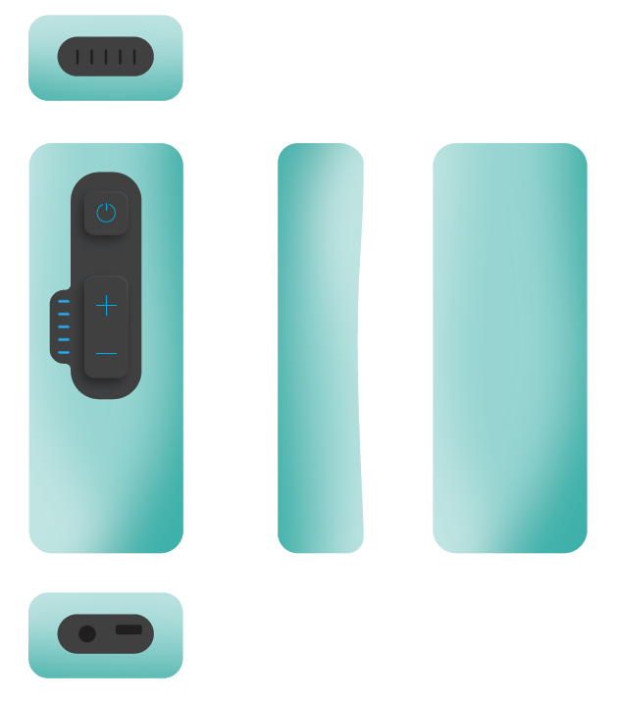
One Channel EMS Device
Device cased in a 2mm thick silicon cover.

Slide 4
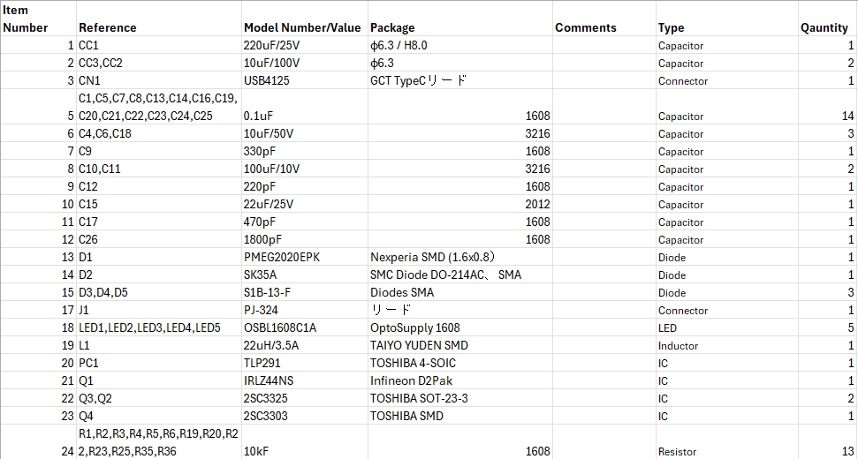
Parts List 1/2

Slide 5
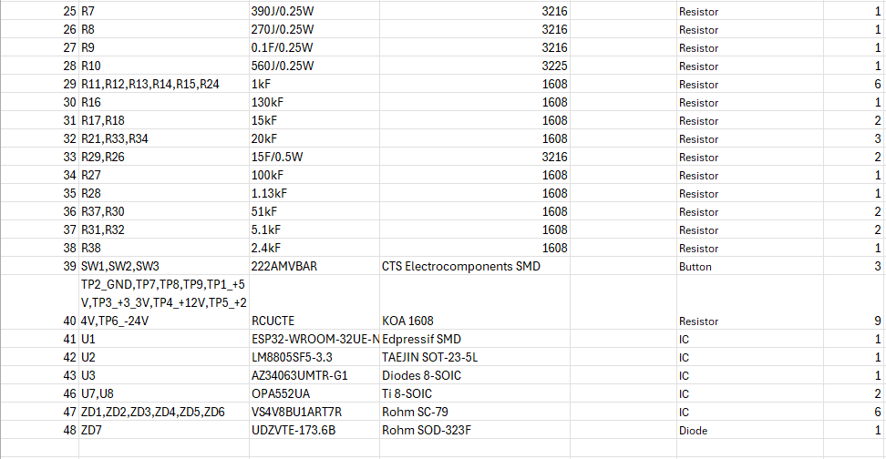
Parts List 2/2

Slide 6
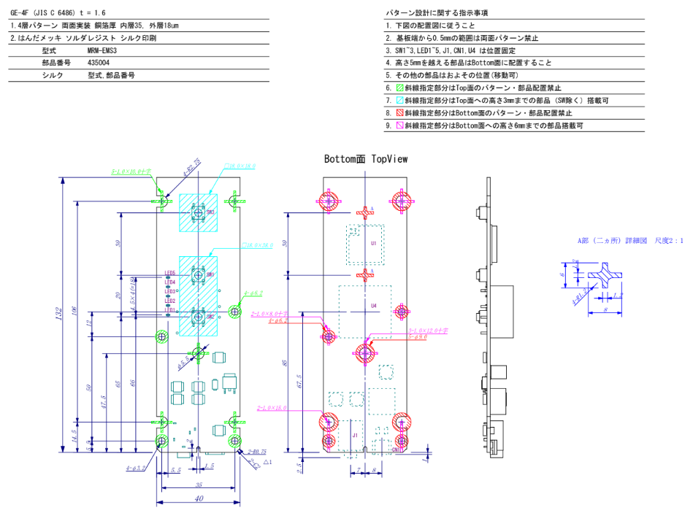
PCB Measurements

Slide 7
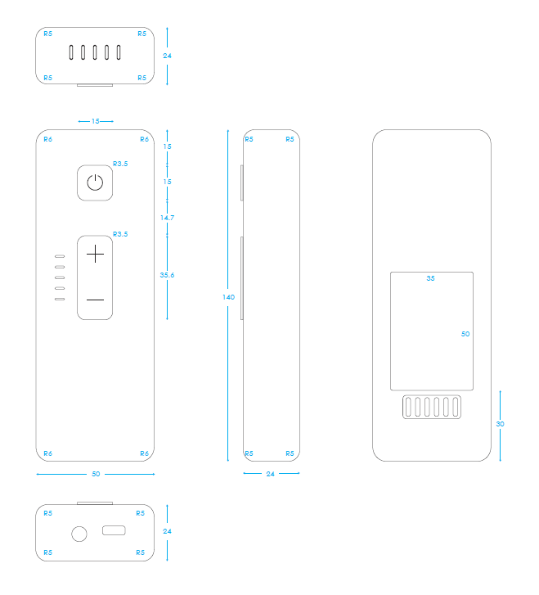
Plastic Case Measurements
This was based on the sample 3D prototype. Need to confirm the production version.

Slide 8
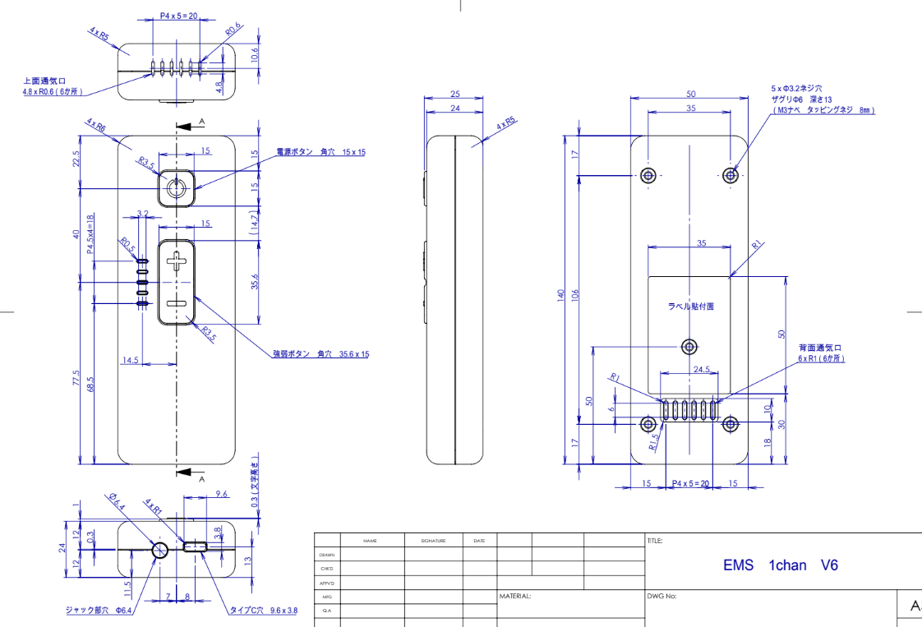
Plastic Case Measurements
This was based on the sample 3D prototype. Need to confirm the production version.

Slide 9
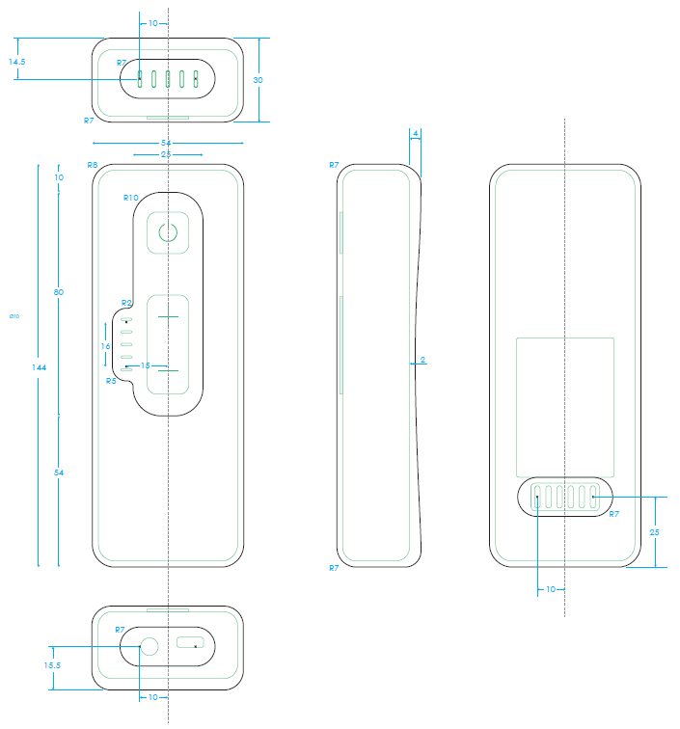
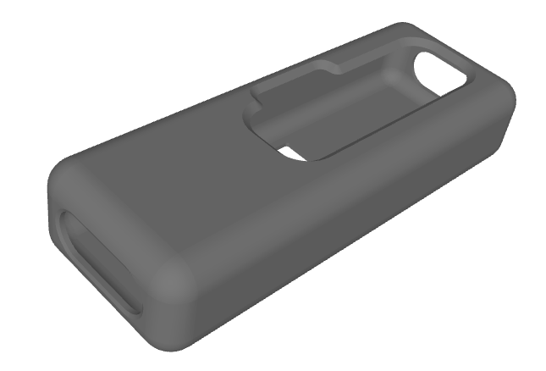
Silicon Cover Measurements
Corrections pending…

Slide 10
Button Functionality and LED Signalling

Slide 11
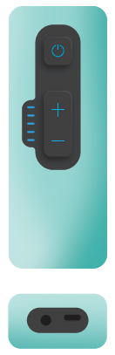
Definitions
Power Button：Power can be turned on and off
＋ Button：You can increase the power level
－ Button：You can decrease the power level
Five Mini LEDs：These LEDs light up based on the power level
USB-C power cable
Electrode

Slide 12
Turning on device, starting mode, and increasing power
Step 1: Plug in USB-C. All LEDs off.
Step 2: Plug in electrode jack. All LEDs off.
Step 3: Press (0.5 sec) power button ⏻ = Device powers on and mode starts.
Step 4: Press the ＋ button = Exercise mode starts on power level 1. Bottom LED blinks slow.
Step 5: Press the ＋ button a second time = Power level goes to level 2. Bottom LED blinks faster.
Step 6: Press the ＋ button a third time = Power level goes to level 3. Bottom LED blinks fastest.
Step 7: Press the ＋ button a fourth time = Power level goes to level 4. Bottom LED light turns solid.
Step 8: Press the ＋ button a fifth time = Power level goes to level 5. Bottom LED light is solid. 2nd to the bottom LED blinks slowest.
Step 9: Continue this pattern to max power 20.
Button and LED Functionality
Step 10: Press the - button = Decrease power
Follow the reverse pattern of steps 4 to 8.
Step 11: Press (0.5 sec) power button ⏻ = Mode stops and device powers off. LEDs blink from top LED downward.

