Slide 1

Text Analytics & Transformer
Teoh Teik Toe
ITOM/NBS
ttteoh@ntu.edu.sg
97905202

Slide 2
Recording
Classification - https://1drv.ms/v/s!Aik2a4x7tvLyi-AMfyTKjUhwyDVFcw?e=uulQ1A
Sentiment - https://1drv.ms/v/s!Aik2a4x7tvLyi-ALWp3q4603WJPjKA?e=fqcMz3

Slide 3
Agenda
Text Sentiment
Python
Transformer
Text Classification & Clustering (Embedding)
Vectorization
TFIDF
BERT
Code: https://drive.google.com/drive/folders/1fXjR7HWQVDvW4b_UwFmEM_NymlOo4Wbw?usp=sharing
Data:
https://drive.google.com/drive/folders/1DWSSkL9zMwXktar8rxC_3rUGqxwNNTrR?usp=sharing

Slide 4
Text Analytics
Text Sentiment
Python - Textblob
R – Afinn
Text Classification & Clustering
Chatbot
Transformer – Pipeline
Embedding – SKLearn (No of words in document)
Embedding – TFIDF (No of words in document)
Embedding – BERT by Google (768)
Transformer – OpenAI
Orange – FastText (300)
WebCrawler – Beautiful Soup & NLTK

Slide 5
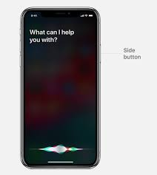

Application
Speech Recognition
Text to Speech
Generating Reports
Chatbot
Check document
Alibaba Chatbot 350m enquiries per day
Siri
Google Nest

Slide 6


Natural Language Processing Libraries
NLTK (Python)
NLP (R)
Google News Corpus
Scrapping, Tokenization, Stemming and Lemmatization, Part-Of-Speech (Structure the Unstructured), Classifier

Slide 7
Text Sentiment in Finance
1. Market Sentiment Analysis: Gauging overall market mood through financial news, social media, and analyst reports.
2. Company-Specific Sentiment: Analyzing sentiment in earnings reports, press releases, and CEO speeches to predict stock reactions.
3. Customer Sentiment and Feedback: Assessing customer satisfaction through feedback from surveys, reviews, and social media.
4. Portfolio Management: Enhancing automated trading decisions based on sentiment trends in financial news and reports.
5. Risk Management: Monitoring sentiment around geopolitical events, economic reports, and regulatory changes for risk assessment.
6. Credit Risk Assessment: Using sentiment analysis of borrower reviews and public data to complement traditional credit scoring.

Slide 8
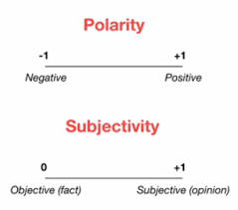
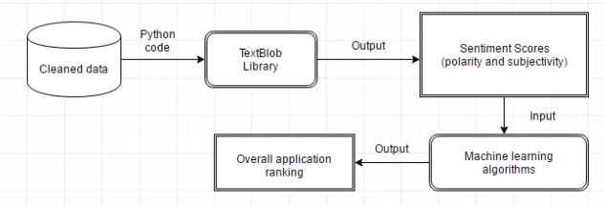
Text Sentiment by Textblob

Slide 9
Text Sentiment
https://colab.research.google.com/drive/1tKaxPCZy-1n_nZSweYLcJ5RCY8xylf4V?usp=drive_link
pip install textblob
from textblob import TextBlob
d = input("please enter the text : ")
TextBlob(d).sentiment
Alternatively
#open text file in read mode
f = open("Tesla News.txt")
#read whole file to a string
d = f.read()
import io
f = io.open("rally2004U.txt", mode="r", encoding="utf-8")

Slide 10
Front End
<html>
<body>
<h1>Text Sentiment Analysis</h1>
<form action="/" method="post">
<p>Please enter your text: </p>
<p><input type="text" name="text"></p>
<p><input type="submit" value="Enter"></p>
</form>
{{result}}
</body>
</html>

Slide 11
Back End
requirements.txt
flask
gunicorn
textblob
from textblob import TextBlob
from flask import Flask
app = Flask(__name__)
from flask import render_template,request
@app.route("/", methods=["GET", "POST"])
def index():
if request.method == "POST":
text = request.form.get("text")
print(text)
r = TextBlob(text).sentiment
return(render_template("index.html", result=r))
else:
return(render_template("index.html", result="2"))
if __name__=="__main__":
app.run()

Slide 12
Transformer – Sentiment Analysis
https://colab.research.google.com/drive/1tKaxPCZy-1n_nZSweYLcJ5RCY8xylf4V?usp=drive_link
pip install transformers
from transformers import pipeline
classifier = pipeline("sentiment-analysis")
text = input("Please input your text for sentiment analysis : ")
classifier(text)
Pipelines
The pipelines are a great and easy way to use models for inference. These pipelines are objects that abstract most of the complex code from the library, offering a simple API dedicated to several tasks, including Named Entity Recognition, Masked Language Modeling, Sentiment Analysis, Feature Extraction and Question Answering.

Slide 13
Text Classifier

Slide 14
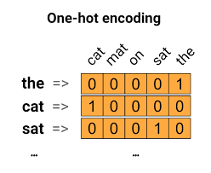
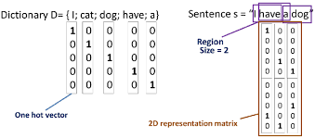
Text Embedding (Converting the unstructured data to structured data)
23 Jun 2022 — Word2Vec is trained on the Google News dataset (about 100 billion sentences). It has several use cases such as Recommendation Engines.
https://www.analyticsvidhya.com/blog/2020/03/pretrained-word-embeddings-nlp/

Slide 15
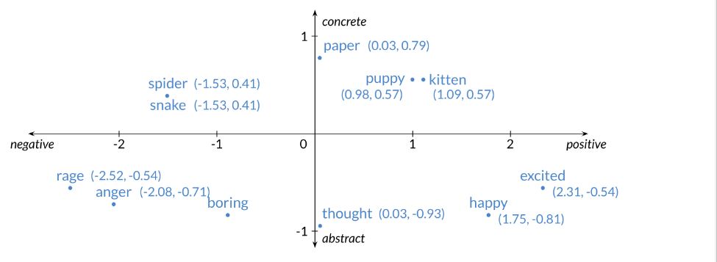

2d word embedding
ChatGPT uses a model called BERT to convert its words into numbers.
BERT is using WordPiece, which is a sub-word strategy like byte pair encoding. Its vocabulary size is 30,000.

Slide 16
Neural Network Example
2
.5
1
.3
=-1
2(0.5) + 1(0.3) + -1 = 0.3
Learning Procedure:
Randomly assign weights (between 0-1)
Present inputs from training data
Get output O, measure the difference, adjust weights
Repeat; stop when no errors, or enough epochs completed

Slide 17
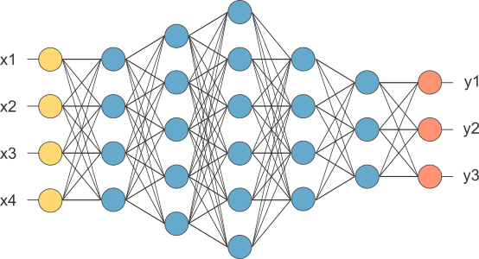
MLP
This is our fully connected network. If x_{1 .}... x_{n}, n is very large and growing,
this network would become too large. We now will input one x_{i} at a time,
and re-use the same edge weights.

Slide 18
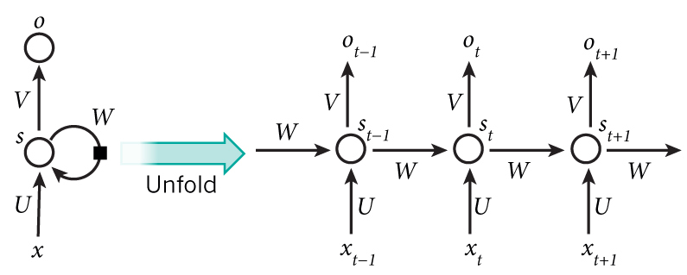
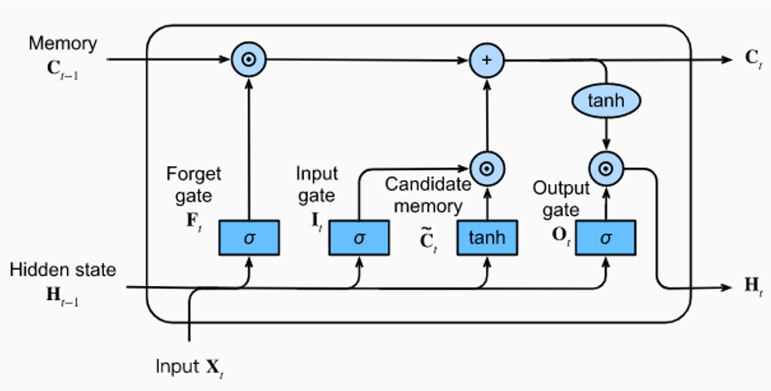
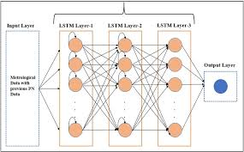
Recurrent Neural Network - LSTM

Slide 19
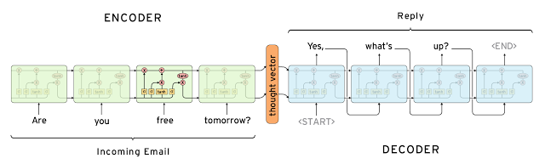
Before transformer - LSTM

Slide 20
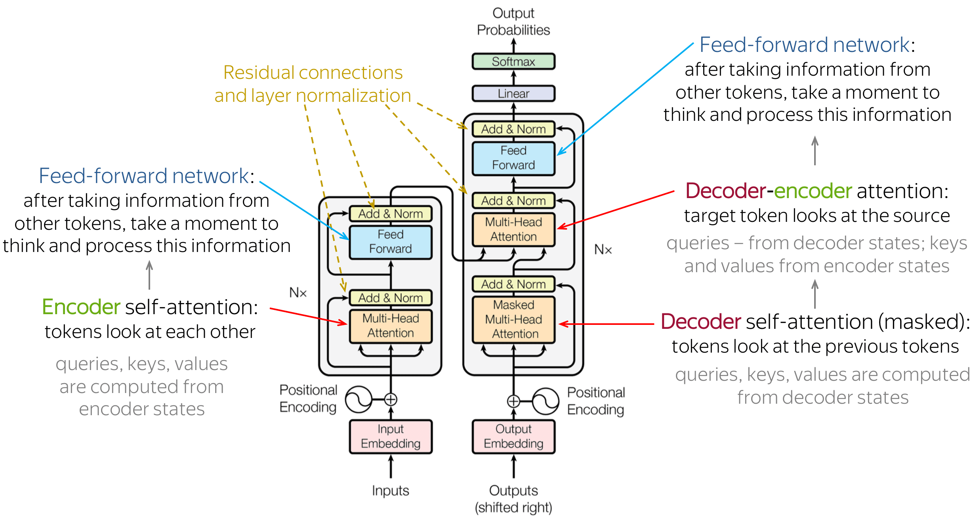
Transformer
https://youtu.be/TQQlZhbC5ps?si=oSF3pywLn5ptX6oQ

Slide 21
BERT
The BERTBase model uses 12 layers of transformers block with a hidden size of 768 and number of self-attention heads as 12 and has around 110M trainable parameters
https://web.stanford.edu/class/archive/cs/cs224n/cs224n.1194/reports/default/15843151.pdf
Bert trained on the Toronto BookCorpus^{[6]} (800M words) and English Wikipedia (2,500M words).

Slide 22
BERT and ChatGPT - Pretrain Transformer
Word – 2D word2Vec trained by 100billion words
Sentence – BERT Encoder – Trained by 3.3 billion sentences – 12 layers – 110m parameter – 768 output dimension
ChatGPT – 768 input from BERT – 92 layers 12k neurons per layer – 100 Triliion parameter – output (possibly up to 5000 words)

Slide 23
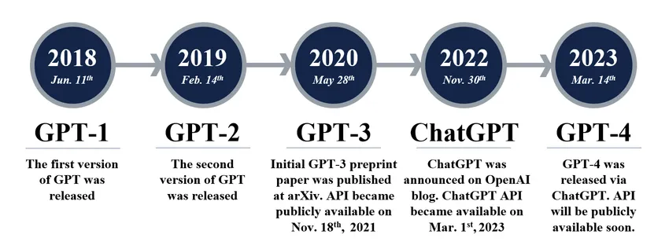
BERT (encoder for classifier) 100m -> GPT (Generative) 100trillion

Slide 24
Data – News Categories Classification
Efficient Information Retrieval: Enables investors, analysts, and traders to quickly find relevant news by category, improving response times to market events.
Enhanced Decision-Making: Categorized news helps stakeholders focus on specific areas like company updates, economic changes, or sector trends, aiding more informed decisions.
Automated Trading Systems: Properly categorized news can feed into algorithms, enabling automated systems to make more accurate and timely trades based on specific types of news.
Targeted Sentiment Analysis: Sentiment analysis can be more effective when applied to specific categories, such as company earnings or regulatory news

Slide 25
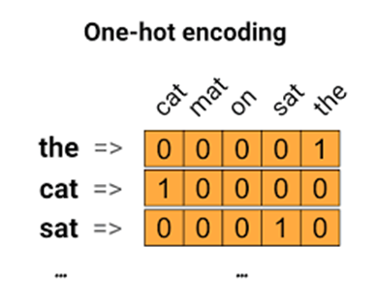
https://colab.research.google.com/drive/1SuhxD612_dZIQ2RiPhO4BSttDf3umMm7?usp=drive_link
import pandas as pd
df = pd.read_csv(r"C:\Users\Teoh Teik Teo\OneDrive - TSS Global Pte. Ltd\TT Library\AI Model\Data\News Category (Text).csv")
X=df['Sentence']
Y=df['Sentiment’]
from sklearn.feature_extraction.text import CountVectorizer
X_CV = CountVectorizer().fit_transform(X)
from sklearn.model_selection import train_test_split
X_train, X_test, Y_train, Y_test = train_test_split(X_CV, Y)
from sklearn.linear_model import LogisticRegression
from sklearn.metrics import confusion_matrix
model = LogisticRegression()
model.fit(X_train, Y_train)
pred = model.predict(X_test)
cm=confusion_matrix(Y_test, pred)
print(cm)
acc=(cm[0,0]+cm[1,1]+cm[2,2])/sum(sum(cm))
print('Accuracy without TFIDF is ', acc)
Text Classification: CountVec
X_CV.shape #10045

Slide 26
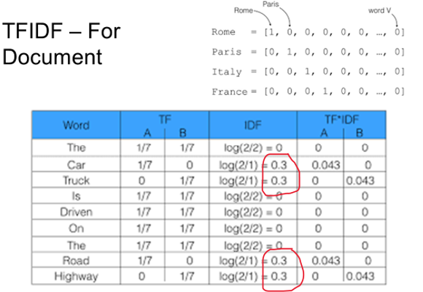
from sklearn.feature_extraction.text import TfidfVectorizer
X_Tfidf = TfidfVectorizer().fit_transform(X)
X_train,X_test,Y_train,Y_test = train_test_split(X_Tfidf,Y)
model = LogisticRegression()
model.fit(X_train, Y_train)
pred = model.predict(X_test)
cm=confusion_matrix(Y_test, pred)
print(cm)
acc=(cm[0,0]+cm[1,1]+cm[2,2])/sum(sum(cm))
print('Accuracy with TFIDF is ',acc)

Slide 27
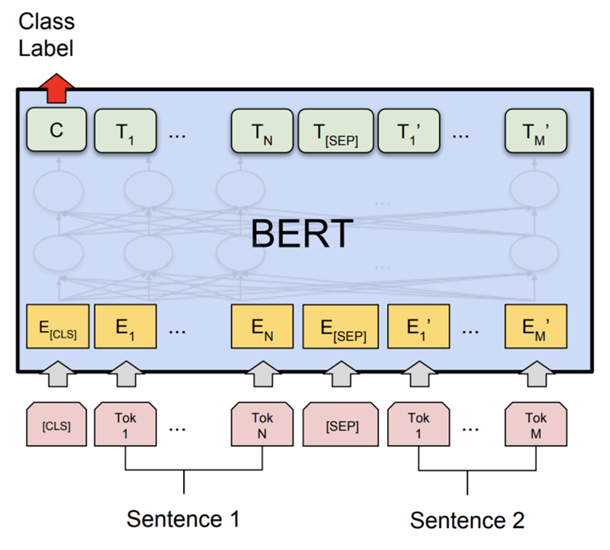
#for colab
pip install sentence_transformers #may need to do in conda
from sentence_transformers import SentenceTransformer
model = SentenceTransformer('bert-base-nli-mean-tokens')
X_bert = model.encode(X)
from sklearn.model_selection import train_test_split
X_train, X_test, Y_train, Y_test = train_test_split(X_bert, Y)
from sklearn.linear_model import LogisticRegression
from sklearn.metrics import confusion_matrix
model = LogisticRegression()
model.fit(X_train, Y_train)
pred = model.predict(X_test)
cm=confusion_matrix(Y_test, pred)
print(cm)
acc=(cm[0,0]+cm[1,1]+cm[2,2])/sum(sum(cm))
print('Accuracy using Bert is ', acc)

Slide 28
deployment
#store model
import joblib
joblib.dump(model, 'model.pkl’)
model1= joblib.load("model.pkl")
X_emb = model1.encode("Free entry in 2 a wkly comp to win FA Cup final tkts 21st May 2005.")
pred = model.predict([X_emb])
if pred=="ham":
print("Not Spam")
else:
print("Spam")

Slide 29
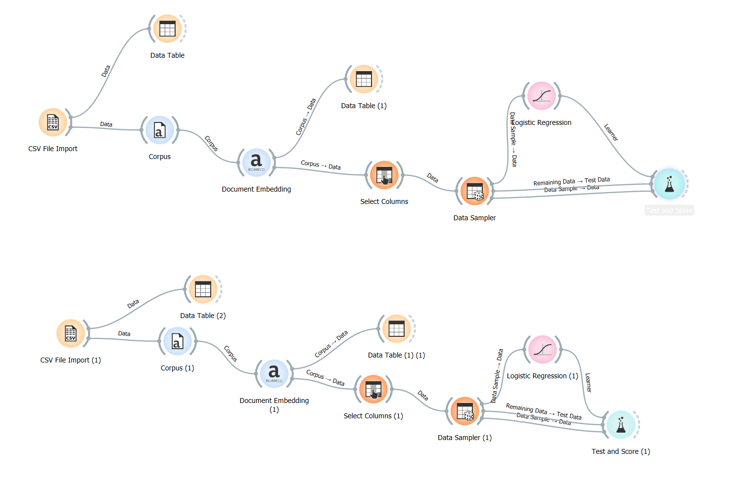
Orange - FastText

Slide 30
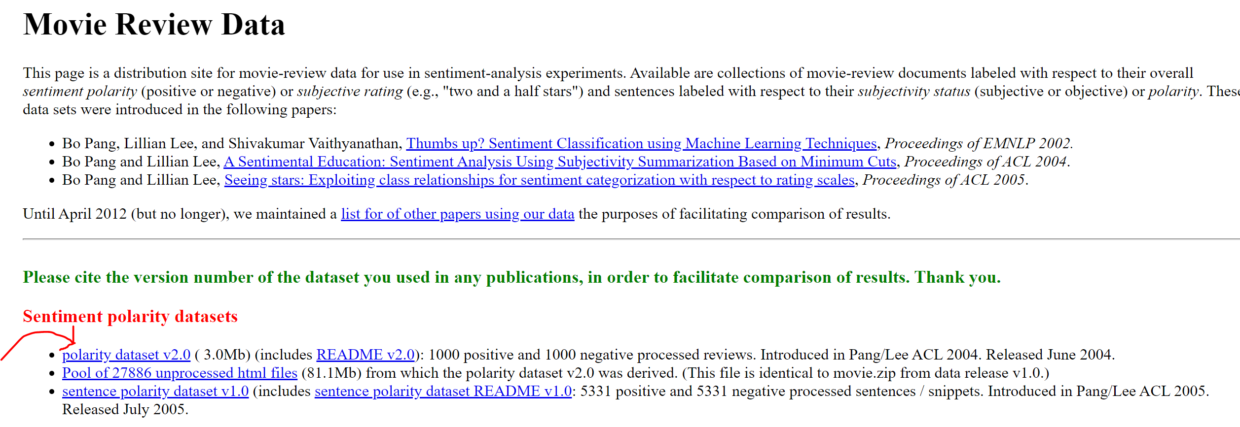
MOVIE REVIEW: https://stackabuse.com/text-classification-with-python-and-scikit-learn/
from sklearn.datasets import load_files
d = load_files(r"C:\Users\Teoh Teik Teo\OneDrive - TSS Global Pte. Ltd\TT Library\AI Model\Data\Movie Review (Text)")
X, Y = d.data, d.target
from sklearn.feature_extraction.text import CountVectorizer
X_CV = CountVectorizer().fit_transform(X)
from sklearn.model_selection import train_test_split
X_train, X_test, Y_train, Y_test = train_test_split(X_CV, Y)
from sklearn.linear_model import LogisticRegression
from sklearn.metrics import confusion_matrix
model = LogisticRegression()
model.fit(X_train, y_train)
pred = model.predict(X_test)
cm=confusion_matrix(y_test, pred)
print(cm)
acc=(cm[0,0]+cm[1,1])/sum(sum(cm))
print('Accuracy without TFIDF is ', acc)
Extra Reading – More examples - Movie Review
https://www.cs.cornell.edu/people/pabo/movie-review-data/

