Slide 1

Tree
Teoh Teik Toe
ITOM/NBS
ttteoh@ntu.edu.sg
97905202

Slide 2



Whatsapp: 65-97905202
Wechat: TeohTeikToe
LinkedIN https://www.linkedin.com/in/teohteiktoe

Slide 3
recording
Colab https://colab.research.google.com/drive/1v8uhUffRi1J9G-c_2dxzT0duNACwI9As?usp=drive_link
Recording:
Theory - https://1drv.ms/v/s!Aik2a4x7tvLyi6xN2jPwJGa6wiftEw?e=WeHwxC
Programming - https://1drv.ms/v/s!Aik2a4x7tvLyi_A6s2x-k0XAkz6NQw?e=gvCjDU

Slide 4
Reading before class
https://youtu.be/ZVR2Way4nwQ
https://youtu.be/RmajweUFKvM
Drive:
Code: https://drive.google.com/drive/folders/1fXjR7HWQVDvW4b_UwFmEM_NymlOo4Wbw?usp=sharing
Data: https://drive.google.com/drive/folders/1DWSSkL9zMwXktar8rxC_3rUGqxwNNTrR?usp=sharing

Slide 5
Agenda
Decision Tree Theory
What is Decision Tree and the metrics
Types of Decision Tree
Application & Interview Question
Advantages & Disadvantages & Comparison & Limitation
Programming
Example - German Credit (Classification)

Slide 6
Part I Theory

Slide 7
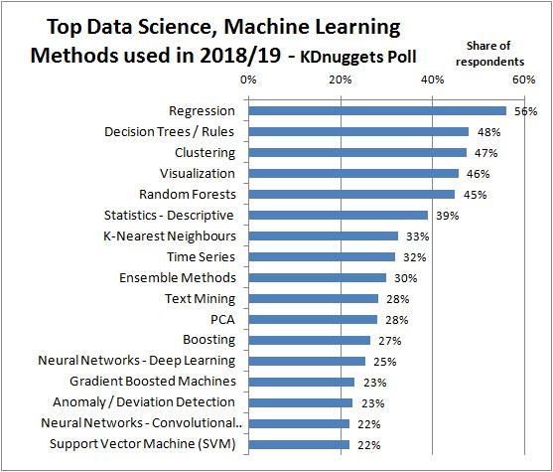
https://images.app.goo.gl/RZL5fApQc5t4syyr5

Slide 8
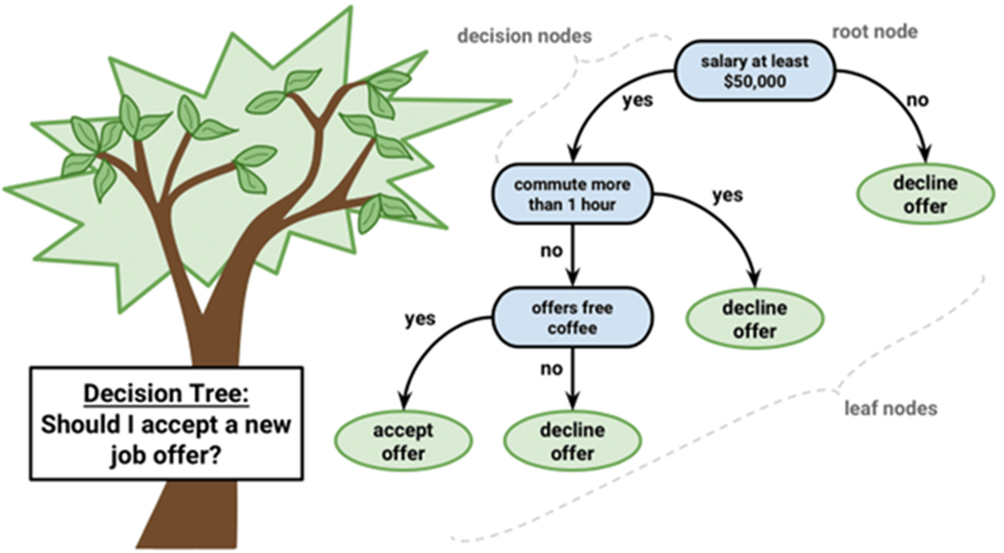
What is Decision Tree
A decision tree is a decision support tool that uses a tree-like model of decisions and their possible consequences, including chance event outcomes, resource costs, and utility.

Slide 9
Common terms used with Decision trees:
Root Node: It represents entire population or sample and this further gets divided into two or more homogeneous sets.
Decision Node: When a sub-node splits into further sub-nodes, then it is called decision node.
Terminal Node: Nodes do not split is called Leaf or Terminal node.
Pruning: When we remove sub-nodes of a decision node, this process is called pruning. You can say opposite process of splitting.

Slide 10
Decision Tree Algorithm (1 Independent Variable X and 1 Dependent Variable Y)
Female
Male
Height
1.7M
Female
Male
Gender
Height > 1.7m
1.63m (average of female height)
1.73m (average of male height)
Male
Female
Use height (X) to classified gender (Y)
Classification or Categorical Y
Use gender (X) to predict Height (Y)
(Regression or Continuous Y)

Slide 11
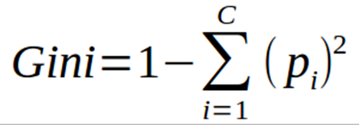
2 Independent Variable, which will be at higher node
Depends on impurity, measurement is GINI – The higher the impurity, the higher GINI and the lower the node in hierarchy (not a good feature) and Vice Versa. Example below, height will be at higher level.
Female
Male
Height
Female
Male
Weight

Slide 12
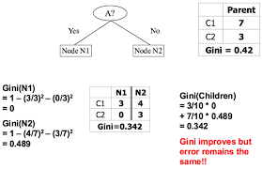
Gini Index – A is “budget”, N1 “Shopping”

Slide 13
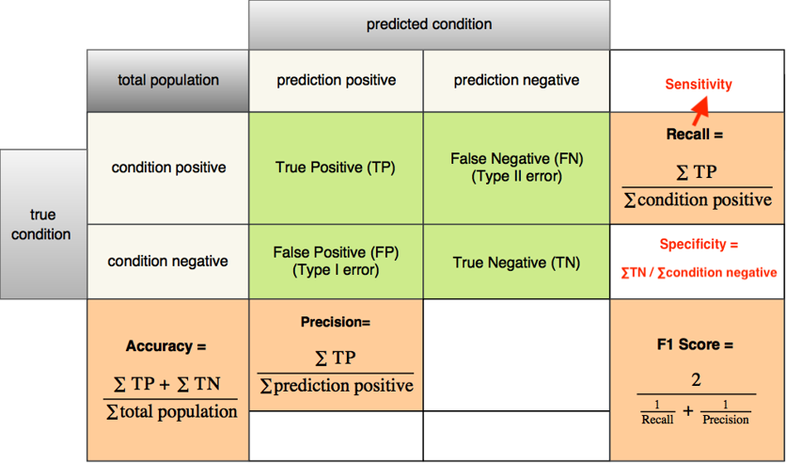
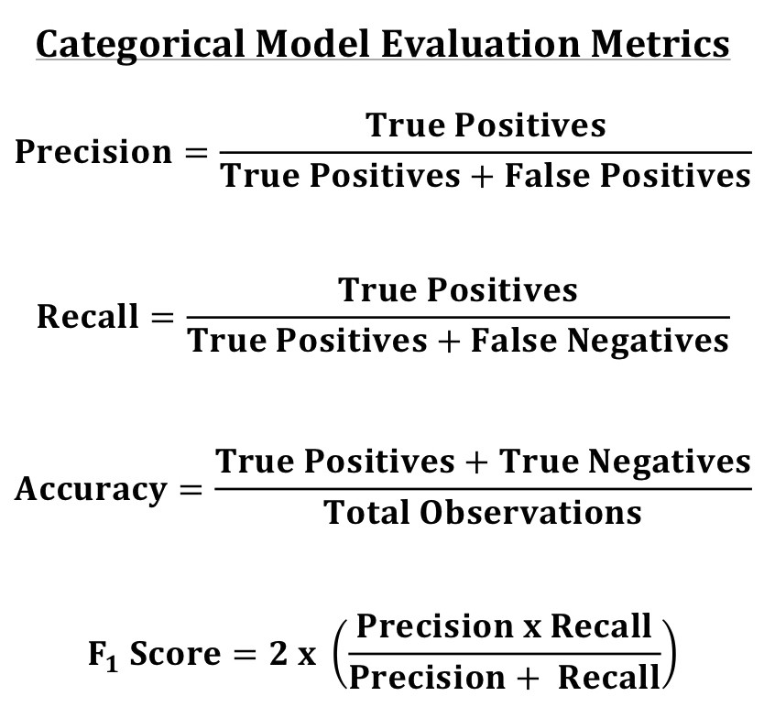
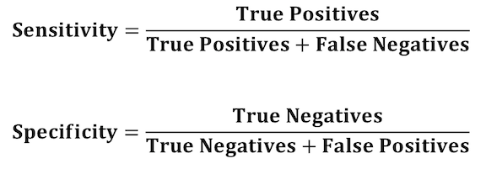
Categorical - Metrics

Slide 14
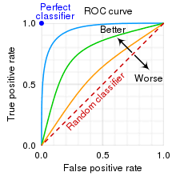
ROC Metrics (Graph) - receiver operating characteristic curve
#colab
from sklearn.metrics import RocCurveDisplay
RocCurveDisplay.from_predictions(Y_test, pred)
plt.show()
from sklearn.metrics import plot_roc_curve
plot_roc_curve(model,X_test,Y_test)

Slide 15

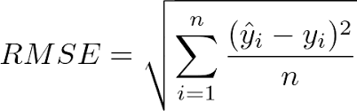
Continuous metrics - RMSE
5 types of error:
Error
Square Error
Sum of Square Error
Mean Square Error
Root Mean Square Error

Slide 16
Types of tree
CART Classification and Regression Trees
Random Forest
XGBoost - Extreme Gradient Boosting

Slide 17
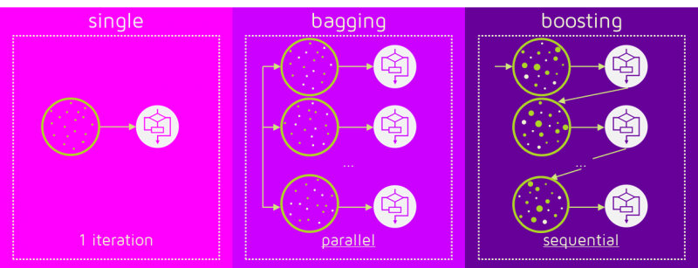
Bagging (Random Forest) & Boosting (XGBoost)
https://images.app.goo.gl/QsNjBambxZRSxyYF9

Slide 18
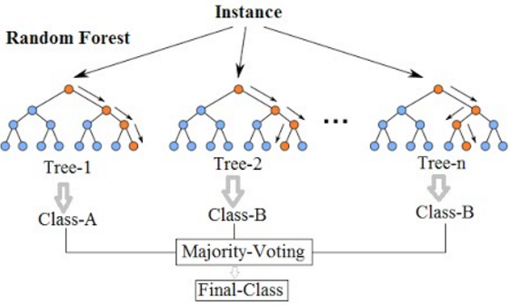
Random Forest

Slide 19
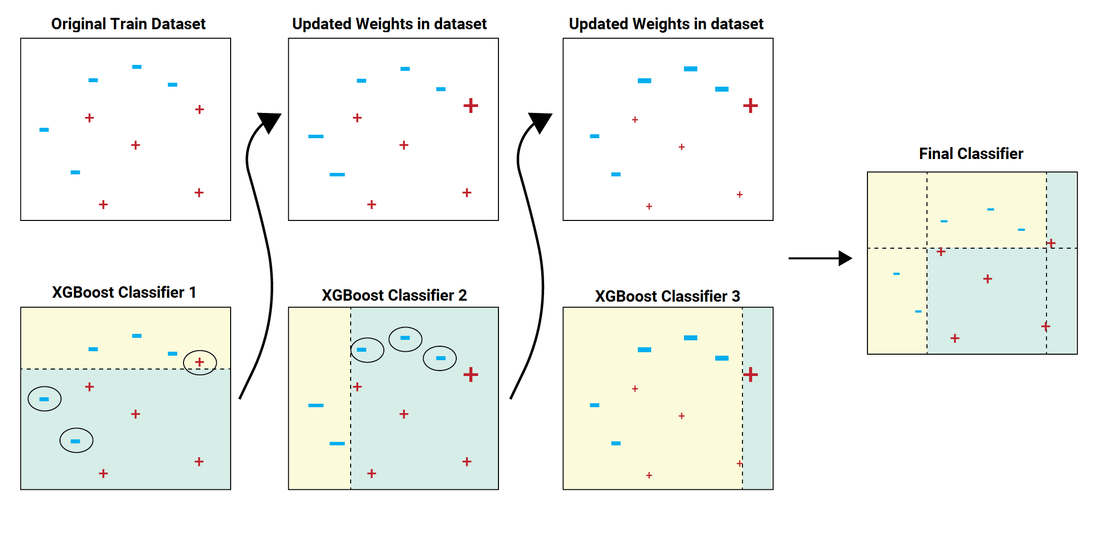
Gradient Boosting Algo – Train on Residual (increase the weight for error data)

Slide 20
Example of Application
Operations research
Customer Relationship Management
Detection of Fraudulent Financial Statements (FFS).

Slide 21
Advantages and Disadvantages
Advantages
Understandable rules.
Feature Selection
Disadvantages
Less appropriate for a continuous attribute.
Overfitting problem

Slide 22
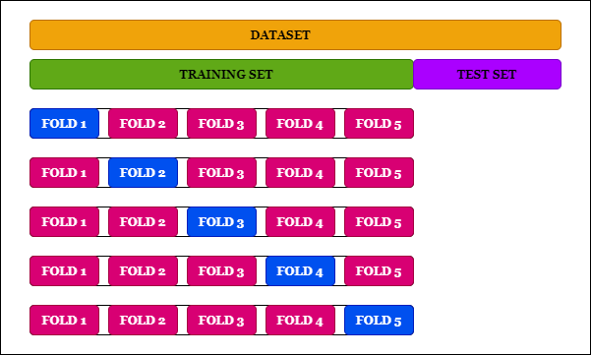
Cross Validation

Slide 23
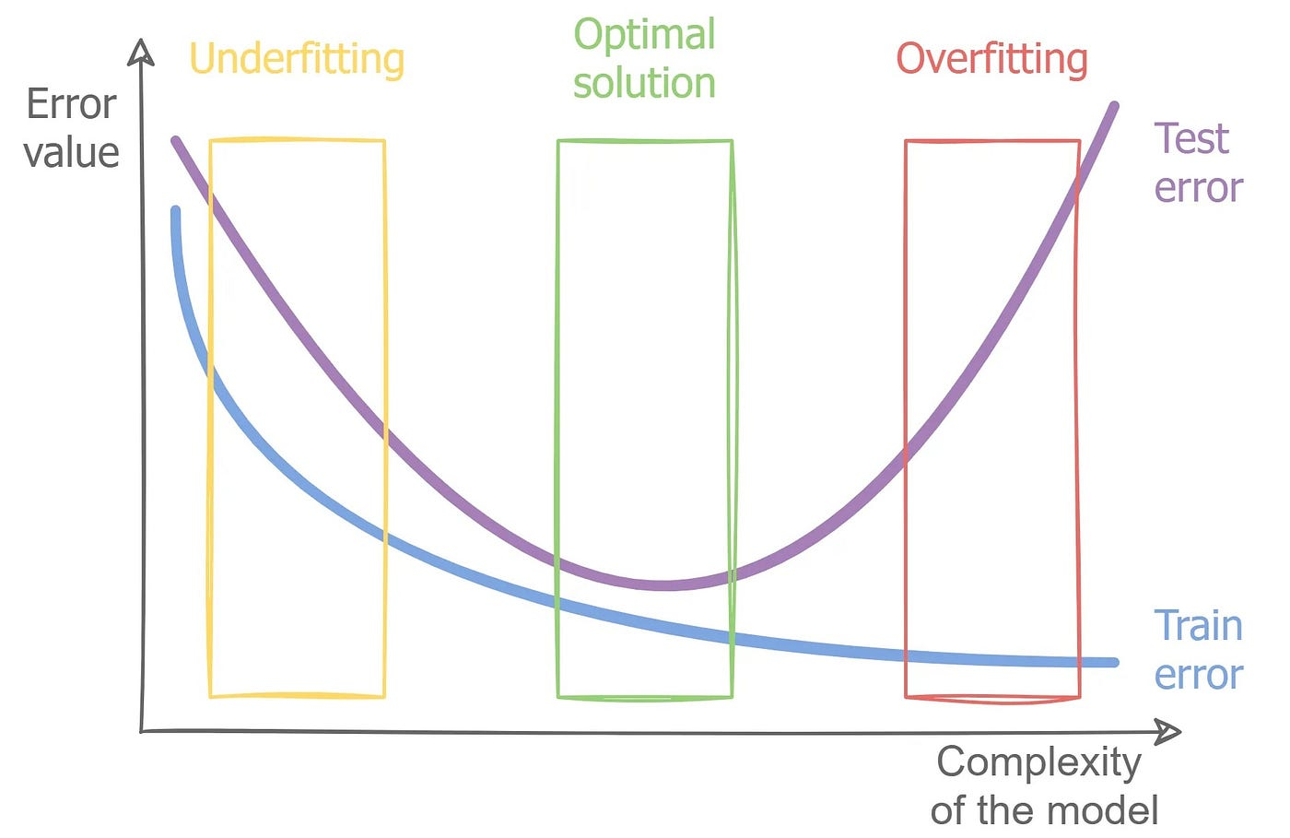

Slide 24
Part II Programming

Slide 25
https://colab.research.google.com/drive/1v8uhUffRi1J9G-c_2dxzT0duNACwI9As?usp=drive_link
pip install lcensemble
from google.colab import drive
drive.mount('/content/drive')
import pandas as pd
df = pd.read_csv("/content/drive/MyDrive/TT Library/AI Model/Data/german_credit.csv")
df.isnull().any()
df = pd.get_dummies(df, columns=["Payment Status of Previous Credit", "Purpose", "Most valuable available asset", "Occupation", "Telephone", "Foreign Worker", "Sex and Marital Status",'Account Balance'])

Slide 26
df.hist(figsize=(50,50))
import seaborn as sns
sns.heatmap(df.corr())
sns.boxplot(data=df["Credit Amount"])
sns.countplot(df,x="Creditability")
sns.catplot(df,x="Creditability",y="Credit Amount", kind="violin")
X = df.drop(columns="Creditability")
Y = df["Creditability"]
from sklearn.model_selection import train_test_split
X_train,X_test,Y_train,Y_test = train_test_split(X,Y,random_state=288)
from scipy import stats
X_train["Credit Amount"] = stats.zscore(X_train["Credit Amount"])
X_test["Credit Amount"] = stats.zscore(X_test["Credit Amount"])

Slide 27
from sklearn import linear_model
model = linear_model.LogisticRegression(max_iter=2000,random_state=288)
model.fit(X_train,Y_train)
pred = model.predict(X_test)
from sklearn.metrics import confusion_matrix
cm = confusion_matrix(Y_test, pred)
print(cm)
print("Accuracy is ", (cm[0,0]+cm[1,1])/(sum(sum(cm))))
import matplotlib.pyplot as plt
from sklearn.metrics import RocCurveDisplay
RocCurveDisplay.from_predictions(Y_test, pred)
plt.show()

Slide 28
from sklearn import tree
model = tree.DecisionTreeClassifier(random_state=288)
model.fit(X_train,Y_train)
pred = model.predict(X_test)
from sklearn.metrics import confusion_matrix
cm = confusion_matrix(Y_test, pred)
print(cm)
print("Accuracy is ", (cm[0,0]+cm[1,1])/(sum(sum(cm))))

Slide 29
from sklearn import ensemble
model = ensemble.RandomForestClassifier(random_state=288)
model.fit(X_train,Y_train)
pred = model.predict(X_test)
from sklearn.metrics import confusion_matrix
cm = confusion_matrix(Y_test, pred)
print(cm)
print("Accuracy is ", (cm[0,0]+cm[1,1])/(sum(sum(cm))))
fr = model.feature_importances_
print(fr)
for importance, name in sorted(zip(model.feature_importances_,X_train.columns),reverse=True)[:5]:
print (name, importance)

Slide 30
model = ensemble.GradientBoostingClassifier(random_state=288)
model.fit(X_train,Y_train)
pred = model.predict(X_test)
from sklearn.metrics import confusion_matrix
cm = confusion_matrix(Y_test, pred)
print(cm)
print("Accuracy is ", (cm[0,0]+cm[1,1])/(sum(sum(cm))))
from lce import LCEClassifier
# Train LCEClassifier with default parameters
model = LCEClassifier()
model.fit(X_train, Y_train)
pred = model.predict(X_test)
cm = confusion_matrix(Y_test, pred)
print(cm)
print("Accuracy is ", (cm[0,0]+cm[1,1])/(sum(sum(cm))))

Slide 31
from sklearn import neural_network
model = neural_network.MLPClassifier(random_state=288)
model.fit(X_train,Y_train)
pred = model.predict(X_test)
from sklearn.metrics import confusion_matrix
cm = confusion_matrix(Y_test, pred)
print(cm)
print("Accuracy is ", (cm[0,0]+cm[1,1])/(sum(sum(cm))))

Slide 32
Regression with 1 independent variable
import pandas as pd
df = pd.read_csv('/content/drive/MyDrive/TT Library/AI Model/Data/german_credit.csv’)
X = df.loc[:, ['Credit Amount']]
y = df.loc[:, ['Creditability’]]
from sklearn import linear_model
model = linear_model.LinearRegression()
model.fit(X,y)
model.coef_
model.intercept_
pred = (-2.51337457e-05 * 1000) + 0.78221872
import numpy as np
pred = np.where(pred>0.5,"yes","no")
pred = str(pred)

Slide 33
chatGPT in analytics
https://colab.research.google.com/drive/1tvV4O-In2HGZR-lwJ2cCHpdrEjjCK-S-?usp=drive_link

Slide 34
Other Programming

Slide 35
pip install keras
from keras.models import Sequential
from keras.layers import Dense,Dropout
model = Sequential()
model.add(Dense(100,input_dim=47,activation="relu"))
model.add(Dropout(0.1))
model.add(Dense(100,activation="relu"))
model.add(Dropout(0.1))
model.add(Dense(1, activation="sigmoid"))
model.compile(loss="binary_crossentropy",optimizer="adam",metrics=["accuracy"])
h = model.fit(X_train,Y_train,batch_size=10,epochs=300)
import matplotlib.pyplot as plt
plt.plot(h.history["loss"])
pred = model.predict(X_test)
import numpy
pred = numpy.where(pred>=0.5,1,0)
from sklearn.metrics import confusion_matrix
cm = confusion_matrix(Y_test,pred)
print(cm)
print("accuracy is ", (cm[0,0]+cm[1,1])/(sum(sum(cm))))
import numpy as np
X_train = np.array(X_train).astype('float32')
X_test = np.array(X_test).astype('float32')

Slide 36
Feature Selection
from sklearn.feature_selection import SelectKBest,f_regression
X = df.drop(columns="Creditability")
Y = df["Creditability"]
f = SelectKBest(score_func=f_regression, k=30).fit(X,Y).get_support()
X.columns[f]
df = df.loc[:,["Creditability",'Duration of Credit Mths', 'Credit Amount',
'Value of Savings and Stocks', 'Length of current employment',
'Instalment per cent', 'Age', 'Concurrent Credits',
'No of Credits at this Bank', 'Payment Status of Previous Credit_0',
'Payment Status of Previous Credit_1',
'Payment Status of Previous Credit_2',
'Payment Status of Previous Credit_4', 'Purpose_0', 'Purpose_1',
'Purpose_3', 'Purpose_6', 'Purpose_8',
'Most valuable available asset_1', 'Most valuable available asset_4',
'Occupation_4', 'Telephone_2', 'Foreign Worker_1', 'Foreign Worker_2',
'Sex and Marital Status_1', 'Sex and Marital Status_2',
'Sex and Marital Status_3', 'Account Balance_1', 'Account Balance_2',
'Account Balance_3', 'Account Balance_4']]

Slide 37
Feature Selection (PCA)
from sklearn.decomposition import PCA
pca = PCA(n_components=10)
X = pca.fit_transform(X)
Notes:
.

Slide 38
Imputation
Check null (imputation?) – May need to check correlation before check null
df.isnull().any() and df["Revenue"].isnull().sum()
If needed, pd.set_option("display.max_rows", 10)
If you have categorical and continuous X, need to do dummy first so that you can use for loop.
#imputation ??
df.isnull().sum()/len(df)
m = df["10Y Net Income Growth (per Share)"].mean()
df["10Y Net Income Growth (per Share)"].fillna(m,inplace=True)
for i in df.columns:
m = df[i].mean()
df[i].fillna(m,inplace=True)
#or using model
pip install miceforest
import miceforest as mf
k = mf.ImputationKernel(df,datasets=1,random_state=1)
k.mice(10) #10 interation
df = k.complete_data(0)
#for categorical
from sklearn.preprocessing import Imputer
imp = Imputer(strategy='most_frequent')
imp.fit(df)
Or
imp = Imputer(strategy=‘constant’,fill_value=“missing)

Slide 39
remove outlier
#remove outlier
from sklearn.model_selection import train_test_split df_train,df_test = train_test_split(df)
from scipy import stats
z = abs(stats.zscore(df_train))
df_train = df_train[(z<5).all(axis=1)]

Slide 40
Normalization all features
for i in X_train.columns:
X_train[i] = stats.zscore(X_train[i])
for i in X_test.columns:
X_test[i] = stats.zscore(X_test[i])

Slide 41
Balance the imbalance
Y_train.value_counts()
from imblearn.over_sampling import SMOTE
X = df.drop(columns="Creditability")
Y = df["Creditability"]
X_train,Y_train = SMOTE(random_state=288).fit_resample(X_train,Y_train)

Slide 42
Save model and load model
X = df.loc[:, ["Credit Amount"]]
Y = df.loc[:, ["Creditability"]]
model = tree.DecisionTreeClassifier()
model.fit(X_train, Y_train)
pred = model.predict(X_test)
cm = confusion_matrix(Y_test, pred)
print(cm)
print("accuracy is ", accuracy_score(Y_test, pred))
# save the model to disk
import joblib
joblib.dump(model, 'model name')
# load the model from disk and predict from existing to validate the load
model = joblib.load('model name’)
Print(model.predict([[data]]))

Slide 43
Plot tree
import matplotlib.pyplot as plt
plt.subplots(figsize=(20, 10))
tree.plot_tree(model, fontsize=10)

Slide 44
For Tree - Classifier Optimization
#using grid
from sklearn.model_selection import GridSearchCV
from sklearn import tree
model = tree.DecisionTreeClassifier()
grid = GridSearchCV(estimator = model, param_grid = dict(max_depth = [i for i in range(1, 20)]),cv=10).fit(X_train, Y_train)
grid.best_params_

Slide 45
For Regression - VIF
#vif to check collinearity
#1 = not correlated.
#Between 1 and 5 = moderately correlated.
#Greater than 5 = highly correlated.
from statsmodels.stats.outliers_influence import variance_inflation_factor
vif_data = pd.DataFrame()
vif_data["feature"] = X.columns
vif_data["VIF"] = [variance_inflation_factor(X.values, i) for i in range(len(X.columns))]
print(vif_data)

Slide 46
For Regression – QQ, Anova
QQ plot (check Heteroscedasticity)
import statsmodels.api as sm
from matplotlib import pyplot as plt
mod_fit = sm.OLS(Y,X).fit()
res = mod_fit.resid # residuals
fig = sm.qqplot(res)
plt.show()
Anova (check significant)
from statsmodels.formula.api import ols
from statsmodels.stats.anova import anova_lm
model = ols("Y ~ X", df).fit()
print(model.summary())
anova_results = anova_lm(model)
print('\nANOVA results')
print(anova_results)

Slide 47
LCE
pip install lcensemble
from lce import LCEClassifier
from sklearn.datasets import load_iris
from sklearn.metrics import accuracy_score
from sklearn.model_selection import train_test_split
# Load data and generate a train/test split
data = load_iris()
X_train, X_test, y_train, y_test = train_test_split(data.data, data.target, random_state=0)
# Train LCEClassifier with default parameters
clf = LCEClassifier(n_jobs=-1, random_state=0)
clf.fit(X_train, y_train)
# Make prediction and compute accuracy score
y_pred = clf.predict(X_test)
accuracy = accuracy_score(y_test, y_pred)
print("Accuracy: {:.1f}%".format(accuracy*100))

