Slide 1

A Major Project
On
Feature Based Opinion Mining Using Ontology
By
A.Baby Shanthi(15311A1201)
N.Harini(15311A1217)
S.Pravalika(15311A1222)
S.Harika(16315A1202)
Under the guidance of
Dr.D.Teja Santhosh
Department of Information Technology

Slide 2
Abstract
The idiosyncrasy of the web has, in the last few years, been altered by web 2.0 technologies and applications and the advent of the so called social web.Given the current web size and growth rate, automated techniques are essential if practical and scalable solutions are to be obtained. So as opinion mining comes into picture where the techniques involved in it aiming to extract various kinds of added value and informational elements from user opinion.

Slide 3
Introduction
Opinion mining is a highly active research field that comprises natural language processing, computational linguistics and text analysis techniques with the aim of extracting various kinds of added-value and informational elements from users opinions. However, current opinion mining approaches are hampered by a number of drawbacks such as the absence of semantic relations between concepts in feature search processes or the lack of advanced mathematical methods in sentiment analysis process.

Slide 4
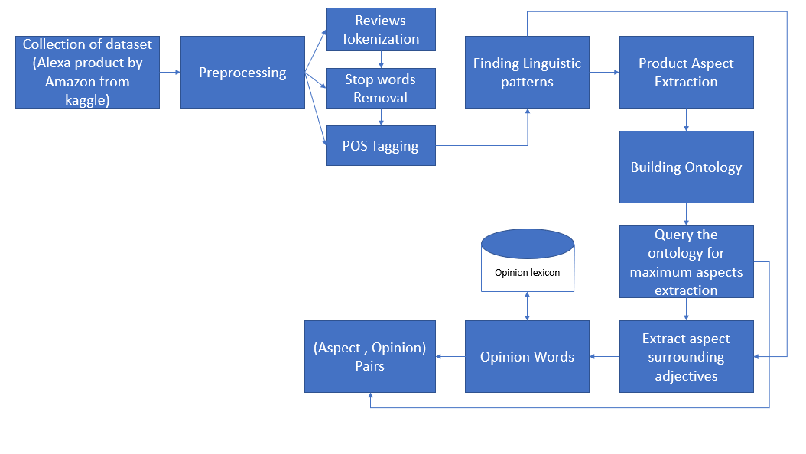
Proposed System

Slide 5
Software Tools Used
Jupyter Notebook
Protégé
Fluent Editor

Slide 6
Opinion Mining
Deeper understanding of the review
Opinion mining is a type of natural language processing for tracking the mood of the public about a particular product

Slide 7
Opinion Mining-
The next level in sentiment analytics.
Sentiment Analysis – a predecessor to the field of opinion mining – examines how people feel about a given topic (be it positive or negative), opinion mining goes a level deeper, to understand the drivers behind why people feel the way they do.
Example :”I am concerned about the current state of the economy” expresses a sentiment, whereas the sentence “I think the economy is not doing well” expresses an opinion

Slide 8
Ontology
Ontology is Formal representations of a set of concepts within a domain and the relationships between those concepts.

Slide 9
NEED
To bridge the semantic gap between the data, applications and mining results.
To provide mining process with a priori knowledge which reduces/constrains the search space.To provide a formal way for representing the data mining

Slide 10
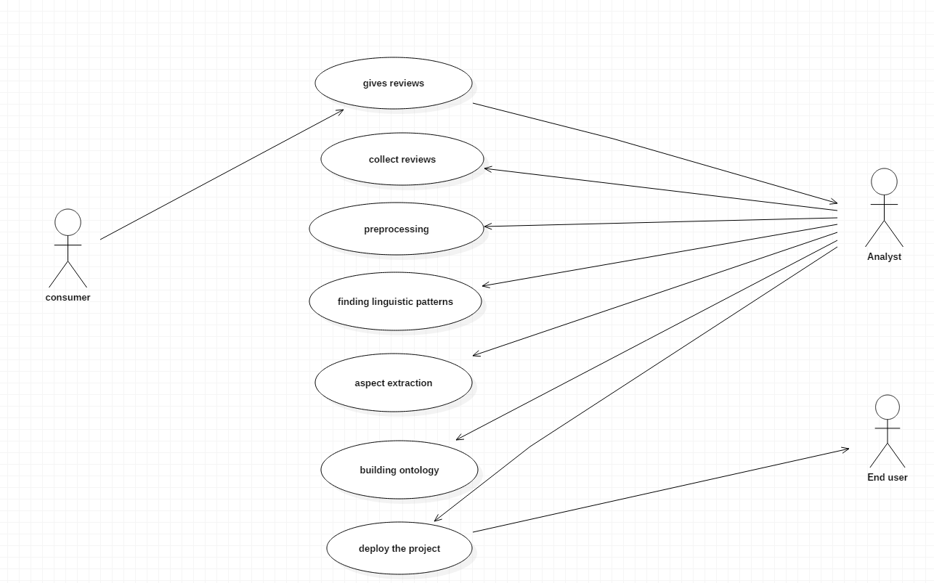
Use case Diagram

Slide 11
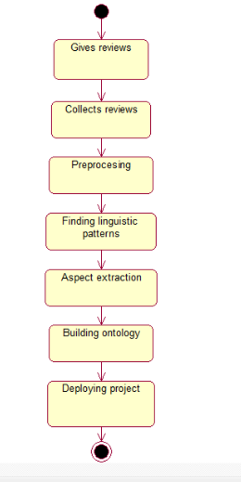
State-chart Diagram

Slide 12
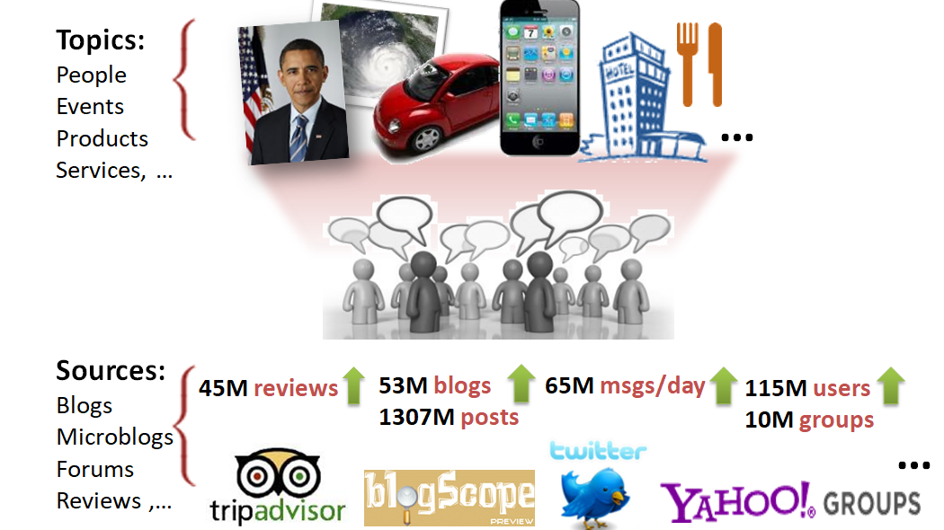
1.Collecting Data

Slide 13
Data Set Used
Online product reviews on product Alexa by Amazon, the dataset is collected from Kaggle.
Staring and ending date of commented reviews :- 16-05-2018 to 31-07-2018
Our Dataset:
https://www.kaggle.com/sid321axn/amazon-alexa-reviews

Slide 14
2.Pre-Processing
Tokenizaton
Stop words removal

Slide 15


2.1.Tokenization

Slide 16
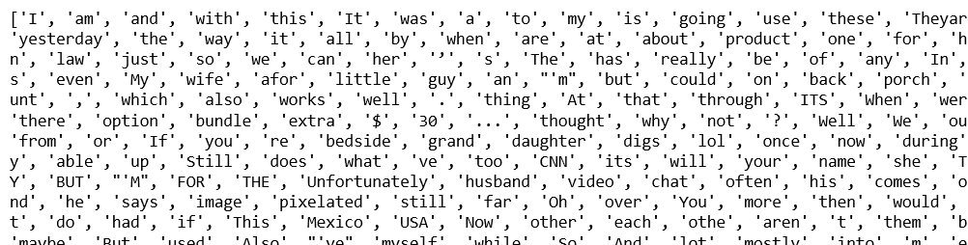
Tokenization Output

Slide 17
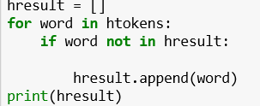
2.2.Stop Words
1.Manual Process
2.Removing similar words

Slide 18
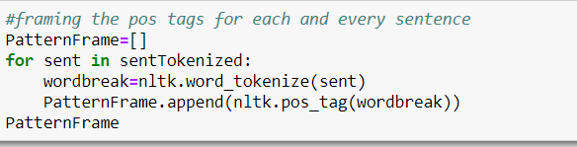
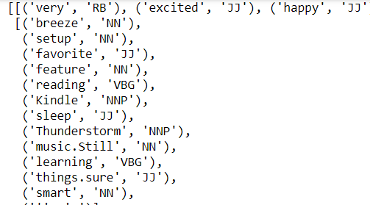
3.POS Tagging

Slide 19
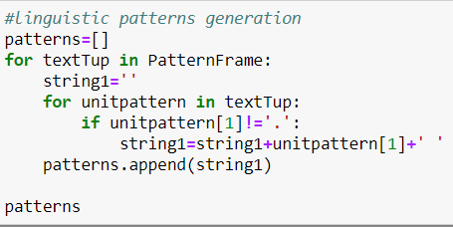
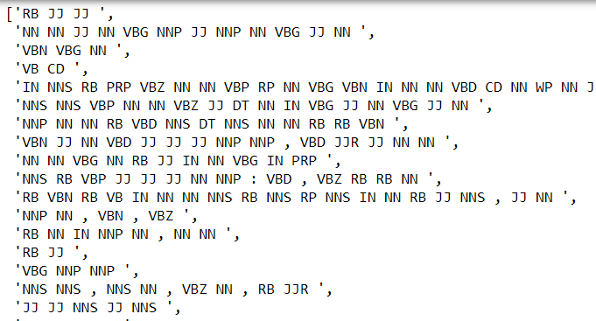
4.Finding Linguistic Patterns

Slide 20
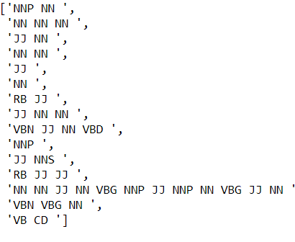
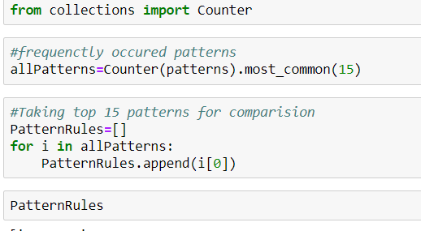
5.Extracting Top Patterns

Slide 21
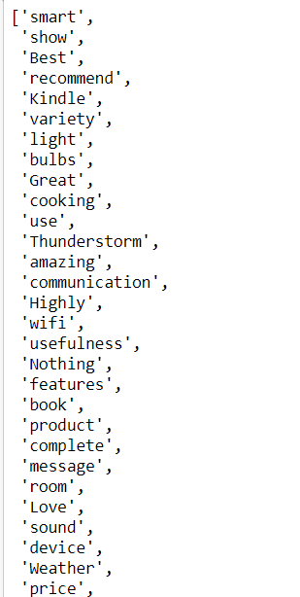
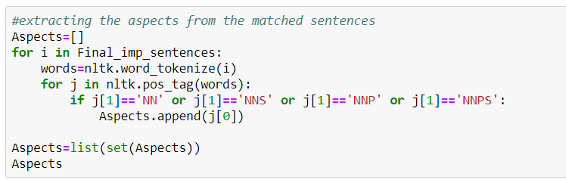
6.Product Aspect Extraction

Slide 22
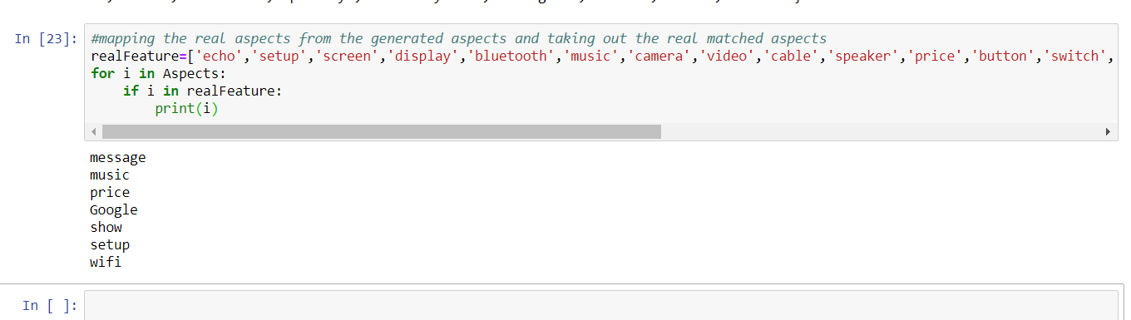
Extracted Aspects

Slide 23
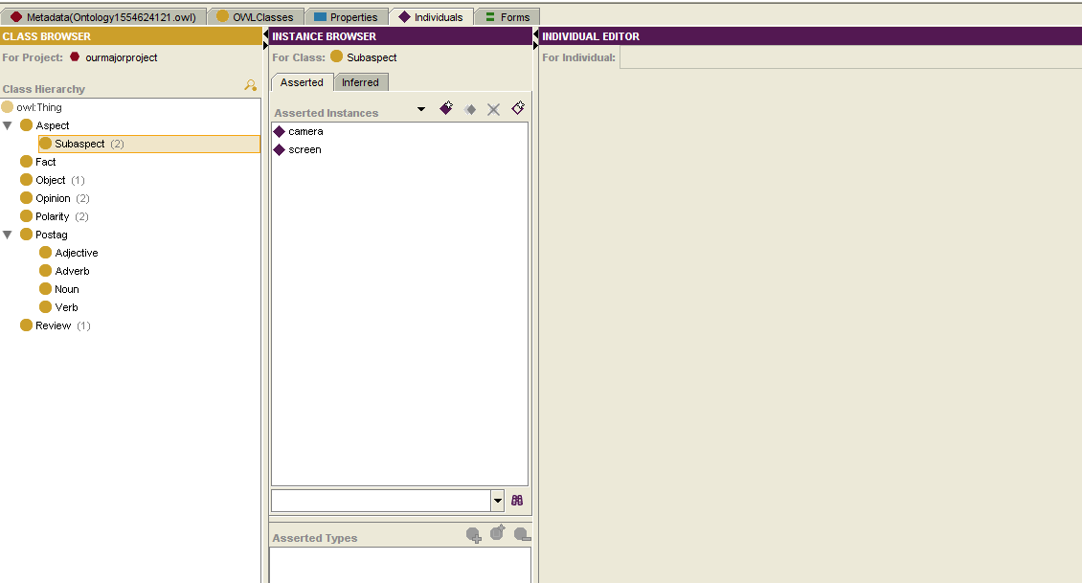
7.Building Ontology
Creation of class hierarchy

Slide 24
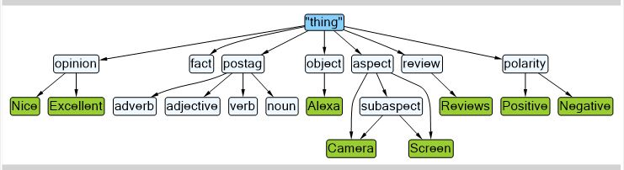
Diagram of Class Hierarchy

Slide 25
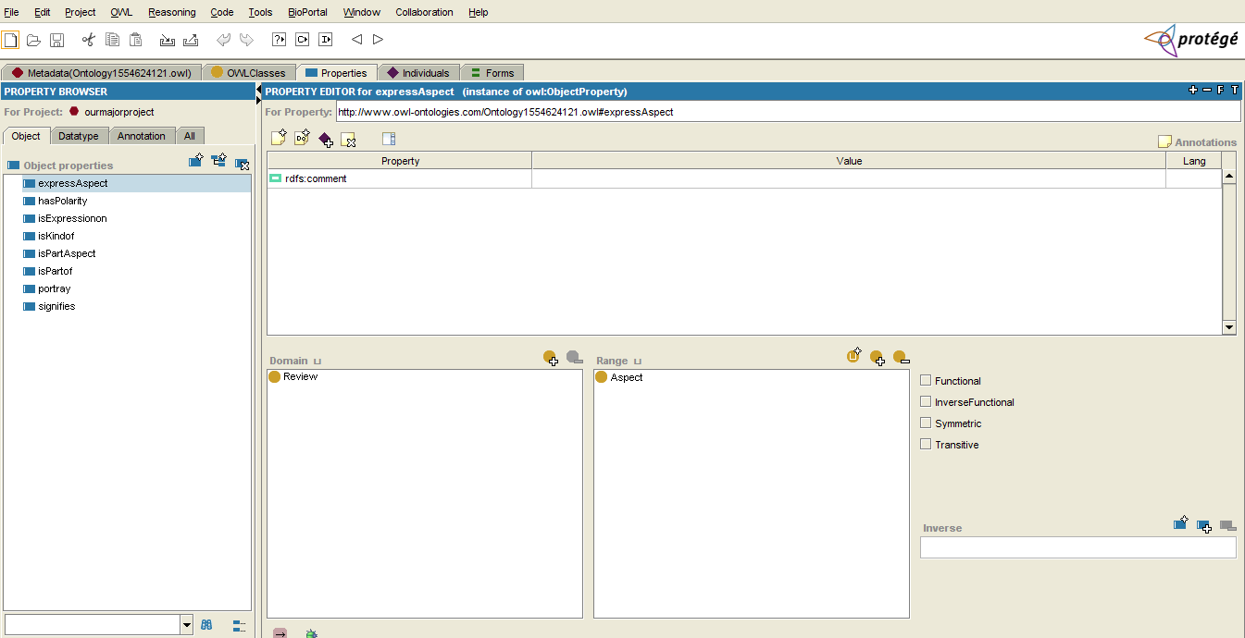
Creation of Object Properties

Slide 26
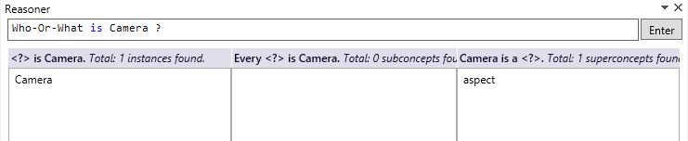
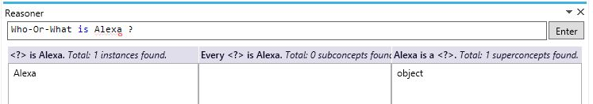
Query to find class of instance camera
Query to find class of the Alexa

Slide 27
Query to find the opinion on Alexa

Slide 28
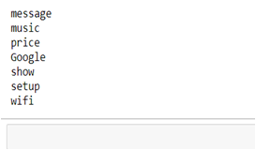
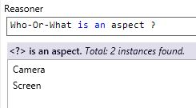
Aspects Obtained
NLP vs Ontology

Slide 29
Conclusion
Opinion Mining using Ontology is a field of study that analyzes people’s attitudes or emotions towards certain entities. It tackles a fundamental problem of sentiment analysis, traditional opinion mining. It is perfect to look for a huge range of customer-initiated reactions to the products and business as a whole, Where ontology is the phase where we extract the hidden aspects for more accuracy and also to overcome the drawbacks of opinion mining.

Slide 30
The End

