Slide 1

JAARVIS - JUSTIFIED ALERT AND REAL-TIME VISUALIZATION FOR INTELLIGENT SURVEILLANCE OF RARE GEO-HAZARDS
PROJECT TEAM
Shanthini P – 812621243049
Eisha Kanth – 812621243015
Rejoe Blesy A – 812621243036
Siva Sankari S – 812621243050
PROJECT GUIDE
Prof.K.Ilango – HOD / AI & DS

Slide 2
TABLE OF CONTENTS
Abstract
Upto Second review
Literature Review
Architecture
Methodology
Work flow diagram
Implementation
Conclusion
Future Enhancement
References

Slide 3
ABSTRACT
Rare geo-hazards such as Glacial Lake Outburst Floods (GLOFs), Soil Liquefaction, Tsunami-Induced Coastal Erosion, Sinkholes & Land Subsidence, Volcanic Mudflows (Lahars), Landslides, and Earthquakes pose significant threats but remain understudied and difficult to predict due to limited real-time data and inefficient early warning systems.
JAARVIS is an AI-powered multi-hazard surveillance system designed to evaluate, predict, and provide real-time alerts for these disasters. The system integrates machine learning, deep learning, and geospatial analysis, leveraging satellite imagery, seismic activity, climate trends, and terrain deformations to generate probabilistic risk forecasts with confidence intervals.

Slide 4
Using an interactive dashboard, JAARVIS provides:
Dynamic risk visualization of hazard-prone regions.
Automated alerts to authorities and communities.
Historical trend analysis for proactive disaster management.
By combining Informer Transformer for time-series forecasting, CatBoost & LightGBM for risk assessment, and ResNet-50 + U-Net for geospatial hazard mapping, JAARVIS enhances disaster preparedness with AI-driven predictive analytics and real-time decision support.

Slide 5
2. UPTO SECOND REVIEW
Problem Identification
Rare geo-hazards (Landslides, GLOFs, Earthquakes, etc.) lack unified prediction models
Real-time alert systems with integrated visualization are limited in research and practice
Hazard Selection
Focused on 7 rare but impactful disasters:
🌋 Lahar 🧱 Soil Liquefaction
🕳️ Sinkholes 🏔️ Landslides
🌊 GLOFs & Tsunamis 🌍 Earthquakes
Data Collection
Sourced and/or created dummy datasets (300–400 rows each)
Common schema includes:
Date, Latitude, Longitude, Rainfall, Soil Moisture, Seismic Activity, etc.

Slide 6
Data Cleaning
Removed outliers, null values, and inconsistent entries
Standardized column names and merged datasets by date & location
Preprocessing
Encoded binary/multiclass target variables
Applied feature scaling and type conversion
Aligned schema across all 7 datasets
Tools & Tech Used So Far:
Python, Pandas, NumPy, Matplotlib, Seaborn
Environment: Windows, VS Code, Jupyter Notebooks

Slide 7
3. LITERATURE REVIEW
Base Paper Title:
Natural Disaster Clustering Using K-Means, DBSCAN, SOM, GMM, and Mean Shift (IJACSA, 2024 – INTI International University, Malaysia)
Study Objective:
To analyze patterns of federally declared disasters in the U.S. using clustering algorithms applied on FEMA datasets for better preparedness and mitigation strategies.
Evaluation Metrics Used:
Silhouette Score
Descriptive Statistics
Visualization: PCA, Time-Series, KDE, Heatmaps
Limitations Identified in Base Paper:
Focused on clustering only, no prediction capability
No use of ensemble models or supervised learning
Region-specific FEMA data only (U.S. based)
No real-time or actionable alert generation system

Slide 8
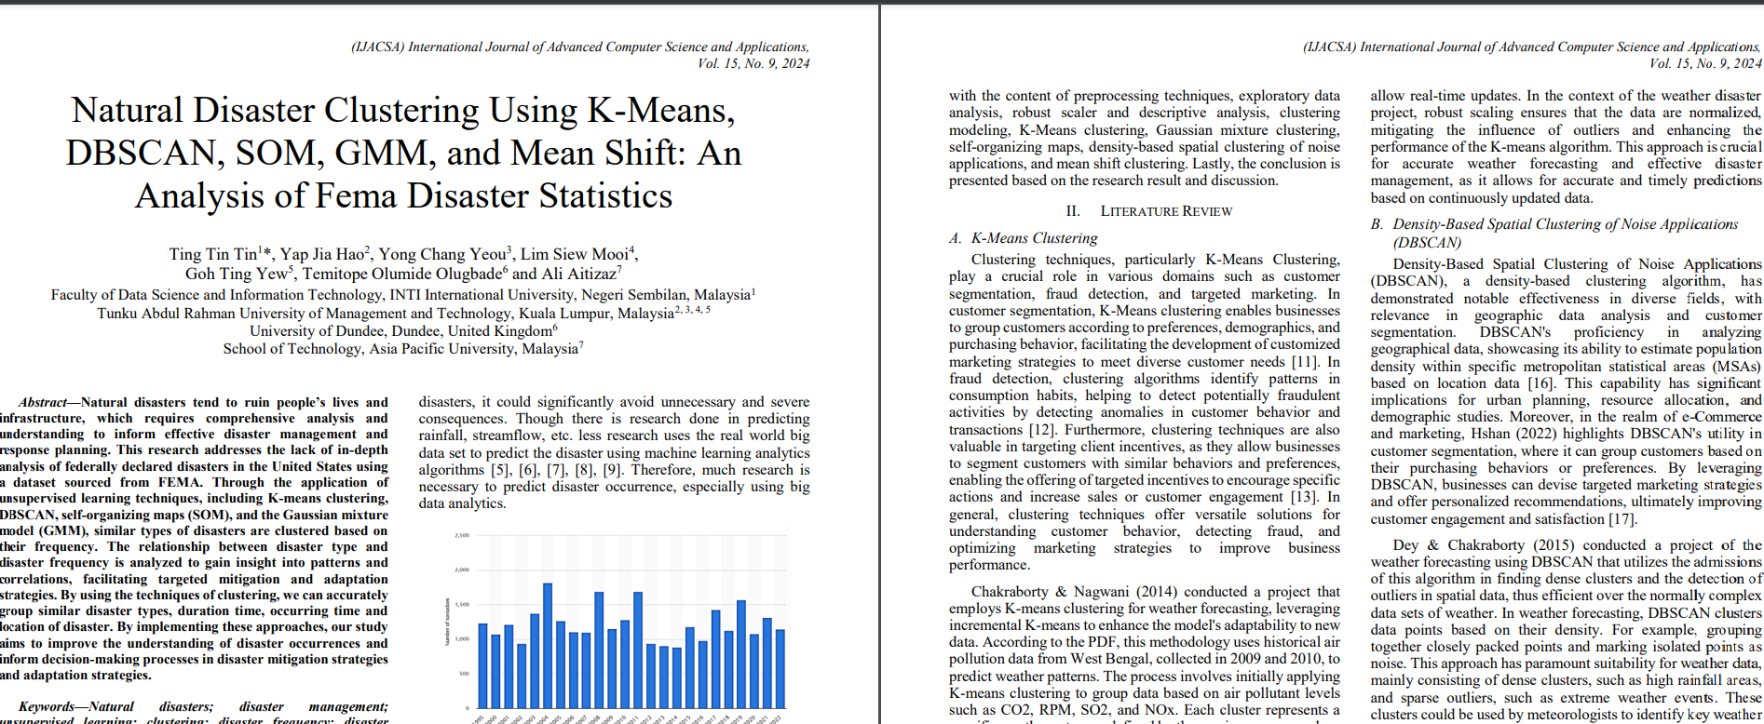

Slide 9
FEATURE | BASE PAPER | JAARVIS
Prediction Capability | No | Yes (ML/DL models)
Ensemble Modeling | No | RF + XGB + CB
Multi-Hazard Integration | Limited | 7 Hazards
Real-Time Surveillance Ready | No | Planned Deployment
Geospatial Flexibility | U.S.-only (FEMA) | Any Region (Dummy + Global Extensible)

Slide 10
4. ARCHITECTURE
LAYERED ARCHITECTURE
Data Layer
Sources: Historical datasets (dummy + public sources)
Input Fields: Date, Latitude, Longitude, Rainfall, Slope, Soil Moisture, Temperature, Seismic Activity, Water Level, etc.
Each dataset → One hazard type
Preprocessing Layer
Cleaning, null handling, outlier removal
Feature encoding (binary/multiclass)
Scaling & transformation
Dataset merging (common schema: date + location)

Slide 11
Model Layer (Core Engine)
Voting Ensemble of:
Random Forest – Strong baseline, low overfitting
XGBoost – Fast, optimized gradient boosting
CatBoost – Categorical power, smart handling of noise
Wrapped inside: MultiOutputClassifier, Predicts all 7 hazards simultaneously
Evaluation Layer
Accuracy, Precision, Recall, F1 Score
Visualizations:
Confusion Matrix ,Bar/Radar/Pie Charts
Visualization & Alert Layer
Results formatted for:
Dashboards (Streamlit/React)
API Integration (Flask-ready)
Region-wise alert display (future: map overlays)

Slide 12
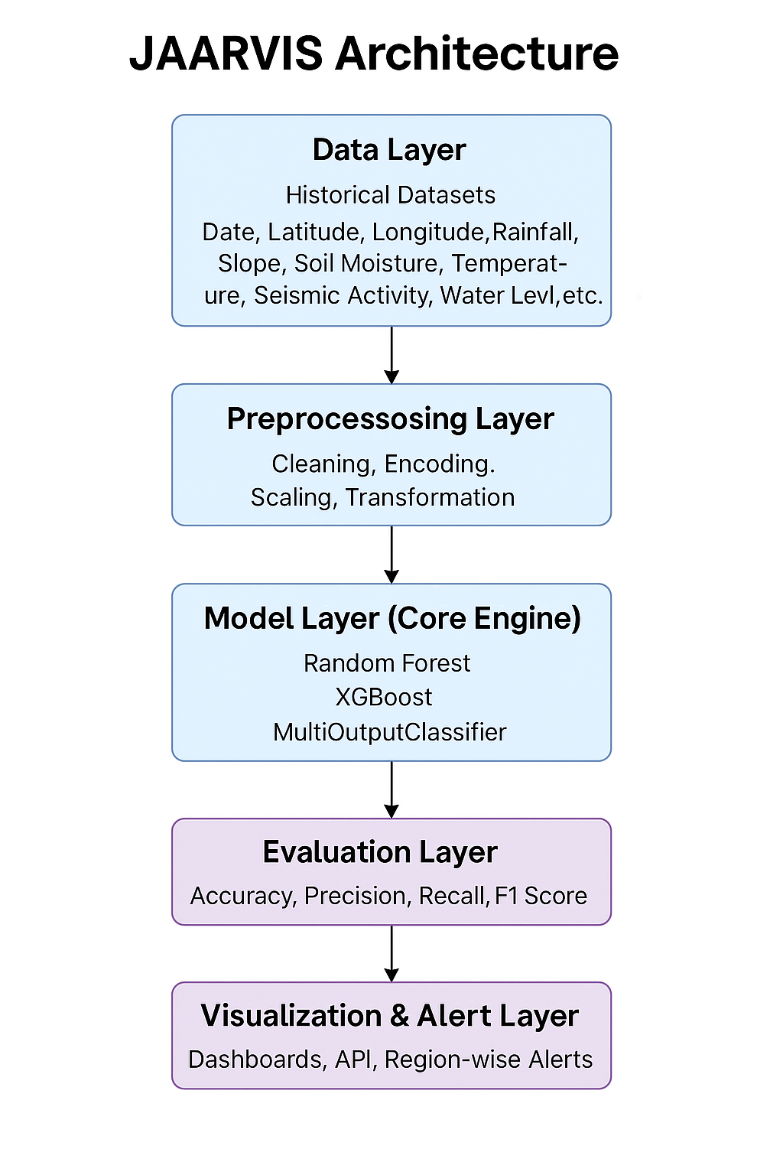

Slide 13
5. METHODOLOGY
Step 1: Data Collection
Historical Disaster Data - Past hazard occurrences, terrain changes, climate records.
Real-Time Environmental Data - Rainfall, soil moisture, seismic activity, glacial melt rate.
Satellite & Geospatial Data - DEM (Digital Elevation Models), Land Use, Oceanic trends.
Step 2: Data Preprocessing
Normalize & clean data for consistency.
Compute hazard-specific features (slope angle for landslides, groundwater depletion for sinkholes).
Label datasets for AI model training.
Step 3: AI Model Selection & Training
Risk Classification (CatBoost + LightGBM) - Identifies high-risk zones.
Time-Series Forecasting (Informer Transformer + SARIMA) - Predicts future hazards.
Geospatial Analysis (ResNet-50 + U-Net) - Maps hazard-prone regions.

Slide 14
Step 4: Risk Visualization & Alert System
Interactive dashboard with GIS-based risk zones.
Real-time hazard probability maps with color-coded alerts (green/yellow/red).
Automated alerts (SMS/Email/Push Notifications) for high-risk areas.
Step 5: Frontend & Dashboard Development
Technology Stack: Flask/Django (Backend) + HTML/CSS/JavaScript (Frontend)
Map Integration: Leaflet.js for interactive risk zone mapping
Live Data Display: Dynamic graphs (Plotly, Chart.js) for real-time hazard trends
User Input & Customization: Search for a location & view hazard probability & forecast
Alert System: Pop-up notifications for high-risk areas + optional SMS/Email alerts
Step 6: Testing & Validation
Compare AI predictions with historical events.
Check false alarm rates & model accuracy.
Simulate real-time hazard detection & dashboard functionality.

Slide 15
6. WORK FLOW WITH DIAGRAM
Data Acquisition
Collect hazard-wise datasets
Format: CSV/GeoData with environmental parameters
Location + Timestamp-based
Data Cleaning & Preprocessing
Handle nulls, outliers
Encode target variables (binary / multiclass)
Normalize and scale features
Dataset Merging
Merge all 7 datasets by common columns (Date, Lat, Lon)
Unified input format for multi-output modeling

Slide 16
Model Training
Train individual models: RF, XGBoost, CatBoost
Combine using VotingClassifier
Wrap into MultiOutputClassifier
Prediction Phase
Single input → Predict 7 hazard labels
Outputs: Risk occurrence classes for each hazard
Evaluation & Visualization
Accuracy, Confusion Matrix, F1-scores
Graphs: Bar, Pie, Radar
Heatmaps + Dashboard-ready plots

Slide 17
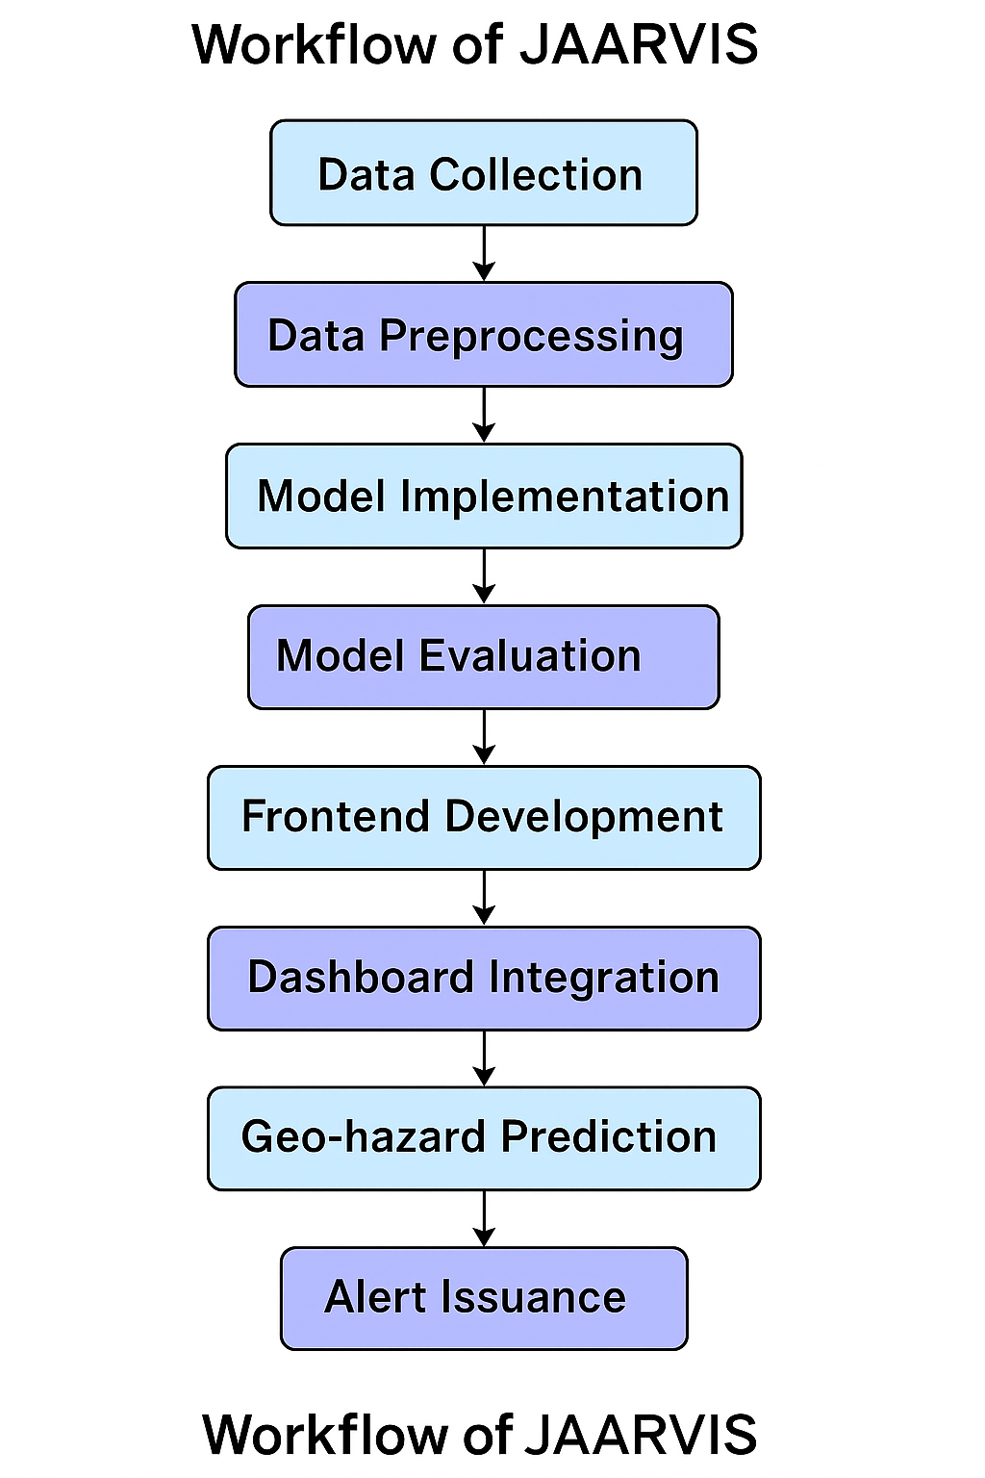

Slide 18
7. IMPLEMENTATION
LAYER | TOOLS USED
Programming | Python (Pandas, NumPy, Scikit-learn)
Models | Random Forest, XGBoost, CatBoost (Voting)
Multi-Hazard Model | MultiOutputClassifier
Data Handling | CSV files, Pandas DataFrames
Visualization | Matplotlib, Seaborn
Dev Environment | Jupyter Notebook, VS Code (WSL on Windows)

Slide 19
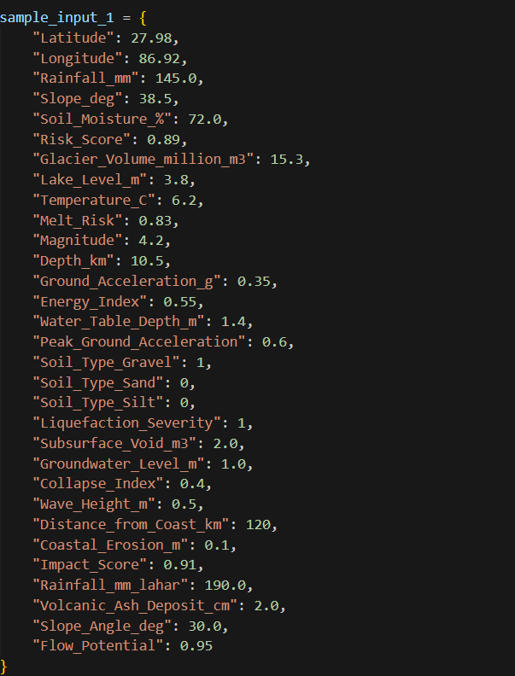
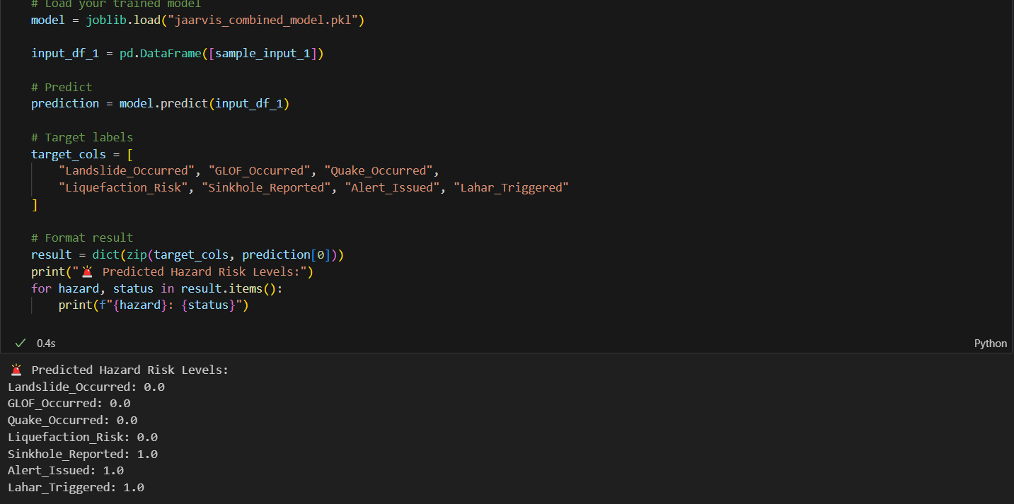

Slide 20
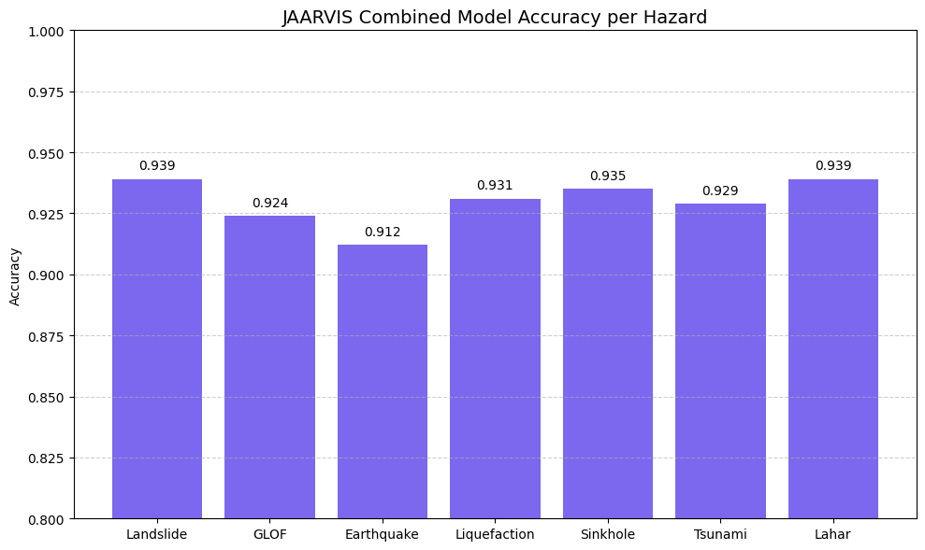

Slide 21
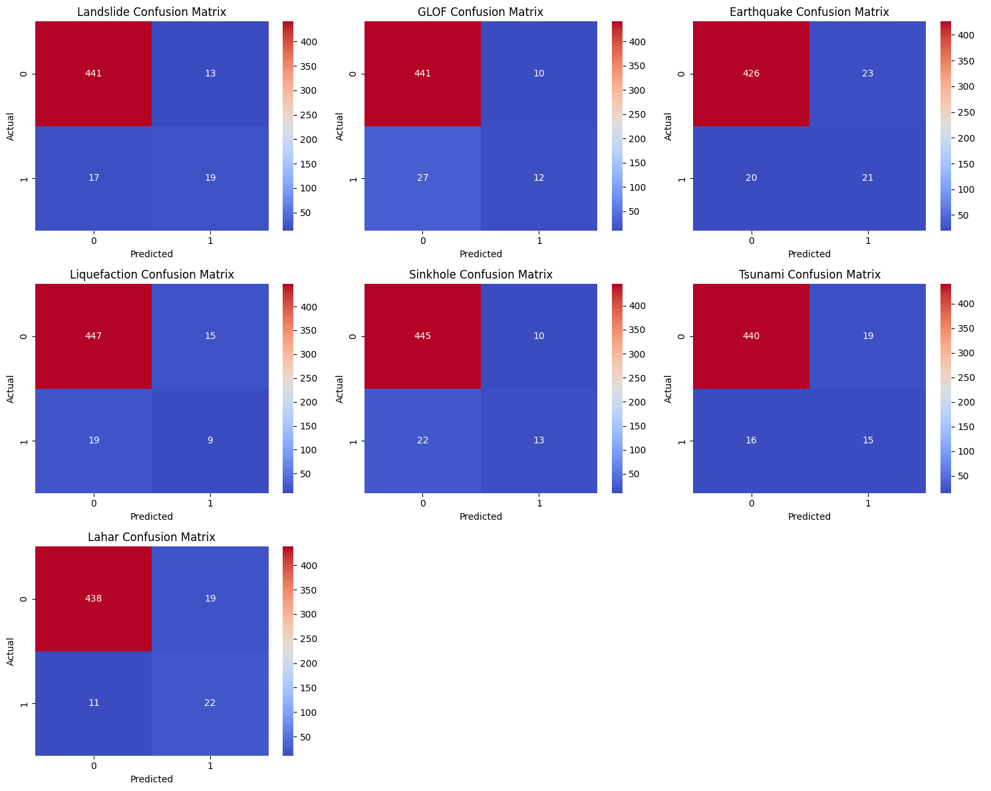

Slide 22
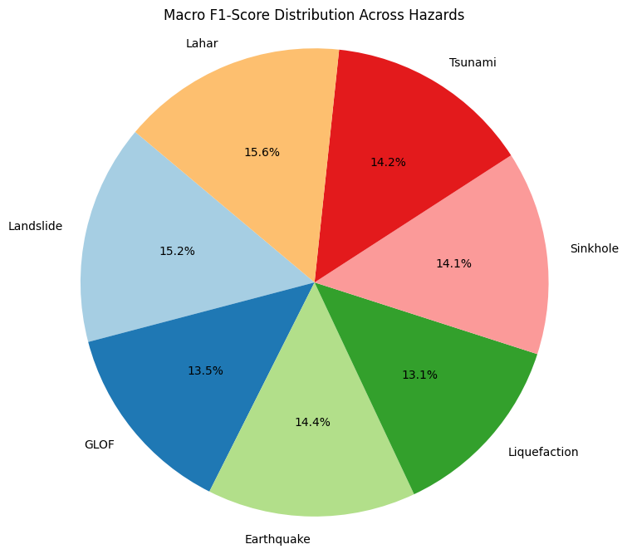

Slide 23
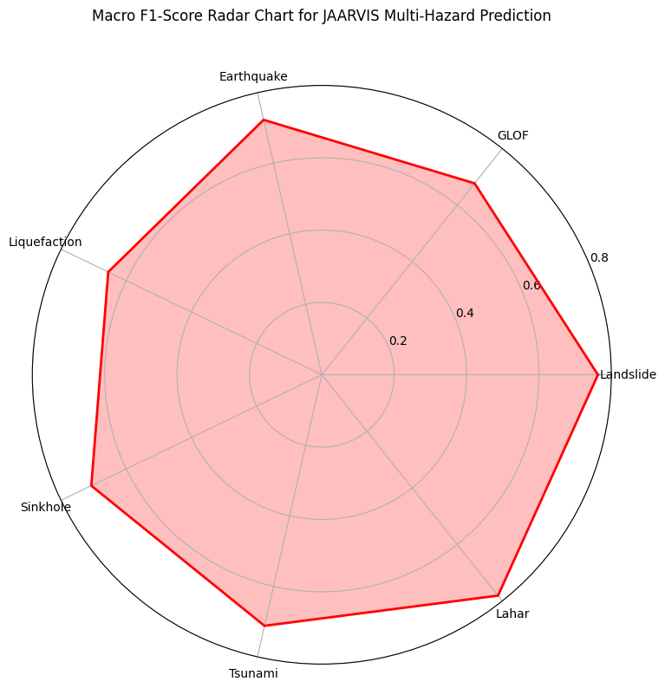

Slide 24
8. CONCLUSION
The JAARVIS system was successfully developed to predict and visualize multiple rare geo-hazards using a unified AI approach. By integrating datasets for seven hazard types and applying ensemble machine learning techniques, we built a multi-output prediction model with high accuracy. The use of Random Forest, XGBoost, and CatBoost in a voting ensemble allowed us to leverage the strengths of each algorithm. The model consistently achieved 92–94% accuracy across most hazard types. Visualization tools like bar plots, heatmaps, and radar charts made the predictions interpretable and dashboard-ready. JAARVIS represents a step forward in intelligent disaster forecasting and lays the groundwork for real-time alert systems.

Slide 25
9. FUTURE ENHANCEMENT
Integrate real-time geospatial and satellite APIs for live hazard data
Deploy JAARVIS as a web-based dashboard using Streamlit or React + Flask
Implement deep learning models (LSTM/CNN) for temporal hazard prediction
Host the system on cloud platforms (AWS/GCP) for scalability and accessibility
Add interactive maps using Folium or Leaflet for geo-visual risk overlays
Expand to include more rare hazards like avalanches, dust storms, or forest fires

Slide 26
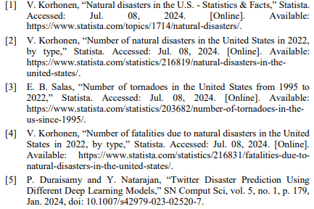
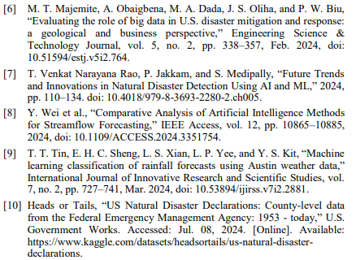
10. REFERENCES

