Slide 1

JAARVIS - JUSTIFIED ALERT AND REAL-TIME VISUALIZATION FOR INTELLIGENT SURVEILLANCE OF RARE GEO-HAZARDS
PROJECT TEAM
Shanthini P – 812621243049
Eisha Kanth – 812621243015
Rejoe Blesy A – 812621243036
Siva Sankari S – 812621243050
PROJECT GUIDE
Prof.K.Ilango – HOD / AI & DS

Slide 2
TABLE OF CONTENTS
Abstract
Objective
Domain of the Project
Existing and Proposed System
Methodology
Project Work Plan
Expected final outcome
Proposed Hardware and Software requirements
Base Paper
References

Slide 3
ABSTRACT
Rare geo-hazards such as Glacial Lake Outburst Floods (GLOFs), Soil Liquefaction, Tsunami-Induced Coastal Erosion, Sinkholes & Land Subsidence, Volcanic Mudflows (Lahars), Landslides, and Earthquakes pose significant threats but remain understudied and difficult to predict due to limited real-time data and inefficient early warning systems.
JAARVIS is an AI-powered multi-hazard surveillance system designed to evaluate, predict, and provide real-time alerts for these disasters. The system integrates machine learning, deep learning, and geospatial analysis, leveraging satellite imagery, seismic activity, climate trends, and terrain deformations to generate probabilistic risk forecasts with confidence intervals.

Slide 4
Using an interactive dashboard, JAARVIS provides:
Dynamic risk visualization of hazard-prone regions.
Automated alerts to authorities and communities.
Historical trend analysis for proactive disaster management.
By combining Informer Transformer for time-series forecasting, CatBoost & LightGBM for risk assessment, and ResNet-50 + U-Net for geospatial hazard mapping, JAARVIS enhances disaster preparedness with AI-driven predictive analytics and real-time decision support.

Slide 5
2. OBJECTIVE
To develop an AI-powered system for real-time monitoring and prediction of rare geo-hazards.
To integrate multiple data sources (satellite imagery, seismic activity, rainfall, soil conditions) for accurate risk assessment.
To implement machine learning and deep learning models for forecasting rare disasters.
To design an interactive dashboard for real-time hazard visualization and alerts.
To provide automated early warning alerts to authorities and the public for proactive disaster response.
To enhance decision-making through AI-driven predictive analytics and geospatial mapping.

Slide 6
3. DOMAIN OF THE PROJECT
Domain:
Artificial Intelligence & Geospatial Analysis for Rare Geo-Hazard Prediction and Disaster Management
Subdomains:
Geospatial Intelligence for Risk Assessment
Time-Series Forecasting for Environmental Disasters
Machine Learning and Deep Learning for Disaster Early Warning Systems
Automated AI-Based Surveillance and Prediction for Rare Geological Events

Slide 7
4. EXISTING AND PROPOSED SYSTEM
EXISTING SYSTEM
Focuses mainly on common hazards (floods, cyclones, earthquakes).
Lacks real-time integration of environmental and geospatial data.
Prediction models are not optimized for rare events.
No uncertainty estimation - Current systems give "yes/no" results instead of probability-based forecasts.
PROPOSED SYSTEM (JAARVIS)
Multi-hazard prediction system focused on rare geo-hazards.
Machine Learning & Deep Learning models for predictive analytics.
Real-time integration of satellite imagery, seismic data, climate patterns.
Dynamic risk visualization dashboard with automated alerts.

Slide 8
5. METHODOLOGY
Step 1: Data Collection
Historical Disaster Data - Past hazard occurrences, terrain changes, climate records.
Real-Time Environmental Data - Rainfall, soil moisture, seismic activity, glacial melt rate.
Satellite & Geospatial Data - DEM (Digital Elevation Models), Land Use, Oceanic trends.
Step 2: Data Preprocessing
Normalize & clean data for consistency.
Compute hazard-specific features (slope angle for landslides, groundwater depletion for sinkholes).
Label datasets for AI model training.
Step 3: AI Model Selection & Training
Risk Classification (CatBoost + LightGBM) - Identifies high-risk zones.
Time-Series Forecasting (Informer Transformer + SARIMA) - Predicts future hazards.
Geospatial Analysis (ResNet-50 + U-Net) - Maps hazard-prone regions.

Slide 9
Step 4: Risk Visualization & Alert System
Interactive dashboard with GIS-based risk zones.
Real-time hazard probability maps with color-coded alerts (green/yellow/red).
Automated alerts (SMS/Email/Push Notifications) for high-risk areas.
Step 5: Frontend & Dashboard Development
Technology Stack: Flask/Django (Backend) + HTML/CSS/JavaScript (Frontend)
Map Integration: Leaflet.js for interactive risk zone mapping
Live Data Display: Dynamic graphs (Plotly, Chart.js) for real-time hazard trends
User Input & Customization: Search for a location & view hazard probability & forecast
Alert System: Pop-up notifications for high-risk areas + optional SMS/Email alerts
Step 6: Testing & Validation
Compare AI predictions with historical events.
Check false alarm rates & model accuracy.
Simulate real-time hazard detection & dashboard functionality.

Slide 10
6. PROJECT WORK PLAN
Phase | Duration | Tasks
Phase 1 | Week 1 | Data Collection & Preprocessing
Phase 2 | Week 2 | ML Model Training (Ensemble ML + Time-Series AI)
Phase 3 | Week 3 | Model Integration with Real-Time Data Sources
Phase 4 | Week 4 | Dashboard Development & Visualization
Phase 5 | Week 5 | Testing, Validation & Accuracy Improvement
Final Phase | Week 6 | Documentation & Project Presentation

Slide 11
7. EXPECTED FINAL OUTCOME
A fully functional AI-powered geo-hazard prediction system.
Real-time monitoring dashboard for rare disasters.
Live risk maps with GIS visualization.
Automated alerts for authorities & communities.
Probabilistic forecasts with confidence intervals.
Integration of satellite & sensor data for accurate hazard prediction.

Slide 12
8. HARDWARE AND SOFTWARE REQUIREMENTS
HARDWARE REQUIREMENTS
SOFTWARE REQUIREMENTS
Component | Specification
Processor | Intel i5 or higher / Ryzen 5 or higher
RAM | 16GB (recommended for deep learning)
Storage | 500GB SSD
GPU (optional) | NVIDIA GTX 1660 or RTX 3060(for training)
External Devices | Optional IoT sensors (rain gauge, soil moisture sensor)
Component | Technology
OS | Windows 10/11 or Ubuntu
Language | Python 3.x
Libraries | TensorFlow, PyTorch, XGBoost, LightGBM, Pandas, NumPy
GIS Tools | QGIS, Rasterio, Geopandas
Backend | Flask / Django
Frontend | Leaflet.js, Dash, HTML, CSS
Data Sources | NASA EarthData, USGS, OpenWeatherMap, Copernicus Sentinel

Slide 13
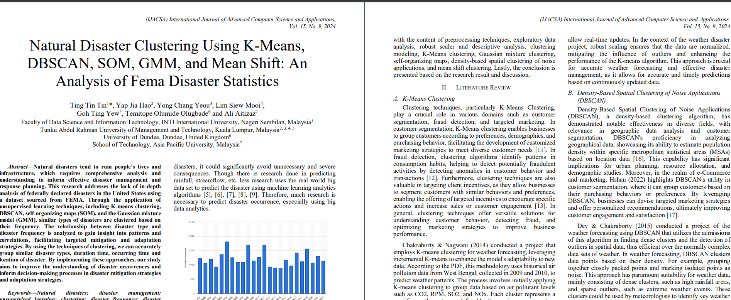
9. BASE PAPER

Slide 14
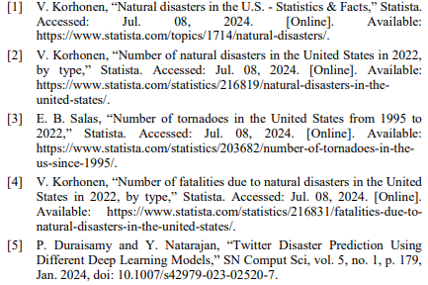
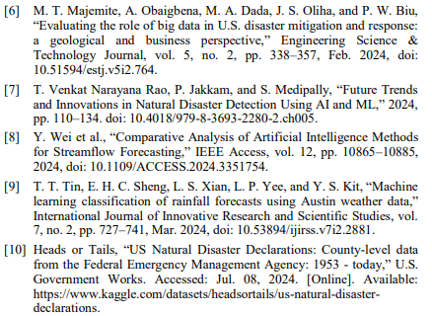
10. REFERENCES

