Slide 1

SONA COLLEGE OF TECHNOLOGY
(Autonomous)
Department of Master of Computer Applications
NGO MANAGEMENT SOFTWARE
Review - I
STUDENT NAME | REGISTER NUMBER
K.SHANTHINI | 61782324401049
PROJECT GUIDE | DESIGNATION
DR. K. SASIREKHA | Assistant Professor/MCA

Slide 2
COMPANY PROFILE
Company Name
ARCASCEND DIGITECH PRIVATE LIMITED
Company Type
Private Limited – IT & Software Solutions
Registered Office
207-B, Mathur MMDA, Mathur Main Road,
Mathur, Chennai – 600068
Domain
Web Application Development & Digital Solutions
ARCASCEND DIGITECH PRIVATE LIMITED is a technology-focused organization providing software development solutions for real-world applications. The company supports academic and industry-oriented projects and offers internship training in full stack development. The organization emphasizes modern technologies, secure application development, and practical learning.

Slide 3
ABSTRACT
NGO Management Software is a web-based application designed to manage and automate the day-to-day activities of Non-Governmental Organizations. Many NGOs face difficulties in handling donor records, beneficiaries, projects, and financial reports manually. This project aims to develop a centralized system that allows NGOs to efficiently manage data related to donations, volunteers, events, and beneficiaries. The system improves accuracy, transparency, and accessibility of information while reducing paperwork and manual effort. The application is developed using modern full-stack technologies to ensure scalability and ease of use.

Slide 4
PROBLEM STATEMENT
Non-Governmental Organizations (NGOs) operate in the social welfare domain and manage activities such as donors, volunteers, beneficiaries, and fund distribution. Many NGOs still use manual records or spreadsheet-based systems for data management.
The key problem is the absence of a centralized and automated system to manage NGO operations efficiently, making data handling slow and error-prone.
This issue affects transparency, accountability, and decision-making, as data errors or loss can impact NGO services. Existing systems also suffer from limitations such as data redundancy, poor security, and difficulty in report generation.
This project aims to develop a web-based NGO Management Software to automate operations and provide a secure, centralized platform. The scope includes managing NGO administrative data but excludes external auditing and third-party integrations. The solution uses modern web technologies to ensure secure and efficient data management.

Slide 5
OBJECTIVES
Develop a web-based NGO Management Software to manage organizational activities efficiently.
Automate the management of donors, volunteers, beneficiaries, and NGO records.
Implement secure user authentication to protect sensitive data.
Design a centralized database for accurate and reliable data storage.
Improve transparency, efficiency, and ease of access to organizational information.

Slide 6
EXISTING SYSTEM
The existing system relies on:
Manual record keeping
Excel sheets
Paper-based documentation
These methods are simple but inefficient for large-scale NGO operations.

Slide 7
LIMITATIONS OF EXISTING SYSTEM
Data redundancy and inconsistency
High risk of data loss
Lack of security
Time-consuming data retrieval
Difficult report generation

Slide 8
PROPOSED SYSTEM
The proposed system is a web-based NGO Management Software that provides:
Centralized database management
Secure login using JWT authentication
Automated data handling
Easy access and reporting

Slide 9
ADVANTAGES OF PROPOSED SYSTEM
Centralized data management
Reduced manual work and errors
Improved transparency and accountability
Faster report generation
Secure data storage and access control
User-friendly interface
Better decision-making support

Slide 10
HARDWARE SPECIFICATION
Processor: Intel i5 or above
RAM: 8 GB minimum
Hard Disk: 256 GB
System Type: 64-bit

Slide 11
SOFTWARE SPECIFICATION
Operating System: Windows / Linux
Backend: Python Flask
Frontend: Vue.js 3
Database: MySQL
Tools: VS Code, Git, Browser

Slide 12
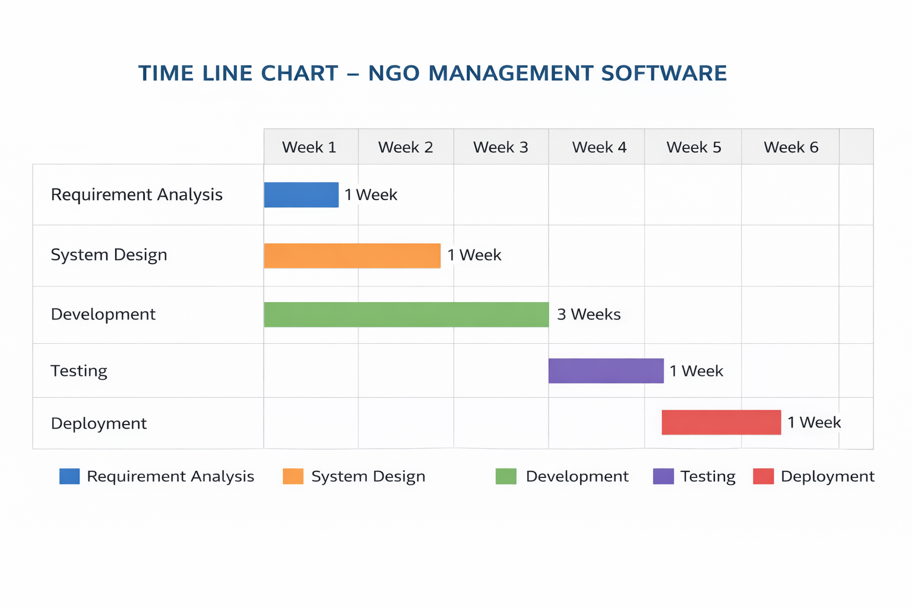
TIME LINE CHART

Slide 13
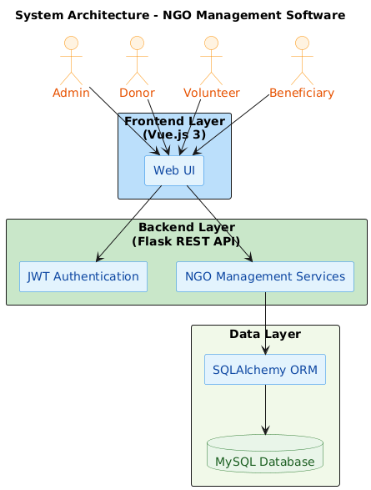
SYSTEM DESIGN
System Architecture diagram of NGO Software

Slide 14
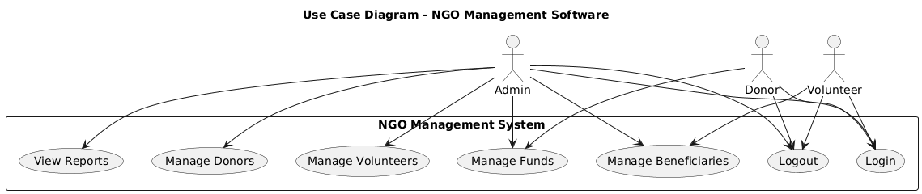
SYSTEM DESIGN
Use case diagram of NGO Software

Slide 15
DATABASE DESIGN
TABLE 1. USER TABLE DESIGN
Table Name: users
Fields | Description | Data Type | Key Constraints
user_id | Unique identifier for user | int(30) | Primary Key
username | Login username | varchar(100) | Not Null
password | Encrypted password | varchar(200) | Not Null
role | User role (Admin/Staff) | varchar(50) | Not Null

Slide 16
DATABASE DESIGN
TABLE 2. DONOR TABLE DESIGN
Table Name: donors
Fields | Description | Data Type | Key Constraints
donor_id | Unique identifier for donor | int(30) | Primary Key
donor_name | Name of the donor | varchar(200) | Not Null
donor_email | Email address of donor | varchar(200) | Not Null
donor_phone | Contact number | varchar(15) | Not Null

Slide 17
DATABASE DESIGN
TABLE 3. VOLUNTEER TABLE DESIGN
Table Name: volunteers
Fields | Description | Data Type | Key Constraints
volunteer_id | Unique identifier for volunteer | int(30) | Primary Key
volunteer_name | Name of the volunteer | varchar(200) | Not Null
volunteer_email | Email address | varchar(200) | Not Null
volunteer_phone | Contact number | varchar(15) | Not Null

Slide 18
DATABASE DESIGN
TABLE 4. BENEFICIARY TABLE DESIGN
Table Name: beneficiaries
Fields | Description | Data Type | Key Constraints
beneficiary_id | Unique identifier for beneficiary | int(30) | Primary Key
beneficiary_name | Name of the beneficiary | varchar(200) | Not Null
age | Age of beneficiary | int(5) | Not Null
address | Address details | text | Not Null

Slide 19
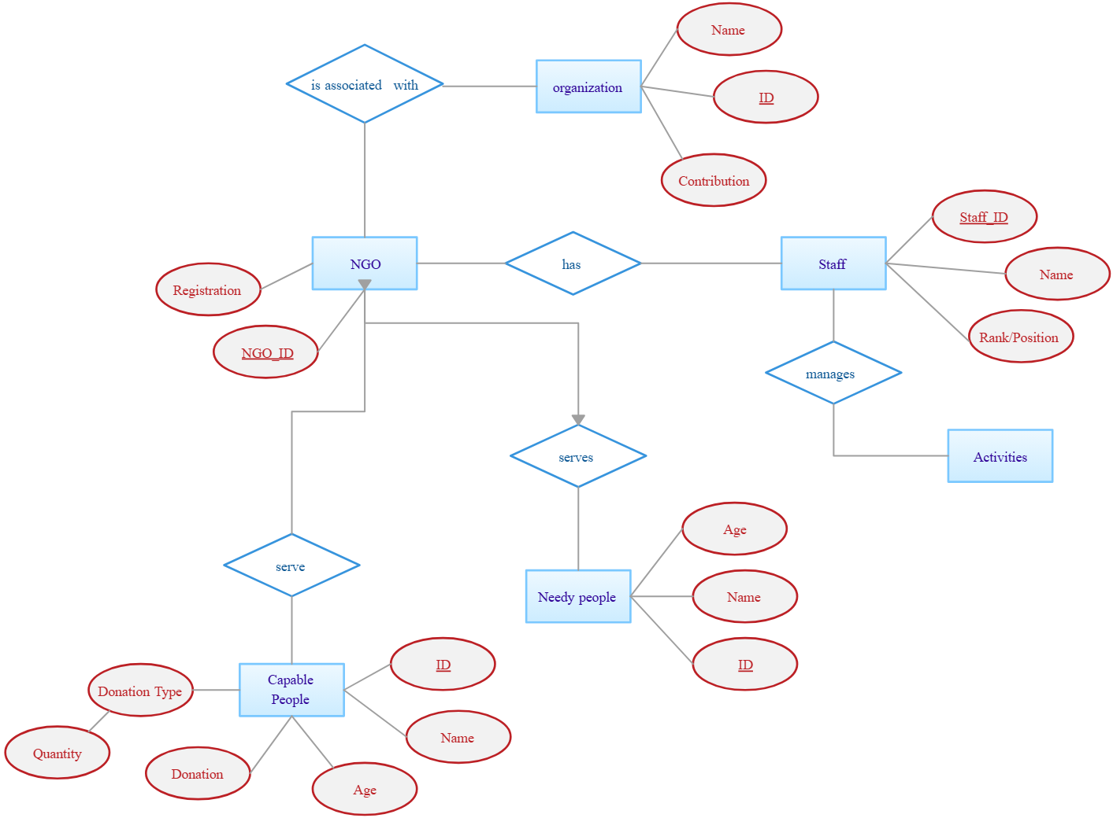
SYSTEM DESIGN
Entity Relationship diagrams of NGO Software.

Slide 20
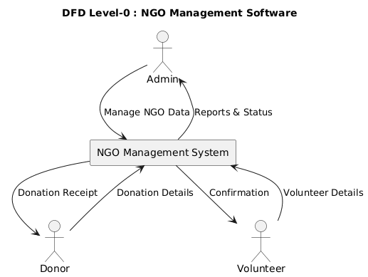
SYSTEM DESIGN

Slide 21
REFERENCES
Flask Documentation – https://flask.palletsprojects.com
Vue.js Official Documentation – https://vuejs.org
MySQL Documentation – https://dev.mysql.com/doc/
SQLAlchemy Documentation – https://docs.sqlalchemy.org
JWT Authentication Standard – https://jwt.io/introduction
Pressman, R. S., Software Engineering: A Practitioner’s Approach, McGraw-Hill.
Sommerville, I., Software Engineering, Pearson Education.
NGO Management System Concepts – https://www.techopedia.com
UML and DFD Standards – https://www.visual-paradigm.com

Slide 22
THANK YOU

