Slide 1
Identify Diversely Owned/Led Business
Design Approach – Agile Techies

Slide 2
Pitch Document
The Diversity Led Business Identification tool created as part of this hackathon is a simple, self-service automated tool that helps the user to identify the diversity dimensions of the ownership and/or the leadership of these commercial customers and/or prospects.
This tool helps in increased opportunities to provide access to capital and become the bank of choice for the diversified owned/led business.
Key points and features that makes our solution exceptional:
Reduction in human bias and error in identification, with effort and cost savings of approx. 30% (once the multi processing feature is implemented as part of the future scope, effort savings would go up to 90%)
Application hosted on cloud resulting in increased server time, scalability, better security and performance
Helmet and Express Rate limit used as a security feature to control XSS and Denial of Service(DoS) from the front end in turn helping mitigate cross-site scripting attacks, misused SSL certificates etc
A complete application which has adopted the 6S strategy as part of its solution
Solutionized by an erudite agile team using tools such as NodeJs, Python, NLTK/NLP, Yugabyte DB, HTML, CSS, Azure,GIT and Visual Studio Code

Slide 3

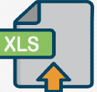












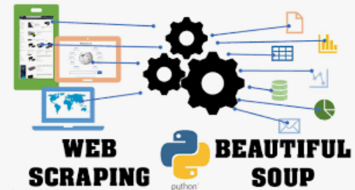
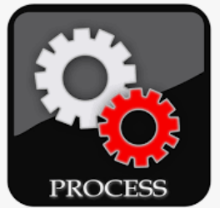

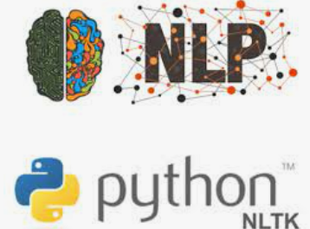
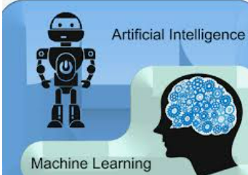
Design Architecture
1
2
The Actor/User enters the URL of the commercial customers and/or prospects in the browser
The Actor/User enters the DUNS Number, DUNS Name and DUNS URL into the front end application
The request is fed into the database upon submission in the front end and the data gets stored into the database
Parallelly the python script is called to run the logic of web scraping, NLP, text mining and keyword mapping
The diverse segments are identified and updated back to the database
Once database is updated the results are displayed in the front end
The Application is hosted on the cloud
Cloud
Frontend Tools
User Interface
6
3
7
Database
Code Repository
Text Processor
5
4
Deployment
Web Crawling
Web Scraping
Text Mining Using NLP
Keyword Mapping

Slide 4
Future Scope
Bulk Upload with multi-processing to be enabled for better efficiency along with effort and cost savings
Additional security aspects to be incorporated which would address Authentication, Authorization, Encryption, Logging, Monitoring and Application security testing
Creation of the dashboard in the results page for graphical representation of diversity dimensions of the ownership and/or the leadership of the commercial customers and/or prospects.
In absence of information from the DUNS URL, extraction of information from LinkedIn
Extraction of information from websites with popup design for diversity decision

Slide 5
Traceability Matrix

Slide 6

Thank You

