Slide 1

Predicting Mental Health Illness of Working Professionals Using Machine Learning
Project Supervisor: M. Madhavi
Name of the Student: Shanthosh V.A
Register Number: 40111182
17 April 2023
Department of CSE

Slide 2
Presentation Outline
Course Certificate
Introduction
Objectives
System Architecture / Ideation Map
Module Implementation
Application Snapshots
Results and Discussions
Conclusion & Future work
References
17 April 2023
Department of CSE

Slide 3
Course Certificate

Slide 4
Introduction
Mental Health First Aid teaches participants how to notice and support an individual who may be experiencing a mental health or substance use concern or crisis and connect them with the appropriate employee resources.
Employers can offer robust benefits packages to support employees who go through mental health issues. That includes Employee Assistance Programs, Wellness programs that focus on mental and physical health, Health and Disability Insurance, or flexible working schedules or time off policies. Organizations that incorporate mental health awareness help to create a healthy and productive work environment that reduces the stigma associated with mental illness, increases the organizations' mental health literacy, and teaches the skills to safely and responsibly respond to a co-worker's mental health concern.
The main purpose of the Mental Health Prediction system is to predict whether a person needs to seek Mental health treatment or not based on inputs provided by them.
We will be using classification algorithms such as Logistic Regression, KNN, Decision tree, Random Forest, AdaBoost, GradientBoost, and XGBoost. We will train and test the data with these algorithms. From this, the best model is selected and saved in pkl format. We will also be deploying our model locally using Flask.
17 April 2023
Department of CSE

Slide 5
Objectives
Project objectives are -
• Know fundamental concepts and techniques used for machine learning.
• Gain a broad understanding of data.
• Have knowledge of pre-processing the data/ transformation techniques and some visualization concepts before building the model
• Learn how to build a machine learning model and tune it for better performance
• Know how to evaluate the model and deploy it using flask
17 April 2023
Department of CSE

Slide 6
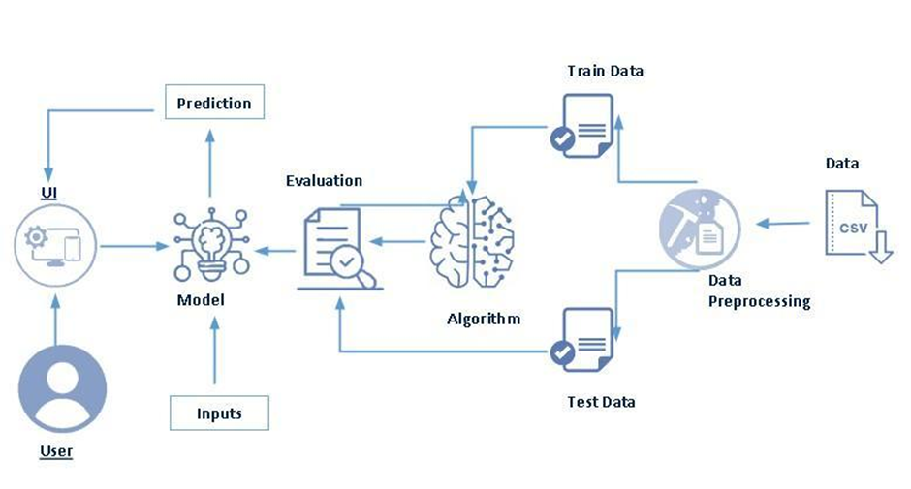
System Architecture/ Ideation Map
17 April 2023
Department of CSE
11 November 2021
Department of CSE
6

Slide 7
Project Implementation
The user interacts with the UI to enter the input.
Entered input is analyzed by the model which is integrated.
The predictions made by the model are showcased on the UI
To accomplish this, we have to complete all the activities listed below
Data collection
Collect the dataset or create the dataset
Data pre-processing
Removing unnecessary columns
Checking for null values
17 April 2023
Department of CSE

Slide 8
Project Implementation contd..
Visualizing and analyzing data
Univariate analysis
Bivariate analysis
Descriptive analysis
Model building
Handling categorical values
Dividing data into train and test sets
Import the model building libraries
Comparing the accuracy of various models
Hyperparameter tuning of the selected model
Evaluating the performance of models
Save the model
17 April 2023
Department of CSE

Slide 9
Project Implementation contd..
Application Building
Create an HTML file
Build python code
17 April 2023
Department of CSE

Slide 10
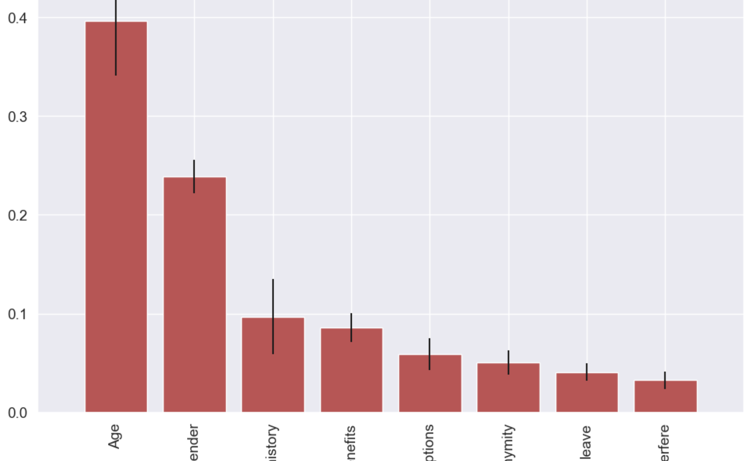

Slide 11
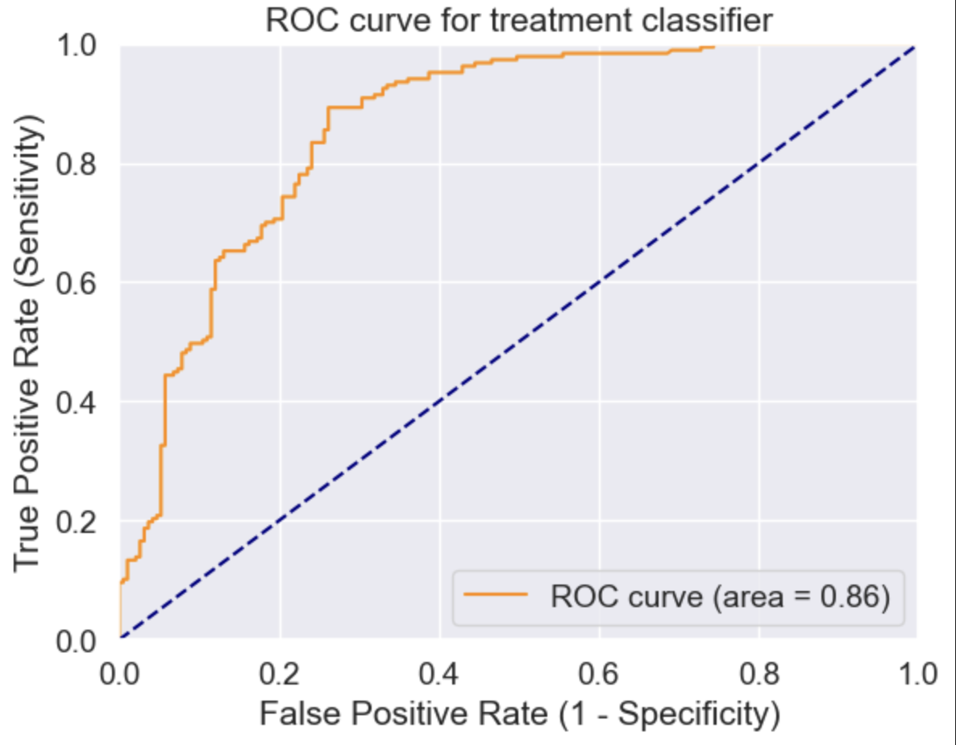
Logistic Regression

Slide 12
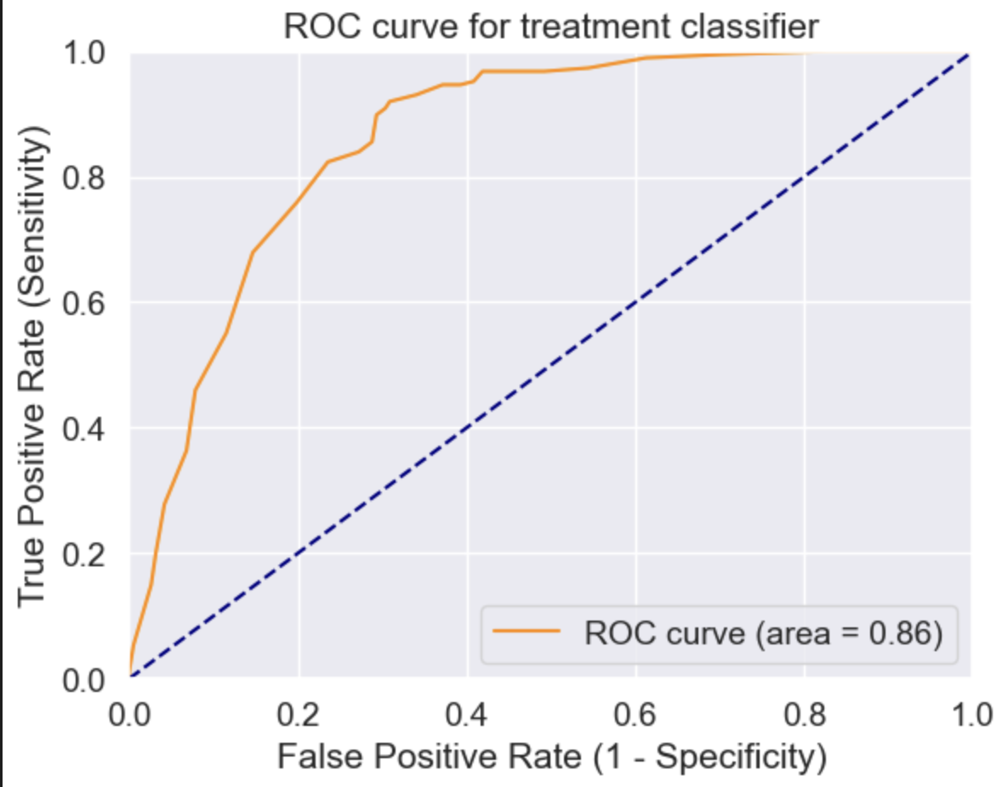
KNN

Slide 13
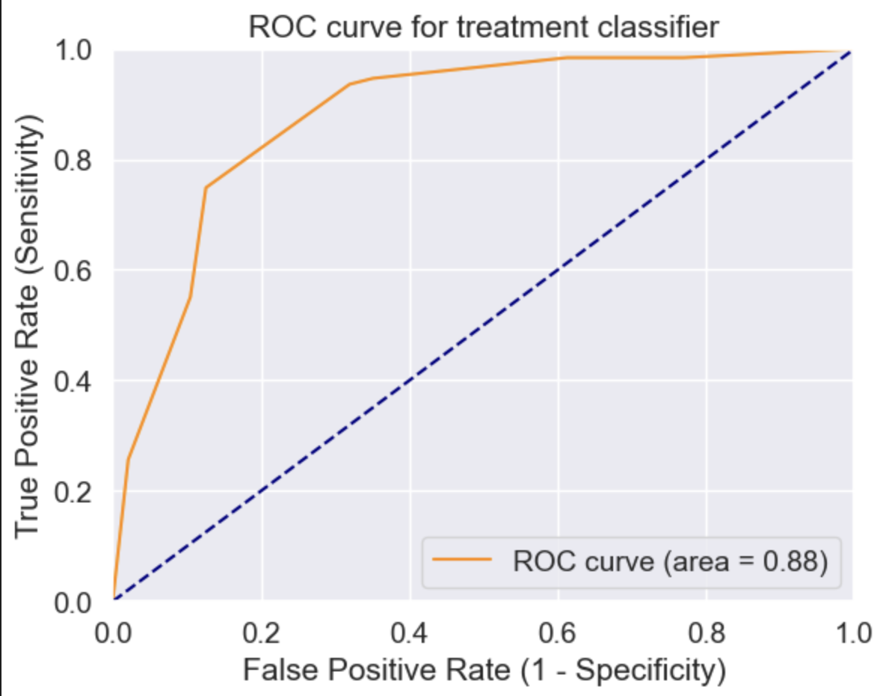
Decision Tree

Slide 14
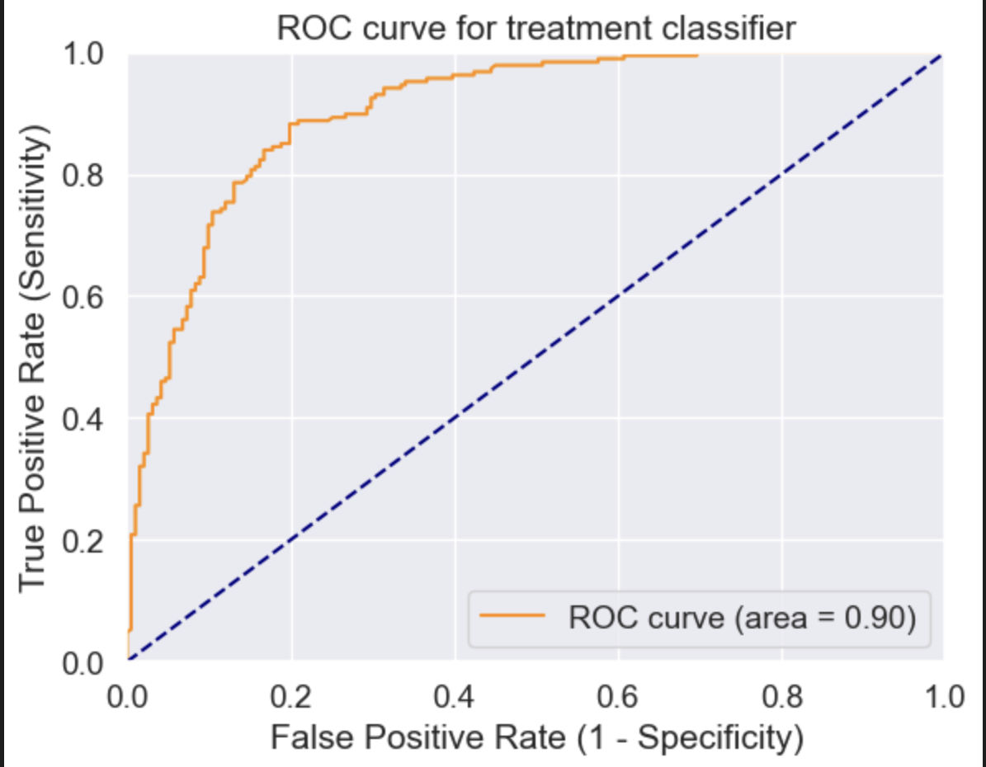
RandomForest

Slide 15
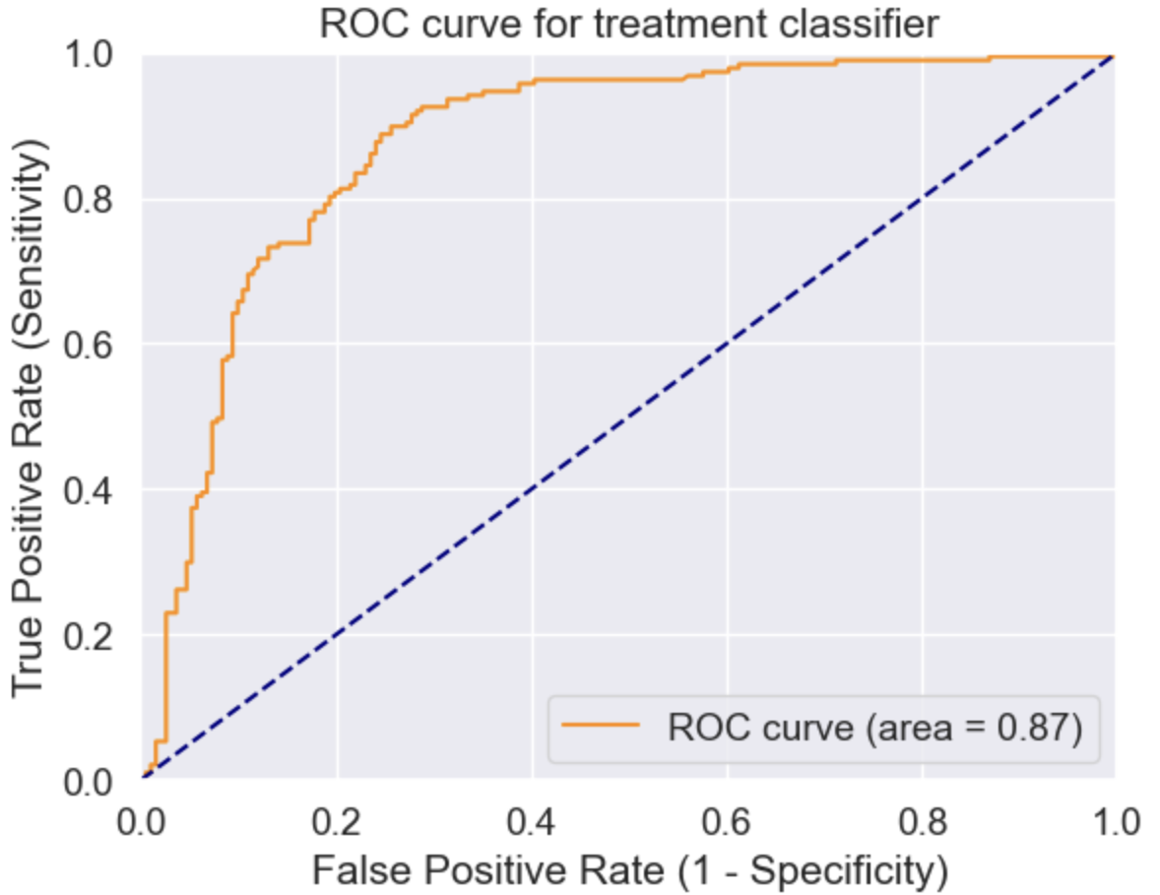
Boosting

Slide 16
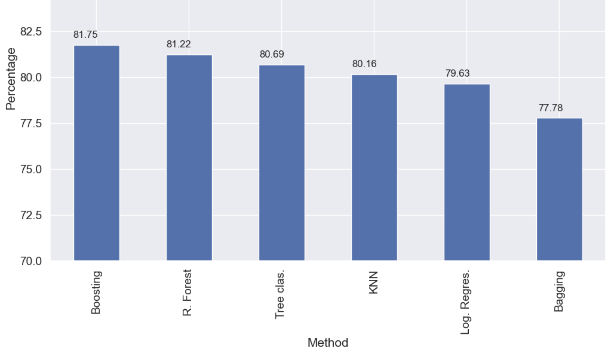

Slide 17
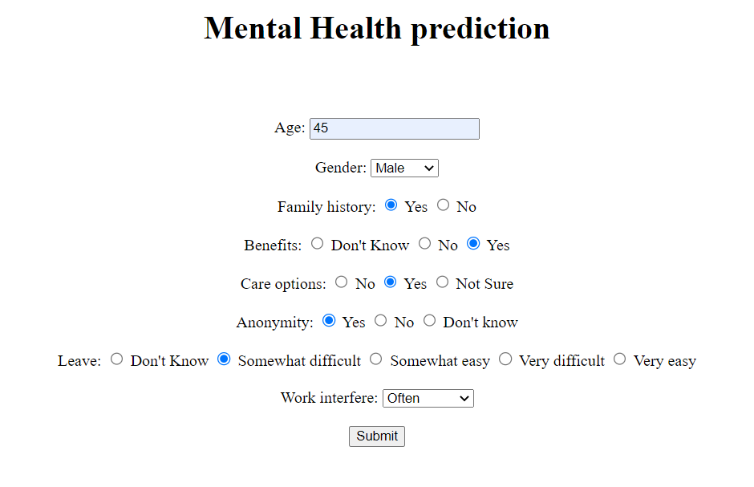
Sample Snapshot
17 April 2023
Department of CSE

Slide 18
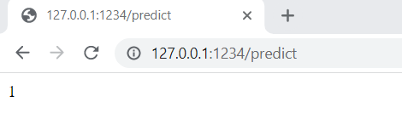
Results and Discussion
Output 1 represents this person requires mental health treatment based on the inputs provided by them.
17 April 2023
Department of CSE

Slide 19
Conclusion
This project helps a person to predict whether he is experiencing mental illness.
17 April 2023
Department of CSE

Slide 20
References
Survey on Mental Health in the Tech Workplace in 2014
https://www.kaggle.com/datasets/osmi/mental-health-in-tech-survey
17 April 2023
Department of CSE

Slide 21
THANK YOU
17 April 2023
Department of CSE

