Slide 1
Compiler Design
F.M. Rahat Hasan
Dept. of CSE, BSMRSTU

Slide 2
Contents
Introduction
A Simple Syntax-Directed Translator
Lexical Analysis
Syntax Analysis
Syntax-Directed Translation
Intermediate-Code Generation
Type Checking
Run-time Environments
Code Generation
Code Optimization

Slide 3
Introduction
Programming languages are notations for describing computations to people & to machines
World depends on Programming Languages
Compilers
Areas:
Compiler construction
Write up Programming languages
Machine architecture
Language theory
Algorithms
Software engineering

Slide 4
Language Processors
Compiler: is a program that can read a program in one language (source language) and translate it into an equivalent program in another language (target language)
The essential interface between applications & architectures
Compiler
Source program
Target program
Mapping inputs to outputs

Slide 5
Language Processors
Target
Program (exe)
Input
Output
Interpreter: instead of producing a target program as a translation, an interpreter appears to directly execute the operations specified in the source program on inputs
Source program
Interpreter
Output
input
Statement-by-statement

Slide 6
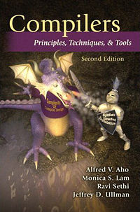
Recommended Book
Compilers: Principles, Techniques, and Tools
-Alfred V. Aho
-Ravi Sethi
-Jeffrey D. Ullman

Slide 7
Requirements
Basic Requirements
Work on your homework individually.
Discussions are encouraged but don’t copy others’ work.
Get you hands dirty!
Experiment with ideas presented in class and gain first-hand knowledge!
Come to class and DON’T hesitate to speak if you have any questions/comments/suggestions!
Student participation is important!

Slide 8
Compiler vs. Interpreter (1/5)
Compilers: Translate a source (human-writable) program to an executable (machine-readable) program
Interpreters: Convert a source program and execute it at the same time.

Slide 9
Compiler vs. Interpreter (2/5)
Ideal concept:
Source code
Compiler
Executable
Input data
Executable
Output data
Source code
Interpreter
Output data
Input data

Slide 10
Compiler vs. Interpreter (3/5)
Most languages are usually thought of as using either one or the other:
Compilers: FORTRAN, COBOL, C, C++, Pascal, PL/1
Interpreters: Lisp, scheme, BASIC, APL, Perl, Python, Smalltalk
BUT: not always implemented this way
Virtual Machines (e.g., Java)
Linking of executables at runtime
JIT (Just-in-time) compiling

Slide 11
Compiler vs. Interpreter (4/5)
Actually, no sharp boundary between them. General situation is a combo:
Source code
Translator
Virtual
machine
Intermed. code
Output
Input data
Java source program may first be compiled into an intermediate
code (Bytecodes)
Bytecodes are then interpreted by a virtual machine.
Benefit: bytecodes compiled on one machine can be interpreted
on another machine (network)

Slide 12
Compiler vs. Interpreter (5/5)
Compiler
Pros
Less space
Fast execution
Cons
Slow processing
Partly Solved (Separate compilation)
Debugging
Improved thru IDEs
Interpreter
Pros
Easy debugging
Fast Development
Cons
Not for large projects
Exceptions: Perl, Python
Requires more space
Slower execution
Interpreter in memory all the time

Slide 13
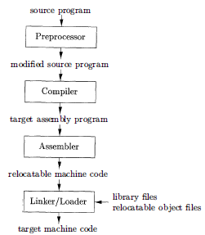
A Language Processing System
The task of collecting the source program is sometimes entrusted to a separate program (preprocessor)
The linker resolves external memory addresses, where the code in one file may refer to a location in another file.
The loader then puts together all of the executable object files into memory for execution.
Macro

Slide 14
Structure of A Compiler
Compiler
Analysis
Synthesis
Intermediate code
+
Symbol table
=
Target code
Back End
Breaks source program (constituent parts)
Impose grammatical structure (Lexical, syntax, semantic)
Intermediate source code
Error checks
Stored in Symbol table
Front End

Slide 15
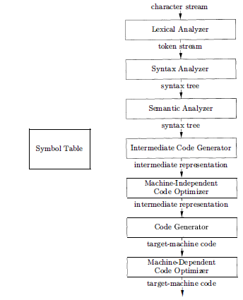
Phase of compilations

Slide 16
Scanning/Lexical analysis
Break program down into its smallest meaningful symbols (tokens, atoms, lexemes)
Tools for this include lex, flex
Tokens include e.g.:
“Reserved words”: do if float while
Special characters: ( { , + - = ! /
Names & numbers: myValue 3.07e02
Start symbol table with new symbols found

Slide 17
Scanning/Lexical analysis
For each lexeme, lexical analyzer produces as output a token: <token-name, attribute-value>
token- name: abstract symbol that is used during syntax analysis ,
attribute-value: points to an entry in the symbol table for this token.

Slide 18
Scanning/Lexical analysis
Assignment Statement (source program):
Lexemes:
posit ion = initial + rate * 60
position is a lexeme that would be mapped into a token <id, 1>, where id is an abstract symbol standing for identifier and 1 points to the symbol table entry for position.
The symbol-table entry for an identifier holds information about the identifier, such as its name and type.

Slide 19
Scanning/Lexical analysis
2. The assignment symbol = is a lexeme that is mapped into the token <=>.
3. initial is a lexeme that is mapped into the token <id, 2> , where 2 points to the symbol-table entry for initial
4. + is a lexeme that is mapped into token <+>
5. rate is a lexeme that is mapped into the token <id, 3> , where 3 points to the symbol-table entry for rate.

Slide 20
Scanning/Lexical analysis
6. * is a lexeme that is mapped into token <*>
7. 60 is a lexeme that is mapped into the token <60>
Blanks (White Space) separating the lexemes would be discarded by the lexical analyzer.
After lexical analysis as the sequence of tokens
<id, 1> < = > <id, 2> <+ > <id, 3> <*> <60>

Slide 21
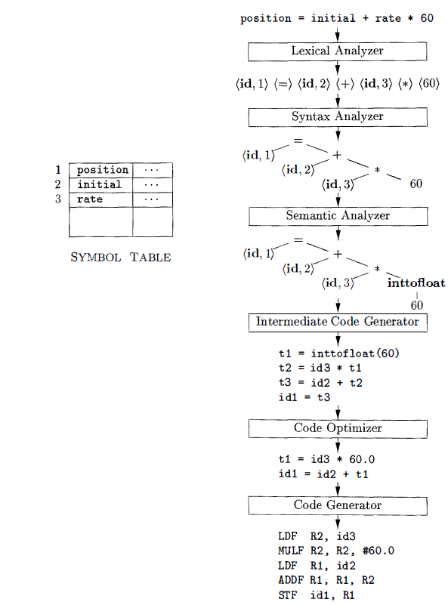
Translation of an assignment statement

Slide 22

Parsing/Syntax Analysis
The parser create a tree-like intermediate representation that depicts the grammatical structure of the token stream.
A typical representation is a syntax/parse tree in which each interior node represents an operation and the children of the node represent the arguments of the operation.

Slide 23
Parsing/Syntax Analysis
This tree shows the order in which the operations in the assignment are to be performed:
position = initial + rate * 60
The tree has an interior node labeled * with <id, 3> as its left child and the integer 60 as its right child. The node <id, 3> represents the identifier rate.
The node labeled * makes it explicit that we must first multiply the value of rate by 60.
The node labeled + indicates that we must add the result of this multiplication to the value of initial.

Slide 24
Parsing/Syntax Analysis
The root of the tree, labeled =, indicates that we must store the result of this addition into the location for the identifier position.
This ordering of operations is consistent with the usual conventions of arithmetic which tell us
multiplication has higher precedence than addition, and hence that the multiplication is to be performed before the addition.

Slide 25
Semantic Analysis
The semantic an analyzer uses the syntax tree & the information in the symbol table to check the source program for semantic consistency with the language definition.
It also gathers type information & saves it in either the syntax tree or the symbol table, for subsequent use during intermediate-code generation.

Slide 26
Semantic Analysis
Important part: type checking
compiler checks that each operator has matching operands.
Ex: many programming language definitions require an array index to be an integer;
the compiler must report an error if a floating-point number is used to index an array.

Slide 27
Semantic Analysis
The language specification may permit some type conversions called coercions.
Suppose that position, initial, and rate have been declared to be floating-point numbers, and that the lexeme 60 by itself forms an integer.
The type checker discovers that the operator * is applied to a floating-point number rate & an integer 60.

Slide 28
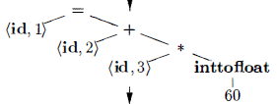
Semantic Analysis
In this case, the integer may be converted into a floating-point number.
The output of the semantic analyzer has an extra node for the operator inttofloat , which explicitly converts its integer argument into a floating-point number.

Slide 29
Intermediate Code Generation
one or more intermediate representations, which can have a variety of forms.
Syntax trees are a form of intermediate representation; they are commonly used during syntax and semantic analysis.
02 important properties:
it should be easy to produce
it should be easy to translate into the target machine

Slide 30

Intermediate Code Generation
Three-address code: a sequence of assembly-like instructions with three operands per instruction.
Each operand can act like a register.

Slide 31
Intermediate Code Generation
Properties:
Each three-address assignment instruction has at most one operator on the right side.
Compiler must generate a temporary name to hold the value computed by a three-address instruction.
Some "three-address instructions“ have fewer than three operands.

Slide 32
Code Optimization
The code-optimization phase attempts to improve the intermediate code so that better target code will result.
Better means faster,
shorter code, or target code that consumes less power.
Ex: a straightforward algorithm generates the intermediate code, using an instruction for each operator in the tree representation that comes from the semantic analyzer.

Slide 33

Code Optimization
The optimizer can deduce that the conversion of 60 from integer to floating point can be done once and for all at compile time,
so the inttofloat operation can be eliminated by replacing the integer 60 by the floating-point number 60.0.
Moreover, t₃ is used only once to transmit its value to id₁ so the optimizer can transform into the shorter sequence

Slide 34
Code Generation
The code generator takes as input an intermediate representation of the source program and maps it into the target language.
If the target language is machine code, registers or memory locations are selected for each of the variables used by the program.
Then, the intermediate instructions are translated into sequences of machine instructions that perform the same task.

Slide 35
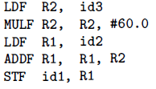
Code Generation
Ex: using registers R1 and R2, the intermediate code in might get translated into machine code:
The first operand of each instruction specifies a destination.
The F in each instruction tells us that it deals with floating-point numbers

Slide 36
Code Generation
The code loads the contents of address id3 into register R2,
then multiplies it with floating-point constant 60.0.
The # signifies that 60.0 is to be treated as an immediate constant
The third instruction moves id2 into register R1
fourth adds to it the value previously computed in register R2.
Finally, the value in register R1 is stored into the address of id1
so the code correctly implements the assignment statement
position = initial + rate * 60

Slide 37
Symbol-Table Management
An essential function of a compiler
is to record the variable names used in the source program
collect information about various attributes of each name.
These attributes may provide information about
the storage allocated for a name, its type, its scope (where in the program its value may be used), and in the case of procedure names, such things as the number and types of its arguments, the method of passing each argument (for example, by value or by reference), and the type returned.
The symbol table is a data structure containing a record for each variable name, with fields for the attributes of the name.
The data structure should be designed to allow the compiler to find the record for each name quickly & to store or retrieve data from that record quickly.

Slide 38
Compiler Construction Tools
The compiler writer, can profitably use modern software development environments:
Tools: language editors, debuggers, version managers, profilers, test harnesses, and so on.
Properties of the Most successful tools:
hide the details of the generation algorithm
produce components that can be easily integrated into the remainder of the compiler.

Slide 39
Commonly used Compiler Construction Tools
1. Parser generators that automatically produce syntax analyzers from a grammatical description of a programming language.
2. Scanner generators that produce lexical analyzers from a regular-expression description of the tokens of a language.
3. Syntax-directed translation engines that produce collections of routines for walking a parse tree and generating intermediate code.

Slide 40
Commonly used Compiler Construction Tools
4. Code-generator generators that produce a code generator from a collection of rules for translating each operation of the intermediate language into the machine language for a target machine.
5. Data-flow analysis engines that facilitate the gathering of information about how values are transmitted from one part of a program to each other part.
Data-flow analysis is a key part of code optimization.
6. Compiler- construction toolkits that provide an integrated set of routines for constructing various phases of a compiler.

Slide 41
The Evaluation of Programming Language
1940: 1st electronic computer
Programmed: machine language (by sequences of 0's and 1 's) that explicitly told the computer what operations to execute and in what order.
Limitations: Operations in very low level:
move data from one location to another, add the contents of two registers, compare two values , & so on.
Disadv: programming was slow, tedious, and error prone.
once written, the programs were hard to understand & modify.

Slide 42
The Move to Higher-level Language
Early 1950: Assembly languages (mnemonic)
Later, macro instructions were added to assembly languages so that a programmer could define parameterized shorthands for frequently used sequences of machine instructions.

Slide 43
The Move to Higher-level Language
Latter half of the 1950's: A major step towards higher-level languages was made
Fortran for scientific computation,
Cobol for business data processing,
Lisp for symbolic computation.
The philosophy behind these languages was to create higher-level notations with which programmers could more easily write numerical computations, business applications, and symbolic programs.
These languages were so successful that they are still in use today.

Slide 44
Classification
Today, there are thousands of programming languages.
Classification:
1. According to Generation
First-generation: machine languages
Second-generation: assembly languages,
Third-generation: higher-level languages (Fortran, Cobol, Lisp, C, C++, C#, and Java)
Fourth-generation: designed for specific applications like NOMAD for report generation, SQL for database queries, and Postscript for text formatting.
Fifth-generation: applied to logic- and constraint-based languages (Prolog and OPS5)

Slide 45
Classification
2. imperative for languages
a program specifies how a computation is to be done and declarative for languages in which a program specifies what computation is to be done.
Languages such as C, C++, C#, and Java are imperative languages.
In imperative languages there is a notion of program state and statements that change the state.
Functional languages such as ML and Haskell and constraint logic languages such as Prolog are often considered to be declarative languages.

Slide 46
Classification
3. von Neumann language
computational model is based on the von Neumann computer architecture.
Fortran and C are von Neumann languages.

Slide 47
Classification
4. An object-oriented language
supports object-oriented programming, a programming style in which a program consists of a collection of objects that interact with one another.
Simula 67 and Smalltalk are the earliest major object-oriented languages.
C++, C#, Java, and Ruby are more recent object-oriented languages.

Slide 48
Classification
5. Scripting languages
interpreted languages with high-level operators designed for "gluing together" computations.
These computations were originally called "scripts."
Awk, JavaS cript, Perl, PHP, Python, Ruby, and Tel are popular examples of scripting languages.
Programs written in scripting languages are often much shorter than equivalent programs written in languages like C.

Slide 49
Application of Compiler Technology
Implementation of High-level programming language
Optimizations for Computer Architecture: parallelism, Memory Hierarchies
Design of New Computer Architecture: RISC, Specialized architecture
Debugging
Fault location
Model checking in formal analysis
Model-driven development
Optimization techniques in software engineering
Program Translation: Binary translation, Hardware synthesis, database query interpreters
Software productivity tools: Type checking, bounds checking, memory-management, software maintenance
Visualizations of analysis results

Slide 50
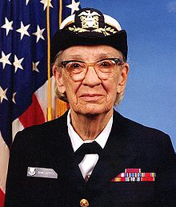

Compiler Scientist
The first compiler was written by Grace Hopper, in 1952, for the A-0 programming language. [COBOL]
(1906 – 1992)
The first autocode and its compiler were developed by Alick Glennie in 1952 for the Mark 1 computer at the University of Manchester and is considered by some to be the first compiled programming language.
(1925-2003)

Slide 51



The FORTRAN team led by John Backus at IBM is generally credited as having introduced the first complete compiler in 1957.
BNF
1924 – 2007
The first self-hosting compiler – capable of compiling its own source code in a high-level language – was created in 1962 for Lisp by Tim Hart and Mike Levin at MIT.
John McCarthy

Slide 52



Dennis Ritchie
1941 – 2011
Bjarne Stroustrup [1983]
James Arthur Gosling [1995]
http://en.wikipedia.org/wiki/List_of_compilers

