Slide 1
Simple Syntax-Directed Translation
F.M. Rahat Hasan
CSE, BSMRSTU

Slide 2
Introduction
The analysis phase of a compiler breaks up a source program into constituent pieces & produces an internal representation for it, called intermediate code.
The synthesis phase translates the intermediate code into the target program.
Analysis is organized around the "syntax" of the language to be compiled.
syntax of a programming language describes the proper form of its programs,
semantics of the language defines what its programs mean; that is, what each program does when it executes.
For syntax: CFG or BNF

Slide 3
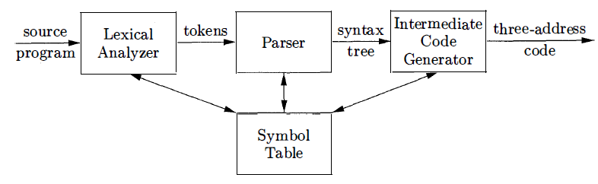
A model of a compiler front end

Slide 4
A model of a compiler front end
Lexical Analyzer: allows a translator to handle multi-character constructs like identifiers, which are written as sequences of characters, but are treated as units called tokens during syntax analysis;
count + 1, the identifier count is treated as a unit.
The lexical analyzer in allows numbers, identifiers, and "white space" (blanks, tabs, and newlines) to appear within expressions.
Intermediate-code generation:
abstract syntax trees or simply syntax trees, represents the hierarchical syntactic structure of the source program.
three-address instructions
Parser: produces a syntax tree, that is further translated into three-address code.
Some compilers combine parsing and intermediate-code generation into one component.

Slide 5
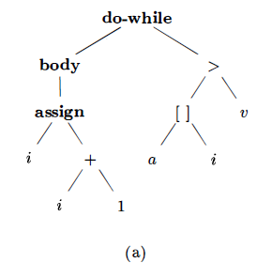
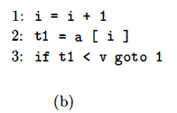
Intermediate code for "do i = i + 1 ; while ( a [iJ < v) ; "
Three-address code
Abstract syntax tree

Slide 6
Syntax Definition
"context-free grammar," or "grammar“ specify the syntax of a language.
A grammar naturally describes hierarchical structure of language constructs.
For example, an if-else statement in Java can have the form
if ( expression ) statement else statement
An if-else statement is the concatenation of the keyword if, an opening parenthesis, an expression, a closing parenthesis, a statement, the keyword else, and another statement.
Using the variable expr to denote an expression and the variable stmt to denote a statement, this structuring rule can be expressed as
stmt → if ( expr ) stmt else stmt
in which the arrow may be read as "can have the form."
Such a rule is called a production.
Lexical elements- keyword if and the parentheses are called terminals.
Variables- expr & stmt represent sequences of terminals and are called non-terminals.

Slide 7
Definition of Grammars
A context-free grammar (CFG) has four components:
1. A set of terminal symbols, sometimes referred to as "tokens."
The terminals are the elementary symbols of the language defined by the grammar.
2. A set of nonterminals, sometimes called "syntactic variables."
Each non-terminal represents a set of strings of terminals
3. A set of productions,
each production consists of a non-terminal, called the head or left side of the production, an arrow, and a sequence of terminals and/or non-terminals , called the body or right side of the production

Slide 8
Definition of Grammars
The intuitive intent of a production is to specify one of the written forms of a construct; if the head non-terminal represents a construct, then the body represents a written form of the construct .
4. A designation of one of the non-terminals as the start symbol
CFG = {T, NT, P, S}

Slide 9
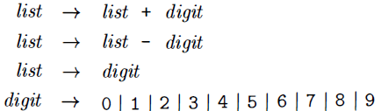
Example
Terminals:
A string of terminals is a sequence of zero or more terminals.
The string of zero terminals is called the empty string (ε)
Non-terminals:
Start symbol:
+ - 0 1 2 3 4 5 6 7 8 9
list digit
list

Slide 10
Derivations
A grammar derives strings by beginning with the start symbol & repeatedly replacing a non-terminal by the body of a production for that non-terminal.
The terminal strings that can be derived from the start symbol form the language defined by the grammar.

Slide 11
Example
(1)
(2)
9-5+2 is a list:
a) 9 is a list by production (3) , since 9 is a digit.
b) 9-5 is a list by production (2) , since 9 is a list & 5 is a digit
c) 9-5+2 is a list by production (1) , since 9-5 is a list and 2 is a digit.
(3)
(4)

Slide 12
Parsing
Parsing is the problem of taking a string of terminals and figuring out how to derive it from the start symbol of the grammar,
if it cannot be derived from the start symbol of the grammar, then reporting syntax errors within the string.
Parsing is one of the most fundamental problems in all of compiling
A source program has multi-character lexemes that are grouped by the lexical analyzer into tokens, whose first components are the terminals processed by the parser.

Slide 13

Parse Trees
A parse tree pictorially shows how the start symbol of a grammar derives a string in the language.
If non-terminal A has a production A → XYZ, then a parse tree may have an interior node with three children labeled X, Y, & Z, from left to right:

Slide 14
Properties of the Parse Tree
1. The root is labeled by the start symbol.
2. Each leaf is labeled by a terminal or by ε.
3. Each interior node is labeled by a non-terminal.
4. If A is the non-terminal labeling some interior node and X₁ , X₂, • • • , X_{n} are the labels of the children of that node from left to right, then there must be a production A → X₁X₂ · · · X_{n}.
Here, X₁ , X₂ , . . . , X_{n} each stand for a symbol that is either a terminal or a non-terminal .
As a special case, if A → ε is a production, then a node labeled A may have a single child labeled ε

Slide 15
Tree Terminology
A tree consists of one or more nodes. Nodes may have labels, which in this book typically will be grammar symbols.
When we draw a tree, we often represent the nodes by these labels only.
Exactly one node is the root.
All nodes except the root have a unique parent; the root has no parent.
When we draw trees , we place the parent of a node above that node and draw an edge between them.
The root is then the highest (top) node.

Slide 16
Tree Terminology
If node N is the parent of node M, then M is a child of N. The children of one node are called siblings. They have an order, from the left, and when we draw trees , we order the children of a given node in this manner.
A node with no children is called a leaf. Other nodes - those with one or more children - are interior nodes.
A descendant of a node N is either N itself, a child of N, a child of a child of N, and so on , for any number of levels. We say node N is an ancestor of node M if M is a descendant of N.

Slide 17
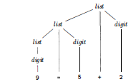
Example: 9-5+2
(1)
(2)
(3)
(4)

Slide 18
Ambiguity
ambiguous grammar: a grammar can have more than one parse tree generating a given string of terminals.
Since a string with more than one parse tree usually has more than one meaning,
we need to design unambiguous grammars for compiling applications,
or to use ambiguous grammars with additional rules to resolve the ambiguities

Slide 19
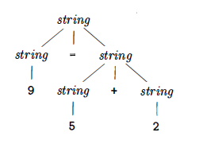
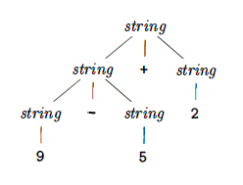
9-5+2 has more than one parse tree with this grammar.
Two ways: (9-5) +2 and 9- (5+2) .
(9-5) +2
9- (5 + 2)

Slide 20
Associativity of Operators
By convention, 9+5+2 is equivalent to (9+5) +2
9-5-2 is equivalent to ( 9-5) -2.
When an operand like 5 has operators to its left and right, conventions are needed for deciding which operator applies to that operand.
operator + associates to the left, because an operand with plus signs on both sides of it belongs to the operator to its left.
In most programming languages: addition, subtraction, multiplication, and division are left-associative.

Slide 21
Associativity of Operators
exponentiation are right-associative.
assignment operator = in C and its descendants is right associative;
the expression a=b=c is treated in the same way as the expression a= (b=c )
right → letter = right I letter
letter → a I b I . . . I z

Slide 22
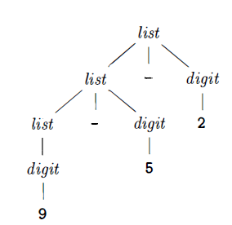
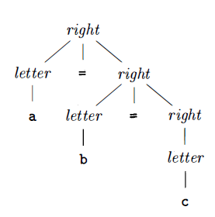
Parse Tree for 9-5-2 and a=b=c
Left associative
Right associative

Slide 23
Precedence of Operators
9+5*2
02 possible interpretations:
(9+5 ) *2 or 9+ ( 5*2)
The associativity rules for + and * apply to occurrences of the same operator, so they do not resolve this ambiguity.
Rules defining the relative precedence of operators are needed 'when more than one kind of operator is present

Slide 24
Precedence of Operators
We say that * has higher precedence than + if * takes its operands before + does.
In ordinary arithmetic, multiplication & division have higher precedence than addition & subtraction
9+5*2 ⇒ 9+ (5*2)
9*5+2 ⇒ (9*5) +2

Slide 25
Example 2.6 : A grammar for arithmetic expressions can be constructed from a table showing the associativity and precedence of operators. Operators on the same line have the same associativity and precedence:
left - associative: + -
left - associative: * /
We create two nonterminals expr and term for the two levels of precedence, and an extra nonterminal factor for generating basic units in expressions.
The basic units in expressions are presently digits and parenthesized expressions.
factor → digit I ( expr )

Slide 26
Binary operators, * and /, that have the highest precedence.
Since these operators associate to the left, the productions are simiilar to those for lists that associate to the left.
Term → term * factor
I term / factor
I factor
Similarly, expr generates lists of terms separated by the additive operators
expr → expr + term
I expr - term
I term

Slide 27
Resulting Grammars
expr → expr + term | expr – term | term
term → term * factor | term / factor | factor
factor → digit | ( expr )

Slide 28
Syntax-Directed Translation
Syntax-directed translation is done by attaching rules or program fragments to productions in a grammar.
For example, consider an expression expr generated by the production
expr → expr₁ + term
expr is the sum of the two sub expressions expr₁ & term.
(The subscript in expr₁ is used only to distinguish the instance of expr in the production body from the head of the production) .

Slide 29
We can translate expr by exploiting its structure:
translate expr₁ ;
translate term;
Handle +;

Slide 30
Attributes
An attribute is any quantity associated with a programming Construct
Examples: data types of expressions, the number of instructions in the generated code, or the location of the first instruction in the generated code for a construct , among many other possibilities.
Since we use grammar symbols (nonterminals and terminals) to represent programming constructs, we extend the notion of attributes from constructs to the symbols that represent them.

Slide 31
(Syntax- directed) translation schemes
A translation scheme is a notation for attaching program fragments to the productions of a grammar.
The program fragments are executed when the production is used during syntax analysis.
The combined result of all these fragment executions, in the order induced by the syntax analysis, produces the translation of the program to which this analysis/synthesis process is applied.

Slide 32
Postfix Notation
The postfix notation for an expression E:
1. If E is a variable or constant , then the postfix notation for E is E itself.
2. If E is an expression of the form E₁op E₂ , where op is any binary operator, then the postfix notation for E is E₁`E₂` op, where E₁` & E₂` are the postfix notations for E₁ & E₂
3. If E is a parenthesized expression of the form (E1), then the postfix notation for E is the same as the postfix notation for E₁ ·

Slide 33
The postfix notation for (9-5)+2 ≡ 95-2+
The translations of 9, 5, and 2 are the constants themselves, by rule (1).
The translation of 9-5 is 95- by rule (2)
The translation of (9-5) is the same by rule (3)
Having translated the parenthesized subexpression, we may apply rule (2) to the entire expression, with (9-5) in the role of E₁ and 2 in the role of E₂ , to get the result 95-2+
9 - (5+2) ≡ 952+-
5+2 is first translated into 52+, and this expression becomes the second argument of the minus sign.

Slide 34
Postfix Notation
No parentheses are needed in postfix notation, because the position and arity (number of arguments) of the operators permits only one decoding of a postfix expression.
Trick
repeatedly scan the postfix string from the left, until you find an operator.
Then, look to the left for the proper number of operands, and group this operator with its operands.
Evaluate the operator on the operands, and replace them by the result.
Then repeat the process, continuing to the right and searching for another operator.

Slide 35
952+-3*
Scanning from the left , we first encounter the plus sign.
Looking to its left we find operands 5 and 2
Their sum , 7, replaces 52+, and we have the string 97-3*
Now, the leftmost the result of the subtraction leaves 23*
Last, the multiplication sign applies to 2 and 3, giving the result 6

Slide 36
Synthesized Attributes
The idea of associating quantities with programming constructs-for example, values and types with expressions-can be expressed in terms of grammars.
We associate attributes with nonterminals and terminals.
Then, we attach rules to the productions of the grammar;
these rules describe how the attributes are computed at those nodes of the parse tree where the production in question is used to relate a node to its children.
A syntax-directed definition associates
1. With each grammar symbol, a set of attributes, and
2. With each production, a set of semantic rules for computing the values of the attributes associated with the symbols appearing in the production.

Slide 37
Synthesized Attributes
Attributes can be evaluated as follows.
For a given input string x, construct a parse tree for x.
Then, apply the semantic rules to evaluate attributes at each node in the parse tree:
Suppose a node N in a parse tree is labeled by the grammar symbol X .
We write X.a to denote the Value of attribute a of X at that node.
A parse tree showing the attribute values at each node is called an annotated parse tree.

Slide 38
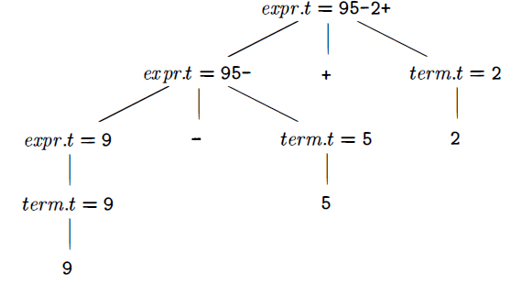
Annotated parse tree for 9-5+2 with an attribute t associated with the nonterminals expr & term.
Attribute values at nodes in a parse tree

Slide 39
Synthesized Vs. Inherited Attribute
Synthesized attribute: An attribute is said to be synthesized if its value at a parse-tree node N is determined from attribute values at the children of N & at N itself.
Inherited attribute: have their value at a parse-tree node determined from attribute values at the node itself, its parent , and its siblings in the parse tree.

Slide 40
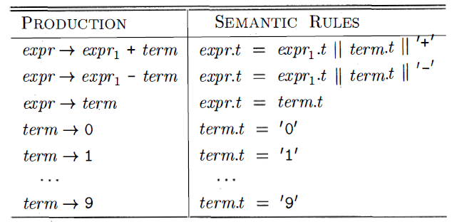
Example 2.10 : syntax-directed definition for translating expressions consisting of digits separated by plus or minus signs into postfix notation. Each nonterminal has a string-valued attribute t that represents postfix notation for the expression generated by that nonterminal in a parse tree. The symbol || in the semantic rule is the operator for concatenation
Infix to postfix translation

Slide 41
Parsing
Parsing is the process of determining how a string of terminals can be generated by a grammar.
A parser must be capable of constructing the tree in principle, or else the translation cannot be guaranteed correct.
Yacc; Parser tool; can implement the translation scheme without modification

Slide 42
Parsing
For any CFG there is a parser that takes at most O (n³ ) time to parse a string of n terminals.
But cubic time is generally too expensive.
For real programming languages, design a grammar that can be parsed quickly (Linear-time algorithms)
Programming-language parsers almost always make a single left-to-right scan over the input, looking ahead one terminal at a time, and constructing pieces of the parse tree as they go.

Slide 43
Parsing Methodology
Mostly 02 classes:
Top-down
Bottom-up
Top-down: construction starts at the root & proceeds towards the leaves
Bottom-up: construction starts at the leaves & proceeds towards the root
top-down parsers is more popular; efficient parsers can be constructed more easily by hand
Bottom-up parsing, can handle a larger class of grammars & translation schemes, so software tools for generating parsers directly from grammars

Slide 44
Top-down parsing
Starting with the root (stmt), & repeatedly performing the following two steps:
1. At node N, labeled with nonterminal A, select one of the productions for A & construct children at N for the symbols in the production body.
2. Find the next node at which a subtree is to be constructed, typically the leftmost unexpanded nonterminal of the tree

Slide 45
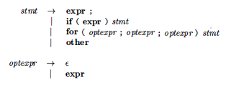
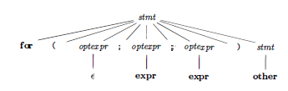
Example
Lookahead symbol: current terminal being scanned in the input
Initially, the lookahead
symbol is the first
leftmost , terminal of the input string.
fo r ( ; expr ; expr ) other

Slide 46
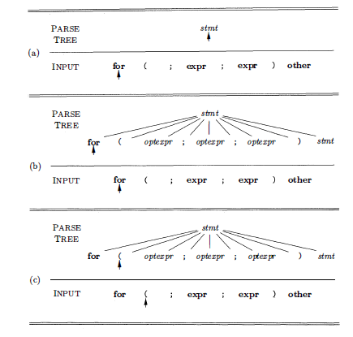
Top-down parsing
while scanning
the input from
left to right

Slide 47
Left Recursion
For a recursive-descent parser to loop forever. A problem arises with "left-recursive" productions like
expr → expr + term
where the leftmost symbol of the body is the same as the nonterminal at the head of the production.
Suppose the procedure for expr decides to apply this production. The body begins with expr so the procedure for expr is called recursively.
Since the lookahead symbol changes only when a terminal in the body is matched, no change to the input took place between recursive calls of expr.
As a result, the second call to expr does exactly what the first call did, which means a third call to expr, and so on, forever.

Slide 48
Left Recursion

Slide 49
Left Recursion

Slide 50
Abstract & Concrete Syntax

