Slide 1
Syntax Directed Translation
F.M.Rahat Hasan
CSE, BSMRSTU

Slide 2

Introduction
A syntax-directed definition specifies the values of attributes by associating semantic rules with the grammar productions
An infix-to-postfix translator might have a production & rule
02 non-terminals: E , T
subscript in E₁ distinguishes the occurrence of E in the production body from the occurrence of E as the head;
Both E & T have a string-valued attribute code.
The semantic rule specifies that the string E.code is formed by concatenating E₁ . code, T. code, & the character ' +'.
While the rule makes it explicit that the translation of E is built up from the translations of E₁ , T, & '+', it may be inefficient to implement the translation directly by manipulating strings.

Slide 3

a syntax-directed translation scheme embeds program fragments called semantic actions within production bodies, as in
By convention, semantic actions are enclosed within curly braces.
(If curly braces occur as grammar symbols, we enclose them within single quotes, as in '{' and ‘}'.)
The position of a semantic action in a production body determines the order in which the action is executed.
In above production , the action occurs at the end, after all the grammar symbols;
in general, semantic actions may occur at any position in a production body.

Slide 4
Which one is to be Chosen Syntax
Directed Definition or Syntax Directed Translation?
Syntax-directed definitions:
can be more readable
hence more useful for specifications.
Translation schemes
can be more efficient
hence more useful for implementations.

Slide 5
Approaches
Syntax-directed translation
construct a parse tree or a syntax tree , and then to compute the values of attributes at the nodes of the tree by visiting the nodes of the tree.
Translation Schemes
translation can be done during parsing, without building an explicit tree.
"L-attributed translations" (L for left-to-right), which encompass virtually all translations that can be performed during parsing.
"S-attributed translations" (S for synthesized) , which can be performed easily in connection with a bottom-up parse.

Slide 6
Syntax-Directed Definitions (SDD)
is a CFG together with attributes & rules.
Attributes are associated with grammar symbols & rules are associated with productions.
If X is a symbol and a is one of its attributes, then we write X.a to denote the value of a at a particular parse-tree node labeled X.
If we implement the nodes of the parse tree by records or objects, then the attributes of X can be implemented by data fields in the records that represent the nodes for X.
Attributes may be of any kind: numbers , types , table references , or strings, for instance.
The strings may even be long sequences of code, say code in the intermediate language used by a compiler.

Slide 7
Inherited vs. Synthesized Attributes
A synthesized attribute for a non-terminal A at a parse-tree node N is defined by a semantic rule associated with the production at N.
Note that the production must have A as its head.
A synthesized attribute at node N is defined only in terms of attribute values at the children of N and at N itself.

Slide 8
Inherited vs. Synthesized Attributes
2. An inherited attribute for a non-terminal B at a parse-tree node N is defined by a semantic rule associated with the production at the parent of N.
Note that the production must have B as a symbol in its body.
An inherited attribute at node N is defined only in terms of attribute values at N's parent , N itself, and N's siblings.

Slide 9
While we do not allow an inherited attribute at node N to be defined in terms of attribute values at the children of node N, we do allow a synthesized attribute at node N to be defined in terms of inherited attribute values at node N itself.
For Non-terminals: S-attribute + L-attribute
For Terminals: S-attribute
Attributes for terminals have lexical values that are supplied by the lexical analyzer; there are no semantic rules in the SDD itself for computing the value of an attribute for a terminal.

Slide 10

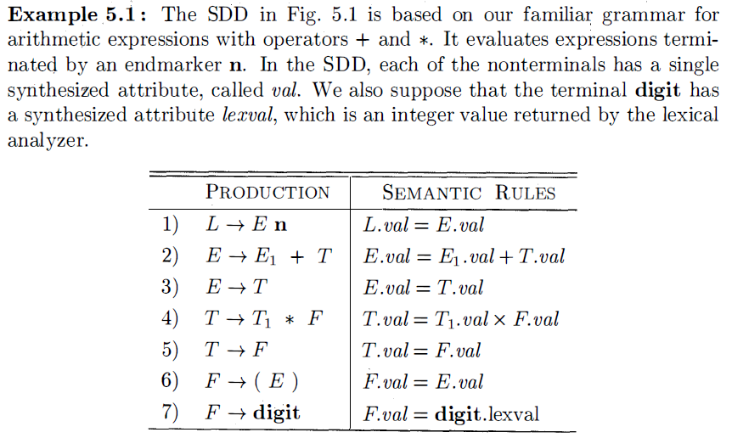

Slide 11
Production 1: L → E n, sets L. val to E. val, which we shall see is the numerical value of the entire expression.
Production 2: E → E₁ + T, also has one rule, which computes the val attribute for the head E as the sum of the values at E₁ and T.
At any parse tree node N labeled E, the value of val for E is the sum of the values of val at the children of node N labeled E and T.
Production 3: E → T, has a single rule that defines the value of val for E to be the same as the value of val at the child for T.
Production 4 is similar to the second production; its rule multiplies the values at the children instead of adding them.
The rules for productions 5 and 6 copy values at a child, like that for the 3rd production.
Production 7 gives F. val the value of a digit, that is, the numerical value of the token digit that the lexical analyzer returned.

Slide 12
SDD involves only synthesized attributes (S-attributed);
In an S-attributed SDD, each rule computes an attribute for the non-terminal at the head of a production from attributes taken from the body of the production.

Slide 13
Evaluating an SDD at the Nodes of a Parse Tree
Imagine therefore that the rules of an SDD are applied by first constructing a parse tree and then using the rules to evaluate all of the attributes at each of the nodes of the parse tree.
A parse tree, showing the value(s) of its attribute(s) is called an annotated parse tree.

Slide 14
How do we construct an annotated parse tree?
In what order do we evaluate attributes?
Before we can evaluate an attribute at a node of a parse tree, we must evaluate all the attributes upon which its value depends
if all attributes are synthesized, then we must evaluate the val attributes at all of the children of a node before we can evaluate the val attribute at the node itself.

Slide 15
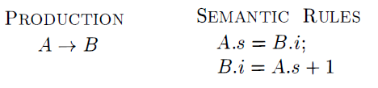
With synthesized attributes, we can evaluate attributes in any bottom-up order, such as that of a post-order traversal of the parse tree
For SDD's with both inherited and synthesized attributes, there is no guarantee that there is even one order in which to evaluate attributes at nodes.
consider non-terminals A & B, with synthesized & inherited attributes A.s & B.i, respectively, along with the production & rules

Slide 16
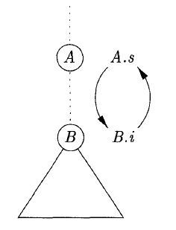
These rules are circular; it is impossible to evaluate either A_{.s} at a node N or B_{.i} at the child of N without first evaluating the other.
The circular dependency of A_{.s} & B_{.i} at some pair of nodes in a parse tree is suggested by Fig.

Slide 17
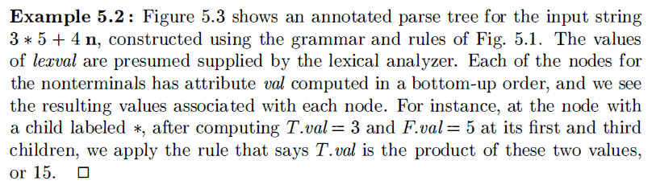
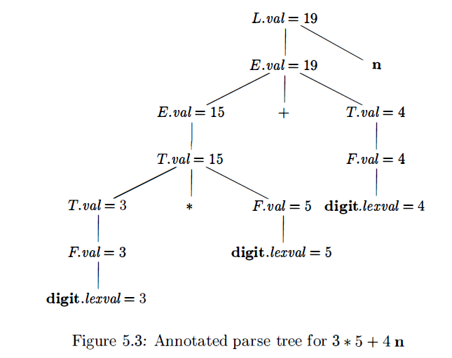

Slide 19
Inherited attributes are useful when the structure of a parse tree does not "match" the abstract syntax of the source code.

Slide 20
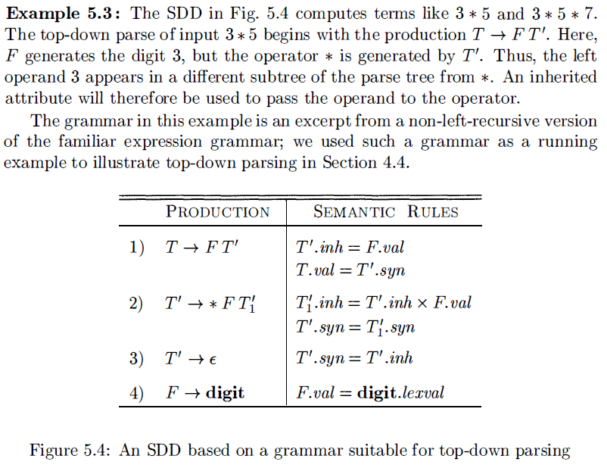

Slide 21
Each of the non-terminals T & F has a synthesized attribute val;
The terminal digit has a synthesized attribute lexval.
The non-terminal T' has two attributes:
an inherited attribute inh
a synthesized attribute syn.

Slide 22
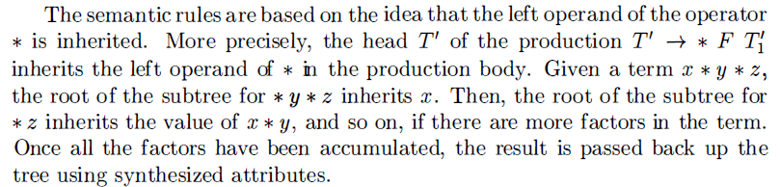
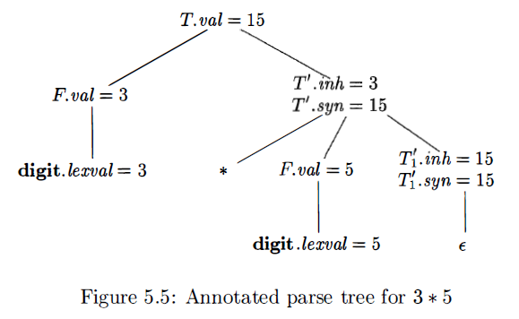
T`_{.inh}=F_{.val}
The production at the node for T' is T' →* FT₁` .The inherited attribute T₁`_{.inh} is defined by the semantic rule T₁`_{.inh} = T’_{.inh} x F_{.val}
With T'_{. inh} = 3 & F_{.val} = 5, we get T₁`_{.inh} = 15. At the lower node for T₁`, the production T' →ε The rule T'_{. syn} = T'_{. inh} defines T₁`_{.syn} = 15.
The syn attributes at the nodes for T' pass the value 15 up the tree to the node for T, where T_{. val} = 15.

Slide 23
Evaluation Orders for SDD
"Dependency graphs" are a useful tool for determining an evaluation order for the attribute instances in a given parse tree.
While an annotated parse tree shows the values of attributes, a dependency graph helps us determine how those values can be computed.
Two important classes of SDD's:
S-attributed
L-attributed

Slide 24
Dependency Graphs
A dependency graph depicts the flow of information among the attribute instances in a particular parse tree; an edge from one attribute instance to another means that the value of the first is needed to compute the second.
Edges express constraints implied by the semantic rules.

Slide 25
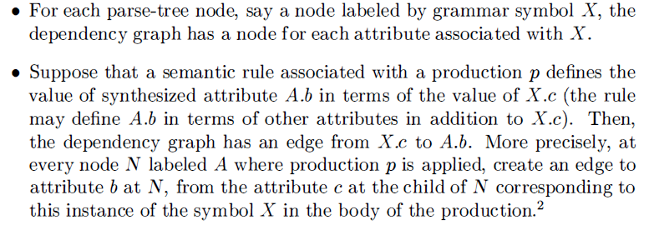
Properties

Slide 26
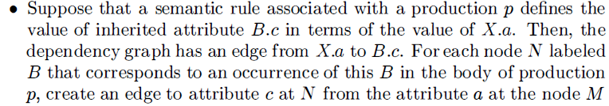
that corresponds to this occurrence of X. Note that M could be either the parent or a sibling of N .

Slide 27
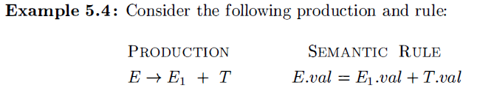
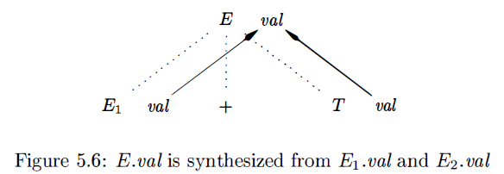

Slide 28

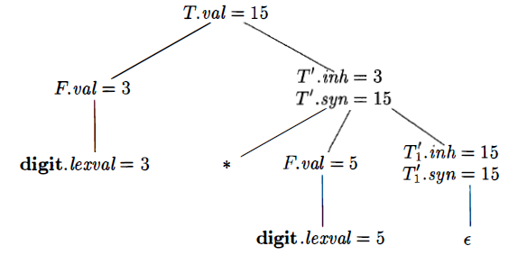
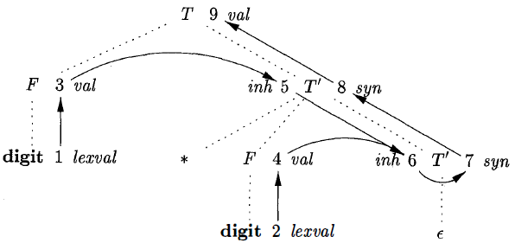

Slide 29
Ordering the Evaluation of Attributes
The dependency graph characterizes the possible orders in which we can evaluate the attributes at the various nodes of a parse tree.
If the dependency graph has an edge from node M to node N, then the attribute corresponding to M must be evaluated before the attribute of N.
Thus, the only allowable orders of evaluation are those sequences of nodes N₁ , N₂ , …. , N_{k} such that if there is an edge of the dependency graph from N_{i} to N_{j} , then i < j
Such an ordering embeds a directed graph into a linear order, and is called a topological sort of the graph.

Slide 30
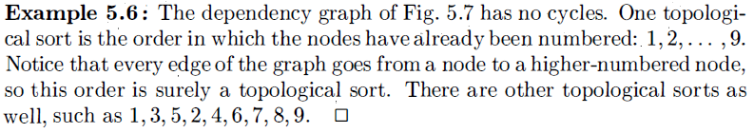

Slide 31
S-Attributes Definitions
An SDD is S-attributed if every attribute is synthesized
Example:
S-Attributes:
L_{.val}, E_{.val}, T_{.val}, F_{.val}
We can evaluate its attributes in any bottom up order of the nodes of the parse tree. It is often especially simple to evaluate the attributes by performing a postorder traversal of the parse tree & evaluating the attributes at a node N when the traversal leaves N for the last time.

Slide 32
L-Attributes Definitions
Between the attributes associated with a production body, dependency-graph edges can go from left to right , but not from right to left (hence "L-attributed" ) .
Characteristics( each attribute must be either):
1. Synthesized, or
2. Inherited, but with the rules limited as follows . Suppose that there is a production A → X₁X₂ …. X_{n}, and that there is an inherited attribute X_{i·a} computed by a rule associated with this production. Then the rule may use only:
(a) Inherited attributes associated with the head A.
(b) Either inherited or synthesized attributes associated with the occurrences of symbols X_{1,} X_{2,} …. X_{i-1} located to the left of X_{i} .

Slide 33
(c) Inherited or synthesized attributes associated with this occurrence of X_{i} itself, but only in such a way that there are no cycles in a dependency graph formed by the attributes of this X_{i}

Slide 34
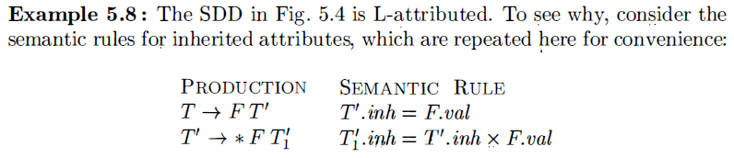
The first of these rules defines the inherited attribute T’_{.inh} using only F_{.val}, & F appears to the left of T' in the production body
The second rule defines T`_{1.inh} using the inherited attribute T’_{.inh} associated with the head, and F_{.val}, where F appears to the left of T`_{1.inh} in the production body.
In each of these cases, the rules use information "from above or from the left," as required by the class. The remaining attributes are synthesized. Hence, the SDD is L-attributed.

Slide 35
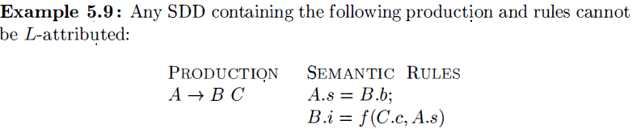

Slide 36
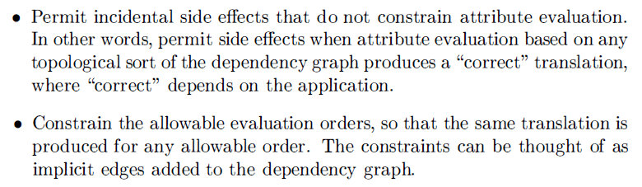
Semantic Rules with Controlled Side Effects
Translations involve side effect s: a desk calculator might print a result; a code generator might enter the type of an identifier into a symbol table.
02 Ways of controlling side effects in SDD's:

Slide 37
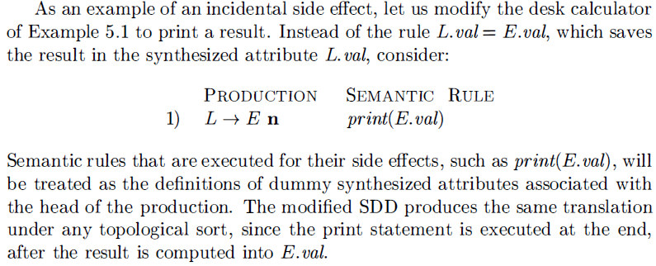

Slide 38
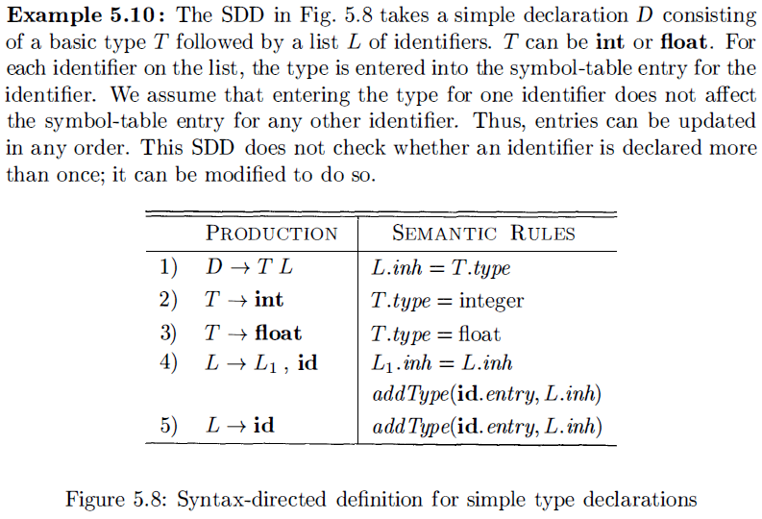

Slide 39
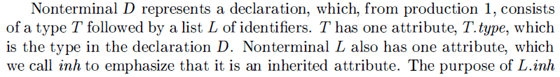
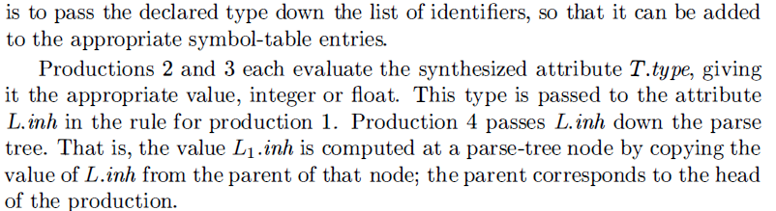

Slide 40
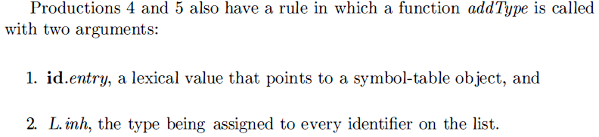

Slide 41
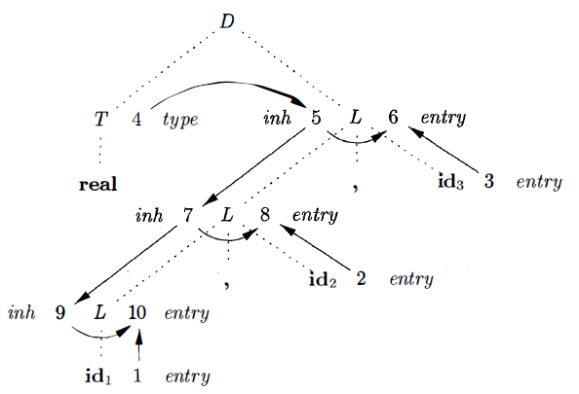


Figure 5.9: Dependency graph for a declaration float id₁ , id₂ , id3

Slide 42
Application of Syntax-Directed Translation
SDT techniques will be applied to type checking & intermediate-code generation.
The main application is the construction of syntax trees.
To complete the translation to intermediate code, the compiler may then walk the syntax tree, using another set of rules that are in effect an SDD on the syntax tree rather than the parse tree.
S-attributed definition, is suitable for use during bottom-up parsing.
L-attributed, is suitable for use during top-down parsing.

Slide 43
Construction of Syntax Tree
Each node in a syntax tree represents a construct; the children of the node represent the meaningful components of the construct.
A syntax-tree node representing an expression E₁ + E₂
has label +
02 children representing the sub expressions E₁ and E₂

Slide 44
We shall implement the nodes of a syntax tree by objects with a suitable number of fields. Each object will have an op field that is the label of the node.
Additional fields :
1. If the node is a leaf, an additional field holds the lexical value for the leaf. A constructor function Leaf( op, val) creates a leaf object. Alternatively, if nodes are viewed as records, then Leaf returns a pointer to a new record for a leaf.
2. If the node is an interior node, there are as many additional fields as the node has children in the syntax tree. A constructor function Node takes two or more arguments: Node (op, c₁ , c₂ , ... ,c_{k} ) creates an object with first field op and k additional fields for the k children c₁ , ... ,c_{k} ·

Slide 45
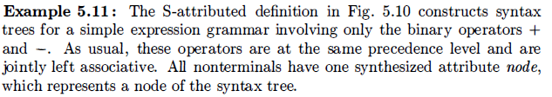
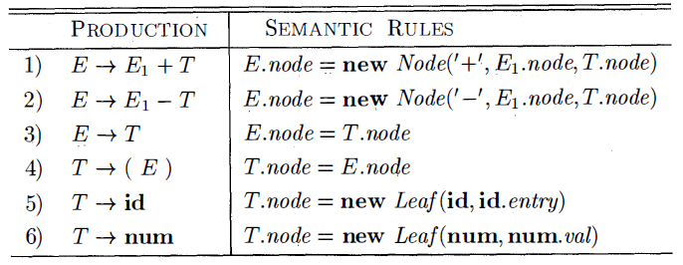

Slide 47
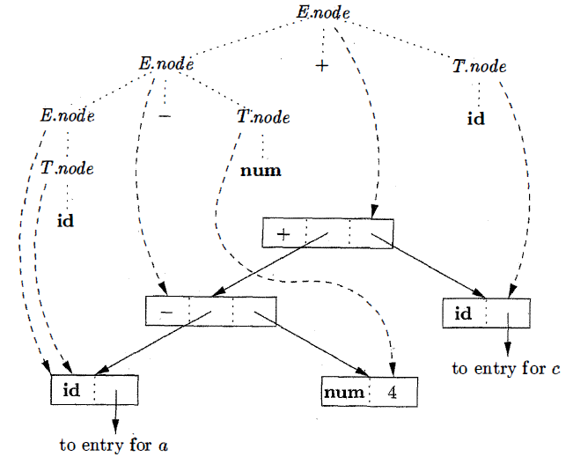
Syntax tree for a-4+c
Syntax-tree edges shown as solid lines.

Slide 48
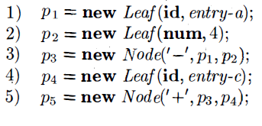
If the rules are evaluated during a postorder traversal of the parse tree, or with reductions during a bottom-up parse, then the sequence of steps:
P5: pointing to the root of the constructed syntax tree.

Slide 49
Syntax-Directed Translation Schemes
SDT is a context-free grammar with program fragments embedded within production bodies
The program fragments are called semantic actions & can appear at any position within a production body.
By convention, we place curly braces around actions; if braces are needed as grammar symbols, then we quote them.
Any SDT can be implemented by first building a parse tree and then performing the actions in a left-to-right depth-first order; that is, during a preorder traversal.

Slide 50
Postfix Translation Schemes
We can construct an SDT in which each action is placed at the end of the production & is executed along with the reduction of the body to the head of that production.
SDT's with all actions at the right ends of the production bodies are called postfix SDT's.

Slide 51
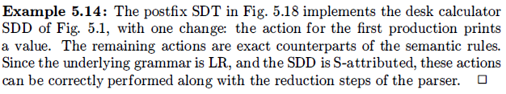
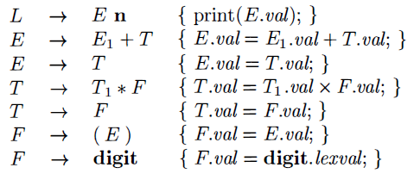

Slide 52
SDT’s with Actions Inside Production
An action may be placed at any position within the body of a production.
It is performed immediately after all symbols to its left are processed.
Thus, if we have a production B → X {a} Y, the action a is done after we have recognized X (if X is a terminal) or all the terminals derived from X (if X is a non-terminal).
More precisely,
If the parse is bottom-up, then we perform action a as soon
as this occurrence of X appears on the top of the parsing stack.
If the parse is top-down, we perform a just before we
attempt to expand this occurrence of Y (if Y a non-terminal) or
check for Y on the input (if Y is a terminal) .

Slide 53

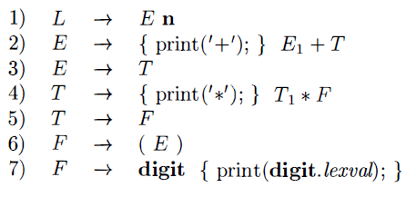

Slide 54
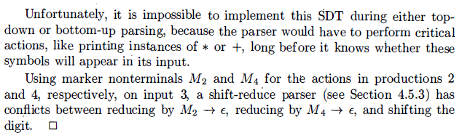

Slide 55
Any SDT can be implemented
1. Ignoring the actions, parse the input & produce a parse tree as a result.
2. Then, examine each interior node N, say one for production A → α. Add additional children to N for the actions in α , so the children of N from left to right have exactly the symbols & actions of α
3. Perform a preorder traversal of the tree, and as soon as a node labeled by an action is visited, perform that action.

Slide 56
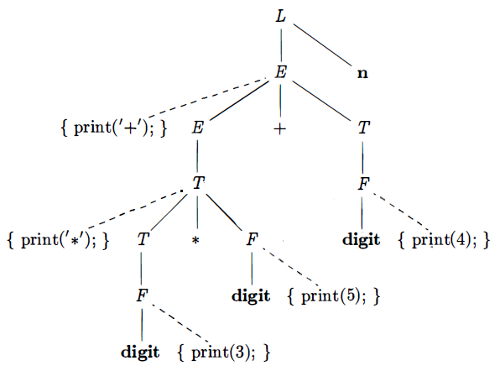
Preorder: action is done when we first Visit a node
Parse tree for expression 3 * 5 + 4 with actions inserted
visit the nodes in preorder,
prefix form
+ * 3 5 4
The preorder of a (sub) tree rooted at node N consists of N, followed by the preorders of the subtrees of each of its children, from the left.

Slide 57
Thanks

