Slide 1
Intermediate Code Generation
F.M. Rahat Hasan
CSE, BSMRSTU

Slide 2
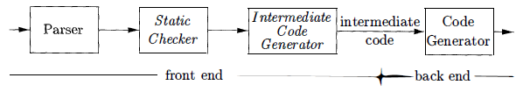

Logical Structure
A compiler might use a sequence of intermediate representations

Slide 3
Variants of Syntax Trees
Nodes in a syntax tree represent constructs in the source program; the children of a node represent the meaningful components of a construct.
A directed acyclic graph (hereafter called a DAG) for an expression identifies the common sub-expressions (sub expressions that occur more than once) of the expression.

Slide 4
DAG for Expressions
A DAG has leaves corresponding to atomic operands & interior codes corresponding to operators.
Difference between DAG & Syntax Tree
a node N in a DAG has more than one parent if N represents a common sub-expression
in a syntax tree, the tree for the common sub expression would be replicated as many times as the sub expression appears in the original expression.
Thus, a DAG not only represents expressions more succinctly, it gives the compiler important clues regarding the generation of efficient code to evaluate the expressions.

Slide 5

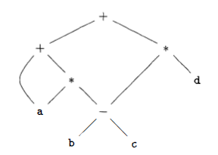
a + a * (b-c) + (b-c) * d
a + a*(b-c)
(b-c) * d
a * (b-c)
(b-c)

Slide 6
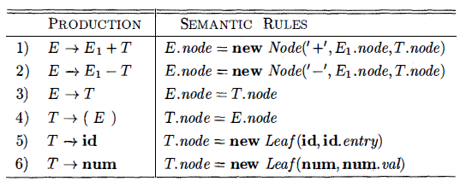
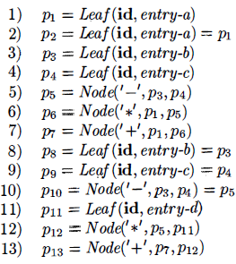
Steps for DAG
a + a * (b-c) + (b-c) * d
p₁₃
a + a*(b-c)
(b-c) * d
a * (b-c)
p₁₂
p₇
(b-c)
p₆
p₅/p₁₀

Slide 7
Value Number Method for Constructing DAG’s
Often, the nodes of a syntax tree or DAG are stored in an array of records.
Each row of the array represents one record, and therefore one node.
In each record, the first field is an operation code, indicating the label of the node.
Array:
leaves have one additional field, which holds the lexical value (either a symbol-table pointer or a constant, in this case),
interior nodes have two additional fields indicating the left and right children

Slide 8
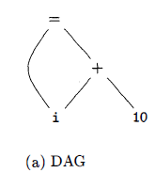
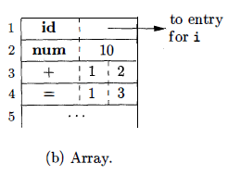
Nodes of a DAG for i = i + 10 allocated in an array
Array:
leaves have one additional field, which holds the lexical value (either a symbol-table pointer or a constant, in this case),
interior nodes have two additional fields indicating the left and right children
Interior node
Value number
Node: < op, l, r >

Slide 9
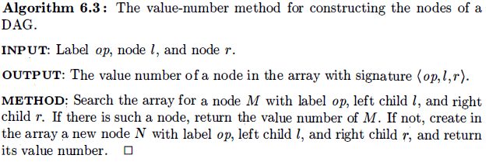
While Algorithm yields the desired output, searching the entire array every time is expensive, especially if the array holds expressions from an entire program.

Slide 10
More efficient
hash table
in which the nodes are put into “buckets” each of which typically will have only a few nodes.
The hash table is one of several data structures that support dictionaries efficiently.
A dictionary is an abstract data type that allows us to insert & delete elements of a set, & to determine whether a given element is currently in the set.
A good data structure for dictionaries, such as a hash table, performs each of these operations in time that is constant or close to constant, independent of the size of the set.

Slide 11
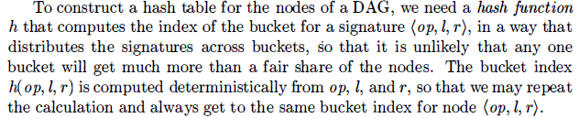
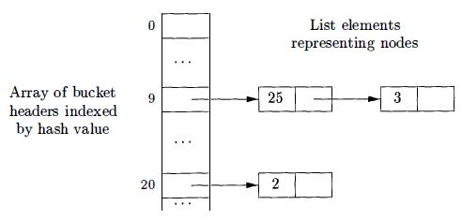
How Constructs?

Slide 12
The buckets can be implemented as linked lists
An array, indexed by hash value, holds the bucket headers, each of which points to the first cell of a list.
Within the linked list for a bucket, each cell holds the value number of one of the nodes that hash to that bucket.
That is, node ( op, l , r) can be found on the list whose header is at index h ( op, l , r ) of the array.

Slide 13
Thus, given the input node op, l, & r, we compute the bucket index h( op, l, r) & search the list of cells in this bucket for the given input node.
Typically, there are enough buckets so that no list has more than a few cells.
We may need to look at all the cells within a bucket, however, and for each value number v found in a cell, we must check whether the signature ( op, l, r) of the input node matches the node with value number v in the list of cells
If we find a match, we return v
If we find no match, no such node can exist in any other bucket
so we create a new cell, add it to the list of cells for bucket index h( op, I, r), & return the value number in that new cell.

Slide 14
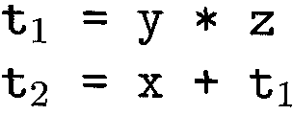
Three Address Code
In three-address code, there is at most one operator on the right side of an instruction;
That is, no built-up arithmetic expressions are permitted.
source-language expression: x + y * z
where t₁ & t₂ are compiler-generated temporary names.

Slide 15

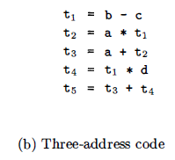
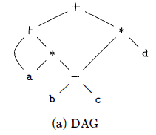

Slide 16
Addresses and Instructions
Three-address code is built from two concepts: addresses & instructions
In object-oriented terms, these concepts correspond to classes, & various kinds of addresses & instructions correspond to appropriate subclasses.
Three-address code can be implemented using records with fields for the addresses;
Records called quadruples and triples

Slide 17
An address can be one of the following:
A name. For convenience, we allow source-program names to appear as addresses in three-address code. In an implementation, a source name is replaced by a pointer to its symbol-table entry, where all information about the name is kept.
A constant. In practice, a compiler must deal with many different types of constants and variables.
A compiler-generated temporary. It is useful, especially in optimizing compilers, to create a distinct name each time a temporary is needed. These temporaries can be combined, if possible, when registers are allocated to variables .

Slide 18
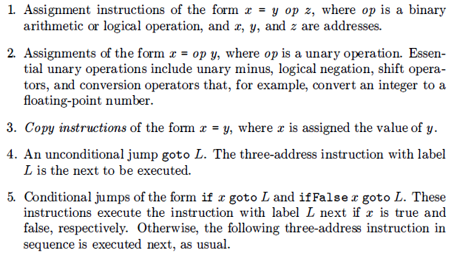
Common three-address instruction forms

Slide 19
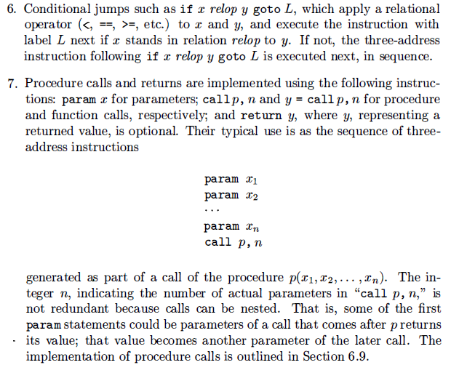

Slide 20
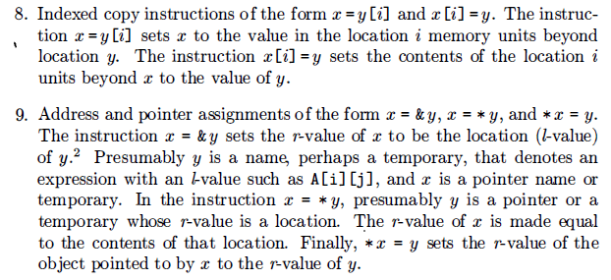

Slide 21

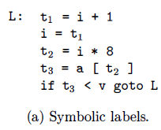
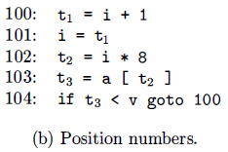
Two possible translations of this statement
The translation uses a symbolic label L, attached to the first instruction.
The translation in (b) shows position numbers for the instructions, starting arbitrarily at position 100.
In both translations, the last instruction is a conditional jump to the first instruction.
The multiplication i*8 is appropriate for an array of elements that each take 8 units of space.

Slide 22
Three-address Implementation Technique
The description of three-address instructions specifies the components of each type of instruction, but it does not specify the representation of these instructions in a data structure.
In a compiler, these instructions can be implemented as objects or as records with fields for the operator and the operands.
quadruples
triples
indirect triples

Slide 23
Quadruples
A quadruple (or “quad”) has four fields: op, arg₁, arg₂ & result.
The op field contains an internal code for the operator.
x = y + z is represented by placing + in op, y in arg₁, z in arg₂ , and x in result.

Slide 24
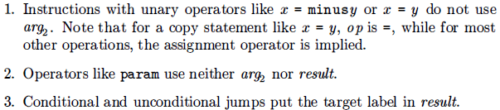
Few exceptions

Slide 25


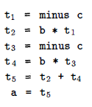
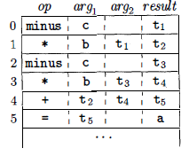
a = b * - c + b * - c
Three-address code
Quadruples

Slide 26
Triples
A triple has only three fields: op, arg₁ , & arg₂
Using triples, we refer to the result of an operation x op y by its position, rather than by an explicit temporary name.
Thus, instead of the temporary t₁, a triple representation would refer to position (0).
Parenthesized numbers represent pointers into the triple structure itself (value numbers)

Slide 27

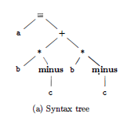
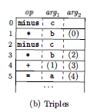
a = b * - c + b * - c
Three-address code

Slide 28

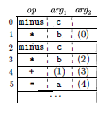
Indirect triples
Indirect triples consist of a listing of pointers to triples, rather than a listing of triples themselves.
For example, let us use an array instruction to list pointers to triples in the desired order.

Slide 29
Array to pointers
 | Statement
(0) | (14)
(1) | (15)
(2) | (16)
(3) | (17)
(4) | (18)
(5) | (19)
Triples
(14)
(15)
(14)
(16)
(17)
(16)
(18)
(17)
(19)
(18)
Indirect Triples

Slide 30
Comparisons
A benefit of quadruples over triples can be seen in an optimizing compiler, where instructions are often moved around.
With quadruples, if we move an instruction that computes a temporary t, then the instructions that use t require no change.
With triples, the result of an operation is referred to by its position, so moving an instruction may require us to change all references to that result
This problem makes triples difficult to use in an optimizing compiler

Slide 31
This problem does not occur with indirect triples, which we consider next.
With indirect triples, an optimizing compiler can move an instruction by reordering the instruction list, without affecting the triples themselves.
Save some space compared with quadruples
When implemented in Java, an array of instruction objects is analogous to an indirect triple representation, since Java treats the array elements as references to objects.

