Slide 1
Type Checking
F.M. Rahat Hasan
CSE, BSMRSTU

Slide 2
Introduction
To do type checking a compiler needs to assign a type expression to each component of the source program.
The compiler must then determine that these type expressions conform to a collection of logical rules that is called the type system for the source language

Slide 3
Importance
Type checking has the potential for catching errors in programs.
In principle, any check can be done dynamically, if the target code carries the type of an element along with the value of the element
A sound type system eliminates the need for dynamic checking for type errors, because it allows us to determine statically that these errors cannot occur when the target program runs.
An implementation of a language is strongly typed if a compiler guarantees that the programs it accepts will run without type errors.

Slide 4
Importance
Besides their use for compiling, ideas from type checking have been used to improve the security of systems that allow software modules to be imported and executed.
Java programs compile into machine-independent bytecodes that include detailed type information about the operations in the bytecodes.
Imported code is checked before it is allowed to execute, to guard against both inadvertent errors and malicious misbehavior.

Slide 5
Must check: Syntactic and Semantic errors
Dynamic Checking: during execution of target program
Static Checking: before execution
Examples:
Type checks: incompatible operand
Flow-of-control checks: enclosing braces
Uniqueness checks: identifier must declared uniquely
Name-related checks: same name beginning & end of a construct

Slide 6
Function of Type Checker
A type checker verifies that the type of a construct matches that expected by its context.
Type checking uses logical rules to reason about the behavior of a program at run time.
Specifically, it ensures that the types of the operands match the type expected by an operator.
For example, the && operator in Java expects its two operands to be Booleans; the result is also of type Boolean.
Syntax
tree
Syntax
tree
Parser
Type Checker
I code generator
3 address
code
token

Slide 7
Type Systems
The design of a type checker for a language is based on information about the syntactic constructs in the language, the notion of types, & the rules for assigning types to language constructs
If both operands of arithmetic operators of addition, subtraction, & multiplication are of type integer, then the result is of type integer
The result of the unary & operator is a pointer to the object referred to by the operand.
If the type of the operand is ‘---’, the type of the result is ‘pointer to---’

Slide 8
Type Expressions
Types have structure, which we shall represent using type expressions: a type expression is either a basic type or is formed by applying an operator called a type constructor to a type expression.
The sets of basic types and constructors depend on the language to be checked.

Slide 9


type expression: array( 2, array(3, integer)
Definition
1. A basic type is a type expression. Typical basic types for a language include boolean, char, integer, float, and void; the latter denotes "the absence of a value."
Type expression for int [2] [3J

Slide 10
2. A type name is a type expression.
A type expression can be formed by applying the array type constructor to a number and a type expression.
A record is a data structure with named fields. A type expression can be formed by applying the record type constructor to the field names & their types.
A type expression can be formed by using the type constructor → for function types. We write s →t for "function from type s to type t”

Slide 11
6. If s & t are type expressions, then their Cartesian product s x t is a type expression.
7. Type expressions may contain variables whose values are type expressions
A convenient way to represent a type expression is to use a graph/Dag
Interior nodes: type constructor
Leaves: basic types, type name, type variables

Slide 12
Type Equivalence
When are two type expressions equivalent?
Many type-checking rules have the form, "if two type expressions are equal then return a certain type else error."
Potential ambiguities arise when names are given to type expressions and the names are then used in subsequent type expressions.
The key issue is whether a name in a type expression stands for itself or whether it is an abbreviation for another type expression.

Slide 13
When type expressions are represented by graphs, two types are structurally equivalent if and only if one of the following conditions is true:
They are the same basic type.
They are formed by applying the same constructor to structurally equivalent types
One is a type name that denotes the other.

Slide 14
Operations Within Expressions
The syntax-directed definition builds up the three-address code for an assignment statement S using attribute code for S and attributes addr and code for an expression E.
Attributes S_{.code} and E_{.code} denote the three-address code for S and E, respectively.
Attribute E_{.addr} denotes the address that will hold the value of E.

Slide 15
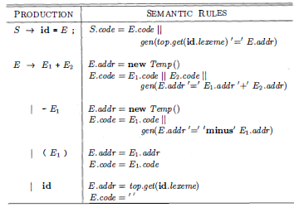
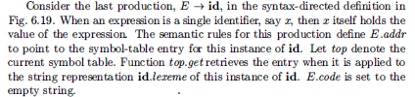

Slide 16
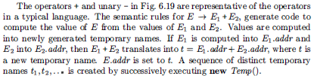


Slide 17



Slide 18

Rules for Type Checking
Type checking can take on two forms: synthesis and inference.
Type synthesis builds up the type of an expression from the types of its subexpressions. It requires names to be declared before they are used.
The type of E₁ + E₂ is defined in terms of the types of E₁ and E₂
A typical rule for type synthesis has the form
Here f and x denote expressions, and s → t denotes a function from s to t.
This rule for functions with one argument carries over to functions with several arguments. The rule can be adapted for E₁ + E₂ by viewing it as a function application add( E₁. E₂ )

Slide 19
Type inference determines the type of a language construct from the way it is used.
Let null be a function that tests whether a list is empty. Then, from the usage null(x) , we can tell that x must be a list.
The type of the elements of x is not known; all we know is that x must be a list of elements of some type that is presently unknown.

Slide 20

Variables representing type expressions allow us to talk about unknown types.
We shall use Greek letters α, β,….. for type variables in type expressions.
A typical rule for type inference has the form

Slide 21
The rules for checking statements are similar to the rules for expressions.
For example, we treat the conditional statement
" if ( E) S;" as if it were the application of a function if to E and S.
Let the special type void denote the absence of a value.
Then function if expects to be applied to a boolean and a void;
the result of the application is a void.

Slide 22
Type Conversions
Consider expressions like x + i, where x is of type float and i is of type integer
Since the representation of integers & floating-point numbers is different within a computer & different machine instructions are used for operations on integers & floats, the compiler may need to convert one of the operands of + to ensure that both operands are of the same type when the addition occurs.

Slide 23

Suppose that integers are converted to floats when necessary, using a unary operator (float)
For example, the integer 2 is converted to a float in the code for the expression 2 * 3 . 14

Slide 24

Semantic Rules for Conversion
We introduce attribute E_{.type} , whose value is either integer or float.
The rule associated with E → E₁ + E₂ builds on the pseudocode

Slide 25
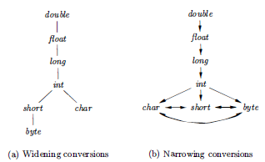
Type conversion rules vary from language to language
The rules for Java
widening conversions, which are intended to preserve information,
narrowing conversions, which can lose information
The widening rules are given by the hierarchy :any type lower in the hierarchy can be widened to a higher type.
Thus, a char can be widened to an int or to a float, but a char cannot be widened to a short.

Slide 26
The narrowing rules : a type s can be narrowed to a type t if there is a path from s to t.
Note that char, short, & byte are pair-wise convertible to each other.

Slide 27
Implicit & Explicit Conversions
Implicit: Conversion from one type to another is said to be implicit if it is done automatically by the compiler.
Implicit type conversions, also called coercions, are limited in many languages to widening conversions.
Explicit: Conversion is said to be explicit if the programmer must write something to cause the conversion.
Explicit conversions are also called casts.

Slide 28
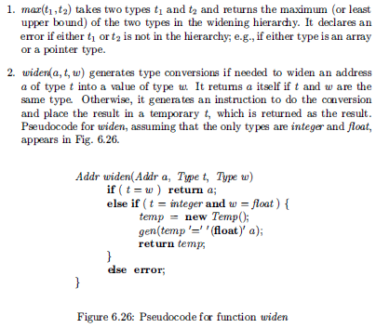
Semantic action for checking E→ E₁ + E₂ uses two functions:

Slide 29

Introducing Type Conversions into Expression
The semantic action for E → E₁ + E₂ illustrates how type conversions can be added for translating expressions.

Slide 30
In the semantic action, temporary variable a₁ is either E_{1.addr}, if the type of E₁ does not need to be converted to the type of E , or a new temporary variable returned by widen if this conversion is necessary.
Similarly, a₂ is either E_{2.addr} or a new temporary holding the type-converted value of E₂
Neither conversion is needed if both types are integer or both are float.
In general, however, we could find that the only way to add values of two different types is to convert them both to a third type.

