Slide 1
Run-Time Environments
F.M.Rahat Hasan
CSE, BSMRSTU

Slide 2
Introduction
A compiler must accurately implement the abstractions embodied in the source language definition.
Abstractions include: the concepts such as names, scopes, bindings, data types, operators, procedures, parameters, and flow-of-control constructs.
The compiler must cooperate with the operating system and other systems software to support these abstractions on the target machine.
To do so, the compiler creates and manages a ‘run-time environment’ in which it assumes its target programs are being executed.

Slide 3
Run-time Environment Issues
the layout & allocation of storage locations for the objects named in the source program
the mechanisms used by the target program to access variables
the linkages between procedures
the mechanisms for passing parameters
the interfaces to the operating system
the interfaces to the input/output devices
the interfaces to the other programs

Slide 4
Storage Organization
From the perspective of the compiler writer, the executing target program runs in its own logical address space in which each program value has a location.
The management & organization of this logical address space is shared between the compiler, operating system, and target machine.
The operating system maps the logical addresses into physical addresses, which are usually spread throughout memory.

Slide 5
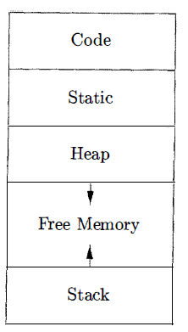
Typical subdivision of run-time memory into code and data areas
The run-time representation of an object program in the logical address space consists of data and program areas
A compiler for a language like C + + on an operating system like Linux might subdivide memory in this way.

Slide 6
run-time storage comes in blocks of contiguous bytes, where a byte is the smallest unit of addressable memory.
A byte is eight bits and four bytes form a machine word.
Multibyte objects are stored in consecutive bytes and given the address of the first byte.
The amount of storage needed for a name is determined from its type.
An elementary data type, such as a character, integer, or float, can be stored in an integral number of bytes.
Storage for an aggregate type, such as an array or structure, must be large enough to hold all its components.

Slide 7
The storage layout for data objects is strongly influenced by the addressing constraints of the target machine.
On many machines, instructions to add integers may expect integers to be aligned, that is, placed at an address divisible by 4.
Although an array of ten characters needs only enough bytes to hold ten characters, a compiler may allocate 12 bytes to get the proper alignment , leaving 2 bytes unused.
Space left unused due to alignment considerations is referred to as padding.
When space is at a premium, a compiler may pack data so that no padding is left; additional instructions may then need to be executed at run time to position packed data so that it can be operated on as if it were properly aligned.

Slide 8
The size of the generated code is fixed at compile time, so the compiler can place the executable target code in a statically determined area Code, usually in the low end of memory.
Similarly, the size of some program data objects, such as global constants, and data generated by the compiler, such as information to support garbage collection, may be known at compile time, and these data objects can be placed in another statically determined area called Static.

Slide 9
One reason for statically allocating as many data objects as possible is that the addresses of these objects can be compiled into the target code.
In early versions of Fortran, all data objects could be allocated statically.
To maximize the utilization of space at run time, the other two areas, Stack and Heap, are at the opposite ends of the remainder of the address space.
These areas are dynamic; their size can change as the program executes.
These areas grow towards each other as needed.
The stack is used to store data structures called activation records that get generated during procedure calls.

Slide 10
In practice, the stack grows towards lower addresses, the heap towards higher.
an activation record is used to store information about the status of the machine, such as the value of the program counter and machine registers, when a procedure call occurs .
When control returns from the call, the activation of the calling procedure can be restarted after restoring the values of relevant registers and setting the program counter to the point immediately after the call.
Data objects whose lifetimes are contained in that of an activation can be allocated on the stack along with other information associated with the activation .

Slide 11
Static Versus Dynamic Storage Allocation
A storage-allocation decision is static, if it can be made by the compiler looking only at the text of the program, not at what the program does when it executes.
A decision is dynamic if it can be decided only while the program is running.

Slide 12
Strategies for dynamic storage allocation
1. Stack storage. Names local to a procedure are allocated space on a stack. The stack supports the normal call/return policy for procedures.
2. Heap storage. Data that may outlive the call to the procedure that created it is usually allocated on a "heap" of reusable storage.
The heap is an area of virtual memory that allows objects or other data elements to obtain storage when they are created & to return that storage when they are invalidated.

Slide 13
Stack Allocation of Space
Almost all compilers for languages that use procedures, functions, or methods as units of user-defined actions manage at least part of their run-time memory as a stack.
Each time a procedure is called, space for its local variables is pushed onto a stack, and when the procedure terminates, that space is popped off the stack.

Slide 14
Activation Trees
Stack allocation would not be feasible if procedure calls, or activations of procedures, did not nest in time.

Slide 15
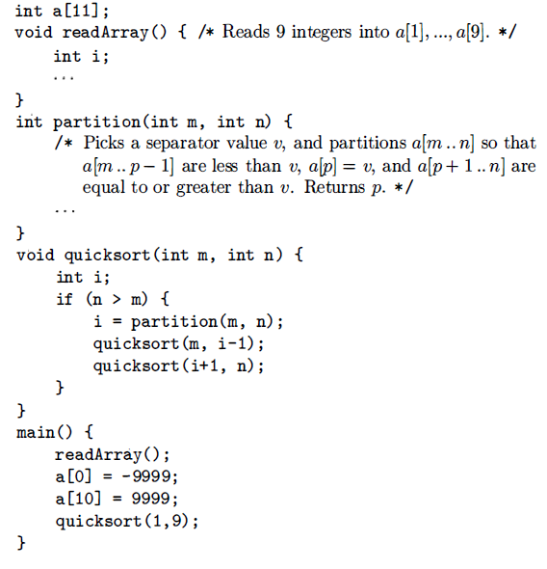
Nesting of procedure calls
Example7.1: Figure 7.2 contains a sketch of a program that reads nine integers into an array a & sorts them using the recursive quicksort algo.

Slide 16
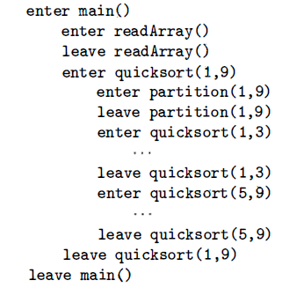
The main function has three tasks:
It calls readArray, sets the sentinels, & then calls quicksort on the entire data array.
Fig. suggests a sequence of calls that might result from an execution of the program.

Slide 18
In this execution, the call to partition(1, 9) returns v= 4, so a[1] through a[3] hold elements less than its chosen separator value v, while the larger elements are in a[5] through a[9] .

Slide 19
Activation of Procedures
Procedure activations are nested in time.
If an activation of procedure p calls procedure q, then that activation of q must end before the activation of p can end. There are three common cases:
1. The activation of q terminates normally. Then in essentially any language, control resumes just after the point of p at which the call to q was made.
2. The activation of q, or some procedure q called, either directly or indirectly, aborts; i.e., it becomes impossible for execution to continue. In that case, p ends simultaneously with q.

Slide 20
3. The activation of q terminates because of an exception that q cannot handle.
Procedure p may handle the exception, in which case the activation of q has terminated while the activation of p continues, although not necessarily from the point at which the call to q was made.
If p cannot handle the exception, then this activation of p terminates at the same time as the activation of q, and presumably the exception will be handled by some other open activation of a procedure.

Slide 21
Activation Trees
We therefore can represent the activations of procedures during the running of an entire program by a tree, called an activation tree.
Properties
Each node corresponds to one activation,
root is the activation of the "main" procedure that initiates execution of the program.
At a node for an activation of procedure p, the children correspond to activations of the procedures called by this activation of p.
Show these activations in the order that they are called, from left to right
Notice that one child must finish before the activation to its right can begin.

Slide 22
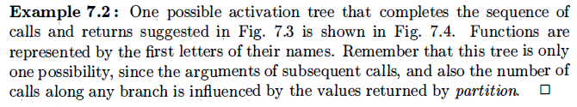
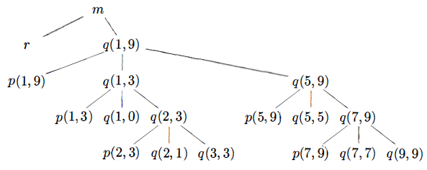

Slide 23
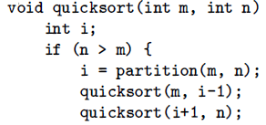
m= 1, n=9, n > m, i =5-1=4
m= 5, n=9, n > m, i =7-1= 6
m= 1, n=3, n > m, i =2-1=1
m= 7, n=9,
n > m, i =8
m= 2, n=3, n > m, i =2

Slide 24
The use of a run-time stack is enabled by several useful relationships between the activation tree & the behavior of the program:
1. The sequence of procedure calls corresponds to a preorder traversal of the activation tree.
2. The sequence of returns corresponds to a postorder traversal of the activation tree .
3. Suppose that control lies within a particular activation of some procedure, corresponding to a node N of the activation tree.
Then the activations that are currently open (live) are those that correspond to node N & its ancestors.
The order in which these activations were called is the order in which they appear along the path to N, starting at the root , and they will return in the reverse of that order.

Slide 25
Activation Records
Procedure calls & returns are usually managed by a run-time stack called the control stack.
Each live activation has an activation record (frame) on the control stack, with the root of the activation tree at the bottom, & the entire sequence of activation records on the stack corresponding to the path in the activation tree to the activation where control currently resides.
The latter activation has its record at the top of the stack.

Slide 26
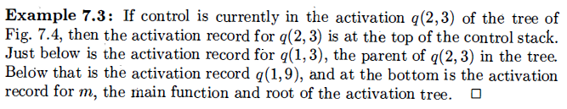

Slide 27
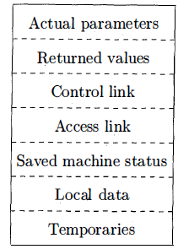
General Activation Record
1 . Temporary values, such as those arising from the evaluation of expressions, in cases where those temporaries cannot be held in registers.
2. Local data belonging to the procedure whose activation record this is.
3. A saved machine status, with information about the state of the machine just before the call to the procedure. This information typically includes the return address (value of the program counter, to which the called procedure must return) and the contents of registers that were used by the calling procedure and that must be restored when the return occurs.

Slide 28
4. An "access link" may be needed to locate data needed by the called procedure but found elsewhere, e.g., in another activation record.
5. A control link, pointing to the activation record of the caller.
6. Space for the return value of the called function, if any. Again, not all called procedures return a value, and if one does, we may prefer to place that value in a register for efficiency.
7. The actual parameters used by the calling procedure. Commonly, these values are not placed in the activation record but rather in registers, when possible, for greater efficiency. However, we show a space for them to be completely general.

Slide 29
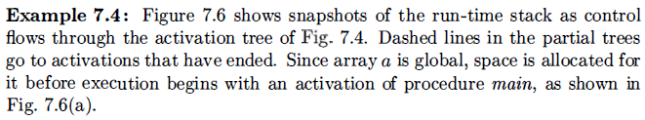
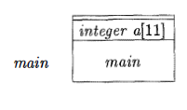
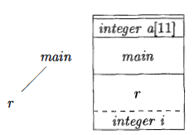
Since array a is global, space is allocated for it before execution begins with an activation of procedure main
( a) Frame for main
When control reaches the first call in the body of main, procedure r is activated, and its activation record is pushed onto the stack .
The activation record for r contains space for local variable i
Recall that the top of stack is at the bottom of diagrams. When control returns from this activation, its record is popped, leaving just the record for main on the stack.
(b) r is activated

Slide 30
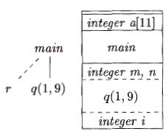
Control then reaches the call to q (quicksort) with actual parameters 1 & 9, and an activation record for this call is placed on the top of the stack.
The activation record for q contains space for the parameters m & n and the local variable i
Notice that space once used by the call of r is reused on the stack.
No trace of data local to r will be available to q(1, 9).
When q (1, 9) returns, the stack again has only the activation record for main.
(c) r has been popped & q(1,9) pushed

Slide 31
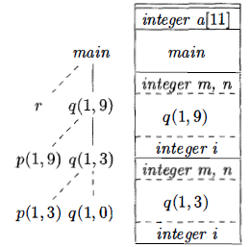
Several activations occur between the last two snapshots.
A recursive call to q (1,3) was made.
Activations p(1,3) and q (1, 0) have begun & ended during the lifetime of q (1, 3), leaving the activation record for q(1, 3) on top
Notice that when a procedure is recursive, it is normal to have several of its activation records on the stack at the same time.
(d) Control returns to q (1, 3)

Slide 32
Heap Management
Page 452-454: Read Yourself

