Slide 1
Code Generation
F.M. Rahat Hasan
CSE, BSMRSTU

Slide 2

Introduction
Takes as input intermediate representation (IR) produced by the font end of the compiler, along with relevant symbol table information, & produces as output a semantically equivalent target program

Slide 3
Primary tasks
Instruction selection
Register allocation & assignment
Instruction ordering
Instruction selection involves choosing appropriate target-machine instructions to implement the IR statements.
Register allocation & assignment involves deciding what values to keep in which registers.
Instruction ordering involves deciding in what order to schedule the execution of instructions

Slide 4
Issues in the Design of a Code Generator
Input to the Code Generator
The input to the code generator is the intermediate representation of the source program produced by the front end, along with information in the symbol table that is used to determine the run-time addresses of the data objects denoted by the names in the IR .
The many choices for the IR include
three-address representations such as quadruples, triples, indirect triples;
virtual machine representations such as bytecodes and stack-machine code;
linear representations such as postfix notation; & graphical representations such as syntax trees and DAG's.

Slide 5
2. The Target Program
The instruction-set architecture of the target machine has a significant impact on the difficulty of constructing a good code generator that produces high-quality machine code.
The most common target-machine architectures are RISC (reduced instruction set computer) , CISC (complex instruction set computer) , and stack based.
A RISC machine typically has many registers, three-address instructions, simple addressing modes, and a relatively simple instruction-set architecture.
In contrast, a ClSC machine typically has few registers, two-address instructions , a variety of addressing modes , several register classes, variable-length instructions, and instructions with side effects .
In a stack-based machine, operations are done by pushing operands onto a stack and then performing the operations on the operands at the top of the stack. To achieve high performance the top of the stack is typically kept in registers. Stack-based machines almost disappeared because it was felt that the stack organization was too limiting and required too many swap and copy operations.

Slide 6
Different Types of Target Program
Producing an absolute machine-language program as output has the advantage that it can be placed in a fixed location in memory and immediately executed. Programs can be compiled and executed quickly.
Producing a relocatable machine-language program (often called an object module) as output allows subprograms to be compiled separately. A set of relocatable object modules can be linked together and loaded for execution by a linking loader. Although we must pay the added expense of linking and loading if we produce relocatable object modules, we gain a great deal of flexibility in being able to compile subroutines separately & to call other previously compiled programs from an object module. If the target machine does not handle relocation automatically, the compiler must provide explicit relocation information to the loader to link the separately compiled program modules.
Producing an assembly-language program as output makes the process of code generation somewhat easier. We can generate symbolic instructions & use the macro facilities of the assembler to help generate code. The price paid is the assembly step after code generation.

Slide 7
3. Instruction Selection
The code generator must map the IR program into a code sequence that can be executed by the target machine.
The complexity of performing this mapping is determined by a factors such as
the level of the IR
the nature of the instruction-set architecture
the desired quality of the generated code
If the IR is high level, the code generator may translate each IR statement into a sequence of machine instructions using code templates.
Such statement-by-statement code generation, however, often produces poor code that needs further optimization.
If the IR reflects some of the low-level details of the underlying machine, then the code generator can use this information to generate more efficient code sequences.

Slide 8
Affecting Factors
The nature of the instruction set of the target machine has a strong effect on the difficulty of instruction selection. For example, the uniformity and completeness of the instruction set are important factors. If the target machine does not support each data type in a uniform manner, then each exception to the general rule requires special handling. On some machines, for example, floating-point operations are done using separate registers
Instruction speeds & machine idioms are other important factors. If we do not care about the efficiency of the target program, instruction selection is straightforward. For each type of three-address statement, we can design a code skeleton that defines the target code to be generated for that construct.

Slide 9

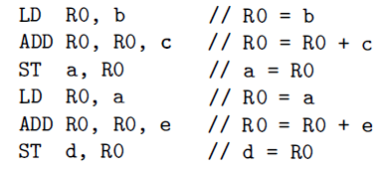
For example, every three-address statement of the form x = y + z, where x, y, & z are statically allocated, can be translated into the code sequence:
This strategy often produces redundant loads and stores. For example, the sequence of three-address statements:
a = b + c
d = a + e
Would be translated into

Slide 10
This strategy often produces redundant loads and stores. For example, the sequence of three-address statements:
a = b + c
d = a + e
Would be translated into
Here, the fourth statement is redundant since it loads a value that has just been stored, and so is the third if a is not subsequently used.

Slide 11

The quality of the generated code is usually determined by its speed & size.
On most machines, a given IR program can be implemented by many different code sequences, with significant cost differences between the different implementations.
A naive translation of the intermediate code may therefore lead to correct but unacceptably inefficient target code.
For example, if the target machine has an "increment" instruction (INC) , then the three-address statement a = a + 1 may be implemented more efficiently by the single instruction INC a, rather than by a more obvious sequence that loads a into a register, adds one to the register, and then stores the result back into a:

Slide 12
4. Register Allocation
A key problem in code generation is deciding what values to hold in what registers.
Registers are the fastest computational unit on the target machine, but we usually do not have enough of them to hold all values.
Values not held in registers need to reside in memory.
Instructions involving register operands are invariably shorter & faster than those involving operands in memory, so efficient utilization of registers is particularly important.

Slide 13
The use of registers is often subdivided into two subproblems:
1. Register allocation, during which we select the set of variables that will reside in registers at each point in the program.
2. Register assignment, during which we pick the specific register that a variable will reside in.
Finding an optimal assignment of registers to variables is difficult, even with single-register machines.
NP-complete problem!!

Slide 14
5. Evaluation Order
The order in which computations are performed can affect the efficiency of the target code.
Some computation orders require fewer registers to hold intermediate results than others.
However, picking a best order in the general case is a difficult NP-complete problem.

Slide 15
A Simple Target Machine Model
Our target computer models a three-address machine with load & store operations, computation operations, jump operations, & conditional jumps.
The underlying computer is a byte-addressable machine with n general-purpose registers, R₀, R₁, . . . , R_{n-1} .
A full-fledged assembly language would have scores of instructions.
Most instructions consists of an operator, followed by a target, followed by a list of source operands.
A label may precede an instruction.

Slide 16
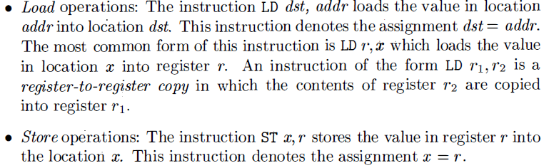
Basic Instructions

Slide 17
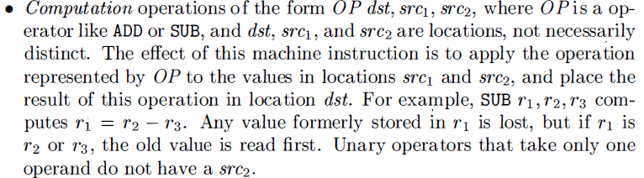
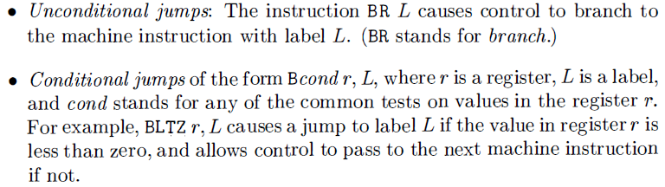

Slide 18
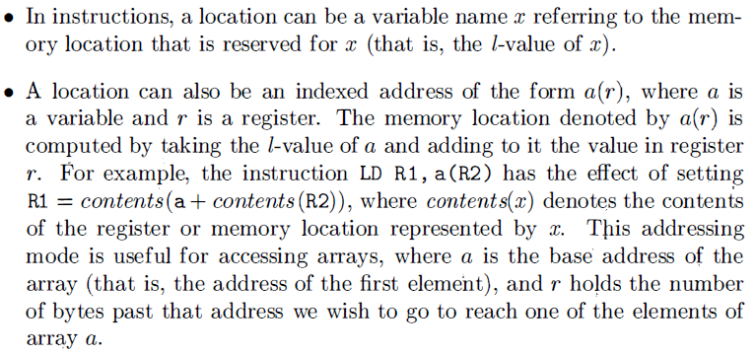
Addressing Modes

Slide 19
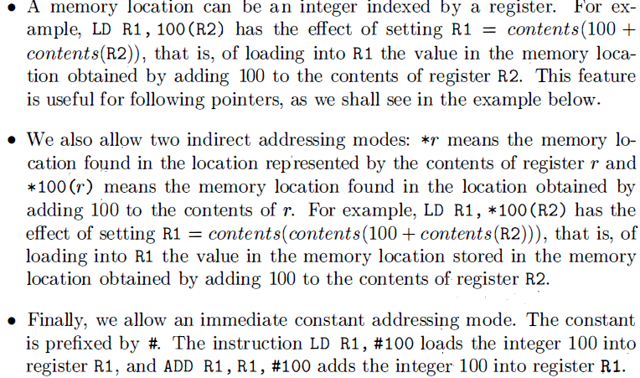

Slide 20
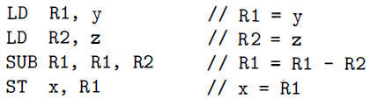

Slide 21
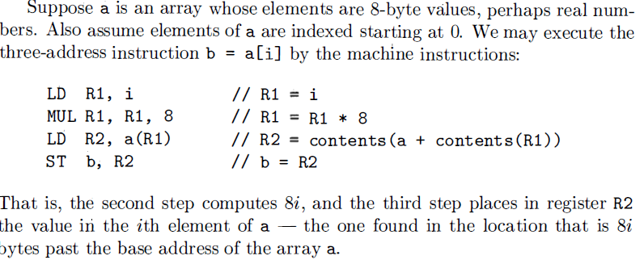

Slide 22
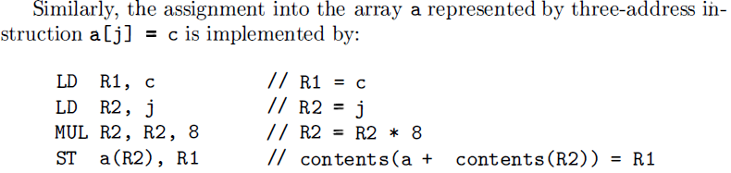
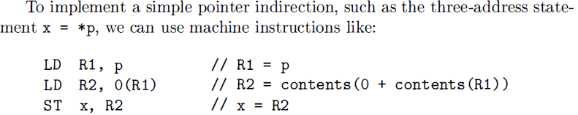

Slide 23
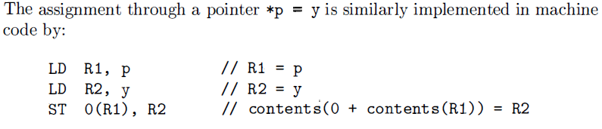

Slide 24

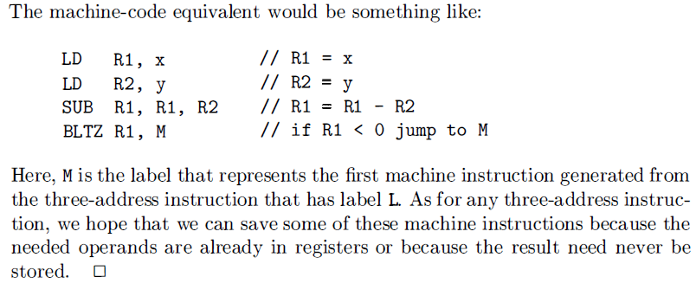

Slide 25
Program & Instructions Costs
Cost = 1 + costs associated with addressing modes of the operands
This cost corresponds to the length in words of the instruction.
Addressing modes involving:
registers have zero additional cost,
a memory location or constant have an additional cost of one
because such operands have to be stored in the words following the instruction

Slide 26
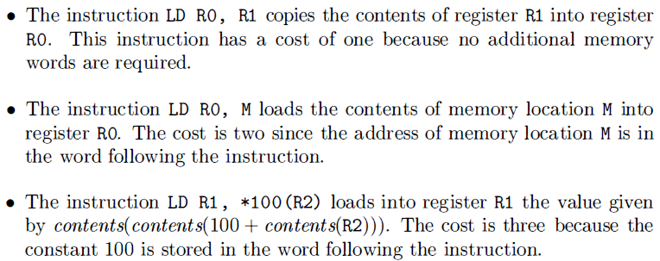
Examples

Slide 27
More Examples
Instructions | Cost/instruction | Cost
MOV b, R₀ ADD c, R₀ MOV R₀, a | 1+1 =2 1 + 1 =2 1 + 1 =2 | Total=06
MOV b, a ADD c, a | 1 + 2 =3 1 + 2 = 3 | Total = 06
MOV *R₁, *R₀ ADD *R₂, *R₀ | 1 + 0 = 1 1 + 0 =1 | Total = 02
ADD R₂, R₁ MOV R₁, a | 1 + 0 = 1 1 + 1 = 2 | Total = 03

Slide 28
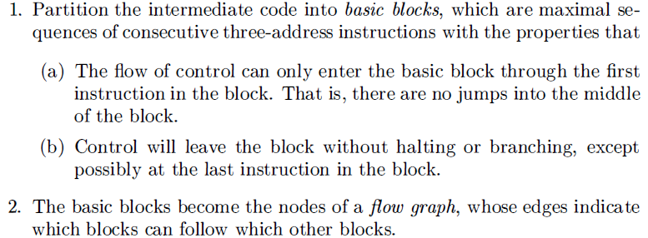
Basic Blocks and Flow Graphs
Construction Rules:

Slide 29
Basic Blocks
First job is to partition a sequence of three-address instructions into basic blocks.
Begin a new basic block with the first instruction & keep adding instructions until we meet either a jump, a conditional jump, or a label on the following instruction.
In the absence of jumps and labels, control proceeds sequentially from one instruction to the next.

Slide 30
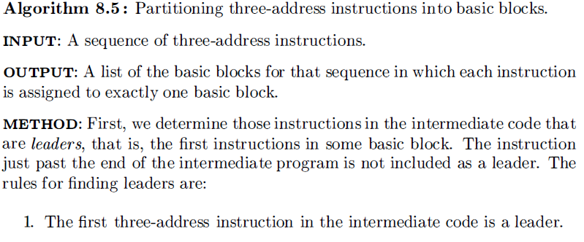
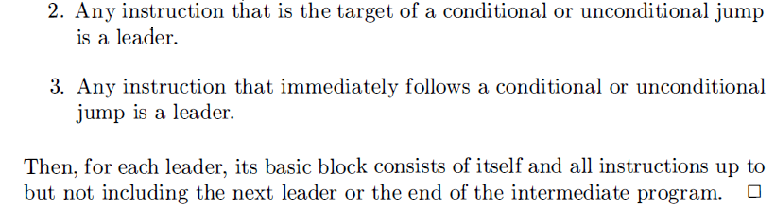

Slide 31
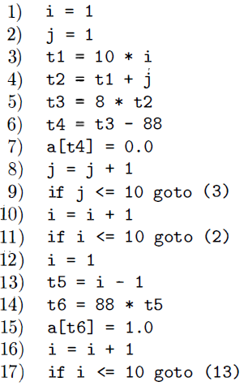
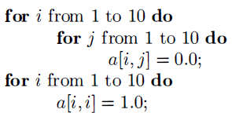
Intermediate code to set a 10 x 10 matrix to an identity matrix

Slide 32
Example: Consider the fragment of source code.
It computes the dot product of two vectors a & b of
length 20.
B₁
(1) prod : = 0
(2) i := 1
(3) t₁ := 8*i
(4) t₂ := a[t₁]
(5) t₃ := 8*i
(6) t₄ := b[t₃]
(7) t₅ := t₂*t₄
(8) t₆ := prod +t₅
(9) prod := t₆
(10) t₇ := i + 1
(11) i := t₇
(12) if i <= 20 goto (3)
begin
prod := 0;
i := 1;
do begin
prod := prod + a [i] * b [i];
i := i +1;
end
while i <= 20
end
B₂

Slide 33
Flow Graphs
(1) prod : = 0
(2) i := 1
(3) t₁ := 8*i
(4) t₂ := a[t₁]
(5) t₃ := 8*i
(6) t₄ := b[t₃]
(7) t₅ := t₂*t₄
(8) t₆ := prod +t₅
(9) prod := t₆
(10) t₇ := i + 1
(11) i := t₇
(12) if i <= 20 goto (3)
B₁
B₂

Slide 34
First, instruction 1 is a leader by rule (1)
To find the other leaders, we first need to find the jumps.
03 jumps: all conditional, at instructions 9, 11, 17
By rule (2) , the targets of these jumps are leaders; instructions 3, 2, 13
Then, by rule (3) , each instruction following a jump is a leader; those are instructions 10, 12
Note that no instruction follows 17 in this code, but if there were code following, the 18th instruction would also be a leader.

Slide 35
Leaders: instructions 1, 2, 3, 10, 12, 13.
The basic block of each leader contains all the instructions from itself until just before the next leader.
basic block of 1 is just 1
Leader 2: block is just 2
Leader 3: instructions 3 through 9
Leader 10: blocks 10 & 11
Leader 12: block is just 12
Leader 13: blocks 13 through 17

Slide 36
Flow Graphs
Once an intermediate-code program is partitioned into basic blocks, we represent the flow of control between them by a flow graph.
The nodes of the flow graph are the basic blocks.
There is an edge from block B to block C if and only if it is possible for the first instruction in block C to immediately follow the last instruction in block B .
There are two ways that such an edge could be justified:
There is a conditional or unconditional jump from the end of B to the beginning of C .
C immediately follows B in the original order of the 03-address instructions, & B does not end in an unconditional jump
We say that B is a predecessor of C , & C is a successor of B .

Slide 37
Often we add two nodes, called the entry & exit, that do not correspond to executable intermediate instructions.
There is an edge from the entry to the first executable node of the flow graph, that is, to the basic block that comes from the first instruction of the intermediate code.
There is an edge to the exit from any basic block that contains an instruction that could be the last executed instruction of the program.
If the final instruction of the program is not an unconditional jump, then the block containing the final instruction of the program is one predecessor of the exit, but so is any basic block that has a jump to code that is not part of the program.

Slide 38
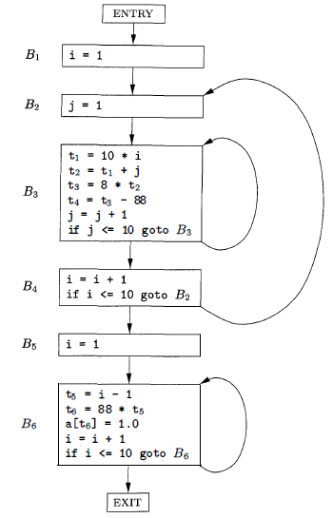
Example: The set of basic blocks constructed in Example 8.6 yields the flow graph of Fig. 8.9.
The entry points to basic block B₁, since B₁ contains the first instruction of the program
The only successor of B₁ is B₂ , because B₁ does not end in an unconditional jump, & the leader of B₂ immediately follows the end of B₁ .

Slide 39
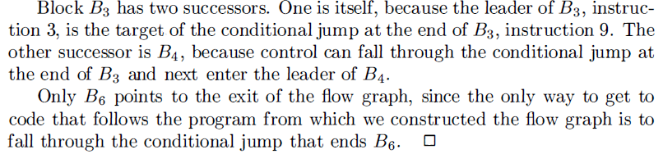

Slide 40
Code Generator
How to use registers to best advantage?
There are four principal uses of registers:
In most machine architectures, some or all of the operands of an operation must be in registers in order to perform the operation .
Registers make good temporaries - places to hold the result of a sub expression while a larger expression is being evaluated, or more generally, a place to hold a variable that is used only within a single basic block.
Registers are used to hold (global) values that are computed in one basic block and used in other blocks, for example, a loop index that is incremented going around the loop and is used several times within the loop .
Registers are often used to help with run-time storage management, for example, to manage the run-time stack, including the maintenance of stack pointers and possibly the top elements of the stack itself.

Slide 41
Assumptions
Machine instructions:
LD reg, mem
ST mem, reg
OP reg, reg, reg

Slide 42
Descriptors
Code generation algo uses descriptors to keep track of register contents & addresses for names:
1. For each available register, a register descriptor keeps track of the variable names whose current value is in that register. Since we shall use only those registers that are available for local use within a basic block, we assume that initially, all register descriptors are empty. As the code generation progresses, each register will hold the value of zero or more names.
2. For each program variable, an address descriptor keeps track of the location or locations where the current value of that variable can be found. The location might be a register, a memory address, a stack location, or some set of more than one of these. The information can be stored in the symbol-table entry for that variable name.

Slide 43
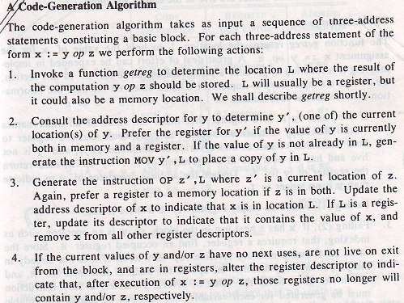

Slide 44

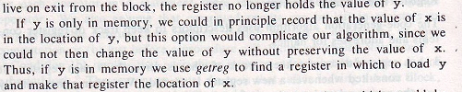
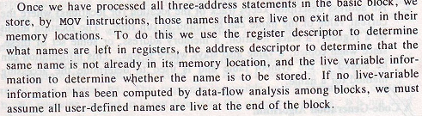

Slide 45
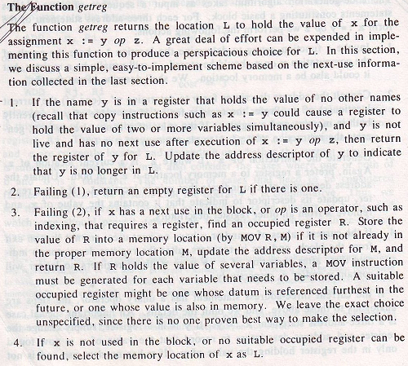

Slide 46
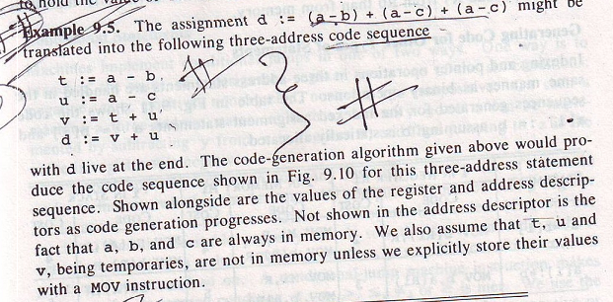

Slide 47
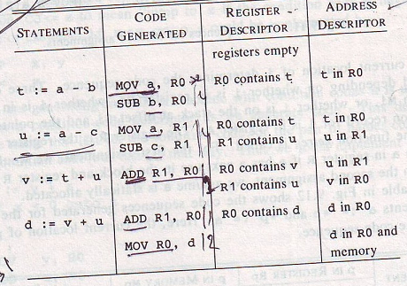

Slide 48
The 1st call of getreg returns R0 as the location in which to compute t.
Since a is not in R0, we generate instructions MOV a, R0 & SUB b, R0.
Update the register descriptor to indicate that R0 contains t.
Proceeds in this way until the last three-address statement d:=v + u has been proceed.
R1 becomes empty because u has no next use.
Generate MOV R0, d to store the live variable d at the end of the block
COST= 2 + 2 + 2 + 2 + 1 + 1 + 2 =12
Can be reduced to 11 (How??)

