Slide 1
Computer Graphics
Lecture-1

Slide 2
Computer Graphics
Computer graphics is an art of drawing pictures on computer screens with the help of programming.
It involves computations, creation, and manipulation of data.
In other words, we can say that computer graphics is a rendering tool for the generation and manipulation of images.

Slide 3
Application of Computer Graphics
Computer graphics user interfaces (GUIs) − A graphic, mouse-oriented paradigm which allows the user to interact with a computer.
Business presentation graphics − "A picture is worth a thousand words".
Cartography − Drawing maps.
Weather Maps − Real-time mapping, symbolic representations.
Satellite Imaging − Geodesic images.
Photo Enhancement − Sharpening blurred photos.
Medical imaging − MRIs, CAT scans, etc. - Non-invasive internal examination.
Engineering drawings − mechanical, electrical, civil, etc. - Replacing the blueprints of the past.
Typography − The use of character images in publishing - replacing the hard type of the past.
Architecture − Construction plans, exterior sketches - replacing the blueprints and hand drawings of the past.
Art − Computers provide a new medium for artists.
Training − Flight simulators, computer aided instruction, etc.
Entertainment − Movies and games.
Simulation and modeling − Replacing physical modeling and enactments

Slide 4
Cathode Ray Tube
The primary output device in a graphical system is the video monitor. The main element of a video monitor is the Cathode Ray Tube (CRT), shown in the following illustration.
The operation of CRT is very simple −
The electron gun emits a beam of electrons (cathode rays).
The electron beam passes through focusing and deflection systems that direct it towards specified positions on the phosphor-coated screen.
When the beam hits the screen, the phosphor emits a small spot of light at each position contacted by the electron beam.
It redraws the picture by directing the electron beam back over the same screen points quickly.

Slide 5
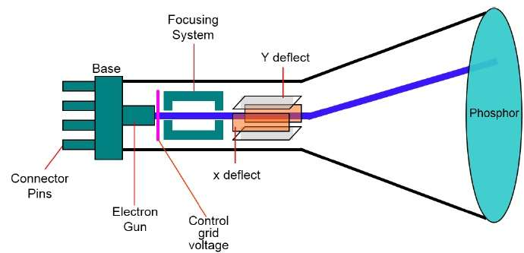

Slide 6
There are two ways by which we can display an object on the screen.
Raster scan display
Random scan display

Slide 7
Raster Scan Display
In a raster scan system, the electron beam is swept across the screen, one row at a time from top to bottom. As the electron beam moves across each row, the beam intensity is turned on and off to create a pattern of illuminated spots.
Picture definition is stored in memory area called the Refresh Buffer or Frame Buffer. This memory area holds the set of intensity values for all the screen points. Stored intensity values are then retrieved from the refresh buffer and “painted” on the screen one row (scan line) at a time as shown in the following illustration.
Each screen point is referred to as a pixel (picture element) or pel. At the end of each scan line, the electron beam returns to the left side of the screen to begin displaying the next scan line.

Slide 8
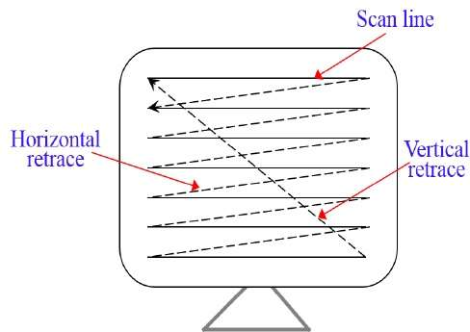
Raster Scan Display

Slide 9
Random Scan Display
In this technique, the electron beam is directed only to the part of the screen where the picture is to be drawn rather than scanning from left to right and top to bottom as in raster scan. It is also called vector display, stroke-writing display, or calligraphic display.
Picture definition is stored as a set of line-drawing commands in an area of memory referred to as the refresh display file. To display a specified picture, the system cycles through the set of commands in the display file, drawing each component line in turn. After all the line-drawing commands are processed, the system cycles back to the first line command in the list.
Random-scan displays are designed to draw all the component lines of a picture 30 to 60 times each second.

Slide 10
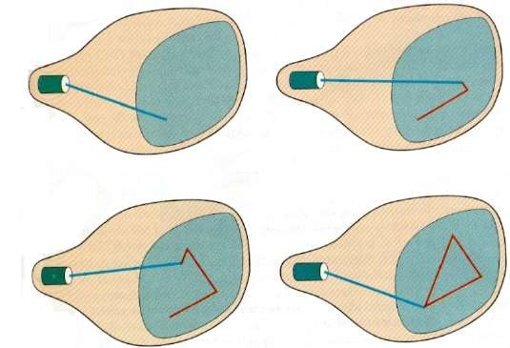
Random Scan Display

Slide 11
Color CRT Monitors
A CRT monitor displays color pictures by using a combination of phosphors that emit different colored light. By combining and emitting light from the different phosphors, a range of colors can be generated.
Two basic techniques for producing color is given below:
Beam-Penetration Method
Shadow-Mask Method

Slide 12
Beam-Penetration Method
The beam penetration method for displaying color pictures has been used with random-scan monitors. Two layers of phosphor, usually red and green, are coated on to the inside of the CRT screen, and the displayed color depends on how far the electron beam penetrates into the phosphor layers.

Slide 13
Shadow-Mask Method
Shadow-mask methods are commonly used in raster-scan systems (including color TV) because they produce a much wider range of color than the beam penetration method. A shadow-mask CRT has three phosphor color dots at each pixel position. One phosphor dot emits a red light, another emits a green light, and the third emits a blue light. This type of CRT has three electron guns, one for each color dot, and a shadow- mask grid just behind the phosphor –coated screen. Fig. below illustrates the delta-delta shadow-mask method, commonly used in color CRT systems. The three electron beam are deflected and focused as a group onto the shadow mask, which contains a series of holes aligned with the phosphor-dot patterns. When the three beams pass through a hole in the shadow mask, they activate a dot triangle, which appears as a small color spot the screen the phosphor dots in the triangles are arranged so that each electron beam can activate only its corresponding color dot when it passes through the shadow mask.

Slide 14
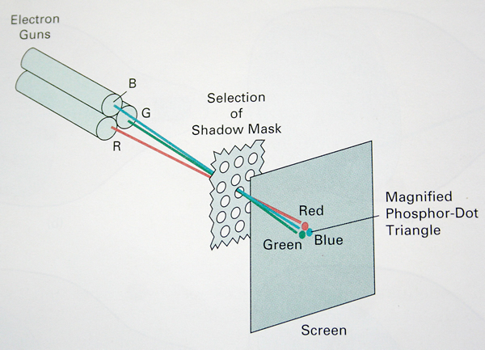

Slide 15
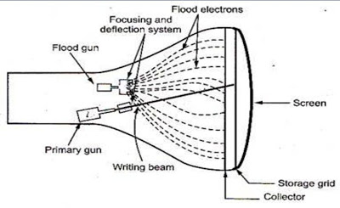
Direct-View Storage Tubes
A direct-view storage tube (DVST) stores the picture information as a charge distribution just behind the phosphor-coated screen. Two electron guns are used in a DVST. One, the primary gun, is used to store the picture pattern; the second, the flood gun, maintains the picture display as shown in the figure below.

Slide 16
A DVST monitor has both disadvantages and advantages compared to the refresh CRT. Because no refreshing is needed, very complex pictures can be displayed at very high resolutions.
Disadvantages of DVST systems are that they ordinarily do not display color and that selected parts of a picture cannot be erased. To eliminate a picture section, the entire screen must be erased and the modified picture redrawn. The erasing and redrawing process can take several, seconds for a complex picture. For these reasons, storage displays have been largely replaced by raster systems.

Slide 17
Flat-Panel Displays
Flat panel display refers to a class of video devices that have reduced volume, weight and power requirements compared to a CRT.
Two types of Flat panel display
1. Emissive Display: The emissive display are devices that convert electrical energy into light. Examples are given below
Plasma Panel Displays
Thin-Film Electroluminescent Display
LED Display
2. Nonemmissive Display: use optical effects to convert sunlight or light from some other source into graphics patterns. Example:
LCD Display

Slide 18
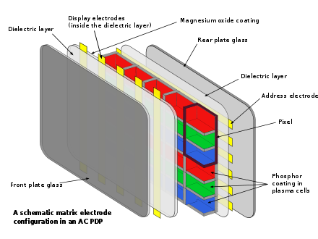
Plasma Panel Display

Slide 19
Thin-Film Electroluminescent Display
The thin film EL glass panel consists of a luminescent phosphor layer sandwiched between transparent dielectric layers and a matrix of row and column electrodes. A circuit board containing the drive and control electronics is connected to the back of the glass panel. Voltage is applied to row and column electrodes causing the area of intersection (a pixel) to emit light.
The result of this solid-state design is a flat, compact, reliable, and inherently rugged display with exceptionally fast response times (< 1 ms).

Slide 20
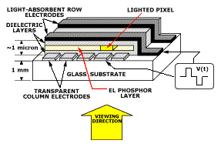

Slide 21
LED
A matrix of diodes is arranged to form the pixel positions in the display, and the picture definition is stored in a refresh buffer. As in scan-line refreshing of a CRT, information is read from the refresh buffer and converted to voltage levels that are applied to the diodes to produce the light patterns in the display.

Slide 22
LCD
LCD is commonly used in small systems, such as calculators, and portable, laptop computers. These non-emissive devices produce a picture by passing polarized light from the surroundings or from an internal light source through a liquid-crystal material that can be aligned either block or transmit the light.

Slide 23
Advantages:
1. Sharpness Image is perfectly sharp at the native resolution of the panel. LCDs using an analog input require careful adjustment of pixel tracking/phase.
2. Geometric Distortion Zero geometric distortion at the native resolution of the panel. Minor distortion for other resolutions because the images must be rescaled.
3. Brightness High peak intensity produces very bright images. Best for brightly lit environments.
4. Screen Shape Screens are perfectly flat.
5. Physical Thin, with a small footprint. Consume little electricity and produce little heat.

Slide 24
Disadvantages:
1. Resolution Each panel has a fixed pixel resolution format determined at the time of manufacture that can not be changed. If you need fine text and graphics at more than one resolution do not get an LCD display.
2. Interference LCDs using an analog input require careful adjustment of pixel tracking/phase in order to reduce or eliminate digital noise in the image. Automatic pixel tracking/phase controls seldom produce the optimum setting. Timing drift and jitter may require frequent readjustments during the day. For some displays and video boards you may not be able to entirely eliminate the digital noise.
3. Viewing Angle Limited viewing angle. Brightness, contrast, gamma and color mixtures vary with the viewing angle.
4. Black-Level, Contrast and Color Saturation LCDs have difficulty producing black and very dark grays. As a result they generally have lower contrast than CRTs and the color saturation for low intensity colors is also reduced. Not suitable for use in dimly lit and dark environments.

Slide 25
5. Color and Gray-Scale Accuracy The internal Gamma and gray-scale of an LCD is very irregular. LCDs typically produce fewer than 256 discrete intensity levels. Generally not suitable for professional image color balancing.
6. Bad Pixels and Screen Uniformity LCDs can have many weak or stuck pixels, which are permanently on or off. Some pixels may be improperly connected to adjoining pixels, rows or columns. Also, the panel may not be uniformly illuminated by the backlight resulting in uneven intensity and shading over the screen.
7. Motion Artifacts Slow response times and scan rate conversion result in severe motion artifacts and image degradation for moving or rapidly changing images.
8. Aspect Ratio LCDs have a fixed resolution and aspect ratio. For panels with a resolution of 1280x1024 the aspect ratio is 5:4=1.25, which is noticeably smaller than the 4:3=1.33 aspect ratio for almost all other standard display modes.
9. Cost Considerably more expensive than comparable CRTs.

