Slide 1
COPMANY- WIDE STRATEGIC PLANNING
By Md:Rakibul Hasan Shanto
Office-15
Roll: 11

Slide 2
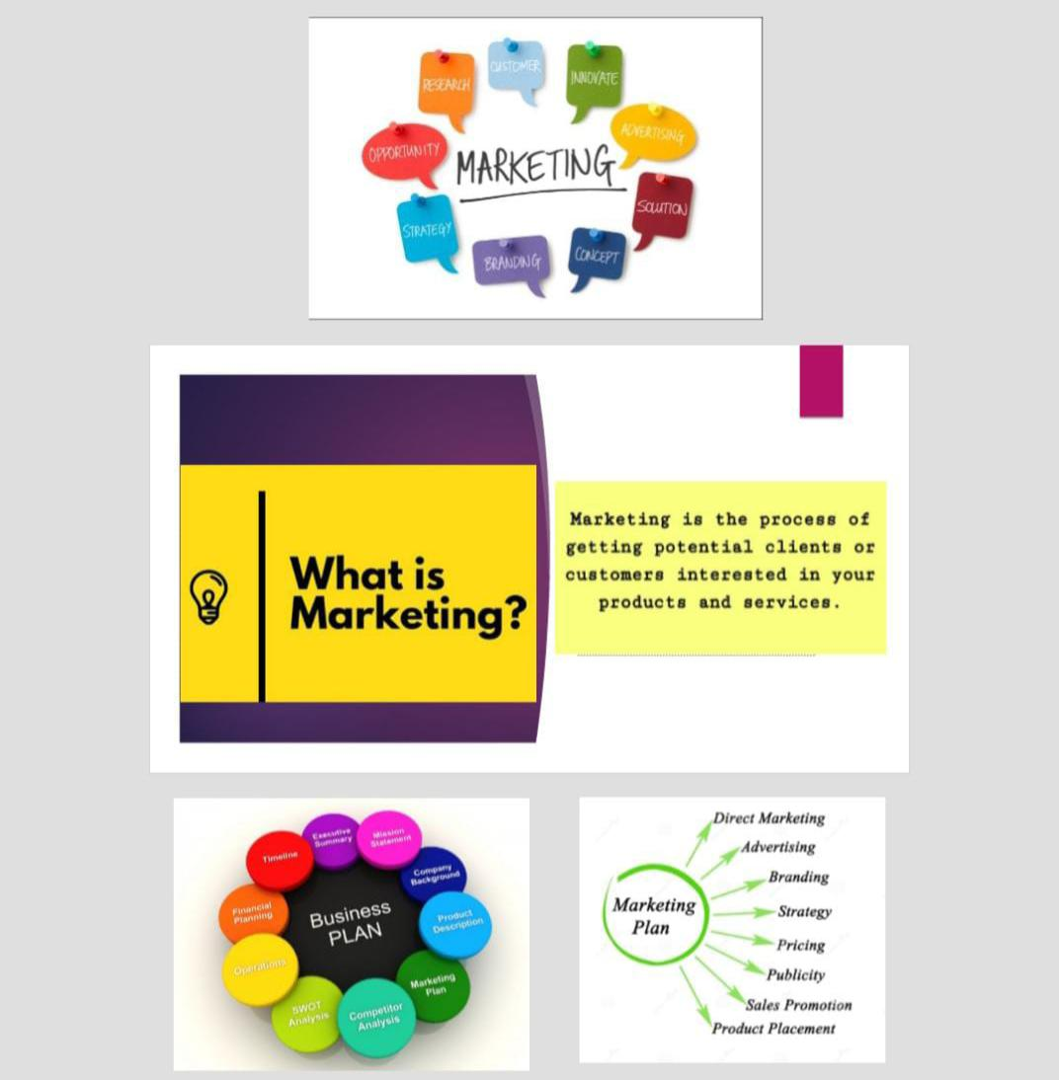

Slide 3
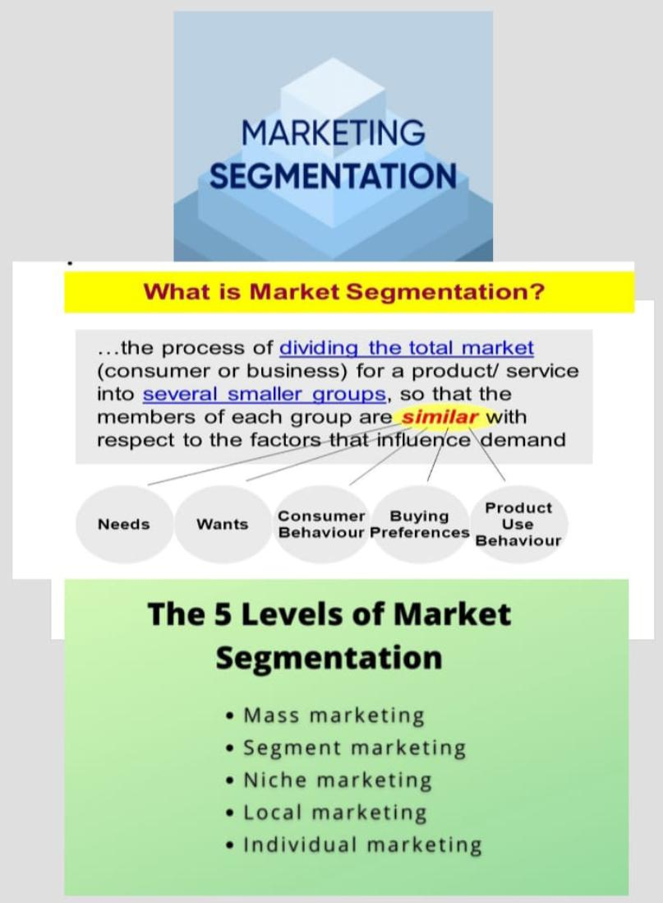
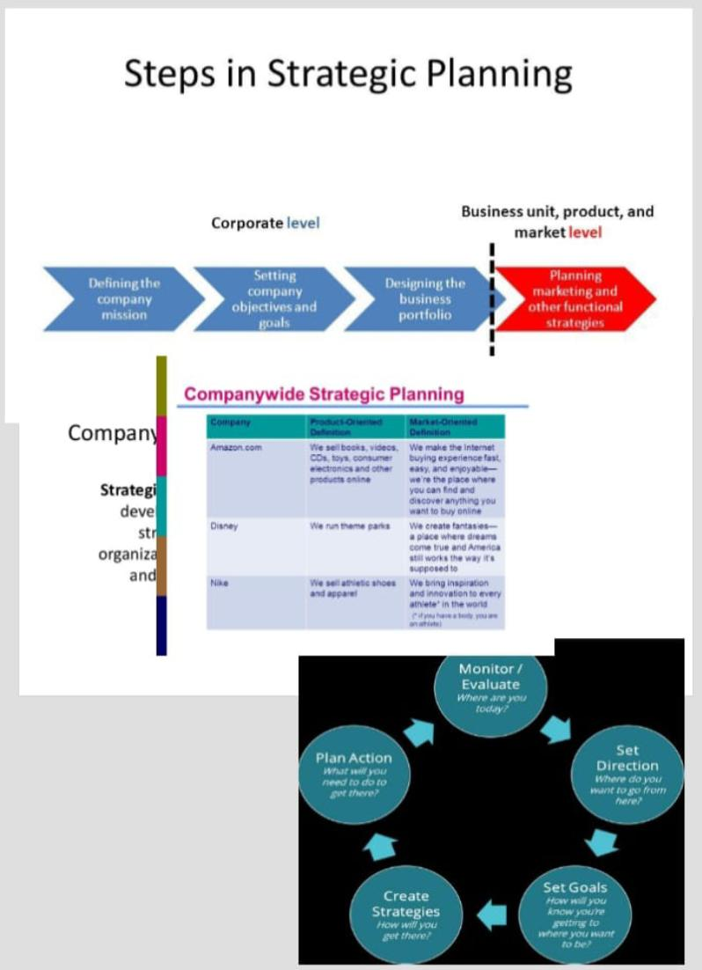

Slide 4
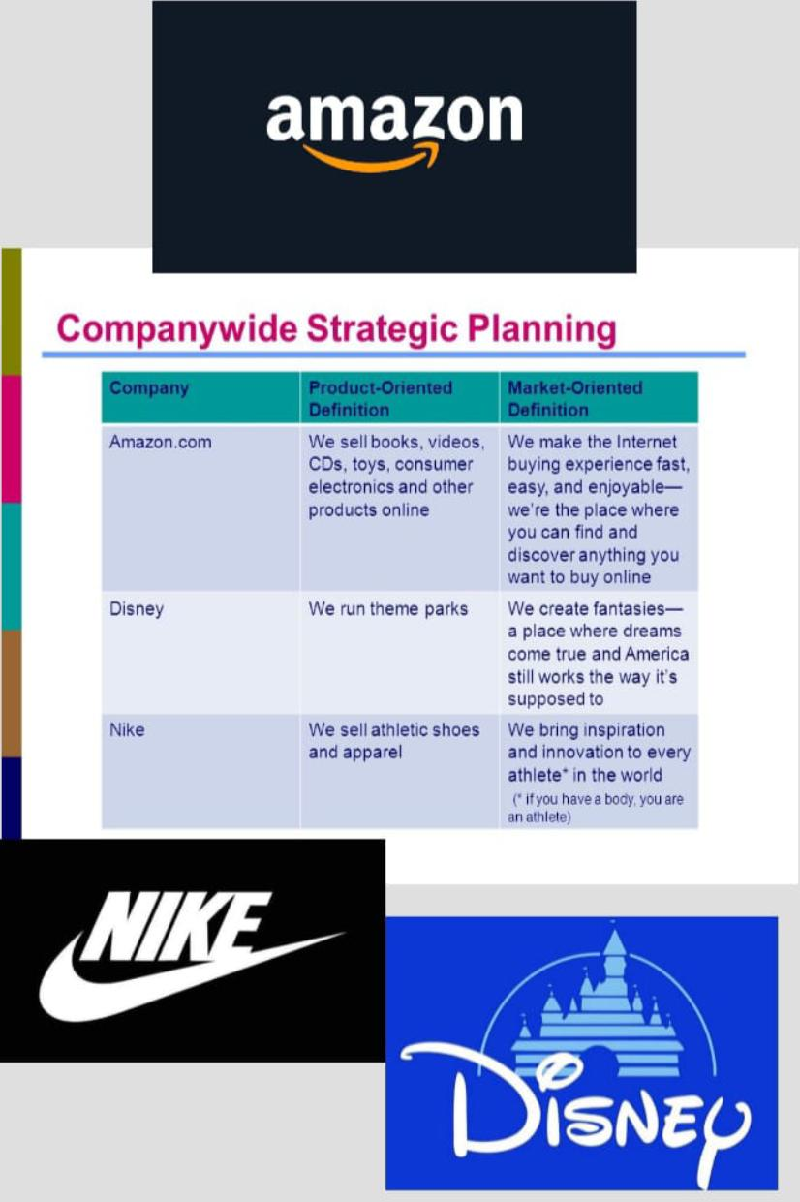

Slide 5
A vision is a big picture of “what” the organization wants to achieve in future.
A mission is about what the organization does to achieve the vision.
Goals are statement of mileposts to achieve this vision.
An objective is a time sensitive statement to achieve the goals.

Slide 6





Company | Product- Oriented Defining | Market- Oriented Defining
 | We are an online social network. | We connect people around the world and help share important moments in their lives.
 | We run discount store. | We deliver low prices every day and give ordinary folks the chance to buy the same things as rich people.
 | We sell books, toys , elections and other products online. | We make the internet buying experience fast,easy and enjoyable.
 | We provide the world's best online search engine. | We help organize the world’s information and make it universally accesible and useful.
 | We sell athletic shoes and appearel. | We bring inspiration and innovation to every athlete.

Slide 7

Product expansion grid
A portfolio planning tool for identifying company growth opportunities through market penetration, market development, product development, or diversification.

Slide 8
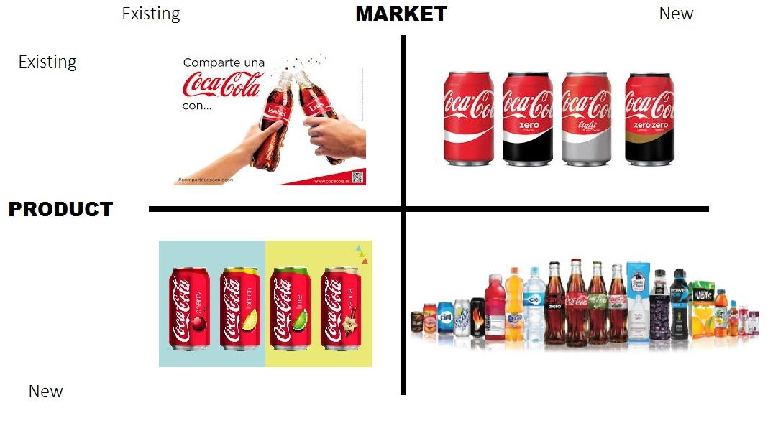

Slide 9
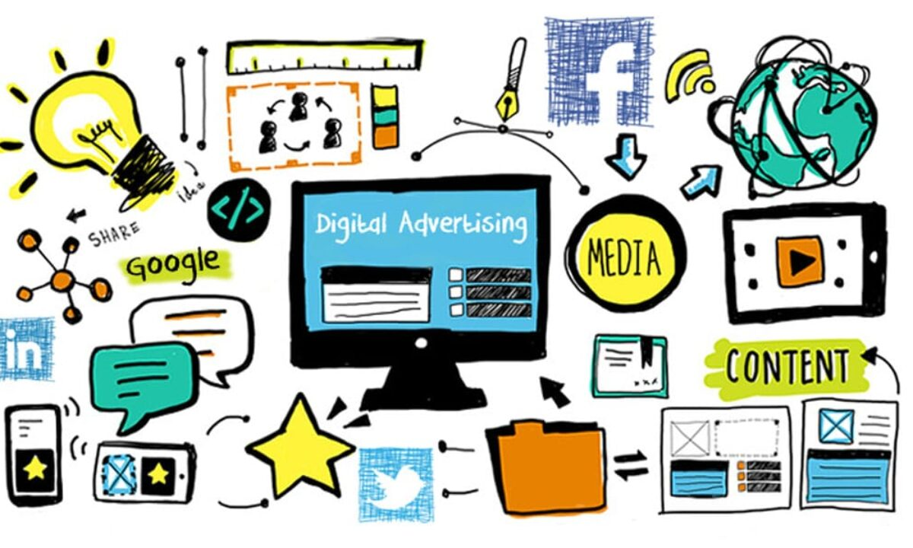


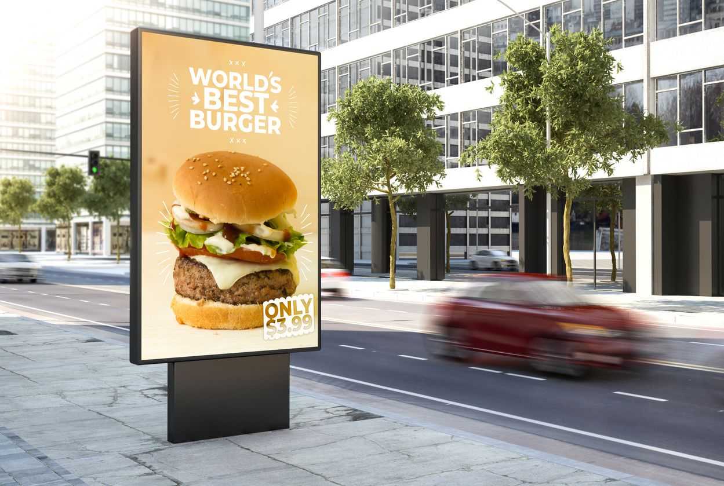
Various Types of Advertisement
Cell Phone Ad.
Online Advertisement
Print Advertisement
Email Advertisement

Slide 10
Explain goals of CRM.
1.To maximize the value and effectiveness of all customer. 2.To provide outstanding service to customer. 3.To maximize customer satisfaction. 4.To attract and retain loyal customer. 5.To cultivate and maintain positive profitable relationships with customer. 6.To develop individualized relationships with customers.

Slide 11
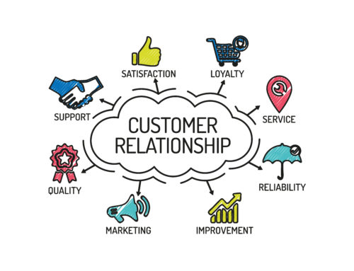

Slide 12
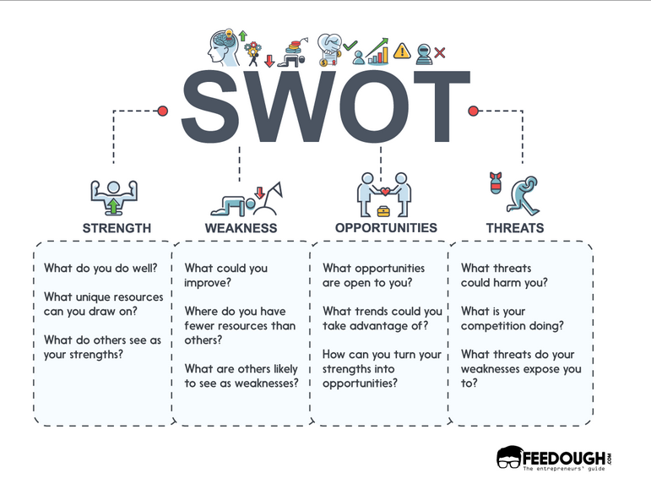

Slide 13

THE END
Thank You

